Slide 1
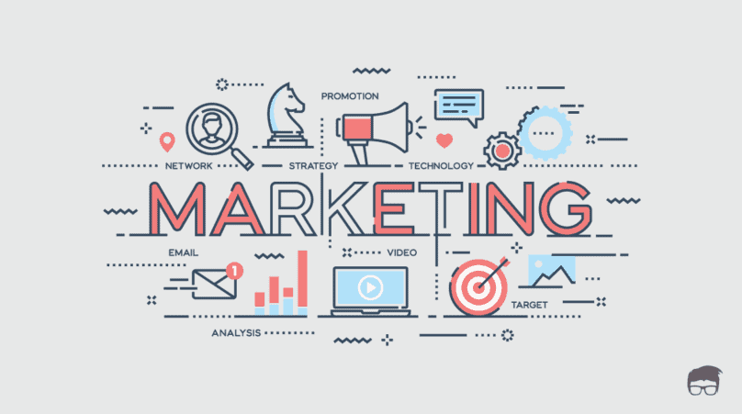
Marketing – Basic Concepts
Dr. J. Hemalatha

Slide 2
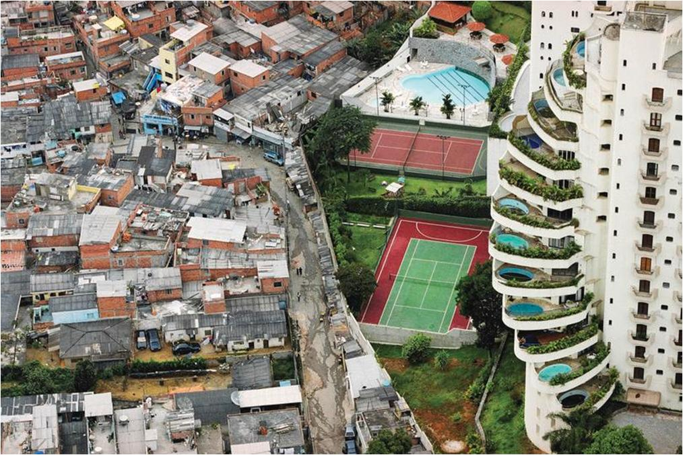
Kotler on Marketing
The future is not ahead of us. It has already happened.
Unfortunately, it is unequally distributed among companies, industries and nations.

Slide 3
The New Economy
Substantial increase in buying power
Greater variety of goods and services
Greater amount of information
Faster communication
Customization of offerings

Slide 4
The Decision Marketers make differs across markets
Consumer Markets
Business Markets
Global Markets
Nonprofit and Governmental Markets

Slide 5
Creation of Demand
Customer Satisfaction
MARKETING
OBJECTIVES
Increased Market Share
Profit Generation
Brand Reputation
Goodwill of the Organization

Slide 6
Scope of
Marketing
Goods
Services
Experiences
Events
Places
Persons
Properties
Organization
Information
Idea

Slide 7
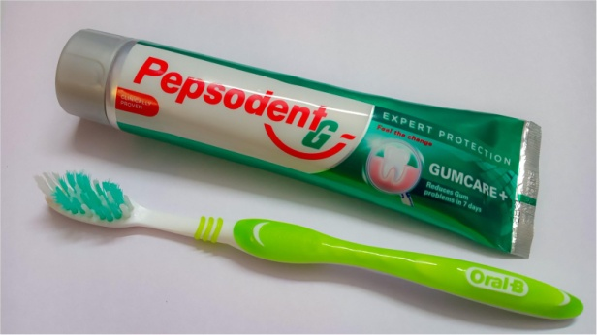
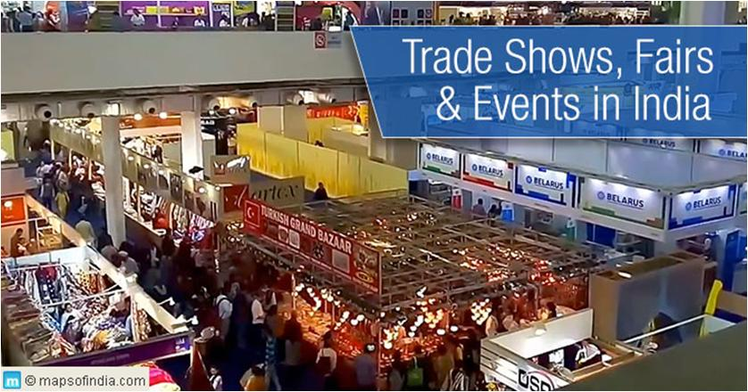

Slide 8
Marketing Definition
Marketing is a societal process by which individuals and groups obtain what they need and want through creating, offering, and exchanging products and services of value freely with others.
The American Marketing Association defines Marketing (management) as the process of planning and executing the conception, pricing, promotion, and distribution of ideas, goods, and services to create exchanges that satisfy individual and organizational goals

Slide 9
Marketing Concepts
Needs, Wants, and Demands
Need: A human need is a state of felt deprivation of some basic satisfaction Needs describe basic human requirements such as food, air, water, clothing, and shelter
Want: Wants are desires for specific satisfiers of these deeper needs
Demand: Demands are wants for specific products that are backed by an ability and willingness to buy them

Slide 10
Marketing Concepts
Products or Offerings
Product: A product is any offering that can satisfy a need or want.
Products or offerings may consist of goods, services, experiences, events, persons, places, properties, organizations, information, and ideas
A brand is an offering from a known source.

Slide 11
Marketing Concepts
Value, Cost and Satisfaction
Value: Value is the consumer’s estimate of the product’s overall capacity to satisfy his or her needs
Value is a ratio between what the customer gets and what he gives
Value = Benefits/Costs
Value = $(Functional Benefits+Emotional Benefits)÷(Monetary Costs+Time Costs+Energy Costs+Psychic Costs)$
Value = (𝐹𝑢𝑛𝑐𝑡𝑖𝑜𝑛𝑎𝑙 𝐵𝑒𝑛𝑒𝑓𝑖𝑡𝑠+𝐸𝑚𝑜𝑡𝑖𝑜𝑛𝑎𝑙 𝐵𝑒𝑛𝑒𝑓𝑖𝑡𝑠)÷(𝑀𝑜𝑛𝑒𝑡𝑎𝑟𝑦 𝐶𝑜𝑠𝑡𝑠+𝑇𝑖𝑚𝑒 𝐶𝑜𝑠𝑡𝑠+𝐸𝑛𝑒𝑟𝑔𝑦 𝐶𝑜𝑠𝑡𝑠+𝑃𝑠𝑦𝑐ℎ𝑖𝑐 𝐶𝑜𝑠𝑡𝑠)

Slide 12
Marketing Concepts
Exchange, Transaction and Relationships
Exchange: Exchange, the core of marketing, involves obtaining a desired product from someone by offering something in return.
Transaction: A transaction involves at least two things of value, agreed-upon conditions, a time of agreement, and a place of agreement.
Relationships: Relationship marketing aims to build long-term mutually satisfying relations with key parties—customers, suppliers, distributors—in order to earn and retain their long-term preference and business

Slide 13
Marketing Concepts
Markets, Marketing and Marketers
Markets: A market consists of potential customers sharing a particular need or want who might be willing and able to engage in exchange to satisfy that need or want.
Marketers: A marketer is someone seeking a resource from someone else and willing to offer something of value in exchange
Marketing: Marketing means working with markets to actualize potential exchanges for the purpose of satisfying human needs and wants

Slide 14
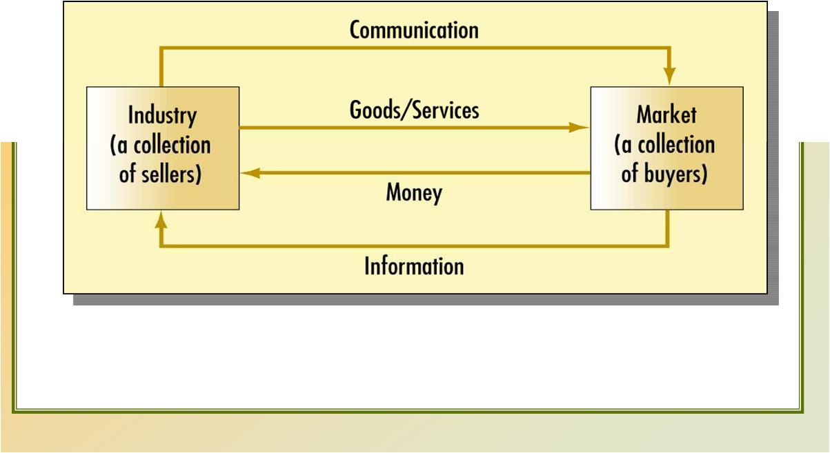
A Simple Marketing System

Slide 15
Marketing Concepts
Marketing Management
Marketing (management) is the process of planning and executing the conception, pricing, promotion, and distribution of ideas, goods, and services to create exchanges that satisfy individual and organizational goals.

Slide 16
Marketing Environment
Task Environment
Broad Environment
Company
Legal
Demographic
Political
Socio-cultural
Suppliers
Competitors
Customers
Technological

Slide 17
Marketing mix is the set of marketing tools that the firm uses to pursue its marketing objectives in the target market
Marketing Mix
Product
Price
Place
Promotion

Slide 18
Company Orientation towards Marketplace
Production Concept
Consumers prefer products that are widely available and inexpensive
Product Concept
Consumers favor those products that offer the most quality, performance, or innovative features
Selling Concept
Consumers must be coaxed into buying so the company has a battery of selling and promotion tools to stimulate buyin
Marketing Concept
Company must be effective than its competitors in creating, delivering, and communicating customer value to its chosen target markets
Societal Marketing Concept
The organization’s task is to determine the needs, wants, and interests of target markets and to deliver the desired satisfactions more effectively and efficiently than competitors to enhance the consumer’s and the society’s well-being

Slide 19
The Marketing Process
Analyzing Market Opportunities
Developing Marketing Strategies
Planning Marketing Programs
Managing the Marketing Effort
Annual plan control
Profitability control
Strategic control
Researching and selecting target markets

Slide 20
Thank you

Slide 21
Typology of products and markets
Dr. J. Hemalatha

Slide 22
Kotler on Marketing
The future is not ahead of us. It has already happened.
Unfortunately, it is unequally distributed among companies, industries and nations.

Slide 23
Products
Goods
Services
Goods are the material items that can be seen, touched or felt and are ready for sale to the customers
Transfer of ownership is possible
Services are amenities, facilities, benefits or help provided by other people
Tangible
Intangible
Transfer of ownership is not possible
Goods can be stored for use in future or multiple use
Services cannot be stored
There is a time lag between production and consumption of goods.
Production and Consumption of services occurs simultaneously

Slide 24
Typology of Products
Consumer Products
Industrial Products
Convenience Products
Farm Products
Shopping Products
Specialty Products
Unsought Products
Natural Products
Manufactured Products
Supplies
Ex: Insurance, fire extinguishers, etc.
Ex: Artwork, Sculptures, paintings, etc.
Ex: Clothing, Furniture, Jewelry, etc.
Ex: Medicines, toiletries, newspapers, etc.
Ex: Wheat, Rice, vegetables, fruits, etc.
Ex: Crude oil, timber, fish, iron ore, etc.
Ex: Ovens, furnaces, steel rods, etc.
Ex: Operating Supplies – fuel, lubricant, etc.
Maintenance Supplies – paint, brooms, etc.

Slide 25
Goods
Non-Durables
White Goods
Brown Goods
Durables
Gray Goods
FMCG

Slide 26
Services Marketing
Services Marketing refers to the marketing of services
The American Marketing Association defines services as - “Activities, benefits and satisfactions which are offered for sale or are provided in connection with the sale of goods.”

Slide 27
Types of Services
B2C
B2B
Post Purchase Service

Slide 28
Difference between B2B and B2C
Criteria
Meaning
B2B
B2C
End User
The selling of goods and services between two business entities is known as Business to Business or B2B.
The selling of goods and services between two business entities is known as Business to Business or B2B.
Customer
Company
Focus
Relationship
Product
Quantity of merchandise
Large
Small
Relationship
Supplier – Manufacturer
Manufacture – Wholesaler
Wholesaler - Retailer
Retailer - Consumer
Relationship horizon
Long term
Short term
Buying and Selling cycle
Lengthy
Short

Slide 29
Thank you

Slide 30
Typology of products and markets
Dr. J. Hemalatha

Slide 31
Kotler on Marketing
The future is not ahead of us. It has already happened.
Unfortunately, it is unequally distributed among companies, industries and nations.

Slide 32
Marketing Trends
Relationship marketing
Demarketing
Neuro marketing
Viral marketing
Web enabled marketing
Digital marketing
Remarketing
Social media marketing
Green marketing
Societal marketing

Slide 33
Relationship Marketing
Relationship Marketing refers to efforts by a company to build long term relationships with customers with a view to engage them for a longer duration.
The ultimate outcome of relationship marketing is the building of a unique company asset called a marketing network.
A marketing network consists of the company and its supporting stakeholders (customers, employees, suppliers, distributors, university scientists, and others) with whom it has built mutually profitable business relationships

Slide 34
Relationship Marketing Strategies
Invest in technology: ERP & CRM solutions
Building Customer Relationship through loyalty points
Email marketing
Website, online chats, toll free numbers
SMS Marketing
Include social media for relationship marketing
Sending Greetings on festivals and other occasions
Consumer campaigns & Referrals

Slide 35
DeMarketing
Demarketing is the marketing strategy adopted by manufacturers such that it discourages demand of a product.
These marketing strategies are aimed at reducing demand but not destroying it. These strategies can be adopted by either private or public organizations.
DeMarketing Strategies
Increased prices
Decreased advertising/ promotional spend
Product redesigning
Providing lesser margins (to retailers etc.)

Slide 36
Neuro Marketing
“Neuromarketing” loosely refers to the measurement of physiological and neural signals to gain insight into customers’ motivations, preferences, and decisions, which can help inform creative advertising, product development, pricing, and other marketing areas.
Neuromarketers use a wide range of neuromarketing techniques and technology to better understand consumer behaviour
The tech is generally separated into two camps: those that measure neurological brain activity and those that infer neurological responses by proxy
The former includes EEG (Electroencephalography), fMRI (Functional magnetic resonance imaging), and Steady State Topography (SST), all of which directly measure brain activity related to specific brain functions
The latter includes eye tracking, facial coding, and biometric data like heart rate monitoring.

Slide 37
Viral Marketing
Viral marketing is a business strategy that uses existing social networks to promote a product.
The basis of viral marketing is in the spread of information by word-of-mouth, but modern technology has allowed the viral effect to include many Internet-based platforms as well.
Its name refers to how consumers spread information about a product with other people in their social networks, much in the same way that a virus spreads from one person to another.

Slide 38
Web Enabled Marketing
Web marketing refers to a broad category of advertising that takes many different forms, but generally involves any marketing activity conducted online.

Slide 39
Web Enabled Marketing
Display Advertising
Search Engine Marketing
Social Media Marketing
Email Marketing
Referral Marketing
Affiliate Marketing
Inbound Marketing
Video Marketing

Slide 40
Digital Marketing
Digital marketing refers to advertising delivered through digital channels such as search engines, websites, social media, email, and mobile apps.
Digital Marketing
Paid Search
SEO
Content Marketing
Social Media Marketing
Email Marketing
Mobile Marketing
Marketing Automation

Slide 41
ReMarketing
Remarketing is a feature that lets you customize your display ads campaign for people who have previously visited your site, and tailor your ads (using dynamic remarketing) to these visitors when they browse the web and use apps.
Remarketing is a digital marketing strategy that focuses on users who have already shown an interest in your brand.
This might be in the form of a website visit, a click on one of your ads, a Google search, an unprocessed order, or following you on social media.
The aim is to remind people of your brand, rekindle their interest with an incentive, engage them, and hopefully encourage them to make a purchase.

Slide 42
Green Marketing
Green marketing refers to the practice of developing and advertising products based on their real or perceived environmental sustainability.
Examples of green marketing include advertising the reduced emissions associated with a product’s manufacturing process, or the use of post-consumer recycled materials for a product's packaging.
Some companies also may market themselves as being environmentally-conscious companies by donating a portion of their sales proceeds to environmental initiatives, such as tree planting.

Slide 43
Societal Marketing
Societal marketing can be defined as a "marketing with a social dimension or marketing that includes non-economic criteria".
Societal marketing "concerns for society's long term interests". It is about "the direct benefits for the organization and secondary benefit for the community".
Societal marketing distinguishes between the consumer's immediate satisfaction and longer term consumer and social benefits. Accordingly, Andreas Kaplan defines societal management as "management that takes into account society's overall welfare in addition to mere profitability considerations.”
It is a 3 dimensional concept of marketing – social welfare, individual welfare, organization profit.

Slide 44
Thank you

Slide 45
UNIT 2

Slide 46
Market Segmentation, Targeting and Positioning
Dr. J. Hemalatha

Slide 47
Kotler on Marketing
The future is not ahead of us. It has already happened.
Unfortunately, it is unequally distributed among companies, industries and nations.

Slide 48
Market Segmentation
Dividing a market into distinct groups with distinct needs, characteristics, or behavior who might require separate products or marketing mixes.

Slide 49
Benefits of Segmentation
Effective use of resources
Gain a focus
Create Value for a target market
Positioning

Slide 50
Requirements for Effective Segmentation
Measurable
Size, purchasing power, and profile of segment
Accessible
Can be reached and served
Substantial
Large and profitable enough to serve
Differentiable
Respond differently
Actionable
Effective programs can be developed

Slide 51
Steps in Market Segmentation, Targeting, and Positioning
Market Segmentation
1. Identify bases for segmenting the market
2. Develop segment profiles
Market Targeting
3. Develop measure of segment attractiveness
4. Select target segments
Market Positioning
5. Develop positioning for target segments
6. Develop a marketing
mix for each segment

Slide 52
Market Segmentation
Levels of Market Segmentation
Through Market Segmentation, Companies Divide Large, Heterogeneous Markets into Smaller Segments that Can be Reached More Efficiently And Effectively With Products and Services That Match Their Unique Needs
Mass Marketing
Segment Marketing
Same product to all consumers
Different products to one or more segments

Slide 53
Markets, Market Segments and Niches
Market Segments
Market Segments are large identifiable groups within a market
Niche
A Niche is a more narrowly defined group that may seek a special combination of benefits

Slide 54
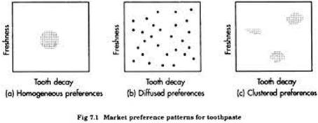
Patterns of Market Segmentation
Homogeneous Preferences
Diffused Preferences
Clustered Preferences
Consumers roughly have same preferences
Consumer preferences may be scattered
The market might distinct preference clusters, called natural clusters

Slide 55
Bases for Market Segmentation
Geographic Segmentation
Demographic Segmentation
Psychographic Segmentation
Behavioural Segmentation

Slide 56
Geographic Segmentation
Density
Climate
Region
City or Metro Size

Slide 57
Demographic Segmentation
Age
Gender
Family Size
Family Life Cycle
Income
Occupation
Education
Religion
Race
Nationality

Slide 58
Psychographic Segmentation
Personality
Social Class
Lifestyle

Slide 59
Behavioural Segmentation
Occasions
Benefits
User Status
Usage rate
Loyalty Status
Readiness stage
Attitude towards product

Slide 60
Market Targeting
Target Market
Consists of a set of buyers who share common needs or characteristics that the company decides to serve

Slide 61
Evaluating Market Segments
Segment size and growth
Segment structural attractiveness
Company objectives and resources
Threat of intense segment rivalry
Threat of new entrants
Threat of substitute products
Threat of growing bargaining power of buyers
Threat of growing bargaining power of suppliers

Slide 62
Selecting the Market Segments – Patterns of Target Market

Slide 63
The Alternative Market Selection Strategies
Company Marketing Mix
Market
Undifferentiated Marketing

Slide 64
The Alternative Market Selection Strategies
Company Marketing Mix 1
Segment 1
Company Marketing Mix 2
Segment 2
Company Marketing Mix 3
Segment 3
Differentiated Marketing

Slide 65
The Alternative Market Selection Strategies
Segment 1
Company Marketing Mix
Segment 2
Segment 3
Concentrated Marketing

Slide 66
Additional Considerations in Evaluating and Selecting Segments
Ethical Choice of Market Targets
Segment Interrelationships and Super-Segments
Segment - By – Segment Invasion Plans

Slide 67
Thank you

Slide 68
Market Segmentation, Targeting and Positioning
Dr. J. Hemalatha

Slide 69
Kotler on Marketing
The future is not ahead of us. It has already happened.
Unfortunately, it is unequally distributed among companies, industries and nations.

Slide 70
Differentiation
Differentiation is the act of designing a set of meaningful differences to distinguish the company’s offer from competitors’ offers

Slide 71
Basic Dimensions of Differentiation
Product
Services
Personnel
Image

Slide 72
Product Differentiation
Features
Performance
Conformance
Durability
Reliability
Repairability
Style
Design

Slide 73
Services Differentiation
Delivery
Installation
Customer Training
Consulting Service
Repair
Miscellaneous

Slide 74
Personnel Differentiation
Competence
Courtesy
Credibility
Reliability
Responsiveness
Communication

Slide 75
Image Differentiation
Symbol
Media
Atmosphere
Events

Slide 76
Differences should be meaningful
Important
Distinctive
Superior
Communicable
Preemptive
Affordable
Profitable

Slide 77
Positioning
Positioning is the act of designing the company’s offer and image so that it occupies a distinct and valued place in the target customers’ minds
Positioning calls for the company to decide how many differences and which differences to promote to the target customers

Slide 78
Major Positioning Errors
Underpositioning
Overpositioning
Confused Positioning
Doubtful Positioning

Slide 79
Positioning Strategies
Attribute Positioning
User Positioning
Product Category Positioning
Quality/Price
Positioning
Benefit Positioning
Use/Application
Positioning
Competitor Positioning

Slide 80
Perceptual Mapping
A Perceptual Map (PERMAP) is a diagrammatic technique used by marketers to visualize (potential) customers’ perceptions and opinions about products, product lines, or brands.
The word perceptual comes from the word ‘perception’, which refers to the customer’s knowledge of competitive products on the market with the accompanying attributes.

Slide 81
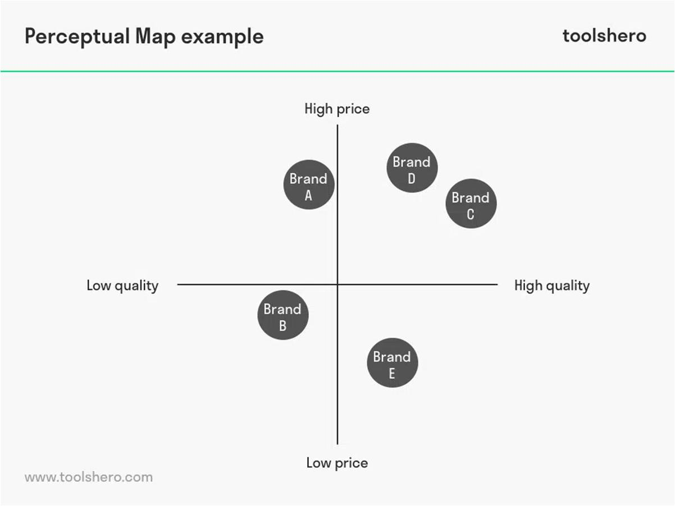
Perceptual Mapping

Slide 82
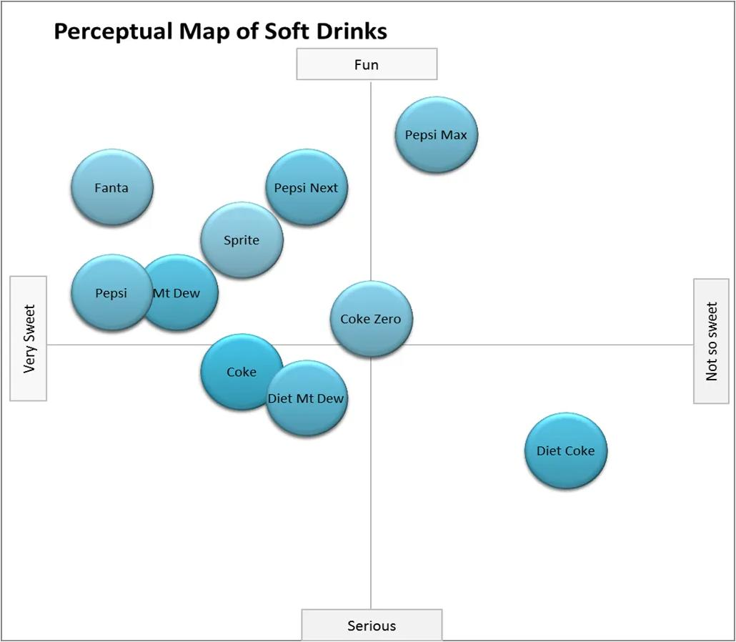
Perceptual Mapping

Slide 83
Thank you

Slide 84
Competitive Market Strategies
Dr. J. Hemalatha

Slide 85
Kotler on Marketing
The future is not ahead of us. It has already happened.
Unfortunately, it is unequally distributed among companies, industries and nations.

Slide 86
Classification of Firms
Market Leader
(40% of market share)
Market Challenger
(30% of market share)
Market Follower
(20% of market share)
Market Nicher
(10% of market share)

Slide 87
Market Leader Strategies – Expanding the Total Market
New Uses
More Usage
New Users

Slide 88
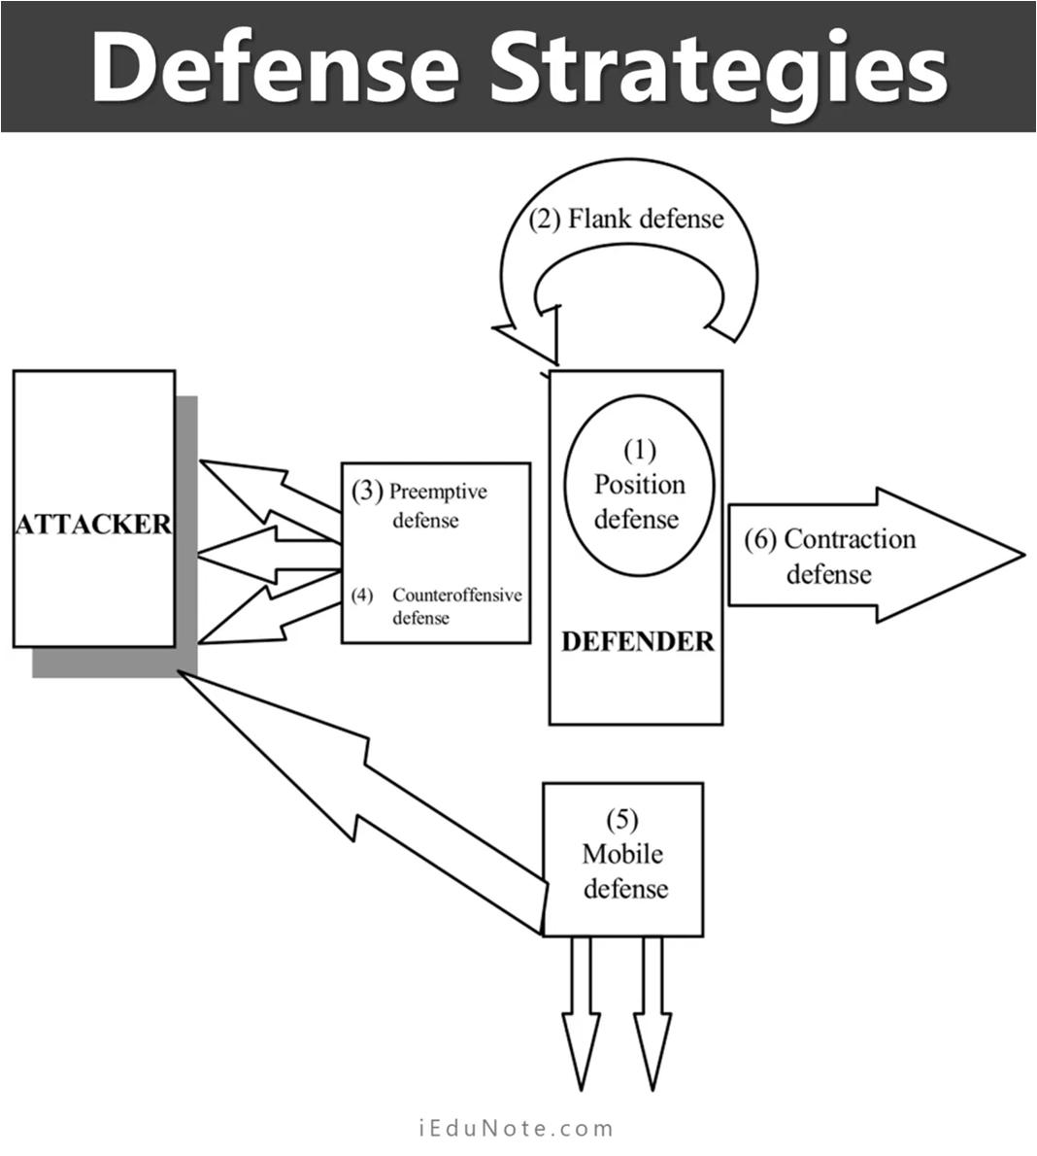
Market Leader– Defense Strategies

Slide 89
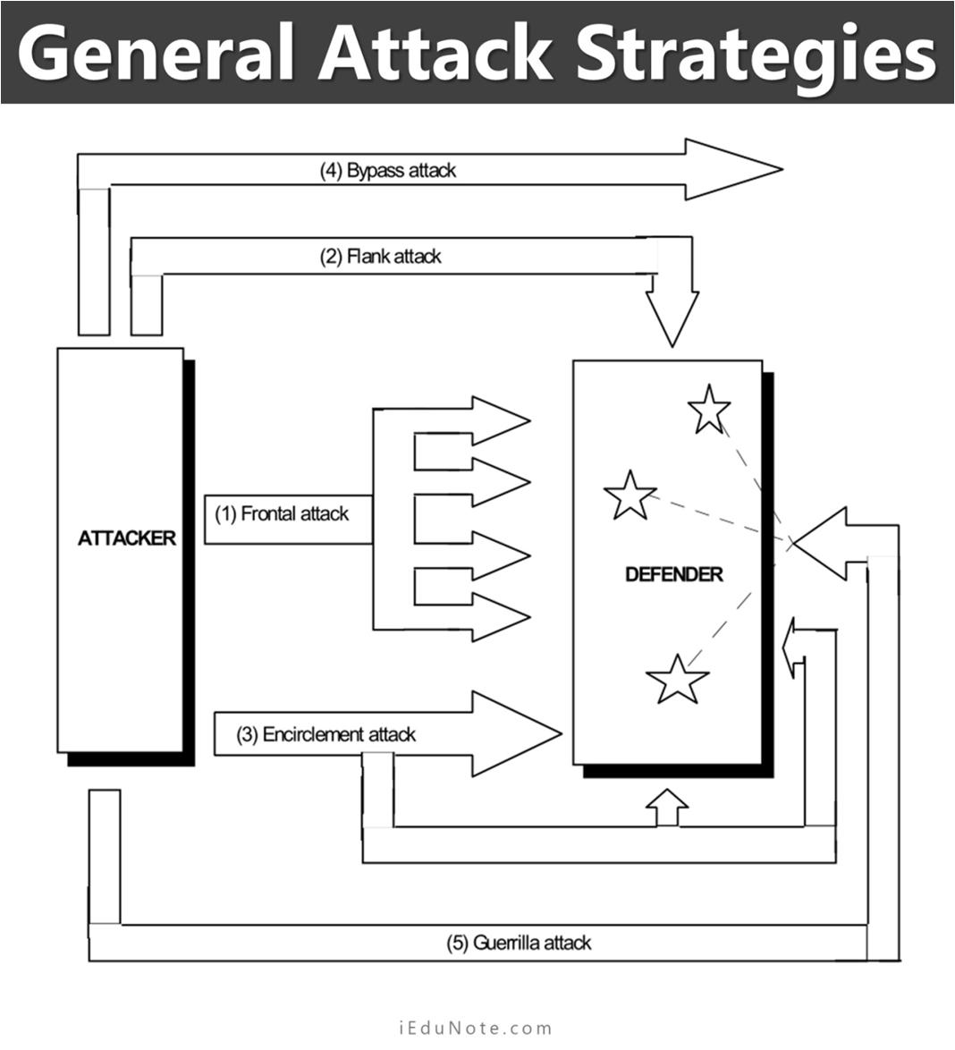
Market Challenger– Attack Strategies

Slide 90
Market - Follower Strategies
Imitator
Adapter
Cloners

Slide 91
Market - Nicher Strategies
Job Shop Specialist
Quality/Price Specialist
End-User Specialist
Vertical -Level Specialist
Customer-Size Specialist
Specific-Customer Specialist
Geographic Specialist
Product or Product-Line Specialist
Product Feature Specialist
Service Specialist
Channel Specialist

Slide 92
Thank you

Slide 93
Competitive Market Strategies
Dr. J. Hemalatha

Slide 94
Kotler on Marketing
The future is not ahead of us. It has already happened.
Unfortunately, it is unequally distributed among companies, industries and nations.

Slide 95
Ansoff’s Matrix
The matrix was developed by applied mathematician and business manager, H. Igor Ansoff, and was published in the Harvard Business Review in 1957
The Ansoff Matrix has helped many marketers and executives better understand the risks inherent in growing their business.
The Ansoff Matrix, also called the Product/Market Expansion Grid, is a tool used by firms to analyze and plan their strategies for growth.
The matrix shows four strategies that can be used to help a firm grow and also analyzes the risk associated with each strategy.

Slide 96
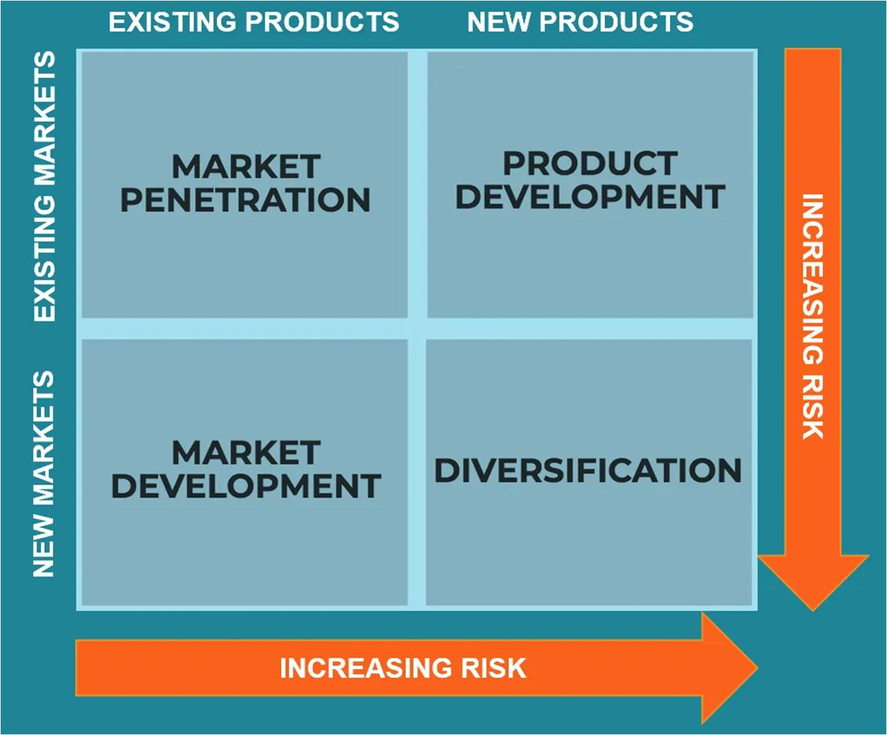
Ansoff’s Matrix

Slide 97
Ansoff’s Matrix Strategies
The four strategies of the Ansoff Matrix are:
Market Penetration: This focuses on increasing sales of existing products to an existing market.
Product Development: Focuses on introducing new products to an existing market.
Market Development: This strategy focuses on entering a new market using existing products.
Diversification: Focuses on entering a new market with the introduction of new products.

Slide 98
Market Penetration
The market penetration strategy can be executed in a number of ways:
Decreasing prices to attract new customers
Increasing promotion and distribution efforts
Acquiring a competitor in the same marketplace

Slide 99
Product Development
The product development strategy can be executed in a number of ways:
Investing in R&D to develop new products to cater to the existing market
Acquiring a competitor’s product and merging resources to create a new product that better meets the need of the existing market
Forming strategic partnerships with other firms to gain access to each partner’s distribution channels or brand

Slide 100
Market Development
The market development strategy can be executed in a number of ways:
Catering to a different customer segment
Entering into a new domestic market (expanding regionally)
Entering into a foreign market (expanding internationally)

Slide 101
Diversification
The diversification strategy can be executed in a number of ways:
Related diversification: There are potential synergies to be realized between the existing business and the new product/market.
Unrelated diversification: There are no potential synergies to be realized between the existing business and the new product/market.

Slide 102
Thank you

Slide 103
Competitive Market Strategies
Dr. J. Hemalatha

Slide 104
Kotler on Marketing
The future is not ahead of us. It has already happened.
Unfortunately, it is unequally distributed among companies, industries and nations.

Slide 105
Porter's Generic Competitive Strategies
A firm's relative position within its industry determines whether a firm's profitability is above or below the industry average.
The fundamental basis of above average profitability in the long run is sustainable competitive advantage.
There are two basic types of competitive advantage a firm can possess: low cost or differentiation.

Slide 106
Porter's Generic Competitive Strategies
The two basic types of competitive advantage combined with the scope of activities for which a firm seeks to achieve them, lead to three generic strategies for achieving above average performance in an industry
Cost Leadership
Differentiation,
Focus
The focus strategy has two variants, cost focus and differentiation focus.

Slide 107
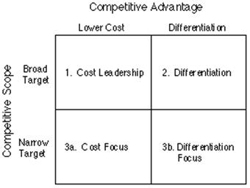
Porter's Generic Competitive Strategies

Slide 108
Cost Leadership
In cost leadership, a firm sets out to become the low cost producer in its industry
The sources of cost advantage include the pursuit of economies of scale, proprietary technology, preferential access to raw materials and other factors
A low cost producer must find and exploit all sources of cost advantage
If a firm can achieve and sustain overall cost leadership, then it will be an above average performer in its industry, provided it can command prices at or near the industry average.

Slide 109
Differentiation
In a differentiation strategy a firm seeks to be unique in its industry along some dimensions that are widely valued by buyers.
It selects one or more attributes that many buyers in an industry perceive as important, and uniquely positions itself to meet those needs.
It is rewarded for its uniqueness with a premium price.

Slide 110
Focus
The generic strategy of focus rests on the choice of a narrow competitive scope within an industry.
The focuser selects a segment or group of segments in the industry and tailors its strategy to serving them to the exclusion of others.
The focus strategy has two variants.
(a) In cost focus, a firm seeks a cost advantage in its target segment
(b) In differentiation focus, a firm seeks differentiation in its target segment.

Slide 111
Diversification
The diversification strategy can be executed in a number of ways:
Related diversification: There are potential synergies to be realized between the existing business and the new product/market.
Unrelated diversification: There are no potential synergies to be realized between the existing business and the new product/market.

Slide 112
Thank you

Slide 113
UNIT 3

Slide 114
Marketing information system
Dr. J. Hemalatha/ Dr. S. BHUVANESWARI

Slide 115
Kotler on Marketing
The future is not ahead of us. It has already happened.
Unfortunately, it is unequally distributed among companies, industries and nations.

Slide 116
Marketing Information System
A Marketing Information System (MIS) consists of people, equipment, and procedures to gather, sort, analyze, evaluate, and distribute needed, timely, and accurate information to marketing decision makers.
The degree of marketing excellence achieved by a firm has a direct relationship with the marketing information system operated by it.
Marketing excellence is the net outcome of correct marketing decisions and the decisions can be corrected only when they are information based.
MIS can make the crucial difference between winning and losing.

Slide 118
Marketing Information System Benefits
It helps marketing planning by making reliable information on the external environment and the internal realities of the company.
It helps effective tapping of marketing opportunities and provides effective defence against emerging marketing threats.
It helps early spotting of changing trends; it provides market intelligence to the firm.

Slide 119
It facilities the development of action programmes for achieving goals.
It helps the firm adjust its products and services to the needs and tastes of the customers.
It helps the firm control its marketing activities
The quality of marketing decisions are decided to a great extent by the quality of marketing information available to the decision maker

Slide 120
Types of Marketing Information
Classification based on the end use (or purpose) of the information
Information for marketing planning
Information for marketing operation
Information for key decisions in marketing
Information for marketing control
Classification based on the subject matter of the information
Product, consumer, pricing, distribution channels, promotion sales force, competition, sales methods
Internal operations of the firm
External environment of the firm

Slide 121
Internal Records System
The Order – to- Remittance Cycle
Sales Reporting System

Slide 122
Marketing Intelligence System
A marketing intelligence system is a set of procedures and sources used by managers to obtain their everyday information about pertinent developments in the marketing environment

Slide 123
Managers scan the environment in four ways
Undirected Viewing
Conditioned Viewing
Informal Search
Formal Search

Slide 124
Marketing Research System
Marketing research is the systematic design, collection, analysis, and reporting of data and findings to a specific marketing situation facing the company
Syndicated –service research firms
Custom marketing research firms
Specialty-line marketing research firms

Slide 125
Marketing Research Process
Defining the problem and research objectives
Developing the research plan
Collecting the information
Analyzing the information
Presenting the findings

Slide 126
Characteristics of Good Marketing Research
Scientific Method
Research Creativity
Multiple Methods
Interdependence of Models and Data
Value and Cost of Information
Healthy Skepticism
Ethical Marketing

Slide 127
Thank you

Slide 128
Marketing metrics & analytics
Dr. J. Hemalatha

Slide 129
Kotler on Marketing
The future is not ahead of us. It has already happened.
Unfortunately, it is unequally distributed among companies, industries and nations.

Slide 130
Marketing Metrics
Marketing metrics are what marketers use to monitor, record, and measure progress over time.
The metrics themselves are varied and can change from platform to platform.
Marketers need to hone in on their goals and choose the metrics that will track their successes and failures.

Slide 131
Marketing Metrics
Marketing metrics are what marketers use to monitor, record, and measure progress over time.
The metrics themselves are varied and can change from platform to platform.
Marketers need to hone in on their goals and choose the metrics that will track their successes and failures.

Slide 132
Thank you

Slide 133
Consumer Buying Behaviour
Dr. J. Hemalatha

Slide 134
Kotler on Marketing
The future is not ahead of us. It has already happened.
Unfortunately, it is unequally distributed among companies, industries and nations.

Slide 135
Consumer Behaviour
The field of consumer behavior studies how individuals, groups, and organizations select, buy, use, and dispose of goods, services, ideas, or experiences to satisfy their needs and desires
Marketers can profit from understanding how and why consumers buy
Not understanding your customer’s motivations, needs, and preferences can lead to major mistakes

Slide 136
Model of Consumer Behaviour
Marketing Stimuli | Other Stimuli
Product | Economic
Price | Technological
Place | Political
Promotion | Cultural
Buyer’s Characteristics | Buyer’s Decision Process
Cultural | Problem Recognition
Social | Information Search
Personal | Evaluation
Psychological | Decision
 | Post Purchase Behaviour
Buyer’s Decisions
Product Choice
Brand Choice
Dealer Choice
Purchase Timing
Purchase Amount

Slide 137
Factors influencing consumer buying behaviour
Cultural factors
Social Factors
Personal factors
Psychological Factors

Slide 138
Cultural factors
Culture
Subculture
Social Class

Slide 139
Social factors
Reference Groups
Membership groups
Aspiration groups
Dissociative groups
Family
Roles and statuses

Slide 140
Personal factors
Age and Life Cycle Stage
Occupation
Economic Circumstances
Personality and Self-Concept
Self-confidence
Dominance
Autonomy
Deference
Sociability
Defensiveness
Adaptability
Lifestyle
Activities
Interest
Opinions

Slide 141
Psychological factors
Motivation
Perception
Selective Attention
Selective Distortion
Selective Retention
Learning
Drives
Stimuli
Cues
Responses
Reinforcement
Beliefs and Attitudes

Slide 142
Industrial Buying Behaviour
Dr. J. Hemalatha / Dr. BHUVANESWARI S

Slide 143
Kotler on Marketing
The future is not ahead of us. It has already happened.
Unfortunately, it is unequally distributed among companies, industries and nations.

Slide 144
Business Market
The business market consists of all of the organizations that acquire goods and services used in the production of other products or services that are sold, rented, or supplied to other customers.

Slide 145
Characteristics of Business Markets
Fewer buyers
Larger buyers
Close-supplier-customer relationships
Geographically concentrated buyers
Derived demand
Derived demand
Inelastic demand
Fluctuatingdemand
Professional purchasing
Several buying influencers
Direct purchasing
Reciprocity
Leasing

Slide 146
Business Markets
# Environmental factors # Organizational factors # Interpersonal factors # Individual factors
The institutional market
The Government market

Slide 147
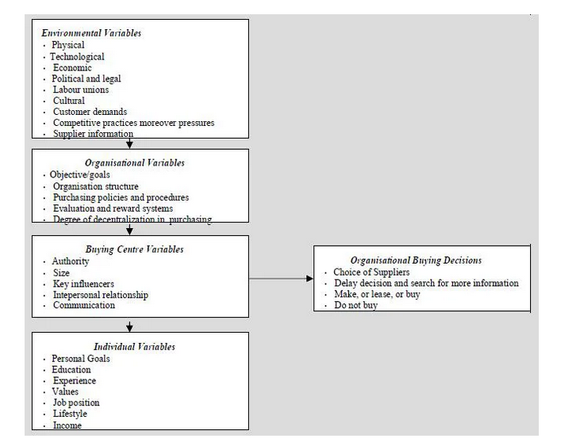
Source: R.E. Webster, Jr and Y Wind, journal of Marketing, 36, pp 12-17, April, 1972.

Slide 148
Business buying situations
Straight rebuy
Modified rebuy
New task

Slide 150
Participants in the business buying process
Users
Influencers
Deciders
Approvers
Buyers

Slide 151
Factors influencing business buying behaviour
Environmental Factors
Organizational Factors
Interpersonal factors
Individual factors

Slide 152
Environmental factors
Level of demand
Economic outlook
Cost of money
Rate of technological change
Political and regulatory developments
Competitive environment

Slide 153
Organizational factors
Objectives
Policies
Procedures
Organizational structures
Systems

Slide 154
Interpersonal factors
Authority
Status
Empathy
Persuasiveness

Slide 155
Individual factors
Age
Income
Education
Job Position
Risk Attitudes
Culture

Slide 156
The buying decisions of industrial buyers are influenced by many factors. Usually, these are influenced by organisational factors or task-oriented objectives viz. best product quality, or dependable delivery, or lowest price and personal factors or non-task objectives viz. like promotion, increments, job security, personal treatment, or favor. When the suppliers proposals are substantially similar, organizational buyers can satisfy organisational objectives with any supplier, and therefore personal factors become more important. When suppliers offers differ significantly, industrial buyers pay more attention to organisational factors in order to satisfy the organisational objectives. There are two models available to provide a comprehensive and integrated picture of the major factors that combine to explain organisational buying behavior.

Slide 157
The consumer buying decision process
Dr. J. Hemalatha

Slide 158
Kotler on Marketing
The future is not ahead of us. It has already happened.
Unfortunately, it is unequally distributed among companies, industries and nations.

Slide 159
The Buying Decision Process
Buying Roles
Types of Buying Behaviour
Buying Decision Process

Slide 160
Buying Roles
Initiator
Influencer
Decider
Buyer
User

Slide 161
Types of Buying Behaviour
Complex buying behaviour
Dissonance-reducing buying behaviour
Habitual buying behaviour
Variety-seeking buying behaviour

Slide 162
The Stages of the Buying Decision Process
Need Recognition
Information Search
Evaluation of Alternatives
Purchase Decision
Post Purchase Behaviour

Slide 163
Consumer adoption process and diffusion
Dr. J. Hemalatha

Slide 164
Kotler on Marketing
The future is not ahead of us. It has already happened.
Unfortunately, it is unequally distributed among companies, industries and nations.

Slide 165
The Consumer Adoption Process
Adoption is an individual’s decision to become a regular user of a product.
An innovation refers to any good, service, or idea that is perceived by someone as new
Rogers defines the innovation diffusion process as “the spread of a new idea from its source of invention or creation to its ultimate users or adopters.

Slide 166
The Consumer Adoption Process
Awareness
Interest
Evaluation
Trial
Adoption

Slide 167
Factors influencing consumer adoption process
Individual differences in innovativeness
Role of Personal influences
Influence of product characteristics on the rate of adoption
Influence of Organizational characteristics on the rate of adoption

Slide 168
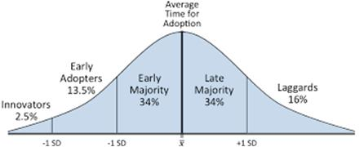
Adopter Categorization on the Basis of Relative Time of Adoption of Innovations
Source: Research gate

Slide 169
Influence of product characteristics on the rate of adoption
Relative Advantage
Compatibility
Complexity
Divisibility
Communicability

Slide 170
Thank you

Slide 171
MODULE IV PRODUCT AND PRICE 6+2

Slide 172
Unit 4
Elements of marketing mix - Product: definition, levels, hierarchy, systems & mix, Product line decisions - New product development stages – Product planning-Product life cycle and Strategies – Packaging- Labeling- Branding - Types of brands - Pricing: objectives, strategies, methods.

Slide 173
Definition
The marketing mix refers to the set of actions, or tactics, that a company uses to promote its brand or product in the market. The 4Ps make up a typical marketing mix - Price, Product, Promotion and Place. However, nowadays, the marketing mix increasingly includes several other Ps like Packaging, Positioning, People and even Politics as vital mix elements.

Slide 174
The Marketing “Mix”

Slide 175
Marketing Mix – 4Ps The marketing mix elements that make up an organization’s marketing program:
Product
Promotion
Price
Place
These are management decisions, controllable factors

Slide 176
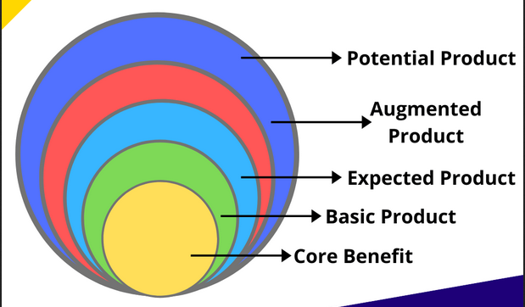
Products levels
A product is anything that can satisfy a want or need of a customer, be it tangible or intangible. It can be physical goods, services, experiences, information, ideas. Etc

Slide 177
Marketing function relates to many people, groups, and forces

Slide 178
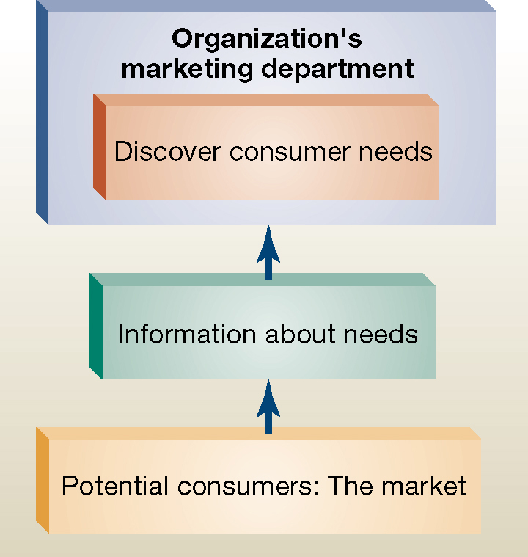
Marketing’s first task: discovering consumer needs

Slide 179
Marketing’s second task: satisfying consumer needs

Slide 180
Product Hierarchy
A product hierarchy can be seen as a family where the customer need is at the top and the specific product variant is at the bottom.
Their could be multiple ways to meet a customer’s need and all those ways can be put under one basket.

Slide 182
Product Mix
A product mix is the combination of all the items and products which a particular company has to offer to the customer.
A product mix consists of multiple product lines.
Product mix is also termed product assortment [variety].
Every product mix has dimensions such as Product Width, Product Length, Product Depth, and consistency.

Slide 183
Product width[Breath] – refers to the total number of product lines a company caries.
Product length refers to the number of product line.. The total length of the product mix would be the total number of items within a product mix.
Product depth refers to the number of variants of each product within a product line. If a specific iPhone model comes in two different colors or 3 different Ram capacities say variants. These variants are considered the depth of the product.
Consistency is the similarlity between several product lines in terms of usage, channels of distribution, methods of production etc.

Slide 185
Product life cycle
A fundamental factor that marketers should consider is managing their product/service through its life-cycle.
The product life-cycle theory was formulated in 1966 by American economist, Raymond Vernon, who addressed US exports in an article called International investment and international trade in the product cycle.
According to this theory, a product/service has a limited life and its sales go through different stages of ups and downs. For this reason, offerings require distinct marketing, production, HR and financial strategies based on their specific life-cycle phase.
This graph represents the life-cycle of a product. It is divided in 5 stages: development, introduction, growth, maturity and decline.
This theory breaks down a product/service life-cycle in five stages according to the revenue generated over time:

Slide 186
Product life cycle
Development: companies develop new products and services all the time, but only a small percentage reaches the market after the validation stage;
Introduction: the offering is promoted and consumers become aware of its existence. Revenues are still low, but they are going to grow exponentially in the next phase;
Growth: the demand and awareness grow. Sales increase on par with profits and production costs decrease. Competitors enter the market with their version of the product/service;

Slide 187
Product life cycle
Maturity: the offering is now well known, the demand tends to stabilize and sales slow down. The industry is characterized by a thick competition which pushes the company to decrease prices in order to maintain the leadership.
The market saturates and the company must activate some differentiating strategies to acquire new consumers.
According to Marketing and management of Kotler and Keller, it can expand the market (market modification), change or improve the quality, features or style of the product/service (product modification), and edit non-product-related elements such as communication, price and distribution;
Decline: as soon as the offering becomes obsolete, sales and revenues drop till it’s not convenient to continue making the product/service anymore.

Slide 188
BRANDING
Branding is a practice of giving a specified name to a product or group of product of one seller.
Branding is the process of finding and fixing the means of identification, eg. Rado watch.
Philip kotler – A brand is defined as a “name, term, sign symbol (or a combination of these) that identifies the maker or seller of the product

Slide 189
Why branding?
A brand name helps an organization to differentiate itself from its competitors
In today’s competitive world customers expect product to have brand
Some people will only purchase a particular brand even though there are acceptable alternative on the market eg. Apple Inc.

Slide 190
Brand Equity
Brand equity refers to the value of a brand. Brand equity does not develop instantaneously.
A brand need to be carefully nurtured and marketed so consumers feel ral value and trust towards that brand.
Nike, Adidas have high brand equity. These brands command high awareness and consumer loyalty.

Slide 191
Major Assets of Brand Equity
Brand awareness
Perceived quality
Brand loyalty
Brand personality

Slide 192
Branding strategies
1. Line extension: This is where an organization adds to its current product line by introducing versions of its products with new features, an examples could be a crisp/ chips manufactures extending its line by adding more exotic flavors.
Brand extension: If your current brand name is successful, you may use the brand name to extend into new business areas. Eg. Virgin Group extending its brand from records, airlines, mobiles and banking.

Slide 193
3. Multi Branding: The company decides to introduce more brands into an existing category. E.g.. Procter & Gamble (P&G) is an American consumer goods company that sells 23 different brands – Tide, Pampers, Gillette, Ace, Head & Shoulders etc.
4. New Brands: An organization may decide to launch a new brand into a market. A new brand may be used to compete with existing rivals and may be marketed as something ‘new and fresh’

Slide 194
Branding Decisions
Strategies adopted by the marketer while branding a product:
Individual names
Blanket family names
Separate family names for all products
Company trade name combined with individual product names.

Slide 195
Packaging
Packaging includes the activities of designing and producing the container of the product
Packaging can be defined as the wrapping material around a consumer item that serves to contain, identify, describe, protect, display, promote and otherwise make the product marketable and keep it clean.
Packaging is the outer wrapping of a product.

Slide 196
Types of Packaging
Transport packing: The product entering into the trade need to be packed well enough to protect against loss damage during handling, transport and storage. E.g. Fiberbroad, wooden crate etc
Consumer Packing: This packing holds the required volume of the product for ultimate consumption and is more relevant in marketing. E.g. beverages, tobacco etc.

Slide 197
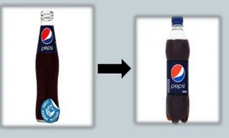
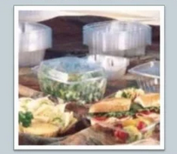
Purpose of packing
Product protection
Product attractiveness
Product identification
Product convenience

Slide 198
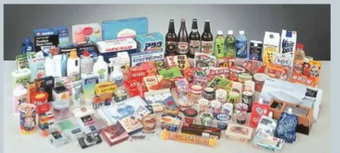
Packing strategies
Packaging the product line
Multiple packaging
Changing the package

Slide 199
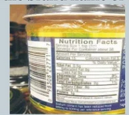
Labeling
Label is a part of product, which carries cverbal information about the product to pr seller. It may be a small slip or printed statement
The seller must label the products
The lable might carry only the brand name or a great deal of information

Slide 200
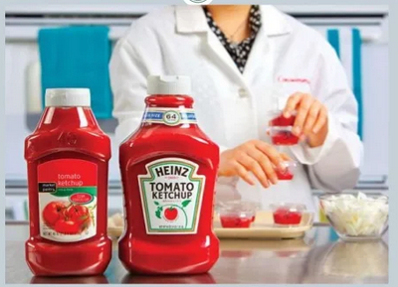
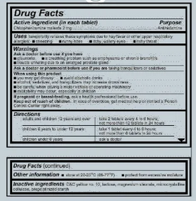
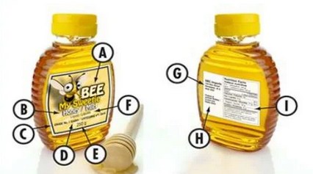
Types of labeling
Brand label
Descriptive label
Grade label

Slide 201
Function of labeling
It enable the producer to give a clear instruction about the users of a product.
Price variation caused by middleman are avoided because of price is maintained and printed.
It encourages producer to make only standard products
Buyers can easily identify the product.

Slide 202
-Pricing: objectives, strategies, methods.

Slide 203
Different Pricing Strategies

Slide 204
Pricing Strategies
market skimming
value pricing
loss leader
psychological pricing
competitor pricing
predatory pricing
cost-plus pricing
penetration pricing
contribution pricing

Slide 205
Penetration Pricing
Pricing Strategies
market skimming
value pricing
loss leader
psychological pricing
competitor pricing
predatory pricing
cost-plus pricing
penetration pricing
contribution pricing

Slide 206
Penetration Pricing
Prices set to ‘penetrate the market’
‘Low’ price to secure high volumes
Typical in mass market products – chocolate bars, food stuffs, household goods, etc.
Suitable for products with long anticipated life cycles
May be useful if launching into a new market

Slide 207
Market Skimming
Pricing Strategies
market skimming
value pricing
loss leader
psychological pricing
competitor pricing
predatory pricing
cost-plus pricing
penetration pricing
contribution pricing

Slide 208
Market Skimming
High price, Low volumes
Skim the profit from the market
Suitable for products that have short life cycles or which will face competition at some point in the future (e.g. after a patent runs out)
Examples include: Playstation, jewellery, digital technology, new DVDs, innovations and First to Market products etc.

Slide 209
Value Pricing
Pricing Strategies
market skimming
value pricing – based on perceived value
loss leader
psychological pricing
competitor pricing
predatory pricing
cost-plus pricing
penetration pricing
contribution pricing

Slide 210
Value Pricing
Price set in accordance with customer perceptions about the value of the product/service
Examples include status products/exclusive products /art pieces
Companies may be able to set prices according to perceived value.
Copyright: iStock.com

Slide 211
Loss Leader
Pricing Strategies
market skimming
value pricing
loss leader – sold at cost or below to attract buyers
psychological pricing
competitor pricing
predatory pricing
cost-plus pricing
penetration pricing
contribution pricing

Slide 212
Loss Leader
Goods/services deliberately sold below cost to encourage sales elsewhere
Typical in supermarkets, e.g. at Christmas, selling bottles of gin at R30 in the hope that people will be attracted to the store and buy other things
Purchases of other items more than covers ‘loss’ on item sold
e.g. ‘Free’ mobile phone when taking on contract package

Slide 213
Psychological Pricing
Pricing Strategies
market skimming
value pricing
loss leader
psychological pricing eg R19.99
competitor pricing
predatory pricing
cost-plus pricing
penetration pricing
contribution pricing

Slide 214
Psychological Pricing
Used to play on consumer perceptions
Classic example - R9.99 instead of R10.99!
Links with value pricing – high value goods priced according to what consumers THINK should be the price

Slide 215
Competitor Pricing(Going Rate)
Pricing Strategies
market skimming
value pricing
loss leader
psychological pricing
competitor pricing
predatory pricing
cost-plus pricing
penetration pricing
contribution pricing

Slide 216
Competitor Pricing (Going Rate)
In case of a price leader, rivals have difficulty in competing on price – too high and they lose market share, too low and the price leader would match price and force smaller rival out of market
In this strategy, we are compelled to follow pricing leads of rivals especially where those rivals have a clear dominance of market share
Where competition is limited, ‘going rate’ pricing may be applicable – banks, petrol, supermarkets, electrical goods – find very similar prices in all outlets

Slide 217
Predatory Pricing
Pricing Strategies
market skimming
value pricing
loss leader
psychological pricing
competitor pricing
predatory pricing
cost-plus pricing
penetration pricing
contribution pricing

Slide 218
Destroyer/Predatory Pricing
Deliberate price cutting or offer of ‘free gifts/products’ to force rivals (normally smaller and weaker) out of business or prevent new entrants
Flooding the market with cheap (often imported) goods
Anti-competitive and illegal if it can be proved

Slide 219
Contribution Pricing
Pricing Strategies
market skimming
value pricing
loss leader
psychological pricing
competitor pricing
predatory pricing
cost-plus pricing
penetration pricing
contribution pricing

Slide 220
Contribution Pricing
Contribution = Selling Price – Variable (direct costs)
Prices set to ensure coverage of variable costs and a ‘contribution’ to the fixed costs/overheads
Similar in principle to cost-plus pricing
Every product sold gives back a contribution towards covering the running costs of the business
Break-even analysis might be useful in such circumstances

Slide 221
Cost-Plus Pricing
Pricing Strategies
market skimming
value pricing
loss leader
psychological pricing
competitor pricing
predatory pricing
cost-plus pricing
penetration pricing
contribution pricing

Slide 222
Cost-Plus Pricing
The cost of the product + mark-up = selling price.
You can do this by using a fixed percentage (150%, 200%) or a fixed markup (R10, R50, R500)
The advantage of this method is that you are able to calculate your expected profit level very easily.
The disadvantage is that it may be less, or more, than customers are willing to pay and, most importantly, some hidden costs may be forgotten and so the actual profit is less than you think (or even a loss)

Slide 223
Influence of Elasticity
Price Elasticity:
Price elasticity of demand (PED) is defined as the measure of responsiveness in the quantity demanded for a commodity as a result of change in price of the same commodity.
e.g. A 4% rise in price would lead to sales falling by something more than 4%
Revenue would fall
e.g. A 9% fall in price would lead to a rise in sales of something more than 9%
Revenue would rise

Slide 224
MODULE V PLACE & PROMOTION
6+2

Slide 225
MODULE V PLACE & PROMOTION 6+2
Marketing channel: importance, functions, flows, levels, characteristics - Selection, design and management of channel members –
Promotion Mix: elements / promotion tools - Integrated communication model –
Communication process - Steps in developing effective communication - Setting promotion budget and promotion mix - Basics of advertising, sales promotion, personal selling and public relations

Slide 227
Chapter 13
Marketing Channels
McGraw-Hill/Irwin
Copyright © 2004 by The McGraw-Hill Companies, Inc. All rights reserved.

Slide 228
After studying this chapter, you should be able to:
Explain the functions and key activities of marketing channels.
Discuss the role of intermediaries in marketing channels.
Distinguish between direct and indirect marketing channels.

Slide 229
After studying this chapter, you should be able to:
Illustrate how some firms use multiple channels successfully.
See how marketing-channel decisions are related to other key marketing decision variables.
Understand how power, conflict, and cooperation affect the operation of a marketing channel.
Give examples of ethical and legal issues encountered in the operations of marketing channels.

Slide 230
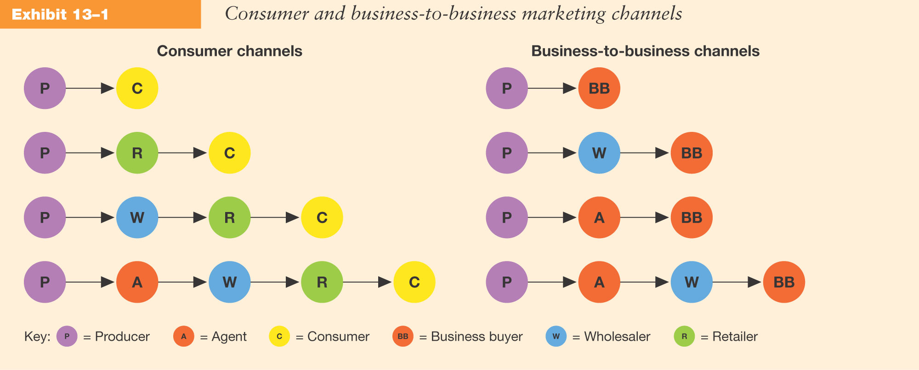
Consumer and Business-to-Business Marketing Channels

Slide 231
The Importance of Marketing Channels
Marketing channels determine how and where customers buy.

Slide 232
Key Functions Performed in Marketing Channels
Marketing Communications
Advertising the Product
Providing P-O-P Displays
Providing a salesforce that offers information & service to customers
Inventory Management
Ordering appropriate merchandise assortment
Maintaining adequate stock to meet customer demand
Storing merchandise in an appropriate facility
Physical Distribution
Delivering products
Coordinating delivery schedules to meet customer expectations
Arranging for the return of defective merchandise

Slide 233
Key Functions Performed in Marketing Channels
Market Feedback
Serving on manufacturer advisory boards
Informing other channel members of competitive activity
Participating in test market evaluations
Financial Risk
Offering credit
Managing risks related to product loss or deterioration
Managing risks related to product safety and liability

Slide 234
Contributions of Intermediries
Provide Economic Value
Provide Social Value
Provide Marketing Support
Impact Supply-chain Management
Add Value to the Market Offering

Slide 235
Types of Marketing Channels
Direct Channels
Indirect Channels
Single Marketing Channels
Multiple Marketing Channels
Vertical Marketing Systems

Slide 236
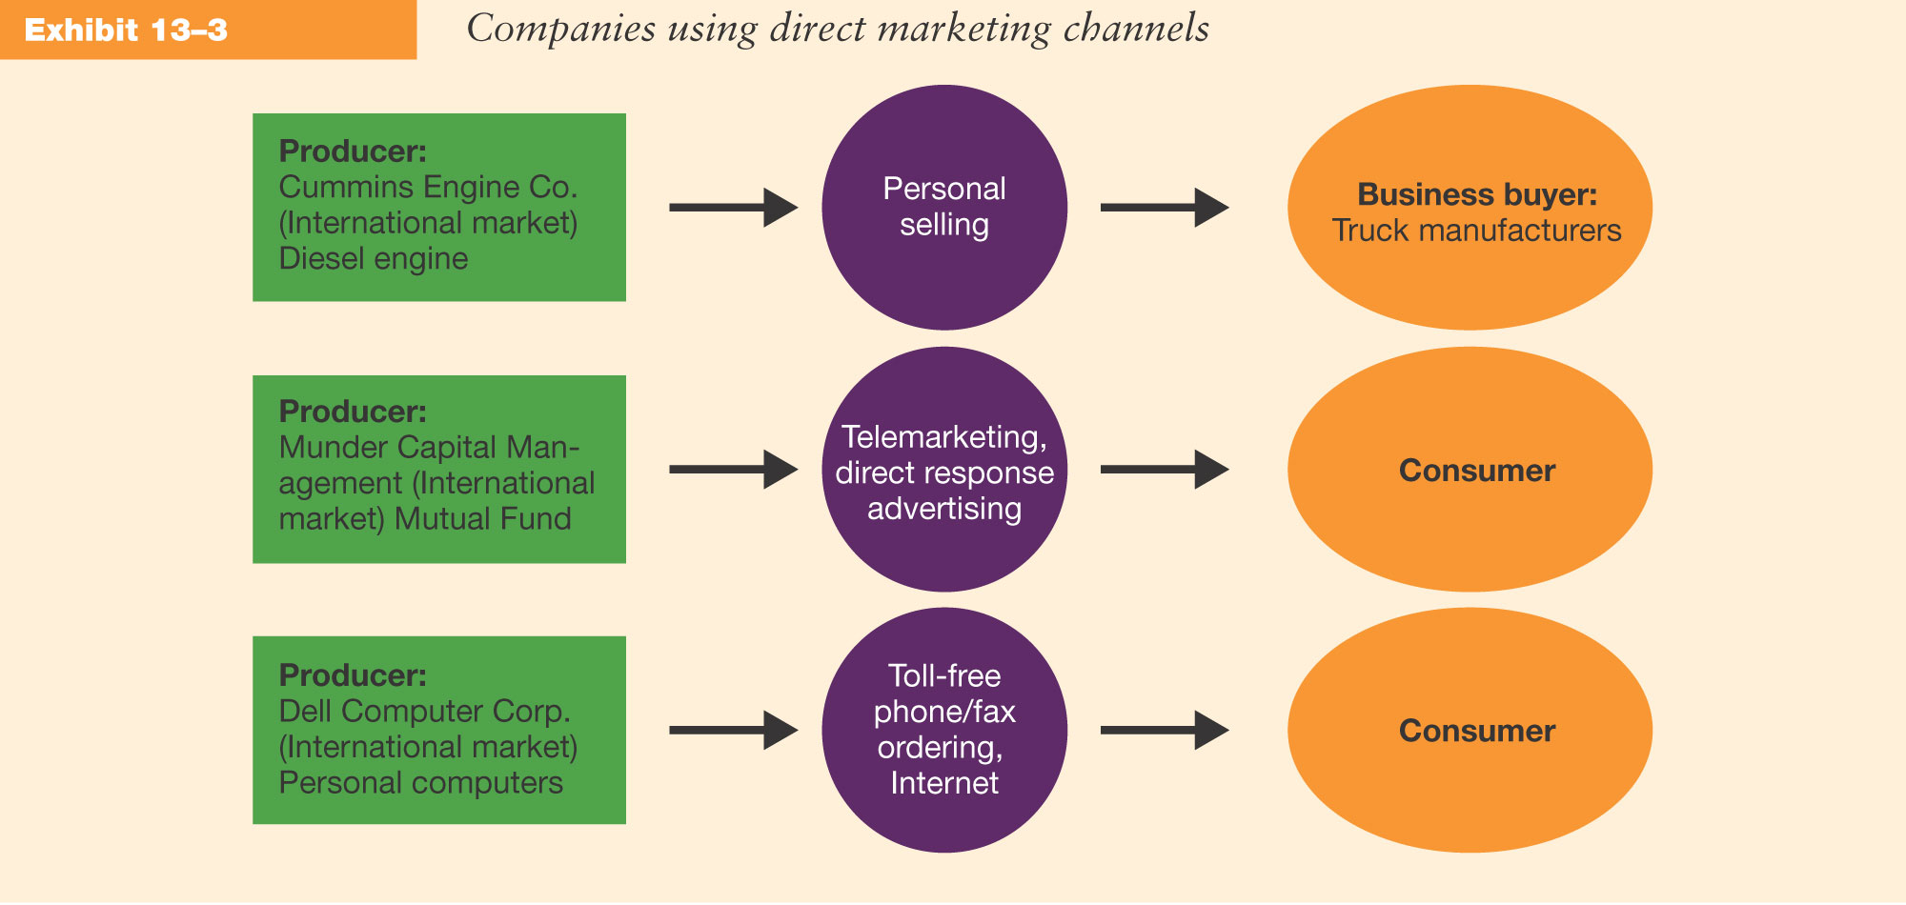
Companies Using Direct Marketing Channels

Slide 237
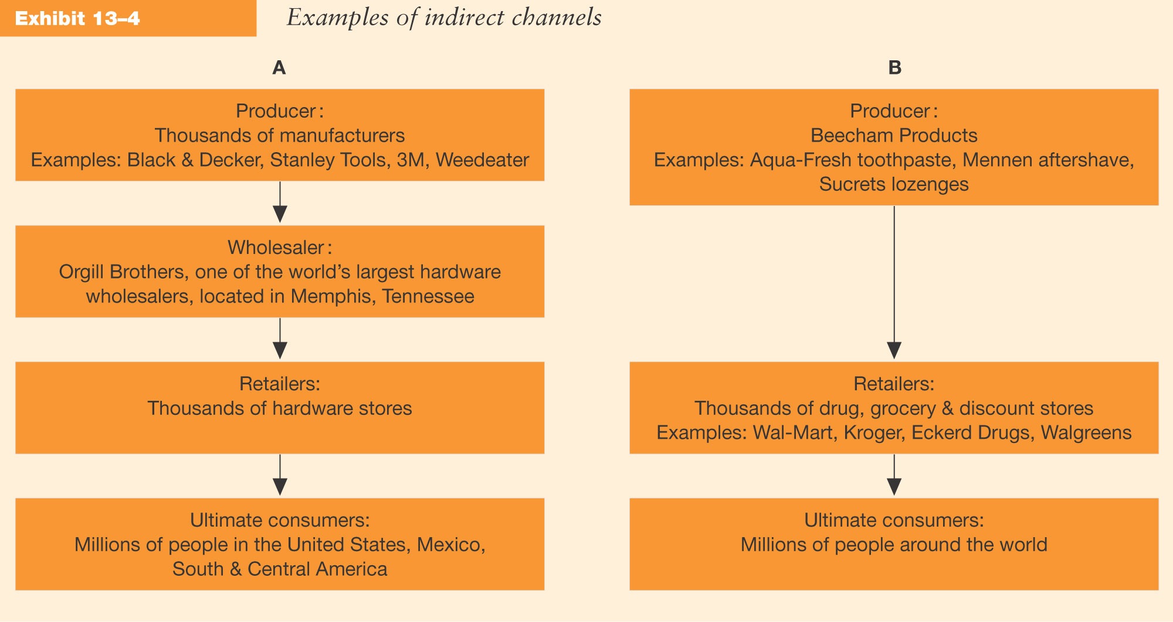
Companies Using Indirect Marketing Channels

Slide 238
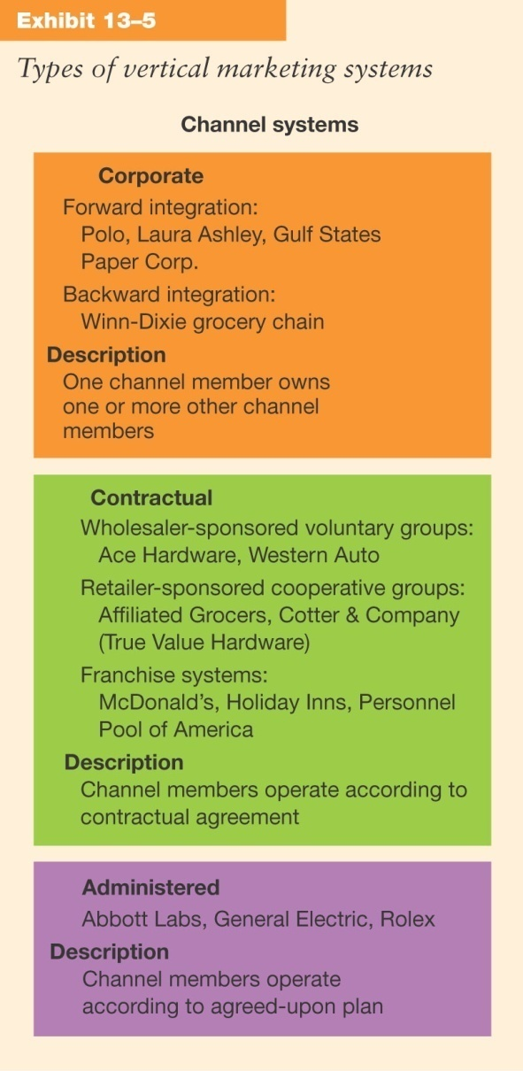
Companies Using Vertical Marketing Systems

Slide 239
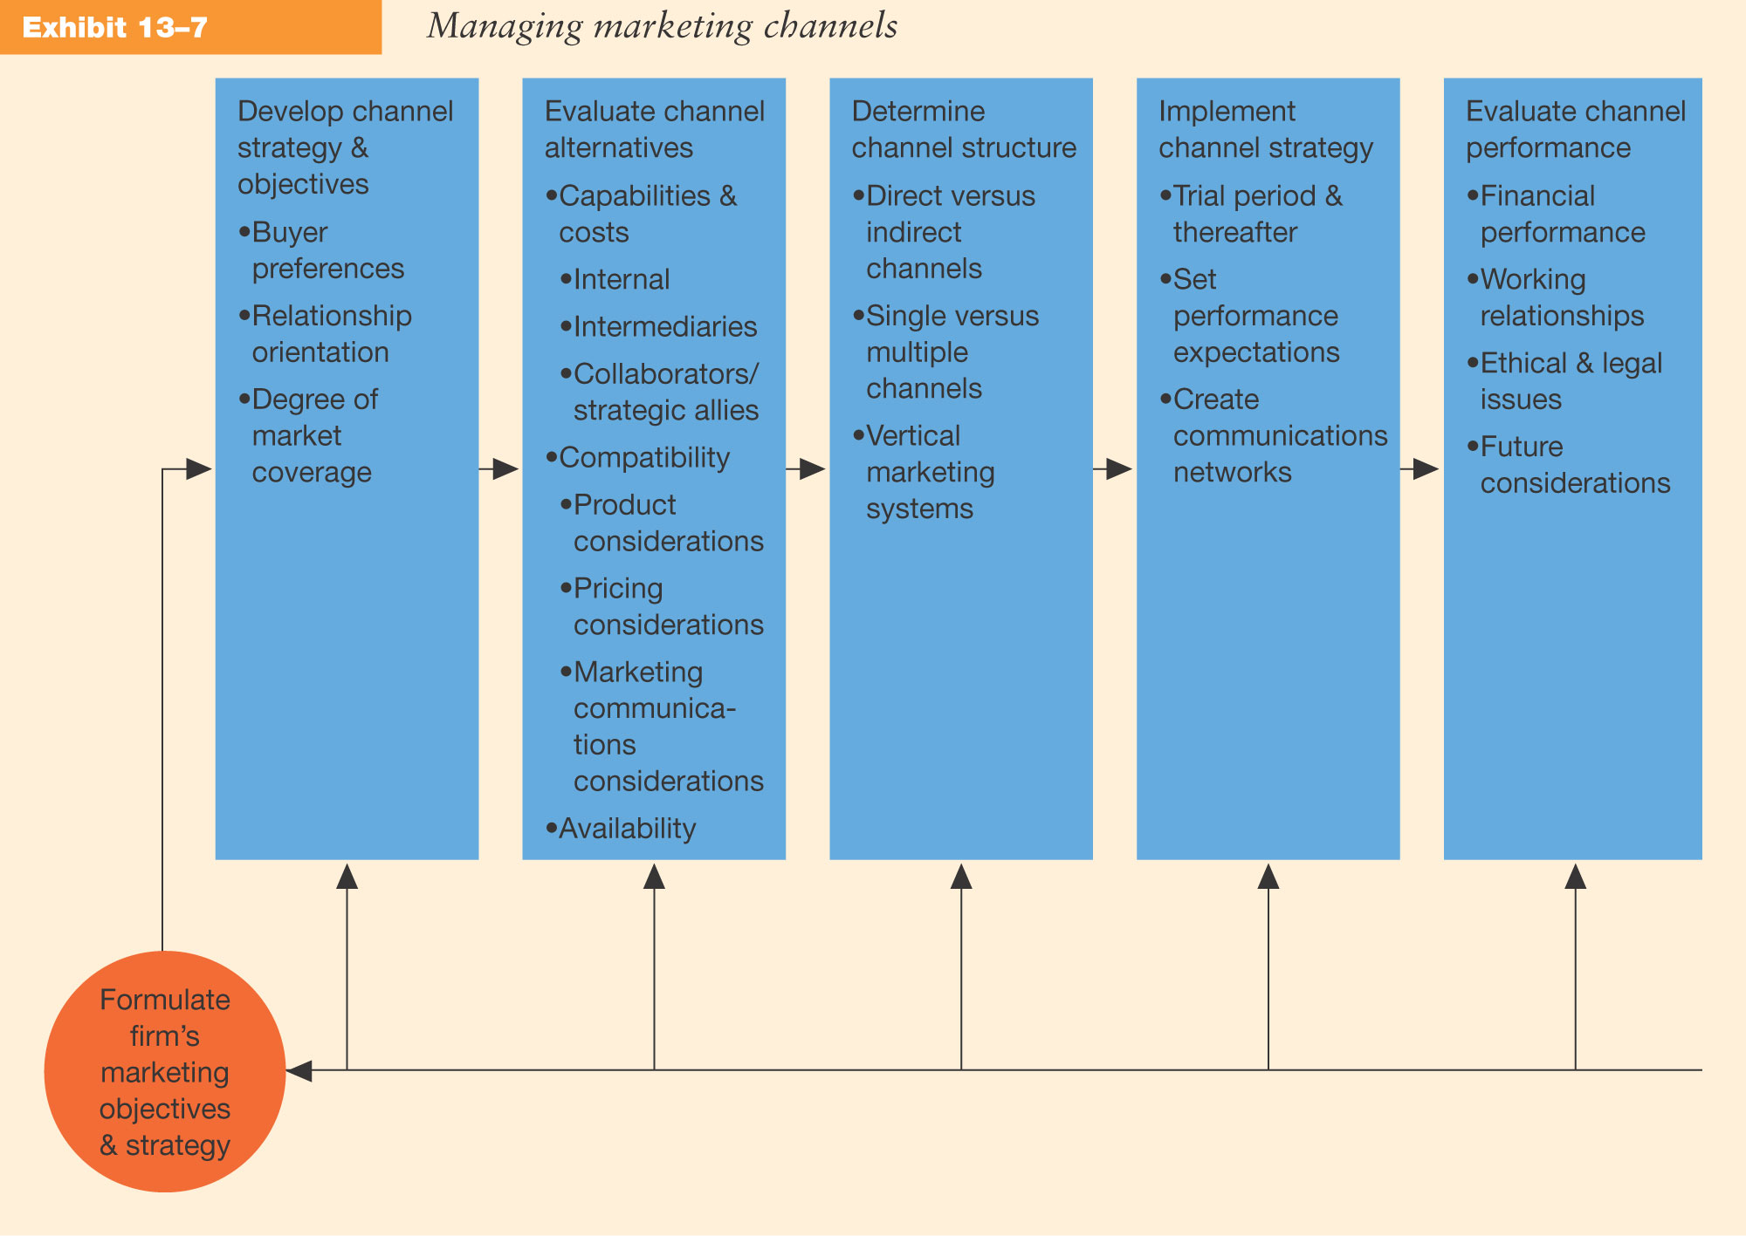
Managing Marketing Channels

Slide 240
Formulating Marketing Objectives and Strategies
Marketing channel objectives and strategies must be compatible with overall marketing strategy.

Slide 241
Developing Channel Objectives and Strategy
The development of channel strategies requires decisions in three key areas:
Buyer Preferences
Relationship Orientation
Degree of Market Coverage

Slide 242
Evaluating Channel Alternatives
Evaluation of Capabilities and Costs
Evaluation of Channel Compatibility:
Product Considerations
Pricing Considerations
Marketing Communications Considerations
Evaluation of Availability

Slide 243
Determining Channel Structure
The key question is “What channel structure is best for us to use?”
Direct of Indirect Channels?
Single or Multiple Channels?
Vertical Marketing Systems?

Slide 244
Implementing Channel Strategy
Run a Trial Period
Set Performance Expectations
Create Communication Networks

Slide 245
Evaluating Channel Performance
Financial Evaluation
Evaluate Working Relationships
Evaluate Legal and Ethical Issues

Slide 246
Financial Evaluation
In the short run channel members
will accept low levels of
financial performance
In the long run channel members
must have positive financial
results to sustain channel relationships

Slide 247
Evaluating Working Relationships
Channel Power
Reward Power
Legitimate Power
Expert Power
Referent Power
Coercive Power
Channel Leader Power
Channel Conflict
Channel Cooperation

Slide 248
Evaluate Legal and Ethical Issues
Are any laws being violated?
Are any exclusive territories set up?
Are any exclusive dealing arrangements being made?
Are resellers being bound to tying contracts?

Slide 249
Future Considerations for Channel Management
Firms must always ask “How well can this channel be expected to perform in the future?”
Companies will be forced to alter their channels because of:
Changing consumer preferences
Intense competition
Innovation in information technology

Slide 250
Marketing Mix – Promotion
GCSE Business Studies
Unit 1
Starting a Business

Slide 251
Learning Outcomes
Describe and explain methods of promotion (advertising, sales promotion, sponsorship and public relations)
Evaluate each method of promotion
Explain how social media can be used to promote business activity
Identify and justify the most appropriate methods of promotion in particular circumstances
Demonstrate knowledge of the following legal constraints on promotion (Trade Descriptions Act, 1968, ASA and Ofcom)

Slide 252
Promotion
Promotion is all about communication. A business needs to let customers know about the product/service they have to offer.
Promotion can also be used to persuade customers that the product/service you offer is better than your competitors

Slide 253
Promotion
Spend 10 minutes
on this activity
Think of methods a business may use to promote their products/services
Would a small business use the same promotional methods as a large business?

Slide 254
Methods of Promotion – Advertising
Advertising – There are two main types of advertising:
(a) Informative Advertising
This informs and educates potential customers about the product/service.
(b) Persuasive Advertising
Tries to use emotions to influence/persuade customers to purchase your product/service.

Slide 255
Methods of Promotion – Advertising
Examples of Advertising:
TV (national and local)
Radio (national and local)
Bill boards/posters
Cinema
Newspapers/Magazines
Internet
ACTIVITY: (20 minutes)
List all the advantages
and disadvantages of
the different types of advertising

Slide 256
Methods of Promotion – Sales Promotion
Sales Promotions – Sales promotions can be divided into many different parts for example:
(a) Coupons and Loyalty Cards (to encourage repeat purchases)
Competitions (used to boost sales as customers are entered in to win a prize)
(c) Product Endorsements (from e.g. a celebrity)
Free Offers
Merchandising
Price reductions/discounts
Loss leaders

Slide 257
Methods of Promotion – Sponsorship
Sponsorship is particularly popular with large businesses
A business will sponsor an event, team or individual in order to build up brand awareness.
ACTIVITY: (20 minutes)
Can you find out the business(es) that sponsor:
(a) Balmoral Show
(b) Usain Bolt
List the advantages and disadvantages of using sponsorship as a method of promotion

Slide 258
Methods of Promotion – Public Relations
Public relations (PR) is focused on creating positive publicity for a business.
It is good for a business to have a good reputation.
A business can gain good PR by e.g. winning awards, working with the press, organising charity events.
Activity: (15 minutes)
Discuss the advantages and disadvantages of PR as a method of promotion

Slide 259
Promotion – Social Media
Activity: (20 minutes)
In groups, discuss how social media can be used to promote business activity

Slide 260
Legal Constraints on Promotion
The Trade Descriptions Act, 1968
The work of the Advertising Standards Authority (ASA)
The Office of Communications (Ofcom)

Slide 261
Check List
Learning Check – Do you know . . .
The methods of promotion and their advantages and disadvantages?
How social media can be used to promote business activity?
How to identify and justify the most appropriate methods of promotion in particular circumstances?
Some legal constraints on promotion?

