Slide 1
DISTRIBUTION NETWORK DESIGN

Slide 2
ROLE OF DISTRIBUTION IN THE SUPPLY CHAIN
Distribution: The steps taken to move and store a product from the supplier stage to the customer stage in a supply chain
Distribution directly affects cost and the customer experience and therefore drives profitability
Choice of distribution network can achieve supply chain objectives from low cost to high responsiveness
Examples: Wal-Mart, Dell, Proctor & Gamble

Slide 3
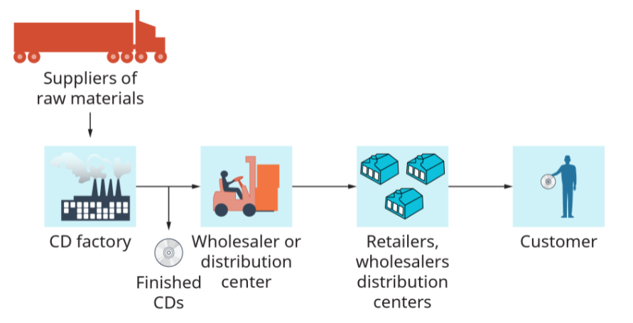
TYPICAL SUPPLY CHAIN

Slide 4

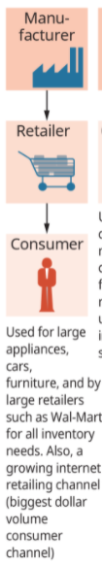



CONSUMER PRODUCT CHANNELS

Slide 5



INDUSTRIAL PRODUCT CHANNELS

Slide 6
EFFICIENT SUPPLY CHAIN VS RESPONSIVE SUPPLY CHAIN
STRATEGY | EFFICIENT SUPPLY CHAIN | RESPONSIVE SUPPLY CHAIN
Primary goal | Meet (predictable) demand at low cost | Respond quickly to demand
Product design | Max performance at min cost | Flexible design(modularity, mix-&-match)
Pricing | Lower margin | Higher margin
Manufacturing | High facility utilisation (low average cost) | Capacity flexibility and cushion
Inventory | Minimise inventory levels | Maintain buffer inventory to meet unexpected demand
Lead Time | Reduce, but not at the expense of production costs | Aggressively reduce
Supplier | Select based on cost and quality | Select based on speed, flexibility and quality
Transportation | Low costs modes | Responsive and speedy modes

Slide 7
FACTORS INFLUENCING DISTRIBUTION NETWORK DESIGN
1. Distribution network performance evaluated along two dimensions at the highest level:
Customer needs that are met
Cost of meeting customer needs
2. Distribution network design options must therefore be compared according to their impact on customer service and the cost to provide this level of service

Slide 8
3. Elements of customer service influenced by network structure:
Response time
Product variety
Product availability
Customer experience
Order visibility
Returnability

Slide 9
4. Supply chain costs affected by network structure
Inventories
Transportation
Facilities and handling
Information

Slide 10
SERVICE AND NUMBER OF FACILITIES
Increasing the number of facilities moves them closer to the end consumer. This reduces the response time.
As Amazon has built warehouses, the average time from the warehouse to the end consumer has decreased.
McMaster-Carr provides 1-2 day coverage of most of the U.S from 6 facilities.
W.W. Grainger is able to increase coverage to same day delivery using about 370 facilities

Slide 11
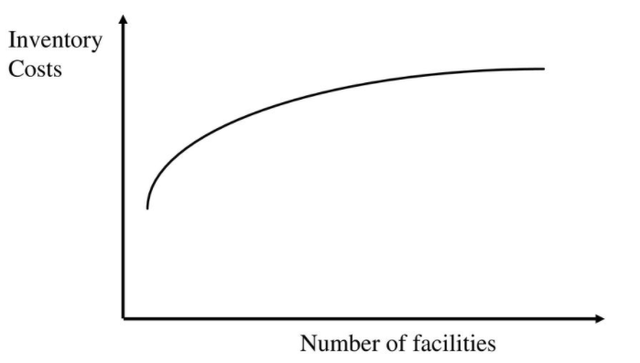
Inventory Costs and Number of Facilities
Inventory costs increase, facility costs increase, and Transportation costs decrease as we increase the number of facilities

Slide 12
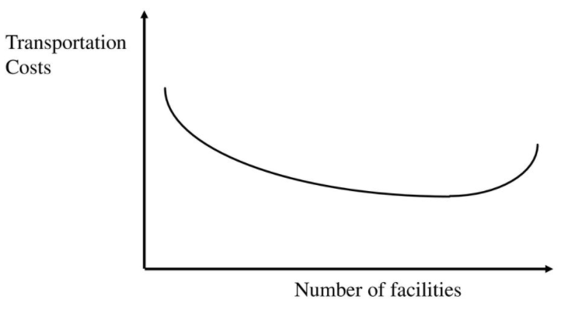
Transportation Costs and Number of Facilities
Inventory costs increase, facility costs increase, and transportation costs decrease as we increase the number of facilities

Slide 13
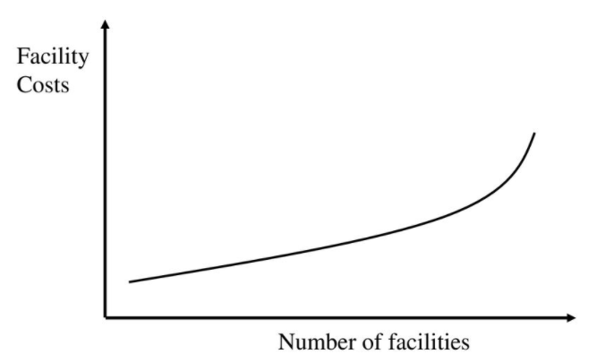
Facility Costs and Number of Facilities
Inventory costs increase, facility costs increase, and transportation costs decrease as we increase the number of facilities

Slide 14
Variation in Logistics Costs and Response Time with Number of Facilities
Total costs decrease and then increase as we increase the number of facilities.
The responsiveness improves as we increase the number of facilities.
A supply chain should always operate above the lowest cost point. Operating beyond that point makes sense if the revenue generated from better responsiveness exceeds the cost of better responsiveness.

Slide 15
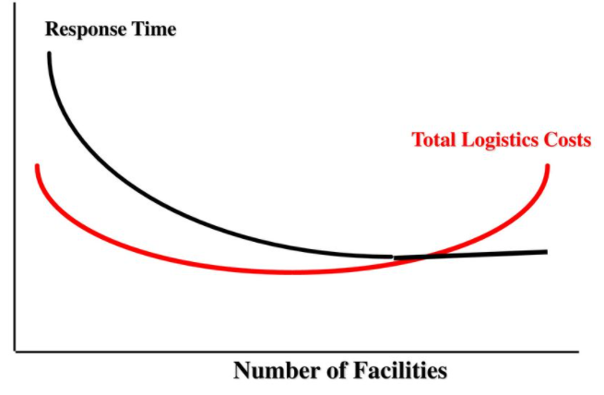

Slide 16
DESIGN OPTIONS FOR A DISTRIBUTION NETWORK
Manufacturer Storage with Direct Shipping
Manufacturer Storage with Direct Shipping and In-Transit Merge
Distributor Storage with Carrier Delivery
Distributor Storage with Last Mile Delivery
Manufacturer or Distributor Storage with Customer Pickup
Retail Storage with Customer Pickup

Slide 17
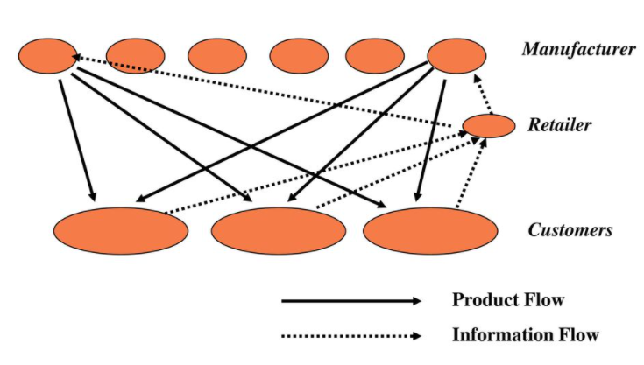
MANUFACTURER STORAGE WITH DIRECT SHIPPING

Slide 18
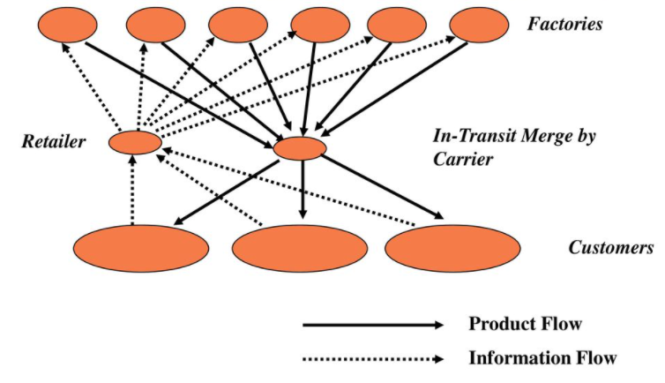
MANUFACTURER STORAGE WITH DIRECT SHIPPING AND IN-TRANSIT MERGE

Slide 19
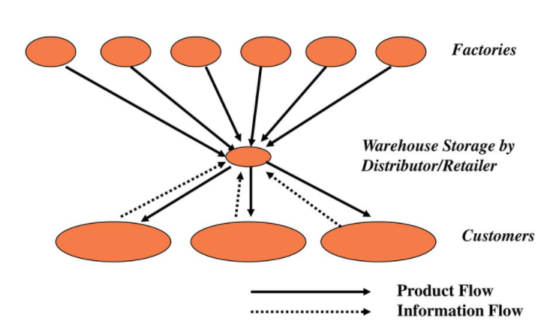
DISTRIBUTOR STORAGE WITH CARRIER DELIVERY

Slide 20
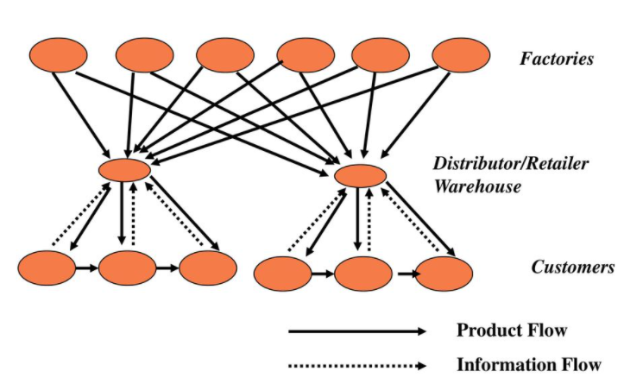
DISTRIBUTOR STORAGE WITH LAST MILE DELIVERY

Slide 21
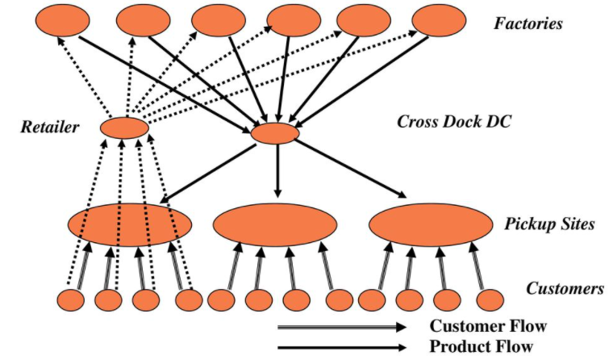
MANUFACTURER OR DISTRIBUTOR STORAGE WITH CUSTOMER PICKUP

Slide 22
RETAIL STORAGE WITH CUSTOMER PICK UP

Slide 23
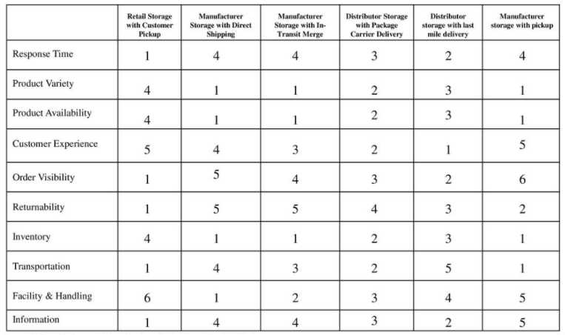
COMPARATIVE PERFORMANCE OF DELIVERY NETWORK DESIGNS

Slide 24
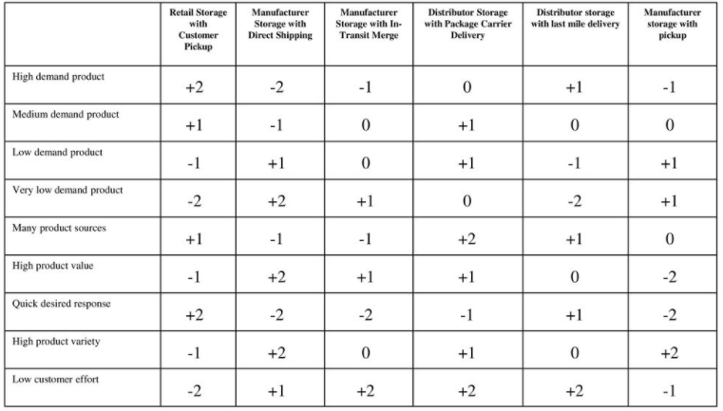
PERFORMANCE OF DELIVERY NETWORKS FOR DIFFERENT PRODUCT/CUSTOMER CHARACTERISTICS

Slide 25
E-BUSINESS AND DISTIBUTION NETWORK
Impact of E-Business on Customer Service
Impact of E-Business on Cost
Using E-Business: Dell, Amazon, Grainger

Slide 26
IMPACT OF E-BUSINESS ON CUSTOMER SERVICE
Response time
Product variety
Product Availability
Customer experience
Time to market
Order Visibility
Returnability
Direct Sales to Customers
Flexible Pricing,
Product Portfolio, and Promotions
Efficient Funds Transfer

Slide 27
IMPACT OF E-BUSINESS ON COST
Inventory
Facilities
Transportation
Information

Slide 28
DISTRIBUTION NETWORKS IN PRACTICE
  The ownership structure of the distribution network can have as big as an impact as the type of distribution network
  The choice of a distribution network has very long-term consequences
  Consider whether an exclusive distribution strategy is advantageous
  Product, price, commoditization, and criticality have an impact on the type of distribution system preferred by customers

Slide 29
What are the key factors to be considered when designing the distribution network?
What are the strengths and weaknesses of various distribution options?
How has E-Business affected the design of distribution networks in different industries?
What roles do distributors play in the supply chain?

Slide 30
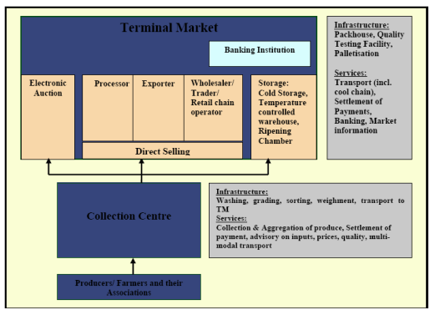
TERMINAL MARKET CONCEPT

Slide 31
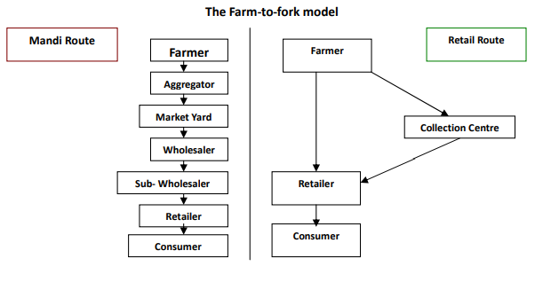

Slide 32
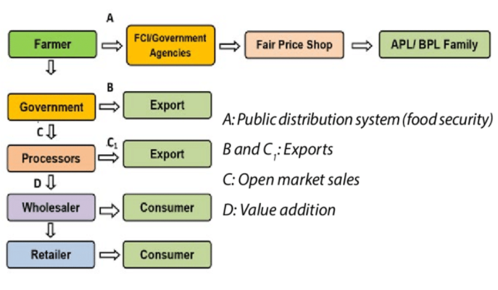
DISTRIBUTION NETWORK(WHEAT)

Slide 33
CHARACTERISTICS OF AGRICULTURAL COMMODITIES
PERISHABILITY
SEASONALITY OF PRODUCTION
BULKINESS OF PRODUCTS
VARIATION IN QUALITY OF PRODUCTS
IRREGULAR SUPPLY OF AGRICULTURAL PRODUCTS
SMALL SIZE OF HOLDING AND SCATTERED PRODUCTION
PRODUCT PRICING
PROCESSING

Slide 34
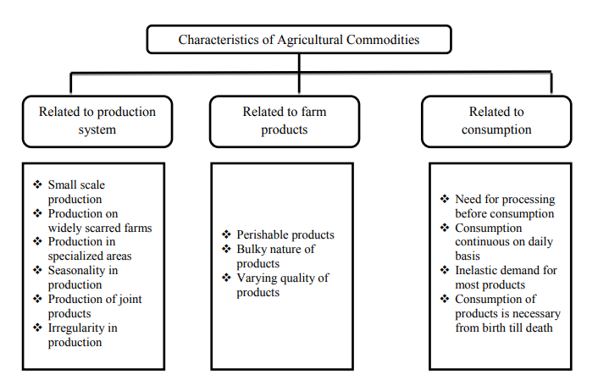

Slide 35
NETWORK DESIGN IN SUPPLY CHAIN

Slide 36
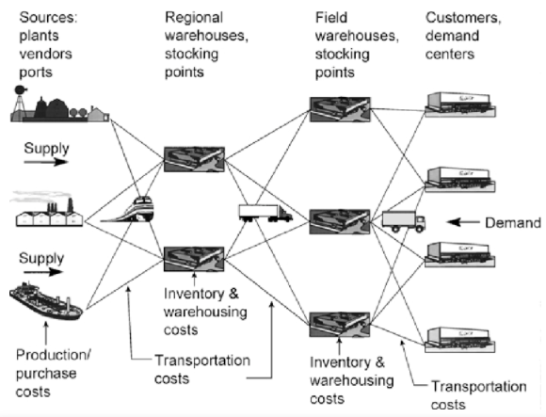
TYPICAL SUPPLY CHAIN WITH COST

Slide 37
ROLE OF NETWORK DESIGN IN SUPPLY CHAIN

Slide 38
ROLE OF NETWORK DESIGN IN SUPPLY CHAIN
Facility role, location of manufacturing, storage or transportation- related facilities, and the allocation of capacity.
• Facility role – What role should each facility play?
What processes are performed at each facility?
• Facility location – Where should facilities be located?
• Capacity allocation – How much capacity should be allocated to each facility?
• Market and supply allocation – What markets should each facility serve?
Which supply sources should feed each facility?

Slide 39
FACILITY ROLE
Production,
Storage,
Cross-docking,
Processes performed and
Products produced (flexibility)
EX: Toyota before ’97, factories serving local needs. In Asian crisis late ‘90s, Asian factory experienced idle capacity that could not be used to produce for other markets. Afterwards, Toyoda added flexibility to their plants so that they can serve other markets.

Slide 40
Facility location
Very costly to open or close a plant
Toyota opened its first US plant in Lexington, Kentucky in ’88. This decision provided Toyota a low cost production option, especially when yen is strengthened against dollar, and responsiveness.
Amazon had to increase the number of warehouses to 6 to be cost effective in supplying books throughout US.

Slide 41
Facility capacity
Allocating too little or too much capacity is costly
Capacity decisions would not change for years.
Facility allocation to markets and supply sources has Significant impact on performance
Must be reconsidered on a regular basis
Amazon had to consider new allocations as it increased the number of facilities in order to reduce the costs

Slide 42
FACTORS INFLUENCING NETWORK DESIGN

Slide 43
FACTORS INFLUENCING NETWORK DESIGN DECISIONS : STRATEGIC FACTOR
•A firm’s competitive strategy has a significant impact on network design decisions within the supply chain.
• Firms that focus on cost leadership tend to find the lowest cost location for their manufacturing facilities, even if that means locating very far from the markets they serve.
• Firms that focus on responsiveness and efficiency tend to locate facilities closer to the market and may select a high-cost location if this choice allows the firm to react quickly to changing market needs.

Slide 44
ROLE OF STRATEGIC FACTOR : OFFSHORE FACILITY
LOW COST FACILITY FOR EXPORT PRODUCTION
• An offshore facility serve the role of being a low cost supply source for market.
• The location selected for an offshore facility should have low labor and other costs to facilitate low-cost production.

Slide 45
SOURCE FACILITY: LOW-COST FACILITY FOR GLOBAL PRODUCTION
• Its primary objective is low-cost. Its strategic roles are broader than that of an offshore facility.
• A source facility is often a primary source of product for the entire global network.
• Source facility tend to be located in places where production costs are relatively low, infrastructure is well developed, and a skilled workforce is available.
• Good offshore facility migrate over time into source facility.

Slide 46
SERVER FACILITY : REGIONAL PRODUCTION FACILITY
• A server facility is built because of tax incentives, local content requirement, tariff barriers, or high logistic cost to supply the region from elsewhere.
CONTRIBUTOR FACILITY: REGIONAL PRODUCTION FACILITY WITH DEVELOPMENT SKILLS
• It serve where the market is located.
• Also assumes responsibility for product customization, process improvements, product modifications or product development

Slide 47
OUTPOST FACILITY: REGIONAL PRODUCTION FACILITY BUILT TO GAIN LOCAL SKILLS
• Located primarily to obtain access to knowledge or skills that may exist within a certain region.
LEAD FACILITY: FACILITY THAT LEADS IN DEVELOPMENT AND PROCESS TECHNOLOGIES
• Creates new products, processes and technologies for the entire network.

Slide 48
TECHNOLOGICAL FACTOR
• Important for production, high capacity are most effectivity.
• Lower fix cost and local facilities can help lower transportation cost.
MACROECONOMIC FACTORS
• Tax, tariffs, exchange rates and other economics factors for global trade
POLITICAL FACTORS
• Company prefer to locate facilities in politically stable countries, where the rules of commerce and ownership are well defined.

Slide 49
INFRASTRUCTURE FACTORS
• Key element of network design, labor, transportation, terminals and rails airports, seaports, highway.
COMPETITIVE FACTORS
• Cares about competitors strategy, size and location.
• To locate their facilities close to competitors or far from them.
• Competition on raw material, labor and production.

Slide 50
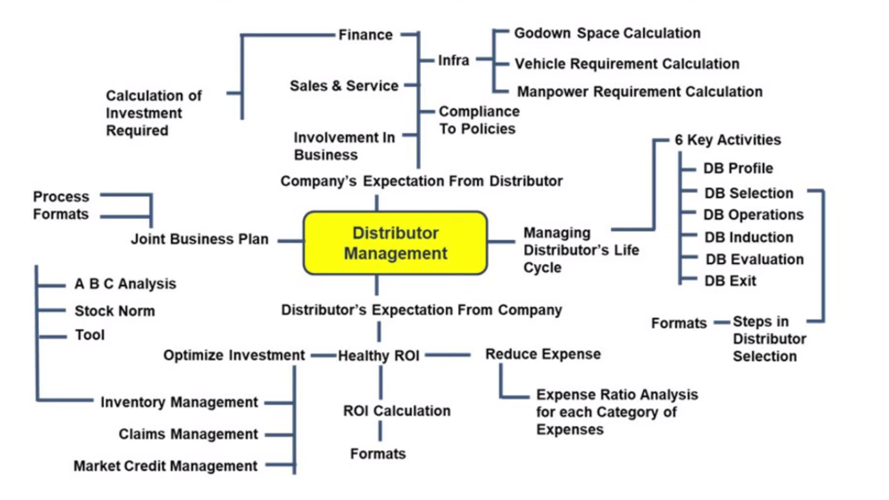

Slide 51
Framework for Network Design Decisions

Slide 52
PHASE1:SUPPLY CHAIN STRATEGY
PHASE2:REGIONAL FACILITY CONFIGURATION
PHASE3:DESIRABLE SITES
PHASE4:LOCATION CHOICES

Slide 53
Phase I: Define a supply chain strategy / design
The objective of the first phase is to define the organization’s high-level supply chain design characteristics, such as determining the stages and whether functions are going to be outsourced or not.
Based on the organization’s business strategy, analysis of global competition (and its likely evolution), and internal constraints, managers must determine a high level supply chain design.
The six major types of distribution networks can come in handy in this phase.

Slide 54
Phase II: Define the regional facility configuration
The second phase aims at defining the regions for facility location, their roles, and approximate capacity.
The second phase starts with aggregated demand forecasting. Such a prediction should include the demand’s characteristics in demand variability and stability of customer’s requirement.
Then the manager can identify opportunities for cost reduction using economies of scale or scope. Such information should be used to determine capacity allocation decisions.
Managers should also consider macroeconomic, political, and competitive factors .

Slide 55
Phase III: Select a set of potentially desirable sites
In Phase III, we identify some potentially desirable sites within each region defined in Phase II.
For each region defined in Phase II, we define a list of potential sites based on the infrastructure availability and other ”soft” factors:
– Available infrastructure: accessibility to suppliers, transportation services, communication, utilities, and warehouse facilities.
– “Soft” factors: availability of skilled workforce, community receptivity.

Slide 56
Phase IV: Choose the locations
From the preliminary list of potential sites defined in Phase III, we pick those that are more suitable to the organization’s needs and define the capacity of each one.
Here we add in the cost components into our decision model, such as labor, materials, site-specifics, transport, inventory, and coordination costs.

Slide 57
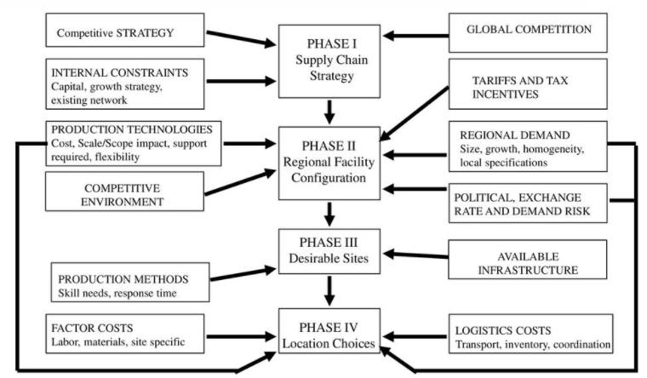

Slide 58
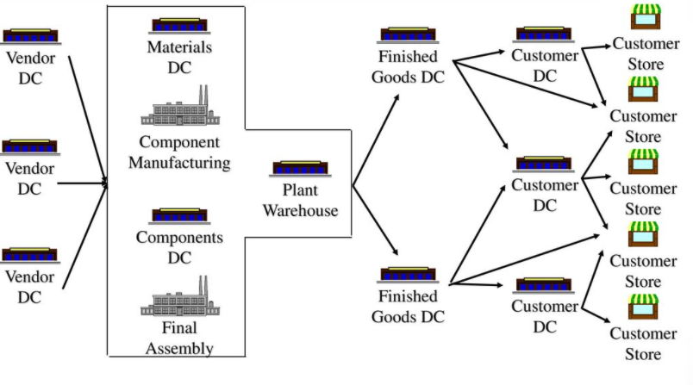
CONVENTIONAL NETWORK

Slide 59
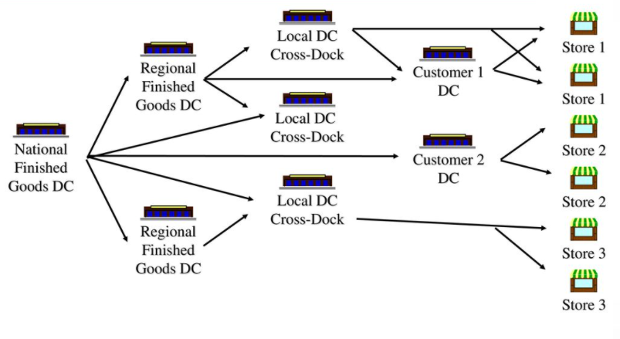
TAILORED NETWORK: Multi-Echelon Finished Goods Network

Slide 60
Models for Facility Location and
Capacity Allocation

Slide 61
• Goal is to maximize the overall profitability while providing the appropriate responsiveness.
• Managers use network design models in two different ways:
Decide on locations and capacities of facilities Decide on the market share of each facility and identify lanes of transportation
• Models are two types: • Network optimization models • Gravity models

Slide 62
Required input for the models
• Location of suppliers
• Location of potential facility sites
• Demand forecast by market
• Facility, labor, material costs
• Transportation costs between sites
• Inventory costs by site and unit
• Sale prices in different regions
• Taxes and tariffs between locations
• Desired response time and other service measures

Slide 63
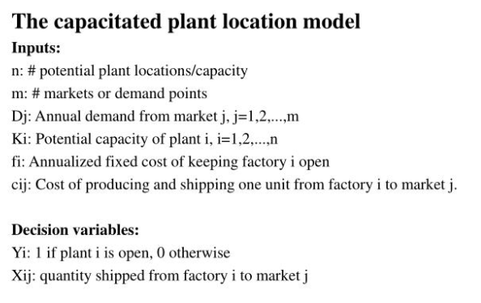
Network optimization model

Slide 64
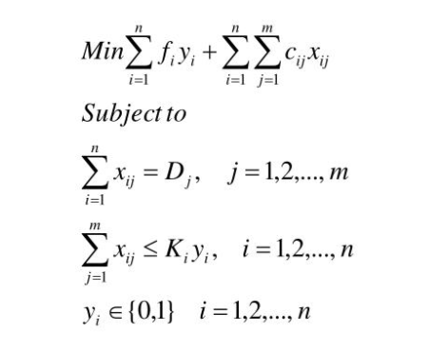

Slide 65
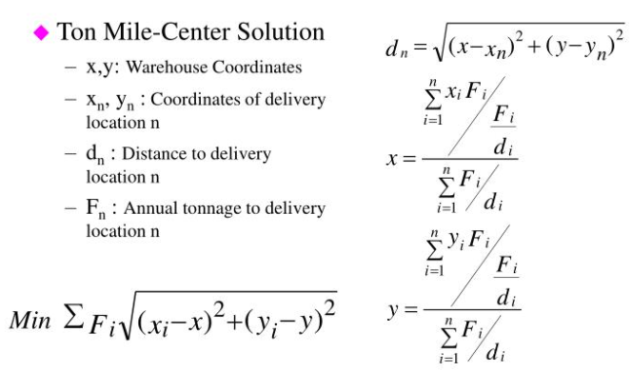
Gravity Methods of location

Slide 66
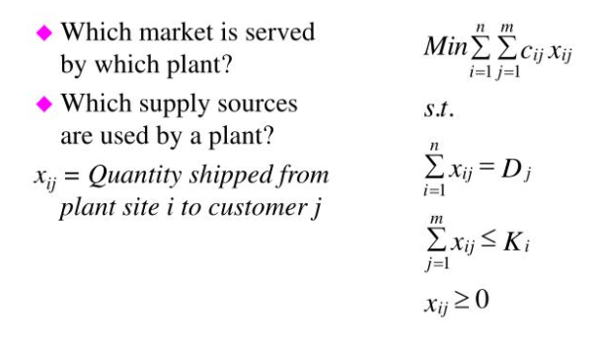
Demand Allocation Model

Slide 67
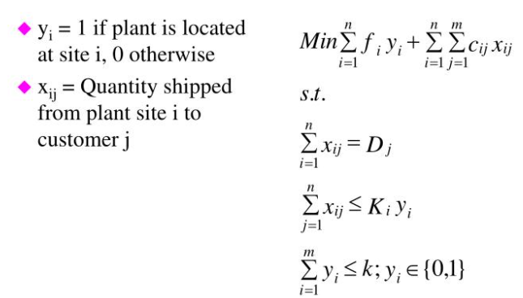
PLANT LOCATION WITH MULTPLE SOURCING

Slide 68
TRANSPORTATION NETWORK DESIGN
Role of Transportation in the Supply Chain - Transportation Infrastructure – Policies –Design options for a Transportation Network – Trade Offs in Transportation Design –Tailored Transportation

Slide 69
ROLE OF TRANSPORTATION IN SUPPLY CHAIN

Slide 70
Transportation involves the movement of materials, component parts and products from one location to another right from the source to the final destination.
Since the customers (markets), manufacturing plants and suppliers are widely scattered geographically and because products are rarely produced and consumed in the same location, transportation plays a significant role in every supply chain.

Slide 71
Any supply chain’s success is closely linked to the appropriate use of transportation. The selection of a mode of transportation or service offering within a mode of transportation depends on a variety of service characteristics such as
Freight rates
Reliability
Transit time
Loss, damage, claims processing and tracing
Shipper market considerations
Carrier considerations.

Slide 72
Importance of Effective Transportation System
Transportation influences or is influenced by many logistics activities to include:
Transportation costs which are directly affected by the location of the firm’s manufacturing facilities, warehouses, suppliers, retailers and customers.
The transportation mode selected has an impact on the packing required, and carrier classification rules determine package choice.

Slide 73
Inventory requirements which are influenced by the mode of transport selected for use.
When high speed, high priced transportation systems are used, the inventories required to be maintained in the logistics system would be smaller as compared to that when slow, less expensive transportation systems are used

Slide 74
The firm’s materials handling equipments are determined by the type of carrier used for transportation, for example, the handling equipments for loading and unloading the carrier and the design of the receiving and shipping docks depend on the type of carriers used.
An order management methodology which encourage maximum consolidation of shipments between common points facilities larger shipments and advantages of volume discounts

Slide 75
Customer service goals which influence the type and quality of carrier source selected by the firm.
An efficient and inexpensive transportation system contributes to greater competition in the market places, greater economies of scale in production and reduced prices for products sold.

Slide 76
TRANSPORTATION INFRASTRUCTURE

Slide 77
Transport Functionality, Principles, and Participants
• Transportation is a very visible element of logistics. Consumers are accustomed to seeing trucks and trains transporting product or parked at business facilities.
• Few consumers fully understand just how dependent our economic system is upon economical and dependable transportation.

Slide 78
Transport Functionality
Transport Functionality primarily consists of product movement services
Product movement is the movement of inventory to specified destinations
Restrictive element—in-transit inventory is “captive”, usually inaccessible during transportation
Flexible element—inventory can be diverted during shipment to a new destination

Slide 79
Transportation consumes time, financial, and environmental resources
• Transportation is more than 60% of the cost of logistics
• One of largest consumers of oil and gas in US
• Impacts traffic congestion, noise and air pollution
Transport also functions as storage services for products while in a vehicle
• In-transit inventory is captive in the transport system
• Managers strive to reduce in-transit inventory to a minimum
Product can also be stored in vehicles at origin or destination (trailers, trucks, railcars, etc) Usually more expensive than traditional warehousing
• Must pay rental or demurrage charges on vehicles used for storage
• Diversion occurs when a shipment destination is changed after a product is in transit

Slide 80
Two Fundamental Concepts of Transport Principles
Economy of scale is the cost per unit weight decreases as the size of the shipment increases. At least until you totally fill the carrying vehicle!
• Cost decreases because the fixed cost of the carrier is allocated over a larger weight of shipment
Economy of distance is the cost per unit weight decreases as distance increases Often called the tapering principle
• Longer distances allow fixed cost of the carrier to be spread over more miles, lowering the per mile charge
• Goal is to maximize the size of the load and distance shipped while still meeting service expectations

Slide 81
Product Movement
• Whether in the form of materials, components, work-in-process, or finished goods, the basic value provided by transportation is to move inventory to specified destinations.
• The primary transportation value proposition is product movement throughout the supply chain.
• The performance of transportation is vital to procurement, manufacturing, and customer accommodation.
• Transportation also plays a key role in the performance of reverse logistics. Without reliable transportation, most commercial activity could not function. Transportation consumes time, financial, and environmental resources.

Slide 82
PRODUCT STORAGE
• A less visible aspect of transportation is the performance of product storage.
• While a product is in a transportation vehicle, it is being stored. Transport vehicles can also be used for product storage at shipment origin or destination, but they are comparatively expensive storage facilities.
• Since the main value proposition of transportation is movement, a vehicle committed to storage is not otherwise available for transport
• A trade-off exists between using a transportation vehicle versus temporarily placing products in a warehouse.
• Another transport service having storage implications is diversion. This occurs when a shipment destination is changed after a product is in transit.

Slide 83
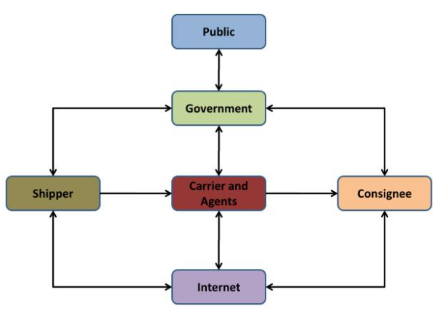
RELATIONSHIP AMONG TRANSPORT PARTICIPANTS

Slide 84
SHIPPER AND RECEIVER
• The consignor and consignee have a common interest in moving goods from origin to destination within a given time at the lowest cost.
• Services related to transportation include specified pickup and delivery times, predictable transit time, and zero loss and damage, as well as accurate and timely exchange of information and invoicing.

Slide 85
CARRIER AND AGENTS
• The carrier desires to maximize its revenue for movement while minimizing associated costs. As a service business, carriers want to charge their customers the highest rate possible while minimizing labor, fuel, and vehicle costs required to complete the movement.
• To achieve this objective, the carrier seeks to coordinate pickup and delivery times to group or consolidate many different shippers’ freight into movements that achieve economy of scale and distance.
• Brokers and freight forwarders are transport agents that facilitate carrier and customer matching. A recent development has been the emergence of internet or online brokers that match carrier capacity and shipper requirements.

Slide 86
Government
• The government has a vested interest in transportation because of the critical importance of reliable service to economic and social well-being. Government desires a stable and efficient transportation environment to support economic growth.
• A stable and efficient transportation environment requires that carriers provide essential services at reasonable cost.
Internet
• A recent development in the transportation industry is a wide assortment of internet-based services.
• The primary advantage is the ability of carriers to share real-time information with customers and suppliers
Public
• The public is concerned with transportation accessibility, expense, and effectiveness as well as environmental and safety standards.
• While minimizing transportation cost is important to consumers, concerns also involve environmental impact and safety.

Slide 87
TRANSPORT REGULATION
Government transportation regulation can be grouped into two categories:
Economic Regulation and Social Regulation.
Regulatory initiatives have historically focused on economic issues; however, recent regulatory initiatives have increasingly been directed toward safety and social issues.

Slide 88
DESIGN OPTIONS FOR TRANSPORTATION NETWORK

Slide 89
Direct shipping network
Direct shipping with milk runs
All shipments via central DC
Shipping via DC using milk runs
Tailored network

Slide 90
Direct Shipment Network
• In direct shipping network, the truck delivers products from a single supplier to multiple buyers or
• Goes from multiple suppliers to a single buyer location.
• The manager has to decide on the routing of each truck, eliminating intermediate warehouses.

Slide 91
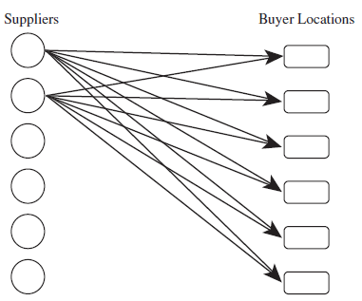

Slide 92
The major advantage of a direct shipment transportation network is the elimination of intermediate warehouses and its simplicity of operation and coordination. The shipment decision is completely local, and the decision made for one shipment does not influence others. The trans­portation time from supplier to buyer location is short because each shipment goes direct.
A direct shipment network to single destination is justified only if demand at buyer loca­tions is large enough that optimal replenishment lot sizes are close to a truckload from each sup­plier to each location.

Slide 93
Direct Shipping with Milk runs
A milk run is a route on which a truck either delivers product from a single supplier to multiple retailers or goes from multiple suppliers to a single buyer location
In direct shipping with milk runs, a supplier delivers directly to multiple buyer locations on a truck or a truck picks up deliveries destined for the same buyer location from many suppliers. When using this option, a supply chain manager has to decide on the routing of each milk run.

Slide 94
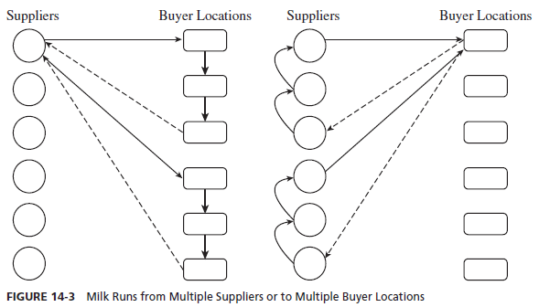

Slide 95
Direct shipping provides the benefit of eliminating intermediate warehouses, whereas milk runs lower transportation cost by consolidating shipments to multiple locations on a single truck.
Milk runs make sense when the quantity destined for each location is too small to fill a truck but multiple locations are close enough to each other such that their combined quantity fills the truck.
Companies such as Frito-Lay that make direct store deliveries use milk runs to lower their transportation cost. If frequent small deliveries are needed on a regular basis and either a set of suppliers or a set of retailers is in geographic proximity, the use of milk runs can significantly reduce transportation costs.
For example, Toyota uses milk runs from suppliers to support its just-in-time (JIT) manufacturing system in both Japan and the United States. In Japan, Toyota has many assembly plants located close together and thus uses milk runs from a single supplier to many plants. In the United States, however, Toyota uses milk runs from many suppliers to each assembly plant, given the large distance between assembly plants

Slide 96
All shipments via DC
Under this option, product is shipped from suppliers to a central distribution center, where it is stored until needed by buyers when it is shipped to each buyer location,
Storing product at an intermediate location is justified if transportation economies require large shipments on the inbound side or shipments on the outbound side cannot be coordinated. In such a situation, product comes in large quantities into a DC, where it is held in inventory and sent to buyer locations in smaller replenishment lots when needed.

Slide 97
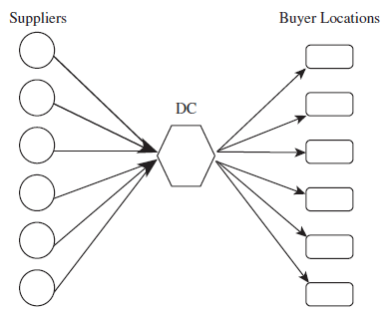

Slide 98
The presence of a DC allows a supply chain to achieve economies of scale for inbound transportation to a point close to the final destination, because each supplier sends a large ship­ment to the DC that contains product for all locations the DC serves. Because DCs serve loca­tions nearby, the outbound transportation cost is not very large.
For example, W.W. Grainger has its suppliers ship products to one of nine DCs (typically in large quantities), with each DC, in turn, replenishing stores in its vicinity with the smaller quantities they need. It would be expen­sive for suppliers to try to serve each store directly.
Similarly, when Home Depot sources from an overseas supplier, the product is held in inventory at the DC because the lot size on the inbound side is much larger than the sum of the lot sizes for the stores served by the DC.

Slide 99
Shipping via DC using Milk runs
Milk runs can be used from a DC if lot sizes to be delivered to each buyer location are small.
Milk runs reduce outbound transportation costs by consolidating small shipments.
For example, Seven-Eleven Japan cross-docks deliveries from its fresh-food suppli­ers at its DCs and sends out milk runs to the retail outlets because the total shipment to a store from all suppliers does not fill a truck. The use of cross-docking and milk runs allows Seven- Eleven Japan to lower its transportation cost while sending small replenishment lots to each store. The use of cross-docking with milk runs requires a significant degree of coordination and suitable routing and scheduling.

Slide 100
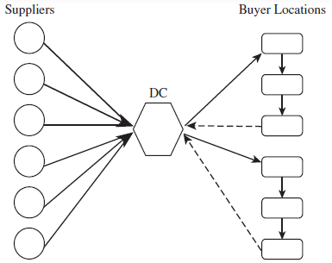

Slide 101
All Shipments via intermediate transit point with cross-docking
Under this option, suppliers send their shipments to an intermediate transit point (which could be a DC), where they are cross-docked and sent to buyer locations without storing them. The prod­uct flow is similar to that shown (All shipments via DC) except that there is no storage at the intermediate facility.
When a DC cross-docks product, each inbound truck contains product from suppliers for several buyer locations, whereas each outbound truck contains product for one buyer location from several suppliers.
Major benefits of cross-docking are that little inventory needs to be held and product flows faster in the supply chain.
Cross-docking also saves on handling cost because product does not have to be moved into and out of storage.
Cross-docking is appropriate when economies of scale in transportation can be achieved on both the inbound and outbound sides and both inbound and outbound shipments can be coordinated.

Slide 102
Walmart has used cross-docking successfully to decrease inventories in the supply chain without incurring excessive transportation costs. Walmart builds many large stores in a geo­graphic area supported by a DC. As a result, the total lot size to all stores from each supplier fills trucks on the inbound side to achieve economies of scale. On the outbound side, the sum of the lot sizes from all suppliers to each retail store fills up the truck to achieve economies of scale.

Slide 103
Tailored network
The tailored network option is a suitable combination of previous options that reduces the cost and improves the responsiveness of the supply chain. Here, transportation uses a combination of cross-docking, milk runs, and TL and LTL carriers, along with package carriers in some cases.
The goal is to use the appropriate option in each situation. High-demand products may be shipped directly to high-demand retail outlets, whereas low-demand products or shipments to low- demand retail outlets are consolidated to and from the DC.
The complexity of managing this transportation network is high because different shipping procedures are used for each product and retail outlet.
Operating a tailored network requires significant investment in information infrastructure to facilitate the coordination. Such a network, however, allows for the selective use of a shipment method to minimize the transportation as well as inventory costs.

Slide 104
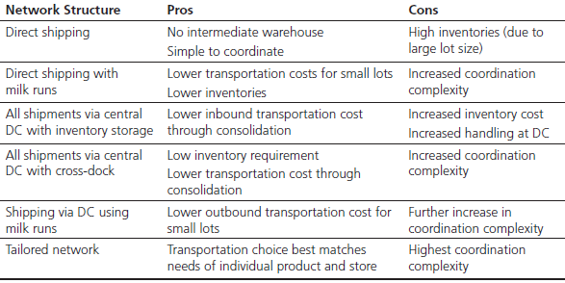

Slide 105
TRADE OFF IN TRANSPORTATION DESIGN

Slide 106
• Transportation and inventory cost trade-off
• Choice of transportation mode
• Inventory aggregation
• Transportation cost and responsiveness trade-off

Slide 107
CHOICE OF TRANSPORTATION MODE
• Selecting a transportation mode is both a planning and an operational decision.
• Decisions made by managers (shippers) must balance transportation and inventory cost.
• A mode with higher transportation costs can be justified if it results in significantly lower inventories
Cheaper Mode: Longer lead time, Larger minimum shipment quantities → Result in higher level of inventory level in Supply chain
Expensive Mode: Shipment of smaller quantities, Lower inventory level
Faster Mode: High value-to-weight ratio (ipad)
Cheaper Mode: Small value-to-weight ratio (furniture)
Other factors Safety, in-transit inventory cost, accounts cycle

Slide 108
INVENTORY AGGREGATION(INVENTORY VS. TRANSPORTATION COST )
As a result of physical aggregation
• Inventory costs decrease
• Inbound transportation cost decreases
• Outbound transportation cost increases
• Inventory aggregation decreases supply chain costs if the product has a high value to weight ratio, high demand uncertainty, or customer orders are large
• Inventory aggregation may increase supply chain costs if the product has a low value to weight ratio, low demand uncertainty, or customer orders are small

Slide 109
Online business: Gain advantage over firms with facilities in many locations.
Ex: Amazon Inventory in few warehouse → Results in decreasing facility cost and inventory cost
 | Online Business | Offline Business
Inbound Transportation cost | Decreases | Increases
Outbound Transportation cost | Increases | Decreases or NIL

Slide 110
TRADE-OFFS BETWEEN TRANSPORTATION COST AND CUSTOMER RESPONSIVENESS
• Temporal aggregation is the process of combining orders across time
• Temporal aggregation reduces transportation cost because it results in larger shipments and reduces variation in shipment sizes
• However, temporal aggregation reduces customer responsiveness

Slide 111
TAILORED TRANSPORTATION

Slide 112
The use of different transportation networks and modes based on customer and product characteristics
Factors affecting tailoring:
• Customer distance and density
• Customer size
• Transportation cost based on total route distance
• Delivery cost based on number of deliveries
• Product demand and value
The above factors allows supply chain to achieve appropriate responsiveness and low cost

Slide 113
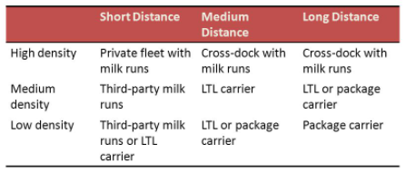
DISTANCE VS DENSITY

Slide 114
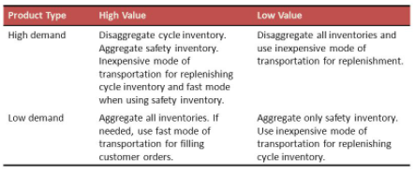
VALUE VS DEMAND

Slide 115
MODES OF TRANSPORTATION
Modes of Transportation – Road Transport – Rail Transport – Water and Air transport – Pipelines – Inter Modal Transport – Factors influencing selection of Modes and Carriers - Transportation Costing and Pricing - Performance Characteristics

Slide 116
Modes of transport
Rail Network
Motor Carriers
Water Transport
Pipelines
Air Transport

Slide 117
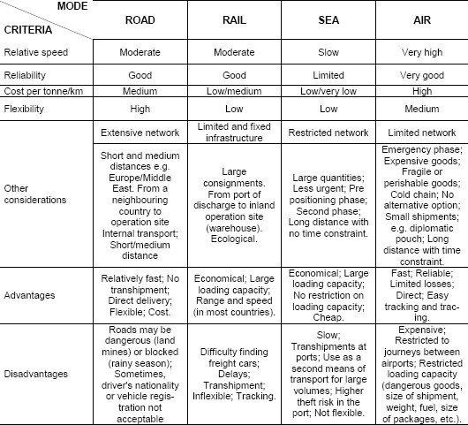

Slide 118
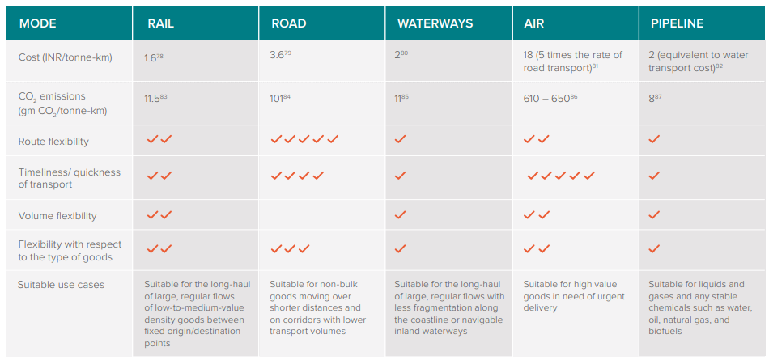

Slide 119
Factors influencing transport mode selection
required delivery date;
cost of transport service;
reliability and service quality;
shipment size;
transit time;
number of transhipment points;
item type;
possibility of damage; and
range of services.

Slide 120
INTERMODAL TRANSPORT
What do we mean by intermodal transportation?
Intermodal shipping refers to moving freight by two or more modes of transportation. By loading cargo into intermodal containers, shipments can move seamlessly between trucks, trains and cargo ships.

Slide 121
“Intermodal transport” is generally defined as the movement of goods in one and the same loading unit or road vehicle, which uses successively two or more modes of transport without handling the goods themselves in changing modes

Slide 122
Road-rail operations refer to the transport of containers, swap-bodies, semi-trailers or lorries that are carried on specially adapted railway wagons. A special form of road-rail transport is the so-called “rolling road” or Rollende Landstrasse (Ro-La) technique, where complete road vehicles, using roll-on roll-off techniques, are transported on low-floor wagon trains.

Slide 123
Roll-on-roll-off (RO-RO) maritime operations refer to the transport of lorries, semi-trailers, containers or swap-bodies to ships on their own wheels or on wheels attached to them for this purpose. This also covers national and international ferry services, including railway ferries as well as national short-sea shipping

Slide 124
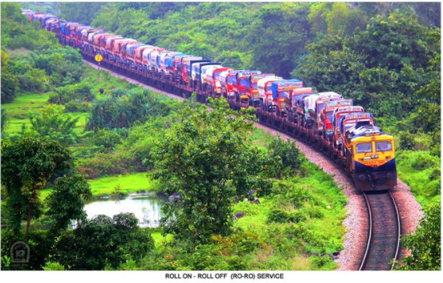

Slide 125
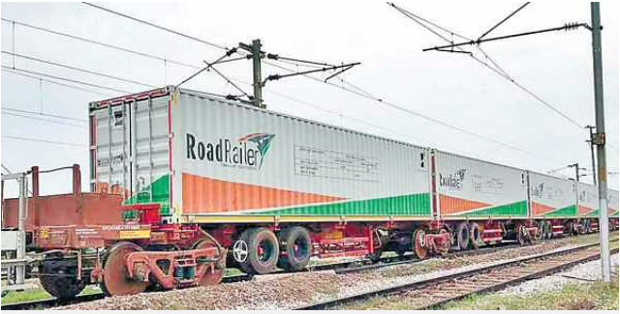
ROAD RAILER

Slide 126
Each RoadRailer unit has eight truck wheels and coupled together with the help of adapter bogies. Each coupling bogie have got four rail wheels. At the goods terminal, the RoadRailer Units will be delinked with the rail adapter bogies and will be taken to destination after putting behind the prime mover
With spiralling fuel prices and high cost of goods transportation, Southern Railway launched commercial operation of India’s first RoadRailer train, a bimodal vehicle which will run as semi-trailer truck on road and as a wagon on rail

Slide 127
Intermodal has lower transport costs than trucks, but can incur other types of costs, particularly inventory carrying costs, which can make it less competitive. Those costs, which are the result of lower speeds and poorer reliability of intermodal, include:
1. Inventory-in-transit cost: Costs incurred while the goods are being transported to the store. These costs are directly related to the transit time of the mode and the value of the product.
2. Safety stock: Costs associated with additional inventory stock at the store for anomalies. These costs are dependent on uncertainty in sales or supplier’s delivery at the expected time.

Slide 128
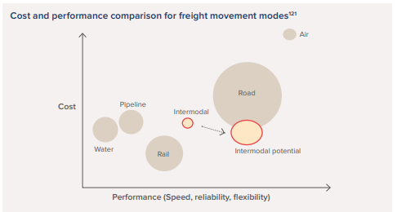

Slide 129
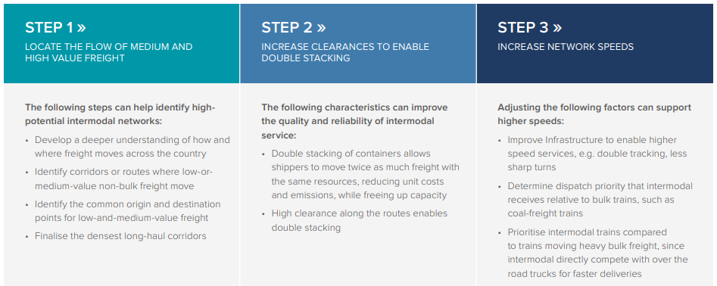
IDENTIFYING POTENTIAL INTERMODAL CORRIDORS

Slide 130
Transportation Costing and Pricing
At the international level, the doubling of transport costs can reduce trade flows by more than 80%.
Mobility is influenced by transport costs

Slide 131
TYPES OF TRANSPORT COST
TERMINAL COST: Costs that are related to loading, transshipment, and unloading.
Two major terminal costs can be considered; loading and unloading at the origin and destination, which are unavoidable, and
Intermediate (transshipment) costs that can be avoided. For complex transport terminals, such as ports and airports, terminal costs can involve various components, including docking/gate fees, handling charges, and pilotage/traffic control fees

Slide 132
Linehaul Costs: Costs that are a function of the distance over which a unit of freight or passenger is carried. Weight is also a cost function when freight is involved. They include labor and fuel and commonly exclude transshipment costs.
Capital costs. Costs applying to the physical assets of transportation, mainly infrastructures, terminals, and vehicles. They include the purchase or major enhancement of fixed assets, which can often be a one-time event that can be amortized over several decades. Since physical assets tend to depreciate over time, capital investments are required on a regular basis for maintenance.

Slide 133
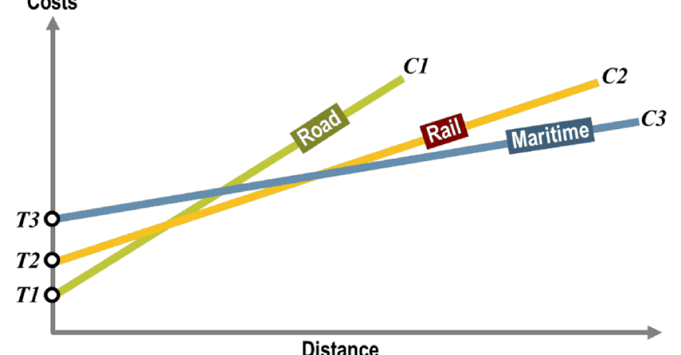
TERMINAL COST

Slide 134
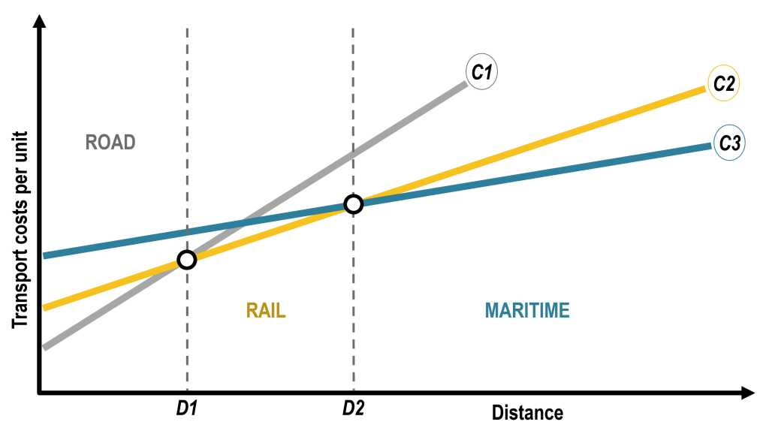
DISTANCE, MODAL CHOICE & TRANSPORT COST

Slide 135
Transportation modes have different cost functions according to the serviced distance.
Using a simple linear distance effect, road, rail, and maritime transport have C1, C2, and C3 cost functions.
While road transport has a lower cost for short distances, its cost increases faster than rail and maritime costs. It becomes more profitable at a distance D1 to use rail transport than road transport, while from a distance D2, maritime transport becomes more advantageous. These are referred to as break-even distances.
Point D1 is generally located between 500 and 750 km of the departure point, while D2 is near 1,500 km

Slide 136
TIMES WHEN BREAK EVEN DISTANCE DOESN’T FIT
It assumes that modal options are interchangeable. For many origins and destinations, modal options such as rail or maritime may not be present and cannot be considered an option. Therefore, a modal option with a higher cost will be used.
Since rail and maritime transportation are discrete networks only accessible through terminals, most locations will involve a road transportation segment, which changes the cost structure.
Also regional differences impact break even distances

Slide 137
FACTORS IN TRANSPORTATION COST

Slide 138
EMPTY BACKHAULS
Many transport interactions involve empty backhauls since it is uncommon to have a perfect match between an inbound and a return trip.
Commuting patterns involve imbalanced flows and empty return trips. For international trade, imbalances between imports and exports have an impact on transport costs. This is especially the case for container transportation since trade imbalances imply the repositioning of empty containers that must be taken into account in the total transport costs. Consequently, if a trade balance is strongly negative (more imports than exports), transport costs for imports tend to be higher than for exports

Slide 139
INFRASTRUCTURE AND MODES
The efficiency and capacity of transport modes and terminals have a direct impact on transport costs. Poor infrastructures imply higher transport costs, delays, and adverse economic consequences.
More developed transport systems tend to have lower transport costs since they are more reliable, connected, and can handle more movements.
Containerized transportation permitted a significant reduction in freight transport rates worldwide by allowing relatively small transport units (containers) to be carried in massified loads

Slide 140
MARKET CHARACTERISTICS
Amount or degree of competition in your market: can you beat Acme’s price?
Distance to market: How far your product needs to travel?
Government regulations: such as dangerous goods requirements, over-dimensional restrictions, or weight limitations
Traffic imbalance: can you prevent backflow or combine some supplier shipments/locations?
Seasonality of product movement: differences in shipping costs across the four seasons
Domestic or international transportation

Slide 141
PRODUCT CHARACTERISTICS
Density
Low-density products tend to cost more to transport per pound. These are bulky items, like furniture, that may not weight a lot, but their weight to volume ratio is high.
Stowability
How well can your product fill the available space in a transport vehicle. In other words, are you “maximizing your cube”? For example grain will fill every bit of available space in a container, but a car leaves lots of empty space around it.
Ease of handling
Are your products uniform in size? Are they secured to the pallet so it’s easy for forklift operators and drivers to work with them? Are your pallets well wrapped and stacked?
Liability
Look into whether you need cargo insurance on top of the basic legal liability of your carrier . Remember that ocean and air carriers have different liabilities—consult your freight forwarder for guidance to make sure you know your options.

Slide 142
VOLUME AND FREQUENCY
Volume
Rate leverage
Lower pick up and drop off costs
Higher carrier revenue
Volume commitments/guarantees
Frequency
Rate leverage
Better planning and improved performance
Improved labour and equipment usage

Slide 143
DISTANCE AND TIME
The impacts of geography mainly involve distance and accessibility
Landlocked countries tend to have higher transport costs, often twice as much, as they do not have direct access to maritime transportation
Time Component is related to Service factor. They include the transport time, the order time, the timing, the punctuality, and the frequency

Slide 144
TYPE OF PRODUCT: Many products require packaging, special handling, which are bulky or perishable
ECONOMIES OF SCALE: The larger the quantities transported, the lower the unit transport cost
SURCHARGE, TAXES AND TOLLS
COMPETITION, REGULATION & SUBSIDY

Slide 145
BALTIC DRY INDEX
https://transportgeography.org/contents/chapter3/transport-costs/baltic-dry-index/

Slide 146
UNIT5-IT IN DISTRIBUTION AND TRANSPORTATION
Technology driven distribution channels - Role of Information Technology in Transportation - Communication systems - Automatic vehicle location systems - Geographic information Systems

Slide 147
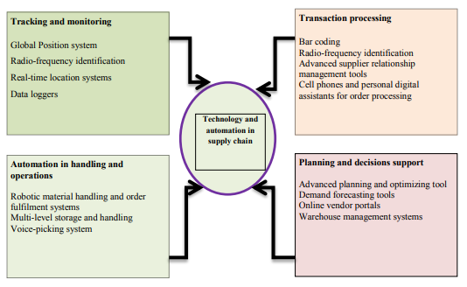
Areas of Technology and Automation adoption in Supply Chain

Slide 148
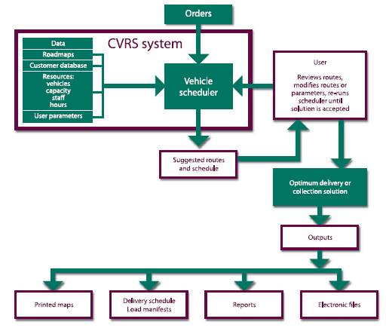
COMPUTERIZED VEHICLE ROUTING AND SCHEDULING(CVRS)

Slide 149
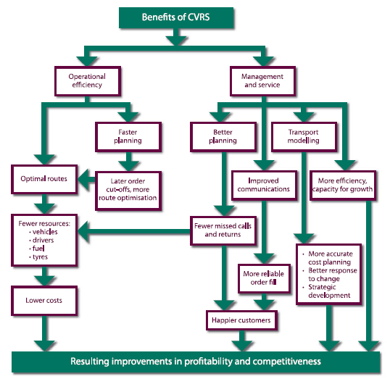
BENEFITS OF CVRS

Slide 150
TACHOGRAPHS-Tachographs record information about driving time, speed and distance
Types of Tachographs: There are 2 types of tachograph - analogue and digital
Information from digital tachographs is saved on smart cards so it can be checked later. There are different types of card for:
1. Drivers 2. haulage companies

Slide 151
DATA IN TACHOGRAPHS
Date
Vehicle registration number
Vehicle speed (for previous 24 hours of driving)
Single or co-driver
Number of times a driver card is inserted each day
Distance travelled by the driver – it reads the vehicle odometer when the card is inserted and removed
Driver activity – driving, rest, breaks, other work, periods of availability
Date and time of activity change
Events (for example driving without a driver card, overspeeding, fraud attempts etc) and faults
Enforcement checks
Details of tachograph calibrations
Tampering with the system

Slide 152
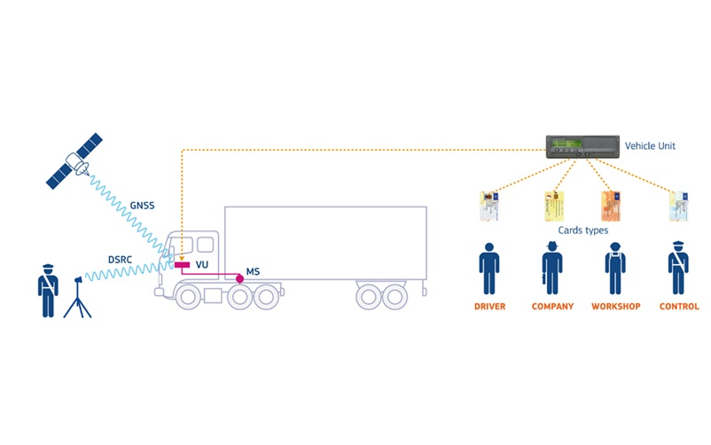

Slide 153
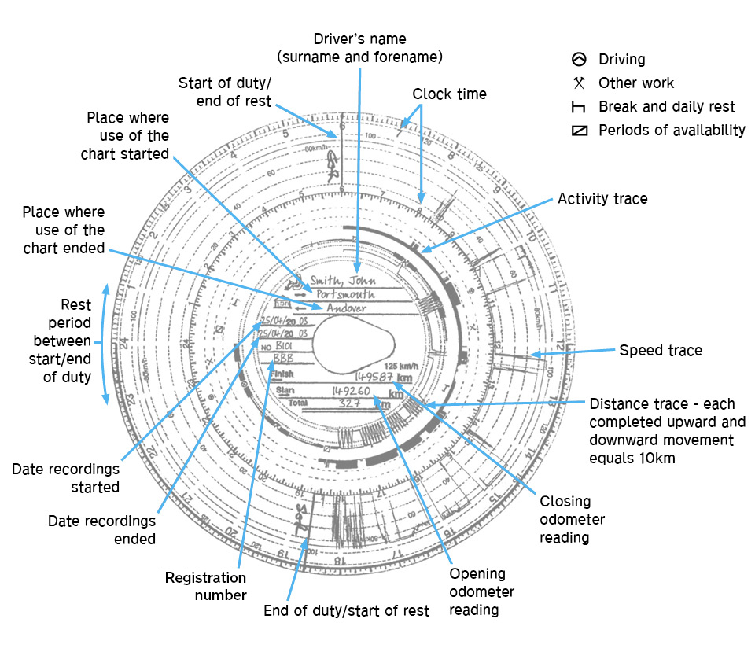

Slide 154
Automatic Vehicle Location System

Slide 155
Automatic vehicle locating (AVL) systems designed for surveillance operations enable law enforcement to discreetly track and monitor vehicles.
AVL systems can report vehicle information, such as location, speed, and stops, to investigators by obtaining data from global positioning system (GPS) satellites.
AVL systems are field-deployable and most can be mounted to the undercarriage of a vehicle in a matter of seconds.

Slide 156
Types of AVL
There are two types of AVL systems: passive and active.
Passive AVL systems, also known as data loggers, store location information and other relevant data to an onboard storage device for later retrieval.
Active AVL systems can report events in near real-time and log data when communication is lost if the tracking device is equipped with onboard storage options.
At a minimum, an AVL system is comprised of a tracking device attached to the tracked vehicle and a mapping application used to access the vehicle track information.

Slide 157
Passive AVL tracking devices
Passive AVL tracking devices are typically comprised of a GPS receiver and an onboard storage device.
Timing and navigation data is processed by the GPS receiver to provide location information, which is saved to an onboard storage device for retrieval at a later time.
Downloading data from a passive tracking device may require device removal from the vehicle and/or:
● A direct connection from the tracking device to a computer ● The removal of a memory module (e.g., secure digital ‘SD’ card) from the tracking device for data download
● A wireless network such as 802.11a/b/g that will automatically download the stored data when the tracking device is within range

Slide 158
Active AVL tracking devices
Active AVL tracking devices contain, at a minimum, the GPS receiver and a communication module.
The communication module consists of a cellular, radio, or satellite modem that receives location information from the GPS receiver and transmits the data via a communications provider’s network for a monthly fee to the end user
Most active AVL systems permit the end-user to adjust the frequency of location updates through the user interface.
The communication module receives these adjustments from the end-user via the communications provider’s network.
Active tracking devices may feature onboard storage options to store location information if the real-time reporting capability is temporarily interrupted.

Slide 159
GEOGRAPHIC INFORMATION SYSTEM

Slide 160
Most of the devices connected to GPS technology possess communication interface that enables connection to a variety of information systems and / or databases.
An example is a system CVS Mobile, which is a top platform for monitoring and management of all motor vehicles, interoperable with tablet computing machines, smartphones and business monitoring systems.
As a result of many years of experience, the use of technological advances most contemporizing, analysis and application of network graphic interface, "cloud" platform system CVS Mobile intend to keep pace with the needs and requirements of customers in the transport and logistics sector

Slide 161
PREFERENCES FOR DISPATCHING SERVICE
management of the fleet through an Internet application;
transport planning;
planning road;
display the current location of each vehicle;
display the current position of each vehicle (moving or place); preparation of work orders;
input and coordination with the desired points of interest;
constant communication with the driver;
monitoring of all telemetry data from the car and electronic sensors (speed, amount of fuel, temperature, load weight, etc.).
monitoring and alarm response of the vehicle

Slide 162
PREFERENCES FOR COMPANIES CLIENT
monitoring of the movement of cargo own online;
calculation of the estimated time of delivery of cargo / product

Slide 163
PREFERENCES FOR MANAGER OF THE FLEET
continuous monitoring costs;
planning, management and maintenance of the fleet;
sorted messages online by different parameters (vehicle, driver, customer, country)
analysis on various parameters (vehicle, driver, customer, country)
connection and integration with existing information systems and other software solutions

Slide 164
PREFERENCES FOR OWNERS
possibility of buying and renting equipment;
fixed monthly charges for use;
return on investment in a short time;
competitive advantage of the enterprise

Slide 165
OVERALL ADVANTAGES
interactive communication with drivers;
fast and acceptable data on the current condition of the entire fleet;
overview analyst with the possibility of configuring periodic information;
simplified oversight fuel consumption;
alert detection for sale of fuel, detection of deviations from optimal travel paths;

Slide 166
Significant benefit between drivers and dispatch centres
constant communication between the driver and dispatch center;
simple navigation of the vehicle by voice command of different languages;
greater security for the driver (information about possible roadblocks, traffic control, radar controls, obstacles on the road etc.).

