Slide 1
EXIM PROCEDURES
EXIM Procedures and Logistics - Importance and Responsibilities of Buyer and Seller- Customs Authority - Registration Procedures - IEC - RCMC - Export Licensing - Methods of Exporting and Importing - Product Selection Criteria - Special Schemes for Importers -Importer Classification

Slide 2
EXIM OVERVIEW
Foreign trade in India is promoted and facilitated by the
Directorate General of Foreign Trade (DGFT), under the
Ministry of Commerce and Industry (MoCI).
The DGFT issues the authorisation to exporters and monitors their corresponding obligations through a network of 38 regional offices. The DGFT also implements the Foreign Trade Policy of India.

Slide 3
EXIM OVERVIEW
Foreign Trade Policy (FTP) is the prime policy that lays down simple and transparent procedures which are easy to comply with and administer for efficient management of foreign trade in India. The Policy aims at enhancing the country’s trade for economic growth and employment generation.
The Customs Tariff Act and the Central Excise Tariff Act are the other two important Acts that lay down how the Customs and Excise duties shall be levied on trade, respectively.

Slide 4
CURRENT ACCOUNT DEFICIT
The current account deficit is a measurement of a country’s trade where the value of the goods and services it imports exceeds the value of the products it exports.
The current account includes net income, such as interest and dividends, and transfers, such as foreign aid, although these components make up only a small percentage of the total current account.
The current account represents a country’s foreign transactions and, like the capital account, is a component of a country’s balance of payments (BOP).

Slide 5
KEY TAKEAWAYS OF CURRENT ACCOUNT DEFICIT
A current account deficit indicates that a country is importing more than it is exporting.
Emerging economies often run surpluses, and developed countries tend to run deficits.
A current account deficit is not always detrimental to a nation's economy—external debt may be used to finance lucrative investments.

Slide 6
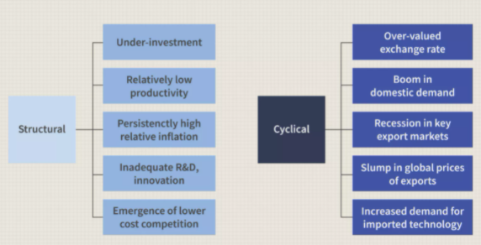
CAUSES OF CURRENT ACCOUNT DEFICIT

Slide 7
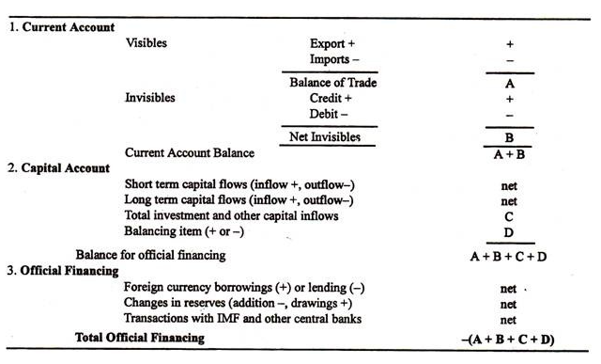
BALANCE OF PAYMENT ACCOUNTS

Slide 8
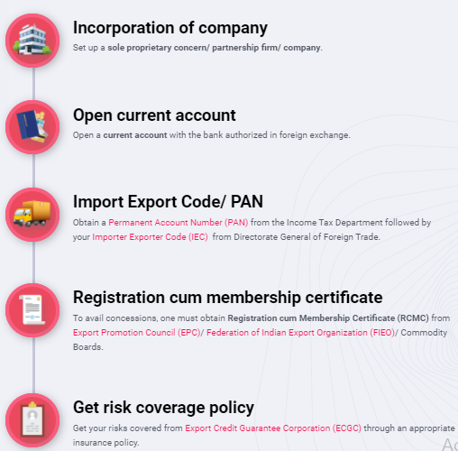
PROCEDURE TO SET UP EXIM UNIT

Slide 9
EXPORT PROCEDURE
STEP 1 - ENQUIRY ➢
STEP 2 - PROFORMA GENERATION
STEP 3 - ORDER PLACEMENT
STEP 4 - ORDER ACCEPTANCE
STEP 5 - GOODS READINESS & DOCUMENTATION
STEP 6 - GOODS REMOVAL FROM WORKS
STEP 7 - DOCUMENTS FOR C&F AGENT
STEP 8 - CUSTOMS CLEARANCE
STEP 9 - DOCUMENT FORWARDING
STEP 10 - BILLS NEGOTIATION
STEP 11 - BANK TO BANK DOCUMENTS FORWARDING
STEP 12 - CUSTOMS OBLIGATION DISCHARGE
STEP 13 - RECEIPT OF BANK CERTIFICATE

Slide 10
IMPORT PROCEDURE
STEP 1 - OBTAINING IMPORT LICENSE AND QUOTA
STEP 2 - OBTAINING FOREIGN EXCHANGE
STEP 3 - PLACING AN ORDER
STEP 4 - DESPATCHING LETTER OF CREDIT
STEP 5 - APPOINTING CLEARING AND FORWARDING AGENTS
STEP 6 - RECEIPT OF SHIPMENT DEVICE
STEP 7 - RECEIPTS OF DOCUMENTS
STEP 8 - BILL OF ENTRY
STEP 9 - DELIVERY ORDER
STEP 10 - CLEARING OF GOODS
STEP 11 -PAYMENT TO CLEARING AND FORWARDING AGENT
STEP 12 - PAYMENT TO EXPORTER
STEP 13 - FOLLOW UP

Slide 11
METHODS OF EXPORTING
The first step in the export marketing process is the selection of market.
The market selection decision may conclude whether to select concentrated market, target Market, differentiated market or undifferentiated market for exports.
The next step is to decide how to enter the market.

Slide 12
(a) Direct Exporting: Direct exporting is the method of exporting goods directly to the foreign buyers by the manufacturer himself or through his agent situated in the foreign country.
(b) Indirect Exporting: in case of indirect exporting, an exporter uses the services of some specialized agencies such as merchant exporters and export houses or trading houses for exporting goods.

Slide 13
DEEMED EXPORTS
Export of goods, in common parlance, means taking goods outside India.
The Central Government may notify certain categories of supplies of goods, which would be treated as deemed exports.
This means that such supplies shall be treated as exports even if such goods are not taken outside India

Slide 14
ESSENTIAL CONDITIONS: DEEMED EXPORTS
Applicable only for the supply of goods (not applicable to services).
Goods are not required to be taken outside India.
Such supply of goods must be notified by the Central Government as Deemed exports under Section 147 of the Central Goods and Services Tax Act, 2017 (CGST Act).
Goods must be manufactured or produced in India.
Payment can be received in Indian Rupees or in convertible foreign exchange.
Such supplies cannot be made under Bond / LUT.
The tax must be paid at the time of supply. Refund of tax paid on such supplies can be claimed.

Slide 15
For example, Dealer 'A' (located in Rajasthan) sells goods to Dealer 'B' which is an EOU. B, in turn, sells the goods to a customer 'C' in Germany. Supply by A to B is treated as deemed exports. Supply by B to C is treated as exports

Slide 16
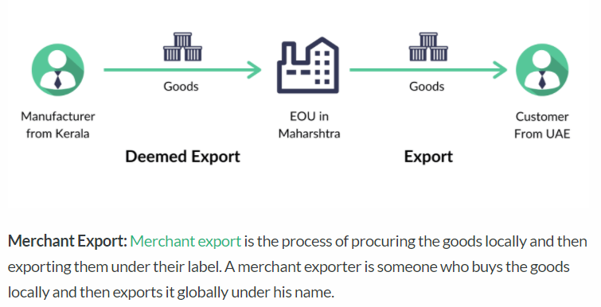

Slide 17
Selection of Export products
Export Trend
Supply base
Production capacity and Product base
Product Adaptability
Servicing Facility
Target Markets
Demand Stability
Trade restrictions
Profitability

Slide 18
Selection of Export Markets
Political Embargo
Special Requirements
Product Specifications
Distant location
Business Community
Preferential treatment(GSP)

Slide 19
NEED OF EXPORT
Earning foreign exchange
International relations
Balance of payment
Reputation in the world
Employment opportunities
Promoting economic development
Optimum utilization of resources
Spread effect
Higher standard of living

Slide 20
IMPORTER-EXPORTER CODE NUMBER(IEC)
No export or import transaction can be made without obtaining an importer-exporter code number.
IEC number is a pre-condition for exports from and imports into India.
IEC number entitles to import or export any item of non-prohibited goods. This code number is made compulsory, now.

Slide 21
The Registered/Head office of the applicant shall make an application for grant of IEC number to the Regional office of DGFT (known as Regional Licensing Authority), having territorial jurisdiction over the firm, along with the following documents:
(A) Profile of the exporter/importer
(B) Demand draft from a bank for Rs.1,000 as fees
(C) Certificate from the banker of the applicant
(D) Two copies of passport size photographs of the applicant, duly attested by bank.
(E) If there is any non-resident investment in the applicant firm and such investment is with full repatriation benefit, full particulars of such investment are to be disclosed and approval of RBI for such investment is to be enclosed.
(F) Declaration on applicant’s letterhead that there is no association of the applicant’s firm with caution listed firms.

Slide 22
The Licensing authority shall allot the IEC number in a prescribed format.
There is no expiry date for IEC number. It shall be valid till it is revoked.
This number is to be, invariably, quoted in all documents, prescribed by rules, in particular, in Bill of Entry incase of imports and in Shipping Bill, in case of exports

Slide 23
Registration cum Membership Certificate (RCMC)
It is obligatory for every exporter to register with appropriate Export Promotion Council(EPC) and obtain Registration cum Membership Certificate.
Any person applying for import or export licence or any other benefit under the current Exim Policy is required to obtain Registration cum Membership Certificate (RCMC).
The benefits provided in the current Exim Policy are available only to those having valid RCMC

Slide 24
A registered exporter receives ocean of literature and necessary guidance regarding export market information from the Council.
Any exporter may obtain RCMC from any Export Promotion Council relating to his main line of business.
There are different Export Promotion Councils such as Engineering Export Promotion Council, Chemical Export Promotion Council, Apparel Export Promotion Council and Textile Export Promotion Council etc.
If the export product is not covered by any EPC, the concerned Regional Licensing Authority of DGFT can issue RCMC to the exporter.
With the receipt of certificate,the exporter will be known as “Registered Exporter”.

Slide 25
EXPORT LICENSING
Many items of goods are free for exports without obtaining any licence, if they do not fall in the Negative List.
The Negative list consists of goods the import or export of which is prohibited, restricted through licensing or otherwise canalized

Slide 26
NEGATIVE LIST OF GOODS
Part–I : Prohibited Items: These items can not be exported or imported. These items include wild life, exotic birds, wood and wood products in the form of logs, timber, pulp and charcoal.
Part–II : Restricted Items: These are the items, export or import of which is restricted through licence. They can be imported or exported only in accordance with the regulations governing in this behalf.
Part–III : Canalized Items: Goods, which are canalized, can be imported or exported through the canalizing agency, specified in the Negative List. The Director General of Foreign Trade may issue a licence to any other person to import or export those items, which are included in the Negative List.

Slide 27
SPECIAL SCHEMES FOR IMPORTERS
Agri Export Zones Various importers that come under the Agri Export Zones are entitled to all the import facilities and incentives.
Served from India In order to create a powerful “Served from India” brand all over the world, the government has provided different type of import incentive to the invisible export providers. Under the Served from India Scheme, import incentive is given for import of any capital goods, spares, office equipment and professional equipment.

Slide 28
Manufacture under Bond Under the Manufacture under Bond Scheme, all factories registered to produce their goods for export are exempted from import duty and other taxes on inputs used to manufacture such goods. Against this the manufacturer is allowed to import goods without paying any customs duty. The production is made under the supervision of customs or excise authority.
Export Promotion Capital Goods Scheme (EPCG) EPCG is a special type of incentive given to the EPCG license holder. Capital goods imported under EPCG Scheme are subject to actual user condition and the same cannot be transferred /sold till the fulfillment of export obligation specified in the license. In order to ensure that the capital goods imported under EPCG Scheme, the license holder is required to produce certificate from the jurisdictional Central Excise Authority (CEA) or Chartered Engineer (CE) confirming installation of such capital goods in the declared premises.

Slide 29
DFIA
Duty Free Import Authorisation or DFIA in short is issued to allow duty free import of inputs which are used in the manufacture of the export product (making normal allowance for wastage), and fuel, energy, catalyst etc. which are consumed or utilised in the course of their use to obtain the export product. Duty Free Import Authorisation is issued on the basis of inputs and export items given under Standard Input and Output Norms (SION).

Slide 30
DUTY DRAWBACK
Duty Drawback rates in India is the special rebate given under the Section 75 of Indian Customs Act on exported products or materials.
Duty drawback rates or concession are only applicable on products which are used in the processing of goods manufactured in India and then exported to foreign countries.
Duty Drawback is not given on inputs obtained without payment of customs or excise duty.
In case of re-export of goods, it should be done within 2 years from the date of payment of duty when they were imported. 98% of the duty is allowable as drawback, only after inspection. If the goods imported are used before its re-export, the drawback will be allowed as at reduced per cent.

Slide 31
PREFERENTIAL RATES
Any type of import incentive under preferential rate is only applicable for the import of goods from certain preferential countries such as Mauritius, Seychelles and Tonga provided certain conditions are satisfied.
The certificate of origin is very important in order to avail of the benefits of such concessional rates of duty

Slide 32
DEPB
Duty Entitlement Pass Book in short DEPB is basically an export incentive scheme. The objective of DEPB scheme is to neutralize the incidence of basic custom duty on the import content of the exported products
Under the post-export DEPB, which is issued after exports, the exporter is given a Duty Entitlement Pass Book at a pre-determined credit on the FOB value.
The DEPB allows import of any items except the items which are otherwise restricted for imports

Slide 33
CUSTOMS
A government authority designated to regulate flow of goods to/from a country and to collect duties levied by a country on imports and exports
The term also applies to the procedures involved in such activities
In other words, customs means a place at a port, airport or frontier in which government officials control incoming goods, people (travellers) and other loads.

Slide 34
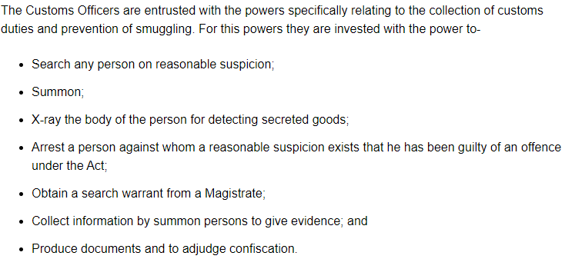
POWERS OF CUSTOMS OFFICIER

Slide 35
TYPES OF CUSTOMS DUTIES
Basic Customs Duty (BCD)
Countervailing Duty (CVD)
Additional Customs Duty or Special CVD
Protective Duty,
Anti-dumping Duty
Education Cess on Custom Duty

Slide 36
Countervailing duty: Occurs when a foreign producer sells a product in host country at a price that is below that producer’s sales price in home market, or at a price lower than its cost of production.
Anti-Dumping duty: Occurs when foreign government provides financial assistance to benefit the production, manufacture or exportation of a goods. (Subsidised)

Slide 37
HOW CUSTOMS DUTY COMPUTED?
Rule 4 & 5 – Comparative value method that compares the transaction value of identical or similar items
Rule 7 – Deductive value method that uses sale price of such good in the importing country
Rule 8 – Computed value method that employs costs related to materials, fabrication, and profit in the country of production
Rule 9 – The Fallback method that is based on previous methods with an element of higher flexibility.

Slide 38
CUSTOMS CLEARANCE PROCEDURES IN EXPORT
Procedure - Steps- Contract - Financing - Institutional Framework – Excise Clearance, - Pre-Shipment Inspection - Methods - Insurance in Transportation - Clearing and Forwarding Agents - E-Filing Procedures - Customs EDI System – Transport Document - Freight Forwarder and Liner Introduction - Bill of Lading - Types of BL - Importance and Uses of BL - BL Terms and Conditions.

Slide 39
Documents to the customs department for securing customs clearance
(i) Shipping Bill (Appropriate type) in quadruplicate, if clearance is manual or
Annexure A or B, in case clearance is given in computerised manner;
(ii) Commercial Invoice (2 copies);
(iii) Exchange Control Form- GR Form or SDF as applicable, in duplicate. SDF form is
used in place of GR Form where customs operations are computerised;
(iv) Copy of Letter of Credit/Copy of Export Order/ Export contract, duly attested by bank;
(v) Packing List;
(vi) Certificate of Origin or GSP certificate of Origin;
(vii) Shipper’s declaration form for export of goods;
(viii) ARE-1, duly approved by the Central Excise office (ARE-1 has replaced AR-4);
(ix) Original copy of Certificate of Insurance, wherever necessary;
(x) Marine Insurance Policy;
(xi) Export Licence, where required and
(xii) Any other documents.

Slide 40
Indian Customs EDI System
1. To simplify customs laws, regulations, administrative guidelines and procedures to the extent possible so that customs clearance is expedited without undue burden;
2. Respond more quickly to the needs of trade;
3 Computerisation of customs related functions including import/export general manifest control, ex-bond clearance of warehoused goods, goods imported against export promotion schemes, monitoring of export promotion schemes;
4. Reduce interaction of trade with Government agencies;
5. Provide retrieval of information from other custom locations to have uniformity inassessment and valuation;
6. Provide management information system for policy making and its effective revenuecollection;
7. Monitoring pendency and
8. Provide quick and correct information on import/export statistics.

Slide 41
PORT PROCEDURES
(A) Carting Permission: Before bringing cargo to the shipment shed, it is necessary to take “Carting permission” from superintendent of the shed and agent of the shipping company.
(B) Vehicle Ticket: At the port gate, while entering with cargo, shipper has to show carting permission and vehicle ticket, in duplicate, to the Gate Inspector. Gate inspector examines goods and documents to ensure permitted goods in the documents only are entering into port. The packages, bundles, cases mentioned in the vehicle ticket are tallied with those in the vehicles before goods are allowed in. Necessary entry is made in the registers in respect of cargo passed through the gate.

Slide 42
(C)Mate’s Receipt: Soon after goods are cleared by customs, exporter/CHA obtains
“Let Ship Order” from the Preventive officer of customs on the exporter’s copy of Shipping Bill. The master of the vessel allows loading of cargo on board, in consultation with Preventive Officer of Customs. The master of the vessel issues mate’s receipt to Port authorities in respect of shipment taken on board, indicating the condition of goods at the time of receipt. After payment of port dues, shipper collects the mate’s receipt. Mate’s receipt is an important document as it is to be exchanged to Bill of Lading. So, shipper has to collect it from the superintendent of the shed, immediately, soon after it is received to avoid the delay and problems in negotiation.

Slide 43
(D)Bill of Lading: Shipper collects blank copies of Bill of Lading from the shipping company and prepares two/three negotiable and required non-negotiable copies of Bill of Lading. Shipping Company issues Bill of Lading to the shipper in exchange of mate’s receipt. Bill of Lading may be marked “Freight Paid” if shipper has paid freight and “Freight to Pay” when freight is to be collected from importer. Shipping Company incorporates those clauses that are appearing in the mate’s receipt, before Bill of Lading is issued.

Slide 44
CLEARING AND FORWARDING AGENT: Their basic function is to provide different range of services to exporters to ensure smooth and timely shipment of goods. Clearing and forwarding agents are also known as Customs House Agents or Freight Forwarders or Shipping Agents
ESSENTIAL SERVICES:
1. Warehousing before Transportation
Soon after the goods are manufactured and are ready for shipping, warehousing facility for goods is made available before they are transported to the docks/port.
2. Local Transportation
When clearance is received from Port, goods are transported to the docks and warehoused in the port.
3. Container Arrangement
Movement through containers has been gaining popularity to facilitate export goods reach in the original condition, they are sent. In case of need, this service is provided.
4. Reservation of Shipping Space
Unless shipping space is finalised, there is no guarantee about the shipment of goods.
C & F agent books the shipping space contacting the agents of the Shipping company, alternatively, making arrangements for air- freighting.

Slide 45
5. Selection of Mode of Transport
Mode of transport is a matter of negotiation between the exporter and importer,
invariably, incorporated in the contract. Either exporter or importer arranges transportation,
depending on price terms. C & F agent provides information about different shipping lines/
air lines and guides on the selection of route, optimal from the standpoint of delivery date
and distribution costs. Delivery of goods as agreed upon is one of the conditions on which
success in exports depends. As transportation cost occupies a significant place in total cost
structure, services of clearing agents are highly valuable in managing timely delivery,
containing costs to achieve sales and profit goals for exporter.
6. Packing, Marking and labelling
Goods are packed, marked and labelled so that goods are ready for inspection and preshipment.
These services are also provided by shipping agents, depending upon the requirement.
7. Completing Customs and Port formalities
Clearing agents prepare the shipping documents to the requirements of customs
procedures. Necessary port formalities are complied with, in time, to avoid delays in shipment of goods.
8. Cargo Insurance
Necessary marine/cargo insurance is made as per the terms of contract. Risk coverage
in insurance policy has to be earlier to the date of shipment of goods

Slide 46
9. Advising Exporters on Trade Laws
They are experts in the field as they deal continuously. They are abreast of the changes in the regulations and trade practices of foreign countries. Exporters can get benefit of their advice.
10. Educating Exporters
Clearing agents educate exporters in respect of developments in transport and changing options available to them to explore new markets that are earlier remote or inaccessible.
11. Coordination with other Agencies
Clearing agents arrange to procure certificates or endorsements from different agencies, required for shipment of goods. To illustrate, where necessary, certificate of origin is procured by them from the local Chamber of Commerce.
12. Procuring Documents
Finally, clearing agent procures documents like Bill of Lading and makes them available to the exporters for negotiation with the bank.

Slide 47
OPTIONAL SERVICE OF C&F
1. Warehousing facilities abroad
When goods reach the destination point and importer refuses to take delivery of goods, exporter faces an embarrassing situation. At some of the major international markets, the leading clearing agents provide warehousing facilities. This facility gives breathing time to plan alternative course of action to gain, at least minimal profit to the exporter.
2. Bringing back Goods
When original importer refuses to take delivery of goods, it is not easy for exporter to find alternative buyer at that place, immediately. If his efforts fail, there is no option to the exporter other than bringing back the goods to his own place or sending goods to another place where sale can be made, with minimum loss. If the clearing agent can perform that service, exporter can avert a major chaos in the business of exports.
3. Locating Stranded Goods
At times, it so happens that the goods may be misplaced and do not reach the intended destination. When the goods are misplaced or stranded at some port, clearing agents provide necessary assistance in locating them.
4. Assessment of Damage
When goods are sent by ship, occasionally, goods may get damaged partly or totally. In such an event, clearing agent coordinates with the ship surveyor for assessment of damage and obtaining surveyor’s certificate. They may provide the assistance to file claim with the insurance company

Slide 48
LINER
(i) Regularity: It operates on a regular route between fixed ports. The schedule of services are predetermined. The schedule does not change, irrespective of the availability of cargo. On account of commitment of regular services, they are ideally suitable and useful for small exporters. It carries small loads of many shippers. For easy understanding, they can be compared to local bus service in Bhopal. Just like local buses, these shipping lines stop on fixed routes. Local buses meet the requirements of general public; similarly these shipping lines cater the demands of the small exporters. They are highly useful to small exporters.
(ii) Fixed Tariff: They generally offer fixed and stable freight rates. Each shipper pays the freight in accordance with weight, volume or value of the cargo. The tariff rates are fixed in the market. So, exporters would be able to plan exports, taking the freight rates that are known and prevail fixed in market.
(iii) Designed to Carry Variety of Cargo: General cargo is in the form of bales, bundles, boxes, barrels, drums etc. The designs of the holds and number of decks are different from those of tramp to suit the varied nature of cargo. It carries even reefer (refrigerated) cargo. Share of containerised cargo is increasing due to its popularity. To suit the container requirements, the specially designed container ships are also increasing.
(iv) Sophisticated Equipment: The cargo handling equipment is expensive and sophisticated. The equipment ensures quick turnaround. A quick turnaround means that the ship spends the least possible time in loading and unloading in the port and more time in transit.

Slide 49
PRE SHIPMENT INSPECTION
A pre-shipment inspection is a step taken by trade operators (buyers, suppliers, agencies) to inspect newly manufactured products before they are shipped for export/import.

Slide 50
PURPOSE
Check the quantity and quality of the merchandise
Check products for any defects
Ensure products meet the safety requirements of the destination market
Issue report for import and billing

Slide 51
PRINCIPLES IN PRE SHIPMENT INSPECTION
Non-discrimination
Transparency
Protection of confidential business information
Avoidance of delays
Price verification based on the price of identical or similar goods in the country of exportation, in which the exporter has the opportunity to explain the price charged
Inspection agencies establish appeals procedures, the findings of which are made available to other exporters

Slide 52
Accredited inspection agencies perform pre-shipment inspections when production is at least 80% complete. This is your final opportunity to take corrective action before your production is shipped, making it an effective tool to safeguard your product against costly import risks.
The pre-shipment inspection typically covers: functionality, performance, durability, overall appearance, and dimensions.

Slide 53
METHODS OF PRE-SHIPMENT INSPECTION
1. Consignment-Wise inspection
Under this system, each consignment, in packed condition, is subjected to detailed inspection by the Export Inspection Agencies. They conduct the inspection on the basis of statistical sampling plan. If the goods conform to the stipulated quality, they issue the inspection certificate. The certificate also carries a validity period before which the export consignment must be shipped. In case of consignment-wise inspection, actual export consignment, in packed condition, is taken for inspection.
No consignment of any notified commodity is allowed to be exported without the certificate issued by the recognised inspection agency. This system is applicable to all commodities other than those that undergo in-process quality control. Generally, Small-scale manufacturers who cannot afford to have their own facilities and personnel adopt consignment-wise inspection certificate procedure.

Slide 54
2. In-process Quality Control
Certain commodities like paints and allied products, linoleum, ceramics, printing ink, sanitary wares etc. come under the purview of In-process quality control.
In case of continuous process industries, an option is given to them to become approved "export-worthy" unit, as they possess the requisite infrastructure for manufacturing/processing products of standard quality. This status enables them to conduct inspection and give declaration and based on their declaration, they get inspection certificate.
3. Self-Certification
With the experience gained in operating the compulsory Quality Control and Pre-Shipment Inspection Scheme in India, there has been a qualitative change in the inspection system also. Recently, a self-certification system has been introduced. This is based on the concept that the manufacturing unit which has in-built responsibility for quality control should have the freedom to certify its own product for export.

Slide 55
INSPECTION OF GOODS
PSIA designates their Authorized Representative / Inspector in the appropriate country to visit the concerned exporter’s yard and carry out the inspection of the products being loaded.
The PSIA Authorized Representative / Inspector visits the Exporter’s yard and physically inspects the material being loaded.
The inspector will conduct a visual inspection to verify the quality of the scrap metal, that is whether the material meets with the description of the relevant grade and quality as per the correct H.S. Code
The inspector will also check the details such as the appearance of any explosives or war material and determining the radio-activity level on the scrap and at the background level using the appropriate equipment.
Loading of the containers will be carried out in the presence of the PSIA Authorized Representative / Inspector.
Once the loading of the containers is completed, the containers will be handed over to the Exporter for shipment
The PSIA Authorized Representative subsequently sends the satisfactory inspection report to PSIA Head Office, along with the loading photographs and copy of the Bill of Lading, along with the radio-activity readings of the consignment inspected.

Slide 56
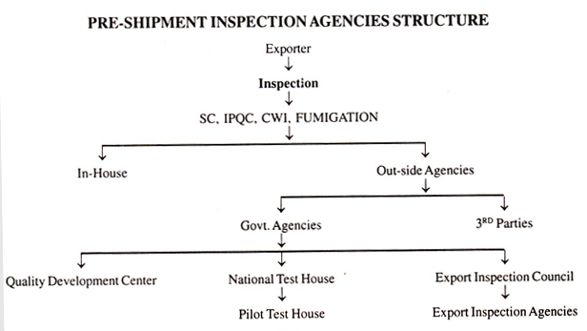

Slide 57
ABBREVIATIONS
FCL: Full Container Load.
LCL: Less than Container Load.
RFI: Request for Inspection.
SGS: Society General de Surveillance.
QC: Quality Control.
NTH: National Test House.
EPC: Engineering Export Promotion council.
IPQC: In-Process Quality Control.
PSI: Pre-Shipment Inspection.
QDC: Quality Development Center.
SC: Self-Certification.
CWI: Consignment Wise Inspection.
EIC: Export Inspection Council.
EIA: Export Inspection Agency.
EPZ: Export Processing Zone.
EOU: Export Oriented Unit.
ISO 9000: International Standards for Quality System.
IAPSIC: International Association of Pre-shipment Inspection Companies.

Slide 58
TRANSPORTATION INSURANCE
What Does Transportation Insurance Mean?
Transportation insurance is a policy that offers coverage on the insured's property while it is in transit from one location to another via any necessary mode of transport. This coverage is based on the value of goods and the amount of risk the insurance company is taking on while the property is moved from loading to the stated destination.

Slide 59
This type of insurance can include transport by land, air, and water. Depending on the type of coverage you purchase, it could consist of the packing and unpacking, loading or unloading, transportation and storage of goods while in transit.
It also covers any damage or loss of the goods due to mishandling or other forms of damage. Examples of such damages could include accidents, explosions, impact fires, theft, and malicious damage or theft. Individuals often rely on this type of insurance when moving or relocating overseas. For businesses who rely on their inventory or goods to arrive as expected, this type of policy offers security and a degree of financial protection for their revenues if losses occur.

Slide 60
EXCISE CLEARANCE FOR EXPORTS
As soon as goods are ready for despatch to the port of shipment, exporter has to apply to the central excise authority for excise clearance of the cargo.
The exporter has, now an option to remove the goods with inspection by the central excise or remove the goods without inspection.
For this, exporter has to apply to the jurisdiction Range Superintendent of central excise in the prescribed form ARE-1, in sixtuplicate.
For inspection, exporter has to give advance notice of 24 hours to the range superintendent.
The inspection may be made by the range superintendent or excise inspector, nominated by the superintendent of excise.
After inspection, they seal the goods and give excise clearance. In case, goods are inspected by the excise authorities and seals are not broken, the customs authorities may not inspect the goods at the port. If goods are removed by the exporter, without the inspection by excise authorities, customs conduct inspection of goods at the port.

Slide 61
As a matter of policy to encourage exports, exporters are exempted from payment of central excise duty on thy, final product. Where exemption is not possible, refund of excise duty is made. Exporter has option to export under rebate or export under bond. In respect of excise duty paid on inputs, refund is made through Cenvat Credit or Duty Drawback.
In case of export under rebate, excise duty has to be paid first by the exporter and once the export transaction is completed, refund of excise duty paid can be claimed. In case of export under bond, excise duty need not be paid, but bond has to be executed by the exporter in the prescribed format, as approved by Controller of Central Excise, by producing security or surety, at least to the amount equivalent to the amount of excise duty chargeable on the goods.

Slide 62
The procedure for clearance of excisable goods for exports can be classified into the following two categories:
1) Procedure for excise clearance in case of exempted units
2) Procedure for excise clearance in case of units other than exempted units

Slide 63
Definition of Exempted Unit:
A manufacturing unit is exempt from the levy of central excise if the value of the goods cleared by it for home consumption in a financial year is within the exemption limit of Rs. 50 lakhs. Such a unit is called the exempted unit.
Declarant’s Code Number: The exempted units are not required to obtain Central Excise Registration but have to file a declaration with the Central Excise Department. These units are then allotted the Declarant’s Code Number.

Slide 64
EXCISE CLEARANCE PROCEDURE
The exempted units should prepare a document for clearance of goods in form of invoice with distinctive serial number
Should have the IEC Code and the Declarant’s Code Number
Should state that the goods are being cleared for Exports.
Should give the details of the description of goods, name and address of the buyer, destination, value, vehicle number, date and approximate time of removal of goods and progressive total value of all excisable goods cleared for home consumption since the beginning of the financial year.
The exempted units have to file quarterly statement of all the clearances with CENTRAL EXCISE DEPT in prescribed form enclosing the proof of export.

Slide 65
PROCEDURE FOR EXCISE CLEARANCE IN CASE OF UNITS OTHER THAN EXEMPTED UNITS
Export under claim of rebate of duty: The excise duty is first paid and then the exporter claims its refund after exportation of goods.
Export under Bond: In this case, the exporter is allowed clearance of goods for export without payment of the excise duty subject to the execution of bond with security or surety for a sum equivalent to the duty chargeable on the goods to be exported.

Slide 66
Central Excise Clearance with or without Examination of Goods
The excise officer draws 3 samples. After clearance of goods, the export boxes are duly sealed by him and hands over the two boxes to the exporter-One for exporter’s records and other to hand over to the customs. The 3rd box is retained by him.
The excise clearance after examination is known as exports under CENTRAL EXCISE SEAL.

Slide 67
DOCUMETATION REQUIREMENT FOR CENTRAL EXCISE CLEARANCE
AR4
GR

Slide 68
BASIC DOCUMENTATION
Basic Documentation - Forms - International Commercial Terms – Invoice and
Packing List-Pricing Calculation - CBM Calculation - IEC code, RCMC, COO, GSP,
Invoice , Packing list, ARE-1, Filing of shipping bill, Concor and shipping concepts,
LET export order, Inco terms.

Slide 69
CBM CALCULATION

Slide 70
What is CBM?
Cubic meter or CBM is a measurement of volume of a shipment. It determines how much space your cargo will take up on a ship, aircraft or truck, which in turn will decide how much it will cost to transport.
How do you calculate CBM?
Length x Width x Height = CBM
This is the formula used to measure your cargo volume in CBM (m³).
Say, you have a carton that is 2 metres long, 2 metres wide and 2 metres high. Then, its volume is 2 x 2 x 2 = 8 m³.
And if you have 10 such identical cartons in a single consignment, you can simply multiply the CBM with the total number of cartons to arrive at the total volume – 8 x 10 = 80 m³.
If the cartons are not of the same size, calculate the CBM for each carton by using the same formula and add up the total.

Slide 71
What is Volumetric Weight and Chargeable Weight?
In shipping, volume (CBM) is one way of calculating freight. The other is weight. Traditionally, the weight of a shipment is said to decide its transportation cost. But what if the shipment is extremely light but has a large volume (a carton of styrofoam cups or a bale of cotton wool, for example)? Such a shipment would take up more space than, say, a shipment of small steel items. But if freight is charged on the basis of its light weight, the amount would be nominal. This is where a concept called dimensional or volumetric weight and chargeable weight comes in.
Gross Weight: This is the actual weight of your cargo, including any packaging, cushioning and pallets.
Dimensional/Volumetric Weight: The volume of cargo converted into its weight equivalent (CBM to kg) is called dimensional weight or volumetric weight. Depending on the freight mode (air, sea, road) and carrier, dimensional weight can be calculated using either of these formulas:
CBM x DIM Factor = Dimensional Weight
Length (cm) x Width (cm) x Height (cm) x Quantity / DIM Factor = Dimensional Weight
Chargeable weight: Once you have both your gross weight and dimensional weight, your freight service provider will charge you on the basis of whichever of the two is greater. This is called chargeable weight. If gross weight is greater than dimensional weight, you will be charged on the basis of the former. But if dimensional weight is greater, that will be the chargeable weight.

Slide 72
https://www.cogoport.com/blogs/what-is-cbm-and-how-do-you-calculate-it

Slide 73
LET EXPORT ORDER
‘Let export order’ is the final procedures of export customs clearance procedures to export any goods outside country.

Slide 74
PROCEDURE TO GET Let Export Order
You may appoint a customs house agent to handle your export shipments smoothly. As per government, it is not necessary to appoint a customs house agent (CHA), exporter can directly complete the customs procedures and formalities
However, in order to save time and concentrate in export business, most of the exporters appoint clearing and forwarding agents (customs house agents).

Slide 75
Once you (exporter) have prepared commercial invoice and packing list, you deliver the same with a declaration called SDF to your appointed Customs House Agent.
Now days, the filing of shipping documents can be done through on line 24 hours a day. Normally, CHA will have the said software downloaded in their office or residence to save maximum time for exporters and serve better.
Once after receiving the invoice, packing list and SDF declaration, Customs House Agent files shipping bill online. The generation of shipping bill is a centralized process which is automatically generated serial wise at one place in the country, as all customs offices are linked with this location.

Slide 76
Once after filing shipping bill with customs, cargo is moved to the airport, sea port, or CFS where in customs facility available to complete export procedures.
The slot to unload cargo has to be discussed with carriers, because different carriers may have their own different handling locations under customs bonded area.
The cargo is unloaded at the allotted slot, the CHA or you (exporter) approaches customs inspector to register goods online for inspection of cargo.

Slide 77
The inspector physically inspect the cargo and makes sure that you (exporter) are exporting the cargo as per shipping documents and verifies quantity, marks and numbers and other required parameters.
After physical inspection of cargo, examiner/ inspector of customs prepares inspection report online and await to get approval from appraising officer of goods or higher officials of customs by online.
The value of goods is assessed by appraiser. Means, the value you (exporter) have mentioned in your invoice should not be abnormal with market price. Means, either should not be too low or too high.

Slide 78
Once after assessment and inspection completed, the report will be updated with the computer system and customs allows the said goods to move out of country by mentioning as ‘Let Export’. This is widely called as “Let export order”.
Then, the prints out of shipping bill is generated under the said shipment and signs physically by the authorized customs officials.

Slide 79
PASS OUT

Slide 80
Pass out of Customs is a term used in import customs clearance procedures and formalities in India. Once goods arrived from a foreign country to Indian customs location, necessary import documents are filed by importer or his authorized customs broker.
Bill of Entry is a prime document to be filed with Indian customs to complete necessary import procedures and formalities along with other required documents related to said import consignment.
The designated customs officials examine goods / assess value of goods where ever applicable and allow taking imported goods out of customs area, once after satisfying their requirements specified by the government of India.
After completion of such import procedures and formalities, proper officer of customs allows importer to take material out of customs by mentioning in bill of entry as ‘Passed out of Customs’.

Slide 81
CONCOR

Slide 82
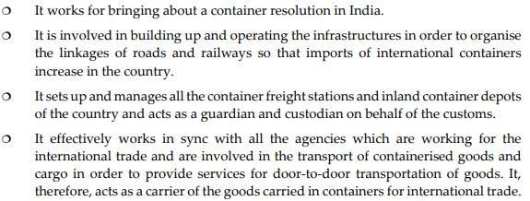
CORE FUNCTIONS OF CONCOR

Slide 83
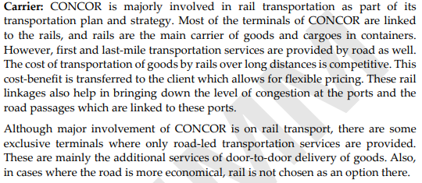
ACTIVITIES OF CONCOR

Slide 84
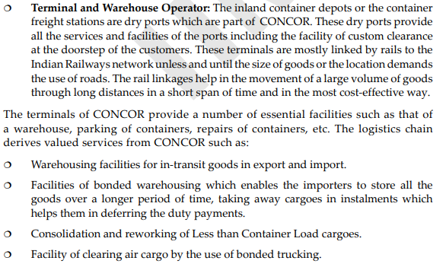

Slide 85
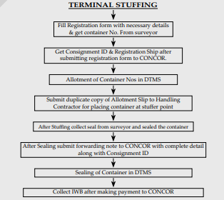
CONTANERISATION IN CONCOR

Slide 86
ARE-1
APPLICATION FOR REMOVAL OF EXCISABLE GOODS FOR EXPORT BY (AIR/SEA/POST/LAND) (This form is issued by manufacturer or merchant when excisable goods are exported)

Slide 87
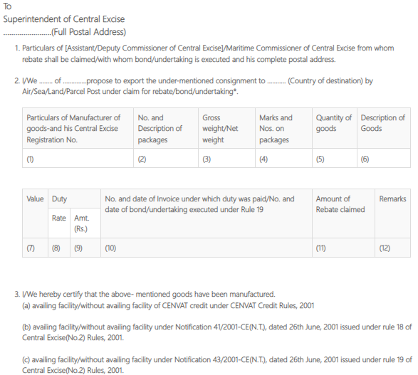

Slide 89
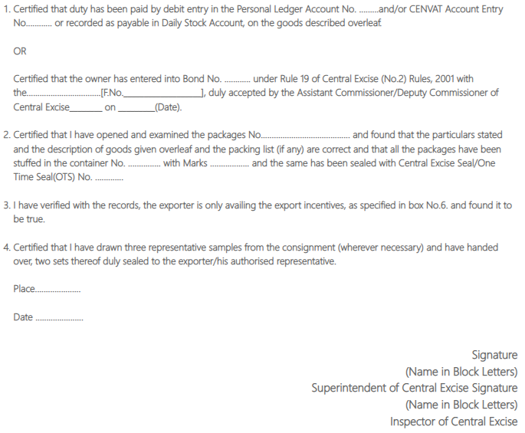
PART-A(CERTIFICATION BY CENTRAL EXCISE OFFICE)

Slide 90
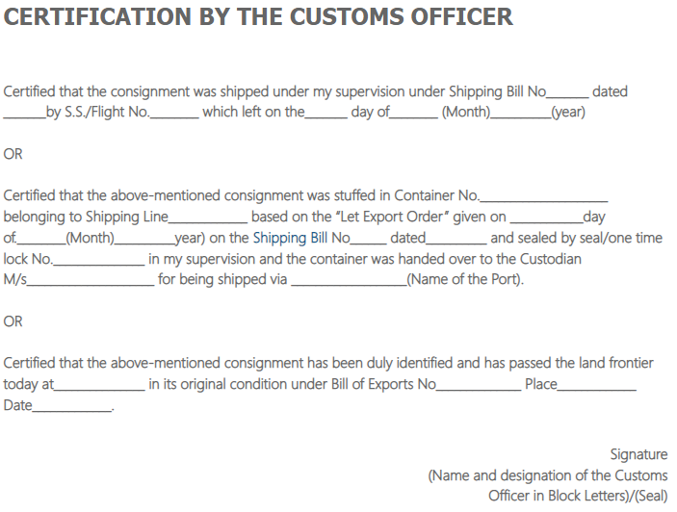
PART-B(CERTIFICATION BY THE CUSTOMS OFFICER)

Slide 91
PART-C(EXPORT BY POST)

Slide 92
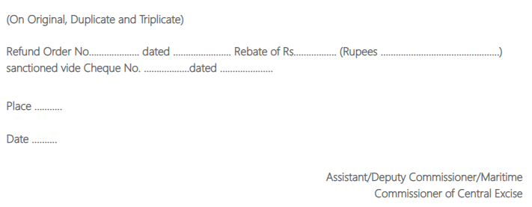
PART-D(REBATE SANCTION ORDER)

Slide 93
SHIPPING BILL
https://www.cbic.gov.in/htdocs-cbec/customs/cs-act/formatted-htmls/cs-import-regu2

Slide 94
IMPORTANCE OF SHIPPING BILL
(A) It is an important document required by the customs authorities for clearance of goods. The customs authorities endorses the duplicate copy of the shipping bill with “Let Export Order” and “Let Ship Order”.
(B) After the clearance of customs, exporter can load the goods on ship.
(C) Shipping bill endorsed by the customs authorities facilitates the exporter to claim incentives such as excise duty refund and duty drawback

Slide 95
TYPES OF SHIPPING BILL
Duty free shipping bills(It is used in case of goods which neither attract any export duty nor entitled for duty drawback. It is printed on simple white paper),
Dutiable shipping bill(It is used in case of goods, which attract export duty. It may or may not be entitled to duty drawback. It is printed on yellow paper),

Slide 96
Shipping bill under Duty draw back(It is used in case when refund of duties is allowed on the goods exported. Generally, it is printed on green paper, but when the drawback claim is paid to a bank, then it is printed on yellow paper),
Ex-bond shipping bills(It is used in case of imported goods for re export and which are kept in bond. It is printed on yellow paper)

Slide 97
INVOICE

Slide 98
COMMERCIAL INVOICE
(A) It is prima facie evidence of the contract of sale and purchase of goods. On the basis of the invoice, all the other documents, in the context of export, are prepared as it is the basic document.
(B) Invoice constitutes the main document for various export formalities such as reshipments inspection, quality, excise and customs procedures.
(C) It is useful for accounting purposes, both by the exporter and importer.
(D) This document is required in collection/negotiation of documents through the bank.
(E) For claiming incentives, this document is essential

Slide 99
CONSULAR INVOICE
Some of the importing countries insist that the invoice is to be signed by the importing county’s consular located in the exporter’s country. Such invoices are known as consular invoice.
Significance of Consular Invoice can be Summarized
Importance to the Exporter
1. Once the invoice is signed by the consulate of the importing country, the exporter is reasonably assured that there are no import restrictions in the importer’s country for the goods and that there would be no problem in realization of export proceeds or foreign exchange.
2. It enables prompt clearance from the customs of exporter’s country for shipping the goods

Slide 100
LEGALIZED INVOICE
Certain Latin American countries like Mexico require this. It is just like consular invoice, which requires certification from consulate or authorized mission, stationed in the exporter’s country

Slide 101
CUSTOMS INVOICE
When the commercial invoice is prepared on the format prescribed by the customs authorities of the importing country, it is called “Customs Invoice”. This is the requirement of U.S.A., Canada and Australia

Slide 102
UNIT4 – CUSTOMS CLEARANCE PROCEDURES IN IMPORTS
Import and Pre Import Procedures - Legal Formalities - Customs Formalities – Storing - Provisions for Exchange Control in Importing - Retirement of Documents

Slide 103
Goods imported into the country by any mode of conveyance- vessel, aircraft, multimodal transport, land, post or even through couriers- attract customs duty.
All goods imported in India have to pass through customs clearance
It is the duty of customs to ensure that the transactions prohibited by different laws do not take place, when goods move into the country.
Customs clearance helps in regulating trade in accordance with national objectives, priorities and policies

Slide 104
TYPES OF IMPORTS

Slide 105
UNRESTRICTED ITEMS
Any person having import-export code Number is allowed to import the goods, which do not have any kind of restriction under the Import Policy 2002-07, as amended from time to time.
Any intending importer has to check the classification of the item by referring to ITC (HS) Classification to find out the policy applicable to that item.
If the item falls under unrestricted category, the only requirement is payment of applicable import duty, after obtaining customs clearance for the import consignment.

Slide 106
RESTRICTED ITEMS
Any business firm intending to import restricted items has to apply for import licence
All restricted items fall under the Negative List. For import of items under the negative list, importer has to give justification of the need to import those goods.
The importer has to submit a statement of reasons to the licensing authority for the import.
Import of restricted items is not a matter of right. It is a privilege extended by the Government.
The licensing authority has the authority to refuse licence if it is not satisfied with the reasons of import

Slide 107
IMPORT OF CAPITAL GOODS
Import of new capital goods is liberal. There is no restriction regarding the import of new capital goods. The only requirement is payment of applicable import tariff for those capital goods and arrangement of customs clearance.
However, in respect of second hand goods, there are certain restrictions. The capital goods to be imported should not be more than 10 years old and after import, they cannot be transferred, sold or otherwise disposed off within a period of two years, without the prior permission of DGFT.
Government has provided a facility to import capital goods, paying concessional import duty under a scheme known as “Export Promotion Capital Goods Scheme”. The aim of the scheme is to facilitate import of machinery and other capital goods to enable them to export.
The concessional import duty is 5% on import of new capital goods but carries Export obligation. The export obligation is of a certain minimum value, in multiple of the value of capital goods imported. An exporter has to obtain EPCG licence to avail of the facility. However, second hand goods cannot be imported under this scheme

Slide 108
Import of raw materials under Duty Exemption Scheme (Advance Licensing)
An importer is entitled to the grant of duty free licence to import raw materials, components, spares, packing materials etc for the purpose of exports. He can also import mandatory spares to the extent of 10% of CIF value of the licence.
However, an export obligation is imposed on the importer, in terms of value addition to be achieved. Standard input-output and value addition norms have been prescribed for individual products. The value of exports to be achieved is mentioned in the advance licence and period allowed to fulfill export obligation is 18 months.
In case, the export obligation is not fulfilled within the above 18months period, on the written application of the importer, a further time limit of 6 months can be extended by Regional Licensing Authority. Any extension beyond six months period can be granted by the DGFT.

Slide 109
RETIREMENT OF DOCUMENTS FOR IMPORTS

Slide 110
On receipt of information from the airlines / Shipping lines, importer approaches the bank for retirement of documents.
Release of documents by bank depends on the terms of payment agreed between the importer and exporter, instructions given by the exporter to his bank while negotiating documents

Slide 111
In case of D/P mode of payment, importer has to make payment for getting the documents.
If the mode of payment is on D/A basis, importer receives documents on acceptance of bill of exchange.
In case, documents are received under Letter of Credit, the importer’s bank, issuing bank, verifies whether the documents are non-discrepant and documents are totally in conformity of the letter of credit opened. In case, documents are discrepant, it may seek instructions of the importer, instead of refusing to make payment to exporter.

Slide 112
DOCUMENTS TO RETIRE
Letter of Authorisation to debit his account along with bank charges. Generally, cheque is not sent to bank as exchange rate fluctuates and importer is not aware of the exact exchange rate on the date of retirement of bill.
Form A-1 for sending remittance to the exporter and
Exchange Control Copy of the Import License, if applicable

Slide 113
PROCESS/PROCEDURE OF CUSTOMS CLEARANCE

Slide 114
1. Arrival of Goods and Import General Manifest
As per Section 30 of the Customs Act, 1962, the person in charge of the conveyance (ship, aircraft etc) carrying imported goods is required to deliver a document known as “Import General Manifest” to the proper officer of Customs.
This is to be submitted within 24 hours of its arrival at the point of entry, in the prescribed format. The Import General Manifest is a list of items that the carrier is carrying for the purpose of unloading at the port of arrival. In the case of a vessel, the IGM is normally submitted before the arrival of the vessel.
If the IGM is not submitted within 24 hours of its arrival, reasons for delay are to be explained. The proper officer accepts even after 24 hours provided the delay is due to genuine grounds.
The imported cargo is transferred to the customs bonded warehouse, attached to port of discharge. Thereafter, the shipping line / airline sends Cargo Arrival Notice to the consignee with details of import consignment.

Slide 115
2. PREPARING BILL OF ENTRY
The basic document used for obtaining customs clearance is known as “Bill of Entry”. Bill of Entry may be filed 30 days, in advance, of the expected arrival of concerned cargo to expedite processing of Bill of Entry. The main contents are the following:
(i) Details of importer’s name and address, IEC number, CHA Code Number, Port of Shipment, particulars of origin of goods, and vessel’s name;
(ii) Particulars of goods imported with regard to the number, quantity, packages etc;
(iii) Description, classification and value of goods;
(iv) Rate and amount of import duty payable;
(v) Currency, weight, freight, insurance etc;
(vi) Details of exporter;
(vii) Import licence number of importer and
(viii) Declaration as to correctness of the information recorded.

Slide 116
For the purpose of giving information in Bill of Entry form, based on goods, Bill of
Entry are divided into three categories:
(i) Bill of Entry for Home Consumption (White coloured): This is used when imported goods are cleared for home consumption, on payment of duty.
(ii) Bill of Entry on Bonded Goods (Yellow coloured): This is used when goods are transferred to recognised bonded warehouse of customs as no duty is paid on imported goods.
(iii)Bill of Entry for Ex-Bond Clearance for Home Consumption: This is used when the importer intends to clear imported goods, fully or partly, for home consumption from bonded warehouse, paying applicable import duty.

Slide 117
3. Services of Customs House Agent
The entire process of customs clearance is complex, so it is desirable to engage services of an accredited clearing agent for securing customs clearance.
The clearing agent prepares the applicable Bill of Entry containing details of goods to be cleared from the customs and submits the same to the customs.
The date of presentation of Bill of Entry is important. Amount of import duty depends on the applicable rate, in force, on the date of presentation of Bill of Entry

Slide 118
4. Presentation of Bill of Entry for Noting
The Bill of Entry, complete in all respects, with proper declarations signed by the importer and his clearing agent, if any, is presented to the Import Noting Department for noting, on receipt of information regarding arrival of goods.
The Bill of Entry is checked with the IGM, submitted by carrier by the concerned official. The date of presentation of Bill of Entry is important.

Slide 119
5. Presentation of Bill of Entry for Appraisal
After the Bill of Entry is noted in the Import Department, it is presented to Appraising counters along with the following documents:
(i) Bank attested Commercial invoice
(ii) Copy of Letter of Credit
(iii) Import licence, if required
(iv) Bill of Lading/Airway Bill (original and non-negotiable) along with delivery order from the carrier
(v) Packing List (2 copies)
(vi) Insurance policy/certificate
(vii) Certificate of Origin
(viii) Freight and insurance certificate, if import is on FOB terms
(ix) Manufacturer’s test certificate
(x) Importer- Exporter Code number
(xi) Weight specifications
(xii) A declaration from the importer that he has not paid any commission to agents in India
(xiii) Catalogue/drawings for machinery imported
(xiv) Customs declaration
(xv) GATT declaration form, duly filled in
(xvi) If second hand machinery is imported, a declaration as per the export-import Policy 2002-2007 and
(xvii) Any other relevant documents

Slide 120
The import licence must be valid and cover the goods imported.
The appraising officer scrutinises documents. If documents submitted are adequate for acceptance to the declared value, the rate of duty is noted on the Bill of Entry. The Appraising officer gives ‘Examination order’.
Once the Appraising office completes the Bill of Entry, the Assistant Collector of Customs countersigns it

Slide 121
6. Payment of Duty
The customs assessed Bill of Entry is given to the importer for deposit of import duty.
After deposit of duty, the original copy is detached for record and rest of documents are returned to the importer

Slide 122
7. Physical Examination as per Examination Order
The importer presents the documents to Dock Appraiser for physical examination of goods. If the goods are in order, the dock appraiser gives “Out of Charge” order. This procedure is known as the ‘Second Check Procedure’, under which 80-90% of consignments is cleared. In this procedure, first the documents are examined and later goods are checked.
When the appraising officer is not able to identify the goods properly or there is insufficient information about the composition/functions/classification of goods in question, the appraising officer marks the papers to the Dock Superintendent for physical examination.
After the physical examination, the Bill of Entry is returned to Scrutinising Appraiser for completion and licence debit. This procedure is known ‘First Check Procedure’.

Slide 123
8. Release Order
The clearing agent presents the documents to the Port Manager who ensures payment of any charges including demurrage. After the importer deposits the same, the port manager issues the release order. On the basis of release order, the goods are taken out of customs area

Slide 124
9. Confiscation of Goods
If customs authorities find that the intended goods of import are prohibited or import is in contravention of the provisions of any Act, import goods can be confiscated.
The authority lies with the Adjudicating authority to release goods on payment of fine or confiscate them

Slide 125
INDIAN CUSTOMS ELECTRONIC DATA INTERCHANGE SYSTEM (ICES) SYSTEM FOR CLEARANCE OF IMPORTS

Slide 126
The objective of ICES is to facilitate acceptance of documents electronically and exchange information electronically between agencies involved in International trade.
To facilitate, streamline and expedite customs clearance for imports, electronic processing of Bill of Entry has been introduced. It replaces all manual operations. It is a communication from computer to computer

Slide 127
(A) If the goods are cleared through the EDI system, no formal Bill of Entry is filed. It is generated in the computer system. The importer does not submit documents as such for assessment. He submits declarations in electronic format containing all the relevant information to the Service Centre for processing of Bill of Entry for customs clearance. A signed paper copy of the declaration is taken by the service centre operator for non-repudiability of the declaration.
(B) Data is fed in the computer of importer or his clearing agent. Separate facility is also made available at Service Centre of customs to facilitate those who do not enjoy computer facility.

Slide 128
(C) The Bill of Entry can be filed at Service Centre, alternatively filed through the Remote EDI System. If filed through the Service Center by the Importer/CHA, importer has to submit signed declaration in a prescribed format along with copy of Invoice and Packing List.
The computer at Service Centre is connected with computer of the Customs department. The data from computer of Service Centre is transferred to computer of the Customs department.
The system assigns a Bill of Entry number, which is endorsed on the checklist. Then, a checklist is generated for verification of data by the importer/CHA. In case any errors are detected, they are corrected.
After verification by the Importer/CHA, the signed “Check List” is to be submitted in the Service Center with signature in token of acceptance. No original documents are taken at this stage. Original documents are taken at the time of examination.

Slide 129
(D) If the Appraiser does not agree with the importer regarding tariff classification notification/declared value etc., he can raise a query in this regard. The Importer/ CHA has to enquire at the Service Centre whether there is any query in respect of their Bill of Entry and should reply to the same through the Service Centre. No print out of bill of entry is taken at this stage.
(E) Bill of Entry is electronically sent to terminal of the concerned Appraiser (Chapter wise) for assessment. Thereafter, they are sent to audit section. After both the stages, the Assistant Collector gives approval for Bill of Entry in the system itself

Slide 130
(F) After approval of Bill of Entry, Bill of Entry comes back to the computer centre where three copies of duty challan (TR6) are generated. The Examination Order is also printed along with the TR-6 Challan.
(G) The duty is to be paid through the designated bank. After payment of Duty, the bank enters the same into the system at a terminal at their end.
(H) The electronically processed bills of entry are sent to the Shed Superintendent.
(I) The shed superintendent sends the bills of entry to Examiner/Inspector for physical verification of goods. Then the Bill of Entry appears on the screen of the Appraiser (Docks). The Importer/CHA presents the checklist/acknowledgment, duty paid challan and other documents including invoice, packing list etc. at the time of examination of goods. The Shed Appraiser examines the goods and enters the examination report in the system. The Shed Superintendent also endorses the report. After the examination of goods is complete, the Appraiser (Docks) gives “Out of Charge” order on the system. Thereafter, the system prints two copies of Bill of Entry for the importer and the Exchange Control Copies.
(J) Thereafter, the system prints three copies of Bill of Entry:
Importer’s copy,
Exchange Control Copy and
Copy for bank that has made the remittance.

Slide 131
EXCHANGE CONTROL GUIDELINES

Slide 132
(a) Documents through Authorised dealer All documents relating to exports have to be routed through the authorised dealer. The documents are allowed to be sent to the buyer, directly, only with the approval of RBI, provided advance payment has been received for full value of the consignment.
(b) Realization through Authorised dealer Payment against exports should be realised through authorised dealer of foreign exchange. Exporter is not allowed to receive the payment directly from the buyer in the form of cheque, draft, currency, foreign currency traveler cheque, unless permitted by RB and to the extent allowed.

Slide 133
(c) Payment within six months
Usance bills should not be drawn for more than six months. Exporter should obtain prior approval of RBI to extend credit for more than six months.
(i) Drawal of Invoice and bill of exchange: Invoice and Bill of Exchange should be drawn for the amount of shipment declared in GR/SDF/PP forms.
(ii) Change of Buyer: The exporter can change the buyer. In such circumstances, fresh Bill of Exchange has to be drawn on the new buyer even for a reduced value of invoice.
iii) Presentation of Shipping Documents: Shipping documents should be presented to the banker for negotiation within 21 days from the date of shipment. If the documents are presented with delay, exporter has to produce necessary documentary evidence as proof for delay. If the evidence is satisfactory, then only bank negotiates the documents.
(d) Export of jewellery In case of export of jewellery, GR form is to be countersigned, in advance, by the authorised dealer. In such a case, documents are to be negotiated within five days from the ate of countersignature.

Slide 134
MISCELLANEOUS

Slide 135
L/C
A letter of credit is essentially a financial contract between a bank, a bank's customer and a beneficiary. Generally issued by an importer's bank, the letter of credit guarantees the beneficiary will be paid once the conditions of the letter of credit have been met

Slide 136
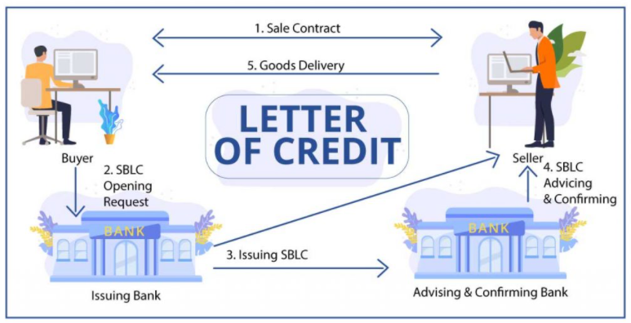

Slide 137
D/A VS D/P
Under a DA terms of payment, importer accepts documents on the basis of an assurance to effect payment by accepting necessary bill of exchange. The importer collects shipping documents required to take delivery of imported goods from his bank after such assurance on payment at mutually agreed maturity date of payment.
In a DP payment terms, the imported need to effect payment against respective import consignment, before collecting documents for delivery of imported goods. Under a payment terms – Documents against Payments, the bank delivers documents required for import clearance only after receiving the value of goods from the importer. The buyer takes delivery of goods with the original transport document of title delivered by his bank after effecting payment under sale of goods mentioned in the document. The buyer’s bank in turn, sends the said amount to seller’s bank as per banking procedures and formalities under international trade.

Slide 138
INSTITUTIONAL FRAMEWORK FOR EXIM
Foreign Trade Policy - Initiatives - Duty Drawback - Deemed Exports - ASIDE – MAI and MDA -Export Houses - EPCG Scheme - Incentives - Export Promotion Councils - Commodity Boards EXIM Bank - SEZs - FIEO - IIFT - EOUs -- ITPO – ECGC – GST & Implications

Slide 139
ASIDE (Assistance to State for Developing Export Infrastructure and Allied Activities)
ASIDE is the Assistance given by the Central Government to States through Council for Developing Export Infrastructure and other Allied Activities.
The objective of this Scheme is to involve the States in the export effort by providing assistance to the State Governments for creating appropriate infrastructure for the development and growth of exports.

Slide 140
FRAMEWORK OF IMPLEMENTATION
The scheme aims to fund activities related to infrastructure for exports. The activities must have a substantial export content and an established linkage with exports. Following are examples of purposes –
Creation of new Export Promotion Industrial Parks / Zones (EPIP) (including Special Economic Zones (SEZs)/ Agri Business Zones) and augmenting facilities in existing ones.
Developing infrastructure for export conclaves
Setting up of transportation infrastructure to connect production centers from ports, such as roads.
Setting up of Inland Container Depots and Container Freight Stations for loading cargo in containers for the ease of transportation.
Construction of minor ports and jetties to serve export purposes.
Establishing power infrastructure such as transformers for additional power supply to production centers.
Setting up Common Effluent Treatment Plants (50% cost would be paid under ASIDE while remaining 50% would be provided by the State or organization concerned)

Slide 141
AGENCIES ELIGIBLE FOR ASIDE
Public Sector Undertakings (PSU’s) of Central/ State Government
Export Promotion Councils (EPC)
Apex Trade Bodies recognized under the EXIM (Export Import) policy of India, such as ASSOCHAM, FICCI, etc.
Individual production/ service units dedicated to exports
Other Agencies of Central/State Government

Slide 142
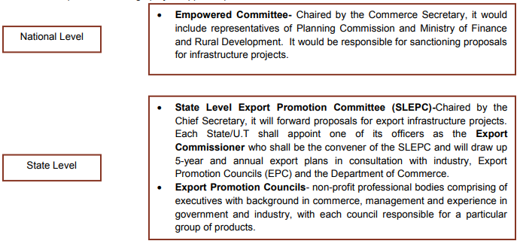
2-STAGE APPROVAL PROCESS

Slide 143
MDA
Market Development Assistance (MDA) Scheme
Export Promotion continues to be a major thrust area for the Government. In view of the prevailing macro economic situation with emphasis on exports and to facilitate various measures being undertaken to stimulate and diversify the country's export trade, Marketing Development Assistance (MDA) Scheme is under operation through the Department of Commerce to support the under mentioned activities:

Slide 144
(i) Assist exporters for export promotion activities abroad
(ii) Assist Export Promotion Councils(EPCs) to undertake export promotion activities for their product(s) and commodities ;
(iii) Assist approved organization/trade bodies in undertaking exclusive nonrecurring innovative activities connected with export promotion efforts for their members ;
(iv) Assist Focus export promotion programmes in specific regions abroad like FOCUS (LAC), Focus (Africa), Focus (CIS) and Focus (ASEAN +2) programmes ; and
(v) Residual essential activities connected with marketing promotion efforts abroad.

Slide 145
Exporting companies with an f.o.b. value of exports of upto Rs. 30 crore in the preceding year will be eligible for MDA assistance for participation in BSMs/fairs/exhibitions abroad to explore new markets for export of their specific product(s) and commodities from India in the initial phase.
This will be subject to the condition that the exporter has completed 12 months membership with concerned EPC etc. and filing of returns with concerned EPC/organisation regularly. However, this condition would not apply in case of a new EPC for a period of 5 years from the date of its creation. No such ceiling is applicable for participation in Focus LAC region.

Slide 146
Assistance would be permissible on travel expenses by air, in economy excursion class fair and/or charges of the built up furnished stall
Area/Sector | No. of Visits | Maximum Financial ceiling per event
Focus LAC | 1 | Rs.2,50,000/-
Focus Africa (including WANA countries) | 1 | Rs.2,00,000/-
Focus CIS | 1 | Rs.2,00,000/-
Focus Asean + 2 | 1 | Rs.2,00,000/-
General Areas | 1 | Rs.1,50,000/-
TOTAL | 5

Slide 147
https://www.pdexcil.org/mda/mai.html
https://pharmexcil.com/relevent-members-forms

Slide 148
MAI
Market Access Initiative (MAI) Scheme
Market Access Initiative (MAI) Scheme is an Export Promotion Scheme envisaged to act as a catalyst to promote India's exports on a sustained basis.
The scheme is formulated on focus product-focus country approach to evolve specific market and specific product through market studies/survey.
Assistance would be provided to Export Promotion Organizations/Trade Promotion Organizations/National Level Institutions/ Research Institutions/Universities/Laboratories, Exporters etc., for enhancement of exports through accessing new markets or through increasing the share in the existing markets.
Under the Scheme the level of assistance for each eligible activities has been fixed.

Slide 149
Financial Assistance under MAI
Marketing Projects Abroad Capacity Building Support for Statutory Compliances Studies Project Development Developing Foreign Trade Facilitation web Portal To support Cottage and handicrafts units

Slide 150
Eligible Agencies in MAI
Departments of Central Government and Organisation of Central/ State Governments including
Indian Missions abroad > Export Promotion Councils > Registered trade promotion Organisation > Commodity Boards > Apex Trade Bodies recognized under Foreign Trade Policy of Govt of India > Recognized Industrial & Artisan Clusters > Individual Exporters (only for statutory compliance etc.) > National Level Institutions (e.g. Indian Institutes of Technology (IITs), Indian Institutes of Management (IIMs), National Institute of design (NIDs), NIFT etc.)/ Research Institutions/Universities/ Recognized laboratories, etc.

Slide 151
ACTIVITIES FUNDED UNDER MAI
 | Opening of showrooms;
 | Opening of warehouses;
 | Display in international Dept. stores;
 | Publicity campaign and Brand promotion;
 | Participation in trade fair etc. abroad;
 | Research & Product development;
 | Reverse visits of the prominent buyers from project focus countries;
 | Export potential survey of the states;
 | Registration charges for product registration abroad for pharmaceuticals, bio- technology and agro-chemicals;
 | Testing charges for engineering products abroad;
 | Support cottage and handicrafts units;
 | Support recognised associations in industrial clusters for marketing aborad;

Slide 152
EXPORT AND TRADING HOUSES

Slide 153
Eligibility for Export and Trading Houses Status
Merchant as well as Manufacturer Exporters, Service Providers, Export Oriented Units (EOUs) and Units located in Special Economic Zones (SEZs), Agri Export Zones (AEZs), Electronic Hardware Technology Parks (EHTPs), Software Technology Parks (STPs) and Bio- Technology Parks (BTPs) shall be eligible for status.

Slide 154
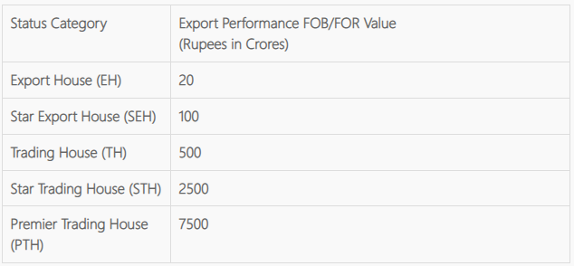
STATUS CATEGORY
Applicant shall be categorized depending on his total FOB (FOR - for deemed exports) export performance during current plus previous three years (taken together) upon exceeding limit below. For Export House (EH) Status, export performance is necessary in at least two out of four years (i.e., current plus previous three years).

Slide 155
Privileges of Export and Trading House Status Holders
i) Authorization and Customs Clearances for both imports and exports on self-declaration basis; (ii) Fixation of Input-Output norms on priority within 60 days; (iii) Exemption from compulsory negotiation of documents through banks. Remittance / Receipts, however, would be received through banking channels; (iv) 100% retention of foreign exchange in EEFC account; (v) Exemption from furnishing of BG in Schemes under FTP; (vi) SEHs and above shall be permitted to establish Export Warehouses, as per DoR guidelines. (vii) For status holders, a decision on conferring of ACP Status shall be communicated by Customs within 30 days from receipt of application with Customs. (viii)As an option, for Premier Trading House (PTH), the average level of exports under EPCG Scheme shall be the arithmetic mean of export performance in last 5 years, instead of 3 years. (ix) Status Holders of specified sectors shall be eligible for Status Holder Incentive Scrip under Para 3 .16 of FTP. (x) Status Holders of Agri. Sector (Chapter 1 to 24 ) shall be eligible for Agri. Infrastructure Incentive Scrip under VKGUY - Para 3.13.4 of FTP.

Slide 156
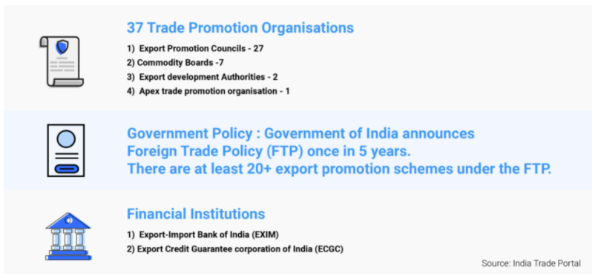
TRADE PROMOTION ECOSYSTEM IN INDIA

Slide 157
EXPORT PROMOTION COUNCIL AND COMMODITY BOARDS

Slide 158
EXPORT PROMOTON COUNCIL(EPC)
The basic objective of Export Promotion Councils is to develop and promote the exports of the nation.
Each Council is in charge of the promotion of a specific group of projects, products, and services.
The council helps in sponsoring the development of export-related industries.
They assist in diversifying the productive sector of the nation and to foster market-oriented, private sector-economy via market oriented export goods development.

Slide 159
ROLE OF EXPORT PROMOTION COUNCILS
The primary role and function of EPCs is to showcase India as the preferred destination for export of high-quality products and services. To achieve this, the EPCs represent India and its exporters in the international markets and promote the products through various means. While consolidating exports in current export destinations, EPCs are also required to help exporters in identifying new markets and expanding their export basket.
On the other hand, they also help the Government in framing effective trade policies by providing insights about the issues faced by exporters in international markets.
The EPCs are constituted as autonomous bodies with independent functioning and decision-making powers. Nevertheless, any laws and by-laws devised / modified by the Central Government from time to time, apply to all the EPCs and they are required to follow them.

Slide 160
FUNCTIONS OF EPC
Promoting exports: The primary objective of EPCs is to help exporters in promoting their products in international markets. They do this through various external and internal promotional activities including organising / participating in international trade fairs, buyer-seller meets, etc.
Assistance in Incentive schemes: Help and assist exporters in availing benefits of various incentive schemes announced in the Foreign Trade Policy. EPCs are authorized to issue RCMC certificates without which exporters cannot avail those benefits.
Expanding to new markets: Help exporters to consolidate their exports and expand into new markets / meet new buyers through EPC’s branches and offices opened in foreign countries. This is helpful more so in the case of small and medium manufacturers who may not have resources to do this on their own.
Strengthen relations: Arrange and send delegations to key foreign countries in order to strengthen or diversify exports in those countries.
Providing timely information: Provide exporters with information on latest trends, happenings, and export opportunities in international markets; changes or updates in trade policies, etc.
Liaisoning: Liaison with the trade and export communities to identify their needs, issues/problems and represent their problems to the Government.
Assist in policy making: Collect comprehensive data on exports concerning their respective product categories and provide the same to the Government to help frame effective trade policies.
Assist exporters in: (a) technology upgradation, (b) product/service quality improvement, (c) design improvement, (d) standards and specifications, (e) product development, (f) innovation

Slide 161
BENEFITS OF EPC
Ease of access to international markets: The biggest benefit for exporters is the ease of access to international markets as EPCs work towards increasing buyer-seller interactions. Small and medium businesses stand to benefit most out of this as many of them do not have the resources to approach international buyers on their own.
Aid in export incentives: Registered exporters with the EPCs benefit from the various export incentive schemes as and when announced by the government. It is mandatory for exporters to register with EPCs to avail these benefits.
Source of trade data: All EPCs collect export and import data of all its members, thus building a repository of valuable information for both the government and the exporters. This data can provide a lot of insights into diversifying and expanding the international market base.
Platform for growth: EPCs arrange foreign tours for trade delegations to help exporters reach out to new markets. Such tours present perfect opportunities to increase the buyer base and exports. It not only strengthens the trade relations, but also overall bilateral relations between the countries.

Slide 162
APPLYING TO EPC
To apply for RCMC from any of the EPCs, exporters must fill the application form that can be downloaded from respective websites of EPCs. Following documents must be submitted along with it:
A self-certified copy of the IEC Number issued by the licensing authority concerned
An Undertaking on non-judicial stamp paper duly notarized on 10/- stamp paper.
A self-attested Copy of Memorandum & Articles of Association / Partnership deed / Certificate of Registrar of firm etc. as the case may be
In case the exporter wants to be registered as Manufacturer exporter self-attested copy of SSI Certificate / Letter of Intent / Industrial License / Factory License / Employee State Insurance Certificate / Employees Provident Fund Registration Certificate.

Slide 163
APPLYING TO FIEO
To apply for FIEO membership, the exporters must download and fill the application form and submit the following documents along with it:
A self-certified copy of the IEC Number issued by the licensing authority concerned.
A Cheque / Pay Order / Demand Draft favouring Federation of Indian Export Organisations towards Annual Membership Subscription.
Letter of Authority on the letterhead of the firm duly completed and signatures attested by C.A.
Self-certified copy(ies) of the SSI Registration Certificate/Industrial Licence/IEM/others, if applicable.
A self-certified copy of One Star Export House / Two Star Export House / Three Star Export House / Four Star Export House / Five Star Export House Certificate, if applicable.
ID proof of Director(s) / Partner(s)/ Proprietor(s) (Adhaar Card/ Driving Licence/ Voter ID Card/ Passport)
GSTIN
Export Turnover country-wise /commodity-wise for the past 3 financial years. Proforma enclosed (OR) Statement of foreign exchange earnings for the past 3 financial years in case of Service Providers

Slide 164
COMMODITY BOARDS(FUNCTONS AND OBJECTIVES)
1. Advising the government on policy matters such as fixing quotas for exports, entering into trade agreements with foreign countries, etc.
2. Undertaking promotional activities such as participation in exhibition and trade fairs, opening of foreign offices abroad, conducting marketing surveys, sponsoring trade delegations, etc.
3. Promoting the consumption of commodities in their jurisdiction by opening branch offices in foreign countries.
4. Resolving all problems relating to commodities in their jurisdiction.
5. Undertaking research activities to develop production and marketing activities within the country. Commodity Boards have research units of their own. Examples include Central Coffee Research Institute, Rubber Research Institute, Coir Research Institute at Alleppy, the Central Sericulture Research Station at Berhampur, etc.
6. Imparting training to workers engaged in the production of the commodity concerned. The National Coir Training and Design Centre, Institutes of Handloom Technology at Salem and at Varanasi are the training institutes set up by their respective commodity Boards.

Slide 165
KINDS OF COMMODITY BOARDS
1. Coffee Board: The Coffee Board was established under the Coffee Act of 1942. It aims at the development of the industry and the promotion of its exports. The Coffee Board has set up a Central Coffee Research Institutes and also six coffee demonstration farms. The results of its research activities are made available to coffee growers. The Board advertises its product in foreign trade journal and mass circulation newspaper media. It also participates in trade fairs and exhibitions to promote the export of the product.
2. Tea Board: The Tea Board was established by the Government of India under the Tea Act of 1955. Development of the tea industry and the promotion of its export are the main objectives of the Tea Board. The board has set up offices in India as well as abroad. It works in collaboration with the Tea councils set up in the U.K, the USA, Germany, France, Australia, New Zealand and Canada with the cooperation of other tea producing countries. The Board also arranges for pre-shipment inspection and quality control under the Tea Control Order of 1959.

Slide 166
3. Cardamom Board: The Cardamom Board was constituted under the Cardamom Act of 1965 by the Government of India. It is the statutory body with its headquarters at Ernakulam. It has set up a foreign office at Brussels which conducts exhibitions abroad and undertakes promotional campaigns.
4. Rubber Board: The Government of India established the Rubber Board under the Rubber Act of 1947 as a statutory body. The Board advises the government on all matters related to rubber industry. Further, it undertakes control, planning, marketing and acquisition of rubber.
Rubber Board promotes the development of rubber industry in India. It is responsible for the registration of estates, issue of new planting and replanting licenses and other development schemes such as replanting subsidy. It has set up a Rubber Research Institute with well equipped laboratories. Its publications are very useful for the rubber industry.

Slide 167
5. Coir Board: The Coir Board was incorporated under the Coir Industry Act. It aims at the development of the coir industries. It has a coir research institute at Alleply and National coir Training and Design centre. The Coir Board conducts research surveys. encourages formation of new industry. It undertakes publicity in India and abroad through mass media and exhibitions.
6. Central Silk Board: The central silk board was set up in 1949 under the Central Silk Board Act. Its headquarters are located at Mumbai. It also runs the central sericulture research stations at Berhampur, Kalimpong, Mysore and Ranchi. The board performs the following functions:
Developing sericulture industry
Implementing annual plans and attaining production and export targets.
Organizing research, training, seed production, and export promotion.
Import and export of raw silk fabrics.

Slide 168
7. The All India Handicrafts Board: The All India Handicraft Board has its headquarters in Delhi. Its activities include the following:
The running of four design centres at Mumbai, Kolkata, Bangalore and New Delhi and one development centre at Bangalore.
Assisting the state government in planning and executing development schemes.
Development and evaluation of new designs which are commercially viable and production of proto-type.
Export promotion measures like participation in trade fairs and exhibitions, production of films, brochures, catalogues and other promotional aids.
8. The All India Handloom Board: The All India Handloom Board promotes the development of handlooms as cottage industry. Two institutes of Handloom Technology are located at Salem and Varanasi. They also offer 3 year diploma courses.
Seven weaver centres are located in Bombay, Indore, Varanasi, Calcutta, Mangalari, Bangalore and Madras. These centres conduct research to evolve attractive designs for domestic as well as foreign markets. They provide technical assistance in printing, dyeing and weaving. They also provide financial assistance and helps the industry by organizing depots abroad. They arrange pre-shipment quality control inspection.

Slide 169
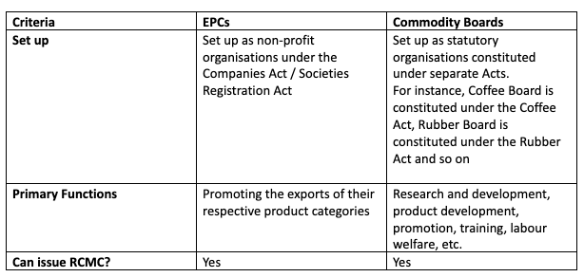
DIFFERENCE BETWEEN EPC AND COMMODITY BOARD

Slide 170
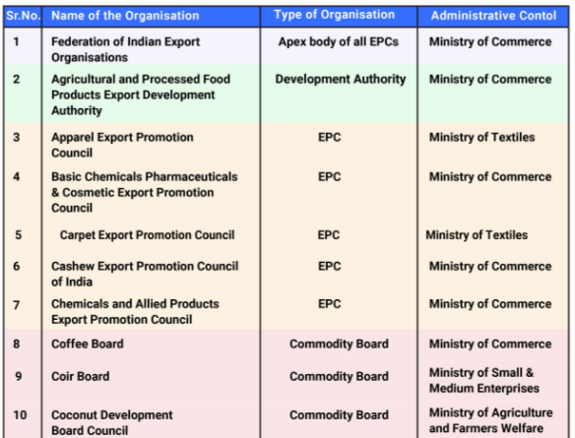

Slide 171
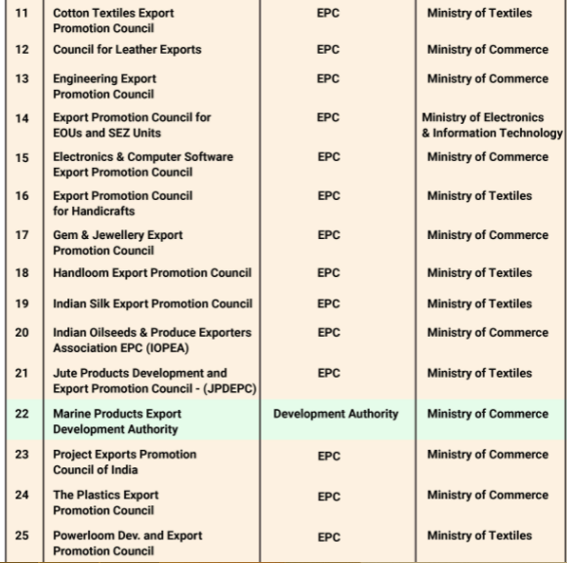

Slide 172
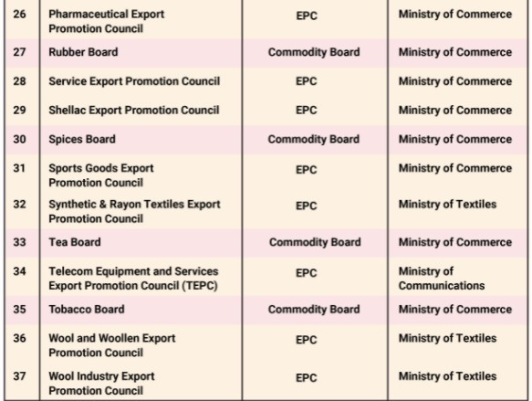

Slide 173
EPCG SCHEME
EPCG (Export Promotion Capital Goods) Scheme helps in facilitating the import of capital goods for manufacturing quality goods and to augment the competitiveness of India’s export.
EPCG scheme enables the import of capital goods that are used in the pre-production, production, and post-production without the payment of customs duty.

Slide 174
This is a Scheme that enables an importer (being an export-oriented business) to import capital goods at zero rates of customs duty. However, the scheme is subject to an export value equivalent to 6 times of duty saved on the importation of such capital goods within 6 years from the date of issuance of the authorization.
In simple words, there is a compulsion on the business to bring in foreign currency which is equal to 600 per cent of duty saved on such importation measured in domestic currency. This is to be done within six years from availing of the Export Promotion Capital Goods Scheme.
The capital goods allowed under Export Promotion Capital Goods Scheme shall include spares (including reconditioned/ refurbished), fixtures, jigs, tool, moulds and dies.

Slide 175
BENEFITS OF EPCG SCHEME
EPCG is intended for promoting exports and the Indian Government with the help of this scheme offers incentives and financial support to the exporters.
Heavy exporters could benefit from this provision. However, it is not advisable to go ahead with this scheme for those who don’t expect to manufacture in quantity or expect to sell the produce entirely within the country, as it could become almost impossible to fulfil the obligations set under this scheme.

Slide 176
DOCUMENTS REQUIRED FOR EPCG LICENSE
Import Export Code (IEC)
Registration cum Membership Certificate (RCMC)
Digital signature
Registration certificate from Tourism Department
Pan Card
Excise Registration (if registered)
GST Registration Certificate
Proforma Invoice
Brochure
Self-Certified Copy + Original of Certificate of Chartered Accountant
Self-Certified Copy + Original of Certificate of Chartered Engineer

Slide 177
FIEO
Federation of Indian Export Organisations, popularly known as FIEO, was set up in 1965 as an Apex Body of Export Promotion Organisations in the country. FIEO is registered under the Societies Registration Act, 1860 with its Headquarters in Delhi, Regional Offices in Delhi, Mumbai, Chennai and Kolkata, and Chapters in Jaipur, Kanpur, Ludhiana, Ahmedabad, Indore, Hyderabad, Kochi, Bangalore, Coimbatore, Bhubaneswar, Ranchi and Guwahati. The organization is ISO 9001:2015 certified and ensures uniform and quality service to its members and associates.
FIEO has a direct membership of over 30,000. In terms of the Foreign Trade Policy, FIEO has been designated as Registering Authority for status holder exporting firms and other exporters dealing in multi-products. It also issues Certificate of Origin (Non-Preferential) which is required by many countries as proof of origin of the goods. It directly and indirectly serves the interests of over 200,000 exporters from every goods and services sector in the country.
FIEO provides the crucial interface between international trading community of India and the Central and State Governments, financial institutions, ports, railways, surface transport and all engaged in export trade facilitation. It serves on the high level committees constituted by the Government of India to facilitate trade. It provides vital inputs to the Government on various matters of trade.

Slide 178
FIEO organises workshops, seminars, training programmes, open house meets with the highest authorities to draw the attention of the Government on important trade issues and help speedy resolution. It facilitates redressal of exporters’ problems by taking them up with the authorities concerned and guides them on policy matters, international trade etc.
FIEO has entered into approximately 100 Memorandum of Understanding (MoU) with international organisations, chambers of commerce and trade associations to promote international trade. It organizes many country specific programmes to prepare the exporters for various global markets. It exchanges business delegations, arranges exhibitions, organizes B2B meets with the members of trade from various countries. FIEO is the India partner of the Enterprise Europe Network and assists MSMEs in internationalization.
FIEO has developed and maintains the Indian Trade Portal – www.indiantradeportal.in, on behalf of the Department of Commerce, Govt. of India. The Portal provides information on India’s export and import policies, export benefits, Most Favoured Nation (MFN)/ preferential tariff, rules of origin, Sanitary and Phytosanitary Standards (SPS) / Technical Barriers to Trade (TBT) measures of 87 markets etc. at tariff line.

Slide 179
IIFT
The Indian Institute of Foreign Trade (IIFT) was established in 1963 as an autonomous body under the Ministry of Commerce & Industry to contribute in the skill building for the external trade sector of India. The Institute was granted “Deemed to be University” status in 2002. The National Assessment and Accreditation Council (NAAC) has recognized IIFT as Grade ‘A’ Institution in 2005 as well as in 2015.
MBA (International Business), flagship programme of IIFT, is a six-trimester general management residential programme with a focus on International Business. IIFT has campuses at Delhi, Kolkata and Kakinada.

Slide 180
ITPO
India Trade Promotion Organisation (ITPO) is the premier trade promotion agency of India, provides a broad spectrum of services to trade and industry and acts as a catalyst for growth of India’s trade. The main Corporate objectives of ITPO are:
To promote external and domestic trade of India in cost effective manner by organizing and participating in international trade fairs in India and abroad; organizing buyer-seller meets and contact promotion programmes abroad; conducting overseas market surveys, exchanging and coordinating visits of business delegations, and undertake need based research to facilitate trade in specific sectors/markets;
To support and assist small and medium enterprises to access markets both in India and abroad;
To disseminate trade information and facilitate E-commerce/trade;
To develop quality physical infrastructure, services and management so as to enable holding of trade promotion events such as conventions and trade exhibitions of international standard; and
To enlist the involvement and support of the State Governments, other government trade promotion agencies, trade and industry associations in trade promotion of India’s external and domestic trade.

Slide 181
SEZs
Area of operations / Setting Up: Can be set up only at designated sites notified as SEZ
Authority / approval for setting up: Approval required under the SEZ laws; to be granted by the Development Commissioner of the concerned SEZ
Imports: All imports are exempt from payment of all types of customs duties (BCD, SWS, IGST, Cess, etc)
Income Tax benefit: Withdrawn (deductions available to units’ setup prior to July 2020)
Existing SEIS Benefit: Available
Duty Drawback benefit: Not available
Export on payment of IGST: Have the option to pay applicable IGST and later claim refund of the same
Applicable Indirect Tax laws: SEZ Act, Customs Act and GST Act

Slide 182
Benefits of EOUs
They can procure raw materials and capital goods through domestic sources or import without paying any duty on the purchase
They can claim reimbursement on GST amounts they pay
In case they have paid duty on the purchase of fuel from domestic oil companies, they can claim a refund on the same
EOUs are allowed to claim an input tax credit on goods and services
EOUs enjoy priority-basis clearance facilities
EOUs are not required to obtain the industrial licensing which is required for manufacturing items that are reserved for the SSI sector

Slide 183
EOUs
Area of operations / Setting Up: Can be set up anywhere in India
Authority / approval for setting up: Approval required under the FTP; to be granted by the jurisdictional Development Commissioner
Imports: All imports are exempt from payment of all types of customs duties (BCD, SWS, IGST, Cess, etc)
Income Tax benefit: Withdrawn (deductions available to units’ setup prior to April 2012)
Existing SEIS Benefit: Not Available
Duty Drawback benefit: Not available
Export on payment of IGST: Do not have the option to pay applicable IGST and later claim refund of the same. Mandatory to supply the same without payment of applicable GST under LUT
Applicable Indirect Tax laws: FTP & HBP, Customs Act and GST Act

Slide 184
ECGC(EXPORT CREDIT GUARANTEE CORPORATION OF INDIA)
To encourage and facilitate globalisation of India's trade.
To assist Indian exporters in managing their credit risks by providing timely information on worthiness of the buyers, banks and the countries.
To protect the Indian exporters against unforeseen losses, which may arise due to failure of the buyer, bank or problems faced by the country of the buyer by providing cost effective credit insurance covers in the form of Policy, Factoring and Investment Insurance services comparable to similar covers available to exporters in other countries.
To facilitate availability of adequate bank finance to the Indian exporters by providing export credit insurance to banks at competitive rates.
To achieve improved performance in terms of profitability, financial and operational efficiency indicators and achieve optimum return on investment.
To develop world class expertise in credit insurance among employees and ensure continuous innovation and achieve highest customer satisfaction by delivering top quality service
To educate the customer by continuous publicity and effective marketing

