Slide 1
MANAGEMENT INFORMATION SYSTEM
Dr.S.Saravanan

Slide 2
UNIT 1

Slide 3
INFORMATON SYSTEM
Functional perspective; an information system is a technologically implemented medium for the purpose of recording, storing, and disseminating linguistic expressions as well as for the supporting of inference making
Structural perspective; an information system consists of a collection of people, processes, data, models, technology and partly formalized language, forming a cohesive structure which serves some organizational purpose or function

Slide 4
Technically as a set of interrelated components that collect (or retrieve), process, store, and distribute information to support decision making and control in an organization

Slide 5
FUNCTIONS OF INFORMATION SYSTEM

Slide 6
COMPONENTS OF A INFORMATION SYSTEM
1. Resources of people: (end users and IS specialists, system analyst, programmers, data administrators etc.).
2. Hardware: (Physical computer equipments and associate device, machines and media).
3. Software: (programs and procedures).
4. Data: (data and knowledge bases), and
5. Networks: (communications media and network support).

Slide 7
BUSINESS INTELLIGENCE

Slide 8
Business intelligence refers to the technology that enables businesses to
organize,
analyze and
contextualize business data from around the company.
BI includes multiple tools and techniques to transform raw data into meaningful and actionable information

Slide 9
PARTS OF BI SYSTEM
Data warehouse stores company information from a variety of sources in a centralized and accessible location.
Business analytics or data management tools mine and analyze data in the data warehouse.
Business performance management (BPM) tools monitor and analyze progress towards business goals.
A user interface (usually an interactive dashboard with data visualization reporting tools) provides quick access the information.

Slide 10
WHERE BI IS USED?
Data scientists and analysts:
Analysts are BI power users, and they use centralized company data paired with powerful analytics tools to understand where opportunities for improvement exist and what strategic recommendations to propose to company leadership.
Finance:
By blending financial data with operations, marketing and sales data, users can pull insights from which decisions can be acted upon and understand factors that impact profit and loss.

Slide 11
Marketing:
Business intelligence tools help marketers track campaign metrics from a central digital space. BI systems can provide real-time campaign tracking, measure each effort’s performance and plan for future campaigns. This data gives marketing teams more visibility into overall performance and provides contextual visuals for sharing with the company.
Sales:
Sales data analysts and operation managers often use BI dashboards and key performance indicators (KPIs) for quick access to complex information like discount analysis, customer profitability and customer lifetime value. Sales managers monitor revenue targets, sales rep performance along with the status of the sales pipeline using dashboards with reports and data visualizations.
Operations:
To save time and resources, managers can access and analyze data like supply chain metrics to find ways to optimize processes. Business intelligence can also ensure that service level agreements are met and help improve distribution routes.

Slide 12
BENEFITS OF BI
Analysis and Insights | BI processes vast amounts of data to forecast, budget, plan, and stay current. Competitive analysis helps companies understand the competition and benchmark competitor performance. This business intelligence enables product and service differentiation.
Decision-Making Support | Companies gain a competitive edge when they can leverage the existing data at the right time to make accurate decisions faster.

Slide 13
Efficiency and Productivity | A 360-degree view of all activities helps companies identify issues, improve operations, increase sales, and in turn, increase revenue.
Customer Satisfaction | BI can help you identify what services or products you're lacking and improve customer satisfaction by making necessary changes. Reports help you understand customer behavior, develop user personas, and use real-time data on the customer's feedback to make corrective changes and improve customer service and, therefore, satisfaction.

Slide 14
Employee Satisfaction | Using BI data, you can assess team members' strengths and weaknesses and assign relevant training modules to support success. BI tools can automatically recognize positive behavior while regularly tracking worker contributions and improvement.
Savings | BI insight into the corporation's raw data will help decision-makers analyze cost-saving opportunities like excess inventory, human resource redundancies, marketing overages, too many vendors or waste in facilities management.
Savings and Profitability | BI tools can analyze any discrepancies, inefficiencies, or errors. BI helps to increase profit margins by providing insights that lead to future sales and guide where to spend future budgets.

Slide 15
INFORMATION SYSTEM
Classification

Slide 16
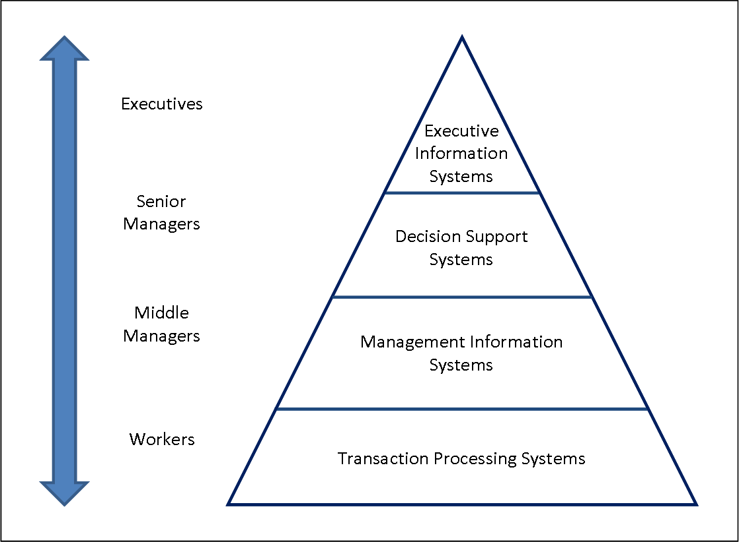

Slide 17
Transaction Processing Systems
Inputs : Transactions Events
Processing:
Validation Sorting Listing Merging Updating Calculation
Output:
Lists Detail reports Action reports Summary reports?

Slide 18
Transaction processing: Examples
Payroll systems
Order processing systems
Reservation systems
Stock control systems
Systems for payments and funds transfers
The role of TPS
Produce information for other systems
Cross boundaries (internal and external)
Used by operational personnel + supervisory levels
Efficiency oriented

Slide 19
Management Information System
INPUT | PROCESSING | OUTPUT
Internal transactions | Sorting | Summary reports
Internal files | Merging | Action report
Structured data | Summarizing | Detailed reports

Slide 20
Some examples of MIS
Sales management systems
Inventory control systems
Budgeting systems
Management Reporting Systems (MRS)
Personnel (HRM) systems
The role of MIS
Based on internal information flows
Support relatively structured decisions
Inflexible and have little analytical capacity
Used by lower and middle managerial levels
Deals with the past and present rather than the future
Efficiency oriented?

Slide 21
DECISION SUPPORT SYSTEM
INPUT | PROCESSING | OUTPUT
Internal transactions | Modeling | Summary reports
Internal files | Simulation | Forecasts
External Information? | Analysis | Graphs/Plots
 | Summarizing

Slide 22
Some examples of DSS
Group Decision Support Systems (GDSS)
Computer Supported Co-operative work (CSCW)
Logistics systems
Financial Planning systems
Spreadsheet Models?
The role of DSS
Support ill- structured or semi-structured decisions
Have analytical and/or modelling capacity
Used by more senior managerial levels
Are concerned with predicting the future
Are effectiveness oriented?

Slide 23
Executive Information System
INPUT | PROCESSING | OUTPUT
External data | Summarizing | Summary reports
Internal files | Simulation | Forecasts
Predefined models | Drilling down | Graphs/plots

Slide 24
Some examples of EIS
Executive Information Systems tend to be highly individualized and are often custom made for a particular client group; however, a number of off-the-shelf EIS packages do exist and many enterprise level systems offer a customizable EIS module.
The role of EIS
Are concerned with ease of use
Are concerned with predicting the future
Are effectiveness oriented
Are highly flexible
Support unstructured decisions
Use internal and external data sources
Used only at the most senior management levels

Slide 26
PERSONAL DIMENSIONS OF INFORMATION

Slide 28
TIME DIMENSION
TIMELINESS
CURRENT CIRCUMSTANCES
FREQUENCY

Slide 29
LOCATION DIMENSION
ACCURACY
RELEVANCE
SCOPE
COMPLETENESS
CONCISENESS

Slide 30
FORM DIMENSION
CLARITY
DETAIL
ORDER
PRESENTATION
MEDIA

Slide 32
ORGANIZATIONAL DIMENSIONS OF INFORMATION
The Organizational Dimensions of Information includes information flows, information granularity, and what information describes

Slide 33
Information flows
Information in an organization flows in four directions: up, down, horizontally, and inward/outward
From top to bottom, the levels are:
Strategic management, which provides an organization with overall direction and guidance.
Tactical management, which develops the goals and strategies outlined by strategic management.
Operational management, which manages and directs the day-to-day operations and implementations of the goals and strategies.
Non-management employees, who actually perform daily activities, such as order processing, developing and producing goods and services, and serving customers.

Slide 34
The downward flow of information consists of the strategies, goals, and directives that originate at one level and are passed to lower levels. Many organizations are taking advantage of collaborative technologies and systems to share and move this type of information.
Information that flows horizontally, or the horizontal flow of information, is between functional business units and work teams

Slide 35
Outward and inward flows of information consist of information that is communicated to customers, suppliers, distributors, and other partners for the purpose of doing business

Slide 37
Information Granularity
Information granularity refers to the extent of detail within the information.
On one end of this spectrum is coarse granularity, or highly summarized information.
At the other end is fine granularity, or information that contains a great amount of detail.
Peoples in the highest levels of the organization deal mainly with a coarse granularity of information, with sales by year being an example.
People in the lowest levels of the organization, on the other hand, need information with fine granularity. If you consider sales again, non-management employees need information in great detail that describes each transaction when it occurred, whether by credit or cash… "Who made the sale, to whom that sale was made", and so on

Slide 38
What the Information describes?
Internal information describes specific operational aspects of an organization
External information describes the environment surrounding the organization
Objective information quantifiably describes something that is known
Subjective information attempts to describe something that is unknown

Slide 39
IT as a key resource in Business

Slide 40
Nessasity of IT
Over the years, technology has caused an explosion in commerce and trade.
Because of technology, many traditional business models and concepts were revolutionized.
Technology gave us the opportunity to see things from a new perspective, and to approach what we were already doing from a new perspective.
Technology also gave us greater efficiency for conducting business.

Slide 41
Technology as a Source of Support and Security
Technology enables us to automate numerous processes, which thereby increases our productivity. This is possible because it enables us to use fewer resources, thereby enabling us to improve on quality at a low cost and to improve the speed with which we can deliver to customers. In the process, it has become possible to serve even more clients.
Technology also makes it easy to store more information while maintaining the integrity of that information. We are better able to store sensitive and confidential information in a way that makes it less vulnerable to a data breach. The information can be retrieved instantly when needed, and it can be analyzed not only to study past trends but also to forecast the future. In turn, this can help with the decision-making process.

Slide 42
Technology as a Link to the World
Communication is a part of business. So, transportation and processes make business a web of complicated processes that interplay with each other.
With technology, it has been possible to globalize business operations. Now, just about anyone can do business practically anywhere, from any room in their house..
Technology has made it possible for businesses to have a wider reach in the world. The best example of this is the internet and the World Wide Web. The internet is now a crucial part of any businesses’ marketing campaign, as it enables the business to attract customers world wide.

Slide 43
Technology, when well-integrated with business, has made life itself worth living.
It would be foolish to deny, however, that there are also threats to business brought about by technology. These include malicious activities by activities and organizations, such as hacking. Because of this, it is important for businesses to exercise responsibility when using technology to conduct business.
With the good that technology brings, there is some bad that must also be dealt with. All the same, it is something that's worth all of the baggage, and we must acknowledge and responsibly utilize it to make our businesses better.

Slide 44
The Advent of Mobile Solutions
Mobility is seen by many as the next great frontier for businesses. Google’s algorithms reflect this, as they make mobile websites a priority.
Your business, and every aspect of it can be handled, using nothing more than a tablet or smartphone. From content marketing to customer relations, to sales, the back-end stuff like invoicing and shipping , all of that power is in your hands.
But mobile solutions aren’t just about businesses; they are also about consumers. The millennial generation uses their phones to do everything from buying and selling to sharing their experiences with their friends and finding local businesses.

Slide 45
The Phenomenon of Cloud Computing
Increased Customer Segmentation
Increased Connectivity
Decreasing Costs and Increasing Utility
A Changing Consumer Base

Slide 46
PORTER’S FIVE FORCE MODEL
Traditional competitors: Existing firms that share a firm's market space
New market entrants: New companies have certain advantages, such as not being locked into old equipment and high motivation, as well as disadvantages, such as less expertise and little brand recognition. Some industries have lower barriers to entry, ie: cost less for a new company to enter the field.
Substitute products and services: These are substitutes that your customers might use if your prices become too high. For example, Internet telephone service can substitute for traditional telephone service. The more substitute products and services in your industry, the less you can control pricing and raise your profit margins.
Customers: The power of customers grows if they can easily switch to a competitor's products and services, or if they can force a business and its competitors to compete on price alone in a transparent marketplace where there is little product differentiation and all prices are known instantly (such as on the Internet).
Suppliers: The more different suppliers a firm has, the greater control it can exercise over suppliers in terms of price, quality, and delivery schedules.

Slide 48
Generic strategies used to manage competitive forces
Low-cost leadership: Use information systems to achieve the lowest operational costs and the lowest prices. For example, a supply chain management system can incorporate an efficient customer response system to directly link consumer behavior to distribution and production and supply chains, helping lower inventory and distribution costs.
Product differentiation: Use information systems to enable new products and services, or greatly change the customer convenience in using your existing products and services. For instance, Land's End uses mass customization, offering individually tailored products or services using the same production resources as mass production, to custom-tailor clothing to individual customer specifications.

Slide 49
Focus on market niche: Use information systems to enable a specific market focus and serve this narrow target market better than competitors. Information systems support this strategy by producing and analyzing data for finely tuned sales and marketing techniques. Hilton Hotels uses a customer information system with detailed data about active guests to provide tailored services and reward profitable customers with extra privileges and attention. Strengthen customer and supplier intimacy: Use information systems to tighten linkages with suppliers and develop intimacy with customers. Chrysler Corporation uses information systems to facilitate direct access from suppliers to production schedules, and even permits suppliers to decide how and when to ship suppliers to Chrysler factories. This allows suppliers more lead time in producing goods. Strong linkages to customers and suppliers increase switching costs (the cost of switching from one product to a competing product) and loyalty to your firm.

Slide 50
The Internet has nearly destroyed some industries and has severely threatened more.
The Internet has also created entirely new markets and formed the basis for thousands of new businesses.
Because of the Internet, the traditional competitive forces are still at work, but competitive rivalry has become much more intense.
Internet technology is based on universal standards, making it easy for rivals to compete on price alone and for new competitors to enter the market.
Because information is available to everyone, the Internet raises the bargaining power of customers, who can quickly find the lowest-cost provider on the Web.
Some industries, such as the travel industry and the financial services industry, have been more impacted than others.
However, the Internet also creates new opportunities for building brands and building very large and loyal customer bases, such as Yahoo!, eBay, and Google.

Slide 51
VALUE CHAIN MODEL
The value chain model highlights specific activities in the business where competitive strategies can best be applied and where information systems are most likely to have a strategic impact. The value chain model views the firm as a series or chain of basic activities that add a margin of value to a firm's products or services. These activities can be categorized as either primary activities or support activities.
Primary activities are most directly related to the production and distribution of the firm's products and services, which create value for the customer. Primary activities include inbound logistics, operations, outbound logistics, sales and marketing, and service.
Support activities make the delivery of the primary activities possible and consist of organization infrastructure (administration and management), human resources (employee recruiting, hiring, and training), technology (improving products and the production process), and procurement (purchasing input).

Slide 53
A value web is a collection of independent firms that use information technology to coordinate their value chains to produce a product or service for a market collectively. It is more customer-driven and operates in a less linear fashion than the traditional value chain.

Slide 54
UNIT II

Slide 55
COMMUNICATION SOFTWARE
If you are sending a message or file to another person using an application with Skype or Gmail, then you’re already using a communications software.
This technology, as its name implies, refers to a set of applications or systems you can use to communicate with other people in real-time. These apps are capable of transmitting information to each other.

Slide 56
What does communication software do?
Communication software handles the day-to-day exchange of messages among stakeholders, either internally or externally.
Aside from that, this type of solution is also used when a remote meeting or discussion must be had, in real-time.
Among the most common systems in this category are live chat platforms, messaging applications, email, VoIP, and FTPs.
A lot of communication solutions are standalone and have features focused on streamlining the communication aspect of businesses, including conversations, feedback, and updates.

Slide 57
FEATURES OF COMMUNICATION SOFTWARE
Auto Receptionist
Some communication software can handle calls by themselves without any human intervention. They act as the front-desk receptionist that facilitates a business’s guest. They can also forward the call to the most suitable agent available, depending on the needs or preferences of the customer.
Voicemail and Greetings
It allows you to record a message that will automatically play when someone calls you, and you’re not available. Other tools provide many custom greetings you can use for the same purpose.
Video Conferencing
This feature lets you conduct group video calls. It is especially helpful to teams with members who are located miles apart from each other. You can hold virtual meetings instead of letting everyone travel and gather in one place.

Slide 58
Audio Conferencing
With this feature, you can call and talk with not just one person. It allows many people to chat simultaneously with each other.
Call Recording
Various communication platforms carry the capability to record conversations, be it audio or video. This is helpful since the recorded call is useful in various ways. For instance, you can use it as future reference or as evidence that will help resolve disputes and issues. It’s also ideal for training purposes or as a recap material for previous meeting sessions

Slide 59
TYPES OF COMMUNICATION SOFTWARE
1. Live Chat
Commonly installed on websites, this type of software allows businesses to give more personalized customer support to their current and potential clients. It’s also the most accessible among the communication software family as it’s usually embedded on business websites, and anyone who visits them will be greeted by either a bot or a live agent through the chat.
Live chat is also a good analytics tool as it provides you with reports regarding the browsing behavior of your visitors. This, in turn, can be used to create customized support and chat experiences for customers. The information gathered can also be used for making and managing advertising campaigns as well.
Examples: RumbleTalk, HelpOnClick Live Chat Software

Slide 60
2. Web Conferencing and Video Software
Perfect for remote settings, this type of solution allows you to conduct meetings, conferences, webinars, etc. in case the involved personnel is unable to meet you physically. It’s also available on various devices like desktops, laptops, tablets, smartphones, and others. Advanced capabilities, like screen-sharing and live document transfer, are supported as well.
Examples: GoToMeeting, Speek, GoToWebinar
3. Unified Communications Software and Call Center Software
This type of product is ideal for call center use. It’s also the best communication software for companies with a large number of telephone lines. Moreover, this type of solution is the most comprehensive with advanced features that support Voice over Internet Protocol (VoIP) and Private Branch Exchange (PBX).
Examples: Five9, Phone.com, RingCentral

Slide 61
DATA OWNERSHIP

Slide 62
What Does Data Ownership Mean?
Data ownership is the act of having legal rights and complete control over a single piece or set of data elements.
It defines and provides information about the rightful owner of data assets and the acquisition, use and distribution policy implemented by the data owner.

Slide 63
Information risks to manage
Inappropriate access to, or disclosure of, protectively marked or personal data by staff, contractors, volunteers and the public, whether accidental or deliberate
Internal threat - staff, acting in error or deliberately, or external parties accessing your information illegally and exposing it/acting maliciously to defraud you or your customers
Information loss - particularly during transfer or movement of information, or as a result of business change (government or internal restructure)

Slide 64
Loss of access to information
Loss of digital continuity - i.e. losing the ability to use your information in the way required when needed. By use we mean being able to find, open, work with, understand and trust your information. The lifecycle of a piece of information - how long you need to use and keep it - is often different to the lifecycle of the IT system used to access and support it.
Poor quality of information and poor quality assurance, for example, of data sets.
Poor change management - business needs change, systems change, your information risk appetite may change, so you need to keep your policies and processes in step accordingly.

Slide 65
CLEAN AND DIRTY DATA

Slide 66
DIRTY DATA
Dirty data refers to data that is inaccurate, incomplete, inconsistent ,outdated or duplicate data in a database.
Dirty data severely hurts your bottom line, wastes a lot of marketing dollars and time

Slide 67
DUPLICATE DATA
Duplicate data are records or entries that negligently share data with another record in your database. The most common form of duplicate data is a complete carbon copy of another record. These are considered to be the worst kind of data pollution. The most typical duplicated objects are contacts, leads, and accounts.
Duplicate data in your CRM can lead to:
Decreased ROI on CRM and marketing automation systems
Poor customer service
Biases in metrics and analytics
Poor targeting and wasted marketing effort
Inaccurate reporting and less informed decisions

Slide 68
OUTDATED DATA
Imagine you found a report which fits your project, only to later discover that the report is outdated. So, Outdated data is basically information that is incorrect, incomplete, or simply no longer in use.
Common ways how outdated data is accumulated:
Unwanted duplicate copies of emails
Individuals who have changed roles or companies
Old server session cookies
Web content that is no longer accurate
When organizations rebrand or get acquired
Software and systems when evolving from their previous iterations

Slide 69
INCOMPLETE DATA
Incomplete data is the most common occurring dirty data.
A record that lacks key fields on master data records such as industry type, title or last names, etc. which are useful for business.
For example, if you failed to classify your customers by industry, you cannot target your sales and marketing initiatives by industry.
Imagine trying to sell geolocation software to a prospect who is located at “N/A”.

Slide 70
INACCURATE/INCORRECT DATA
Collecting information about your customers helps in better understanding them and making informed decisions to satisfy them. This can be only possible if data is collected properly, completely, and accurately and can also lead to costly blunders.
Incorrect data: It occurs when the field values are generated outside of the valid range of values. For example, when filling a month field the range should encompass ranges from 1 to 12, or a house or office address should be a valid address.
Inaccurate data: There are many instances where the data on a field is correct but inaccurate considering the business context. Inaccurate data can lead to costly interruptions. For example, errors in a customer’s address can lead to the delivery of the product at the wrong location even though the address on which it was delivered is correct.

Slide 71
INCONSISTENT DATA
Inconsistent data are also known as data redundancy is when the same field value is stored in different places, which leads to inconsistency. For example, companies have customer information on multiple systems, and data is not kept in sync.
The problem with inconsistent data can be explained, for example, if you want to target all “Vice President” for an upcoming email marketing campaign. Since ‘V.P’ ‘v.p’ ‘VP’ & ‘Vice Pres’ all mean the same thing, however, these would only be included in the campaign if all these variations are included in the campaign list.
Inconsistent data hinders analytics and makes segmentation difficult when you have to consider all variables of the same title, industry, etc.

Slide 72
Where does dirty data originate?
Dirty data mainly comes from two places, systems, and people.
Data becomes dirty in a system when errors and mistakes occur during setup, maintenance, integrations, and duplicated fields.
Data becomes dirty in a database when people don’t understand, make mistakes when manually entering data, become lazy, are lacking time, or do not have a good system for entering data.

Slide 73
WHAT IS CLEAN DATA?
Clean data is data that is complete, meaning there are no missing data fields for a particular record in the database.
Cleaning data increases efficiency, cuts costs, reduces risk and makes the most out of your information.
Clean data is unique, timely, valid, accurate, and consistent. When there are no duplications in your data, your data is easily accessible when needed, the right information is in the right place, the data is correct, and the data is consistent when located in multiple locations your data can be classified as clean

Slide 74
What is data cleaning?
Data cleaning is the process of fixing or removing incorrect, corrupted, incorrectly formatted, duplicate, or incomplete data within a dataset.
When combining multiple data sources, there are many opportunities for data to be duplicated or mislabeled. If data is incorrect, outcomes and algorithms are unreliable, even though they may look correct.

Slide 75
What is the difference between data cleaning and data transformation?
Data cleaning is the process that removes data that does not belong in your dataset.
Data transformation is the process of converting data from one format or structure into another. Transformation processes can also be referred to as data wrangling, or data munging, transforming and mapping data from one "raw" data form into another format for warehousing and analyzing.

Slide 76
How to clean your data?
Remove duplicate or irrelevant observations
Fix structural errors
Filter unwanted outliers
Handle missing data
Validate

Slide 77
WEBSITES
Money Control: Money Control is a website where you can read the latest business, financial news, Get Live Stock prices, get the financial statements of any listed company, and much more.
With their application, you can manage your finance with the online Investment Portfolio. It is one of the most trusted financial websites on the internet.

Slide 78
Investopedia is one of the world’s leading sources of financial content on the web, which includes information about market news, retirement plans, investing, comparison of financial products, and much more.
It is not limited to financial content, you can also find information related to marketing concepts. Most of the time your marketing queries are answered by Investopedia.
The most important thing is that they have a detailed explanation of the concepts.

Slide 79
Statista is an online portal where you can find statistics, consumer survey results, public opinion, data related to industrial sectors.
It is one of the trusted websites for secondary data, as the data is collected and interpreted by the top experts in the industry.
You can find data related to more than 80,000 topics collected from over 22,500 sources.

Slide 80
Google Scholar is a freely accessible web search engine that provides a simple way to search for scholarly literature.
You can find research papers, articles, journals, books, conference papers, abstracts, patents from different scholars all over the world.
It is a wonderful resource that might be helpful while doing research or projects.

Slide 81
Spinbot is a free, automatic tool that rewrite’s the given text using different words but gives the same meaning and saves a lot of time. The best thing is you need not sign-up.
This tool will help you to reduce plagiarism by changing the words.

Slide 82
SEARCH ENGINES
Google
Microsoft Bing
Yahoo
Baidu
Yandex
DuckDuckGo
Ask.com
Ecosia
Aol.com
Internet Archive

Slide 83
WEB 2.0
Web 2.0, term devised to differentiate the post-dotcom bubble World Wide Web with its emphasis on social networking, content generated by users, and cloud computing
For example, when there were few television networks, none could afford to run programs that appealed to a limited audience, which led to the characteristic phenomena of programming aimed at the lowest common denominator. With the proliferation of satellite and cable networks, however, mass marketing began to splinter into highly refined submarkets that cater better to individual tastes.

Slide 84
Traditional brick-and-mortar bookstores could afford to stock and display only a limited range of titles, Internet bookstores such as Amazon discovered that total sales of niche titles actually exceed those of mass-market best sellers. The vast quantity of niche books makes up for the greater sales of a few popular titles—makes up, that is, in the new digital environment of e-commerce, where counter space is no longer limited.

Slide 85
Amazon.com was also a leader in adopting user-created content. One of the appeals to shopping at Amazon’s site was the inclusion of amateur book reviews, with users being able to leave personal perspectives and interact with other reviewers. An even more successful business example of user-created content came from electronic games. Many companies found that, by including simple programming tools with their games, ordinary gamers could create modifications, or mods, and new scenarios that generate as much or more interest as the original game and thereby extend its lifetime sales.

Slide 86
RELATIONAL DATABASE
A relational database is a type of database that stores and provides access to data points that are related to one another.
Relational databases are based on the relational model, an intuitive, straightforward way of representing data in tables. In a relational database, each row in the table is a record with a unique ID called the key. The columns of the table hold attributes of the data, and each record usually has a value for each attribute, making it easy to establish the relationships among data points

Slide 87
Here’s a simple example of two tables a small business might use to process orders for its products. The first table is a customer info table, so each record includes a customer’s name, address, shipping and billing information, phone number, and other contact information. Each bit of information (each attribute) is in its own column, and the database assigns a unique ID (a key) to each row. In the second table—a customer order table—each record includes the ID of the customer that placed the order, the product ordered, the quantity, the selected size and color, and so on—but not the customer’s name or contact information.
These two tables have only one thing in common: the ID column (the key). But because of that common column, the relational database can create a relationship between the two tables. Then, when the company’s order processing application submits an order to the database, the database can go to the customer order table, pull the correct information about the product order, and use the customer ID from that table to look up the customer’s billing and shipping information in the customer info table. The warehouse can then pull the correct product, the customer can receive timely delivery of the order, and the company can get paid.

Slide 89
DATA MINING AND DATA WAREHOUSING

Slide 90
DATA MINING
Data mining, the extraction of hidden predictive information from large databases,
The overall goal of the data mining process is to extract information from a data set and transform it into an understandable structure for further use
Often Not to be confused with analytics, information extraction, or data analysis
But its goal is the extraction of patterns and knowledge from large amount of data, not the extraction of data itself

Slide 91
DATA MINING TECHNIQUES
It extract interesting patterns such as groups of data records(cluster analysis), unusual records(anamoly detection)
These patterns can then be seen as a kind of summary of the input data, and may be used in further analysis or, for example, in machine learning and predictive analytics
For example, the data mining step might identify multiple groups in the data, which can then be used to obtain more accurate prediction results by a decision support system

Slide 92
DATA WAREHOUSING
Also known as an enterprise data warehouse (EDW), is a system used for reporting and data analysis
DWs are central repositories of integrated data from one or more disparate sources
Storing company data in a secondary location which is typically away from production systems.
Location= where information can be proactively reported and queried against
Goal =creation of single logical view of data that may reside in many different physical database

Slide 93
It exists to help users understand and enhance their organization's performance
It is designed for query and analysis rather than for transaction processing,
Usually contains historical data derived from transaction data, but can include data from other sources

Slide 94
TYPES OF DATA WAREHOUSING
Data Mart
Online Transaction Processing
Online Analytical Processing

Slide 95
DATA MART
A data mart is a simple form of a data warehouse that is focused on functional area such as sales, finance or marketing .
Data marts are often built and controlled by a single department within an organization.
Given their single-subject focus, data marts usually draw data from only a few sources.
The sources could be internal operational systems, a central data warehouse, or external data.

Slide 96
For example, the sales or finance teams can use a data mart containing sales information only to make quarterly or yearly reports and projections

Slide 97
How Data Marts Benefit Database Management?
Enable faster data access by retrieving a specific set of data for BI and reporting. As a result, it helps accelerate business processes.
They are easier to implement and more cost-effective than building an enterprise data warehouse.
Designed according to the requirements of a particular group of users working in a specific department.
They are comparatively more adaptable than a data warehouse. Any change in the data model can be easily and quickly incorporated in the data mart because of its smaller size.
Allow granular access control rights because of extensive partitioning and segmentation.

Slide 98
Dependent data marts are the subdivisions of a larger data warehouse that serves as a centralized data source. This is something known as the top-down approach — you first create a data warehouse and then design data marts on top of it. Within this sort of relationship, data marts do not interact with data sources directly. Based on the subjects, different sets of data are clustered inside a data warehouse, restructured, and loaded into respective data marts from where they can be queried. Dependent data marts are well suited for larger companies that need better control over the systems, improved performance, and lower telecommunication costs.

Slide 99
Independent data marts act as standalone systems, meaning they can work without a data warehouse. They receive data from external and internal data sources directly. The data presented in independent data marts can be then used for the creation of a data warehouse. This approach is called bottom-up. Often, the motivation behind choosing independent data marts is shorter time to market. They work great for small to medium-sized companies.

Slide 101
OLAP
Is characterized by a relatively low volume of transactions. Queries are often very complex and involve aggregations.
For OLAP systems, response time is an effectiveness measure.
OLAP databases store aggregated, historical data in multi-dimensional schemas (usually star schemas).
OLAP systems typically have data latency of a few hours, as opposed to data marts, where latency is expected to be closer to one day.

Slide 102
OLAP (Online Analytical Processing) is the technology behind many Business Intelligence (BI) applications. OLAP is a powerful technology for data discovery, including capabilities for limitless report viewing, complex analytical calculations, and predictive “what if” scenario (budget, forecast) planning.

Slide 103
How is OLAP Technology Used?
OLAP is an acronym for Online Analytical Processing. OLAP performs multidimensional analysis of business data and provides the capability for complex calculations, trend analysis, and sophisticated data modeling.
It is the foundation for many kinds of business applications for Business Performance Management, Planning, Budgeting, Forecasting, Financial Reporting, Analysis, Simulation Models, Knowledge Discovery, and Data Warehouse Reporting.
OLAP enables end-users to perform ad hoc analysis of data in multiple dimensions, thereby providing the insight and understanding they need for better decision making.

Slide 105
OLTP
Is characterized by a large number of short on-line transactions (INSERT, UPDATE, DELETE).
OLTP systems emphasize very fast query processing and maintaining data integrity in multi-access environments.
For OLTP systems, effectiveness is measured by the number of transactions per second.
OLTP databases contain detailed and current data.
The schema used to store transactional databases is the entity model (usually 3NF)

Slide 106
OLTP EXAMPLES
OLTP systems (and the database transactions they enable) drive many of the financial transactions we make every day, including online banking and ATM transactions, e-commerce and in-store purchases, and hotel and airline bookings, to name a very few. In each of these cases, the database transaction also remains as a record of the corresponding financial transaction.

Slide 107
Characteristics of OLTP systems
Process a large number of relatively simple transactions: Usually insertions, updates, and deletions to data, as well as simple data queries (for example, a balance check at an ATM).
Enable multi-user access to the same data, while ensuring data integrity: OLTP systems rely on concurrency algorithms to ensure that no two users can change the same data at the same time and that all transactions are carried out in the proper order. This prevents people from using online reservation systems from double-booking the same room and protects holders of jointly held bank accounts from accidental overdrafts.
Emphasize very rapid processing, with response times measured in milliseconds: The effectiveness of an OLTP system is measured by the total number of transactions that can be carried out per second.
Provide indexed data sets: These are used for rapid searching, retrieval, and querying.
Are available 24/7/365: Again, OLTP systems process huge numbers of concurrent transactions, so any data loss or downtime can have significant and costly repercussions. A complete data backup must be available for any moment in time. OLTP systems require frequent regular backups and constant incremental backups

Slide 108
OLTP VS OLAP
OLTP is optimized for executing online database transactions. OLTP systems are designed for use by frontline workers (e.g., cashiers, bank tellers, part desk clerks) or for customer self-service applications (e.g., online banking, e-commerce, travel reservations).
OLAP, on the other hand, is optimized for conducting complex data analysis. OLAP systems are designed for use by data scientists, business analysts, and knowledge workers, and they support business intelligence (BI), data mining, and other decision support applications.

Slide 110
Data mining VS Data warehousing
DAT A WAREHOUSE | DATA MINING
Process of storing data in order in given dataset | Process of finding pattern in given dataset
Data warehousing is the process of extracting and storing data to allow easier reporting | Data mining is the use of pattern recognition logic to identity trends within a sample data set and extrapolate this information against the larger data pool
The tools in data warehousing are designed to extract data and store it in a method designed to provide enhanced system performance | A typical use of data mining is to create targeted marketing programs, identify financial fraud
Helps in identifying the certain data in a collection of data | Helps in figuring out a certain pattern of a data or a cluster of data

Slide 111
BENEFITS OF DATA WAREHOUSING
A Data Warehouse Delivers Enhanced Business Intelligence : By providing data from various sources, managers and executives will no longer need to make business decisions based on limited data
A Data Warehouse Saves : Time Since business users can quickly access critical data from a number of sources—all in one place—they can rapidly make informed decisions on key initiatives

Slide 112
A Data Warehouse Enhances Data Quality and Consistency:
Individual business units and departments including sales, marketing, finance, and operations, will start to utilize the same data repository as the source system for their individual queries and reports
Thus each of these individual business units and departments will produce results that are consistent with the other business units within the organization.

Slide 113
A Data Warehouse Provides Historical Intelligence:
A data warehouse stores large amounts of historical data so we can analyze different time periods and trends in order to make future predictions
Can enable advanced business intelligence including time-period analysis, trend analysis, and trend prediction

Slide 114
A Data Warehouse Generates a High ROI:
Return on Investment(ROI)
Past references shows that companies that have implemented data warehouses have generated more revenue and saved more money than companies that haven’t invested on data warehouses.

Slide 115
CHALLENGES IN DATA WAREHOUSING
User expectation
End-user demands and expects more accurate and refined results in return of processing,
However the performance decreases with exploding data and so the efficiency of the system reduces.
Systems optimization
Business intelligence tools require frequent maintenance and fine tuning of whole system in order to meet users' expectations.

Slide 116
Data structuring
Proper processing of data requires structuring it in a desired format so that further operations can be executed
As the volume of data increases the task of structuring the unstructured data add-on, slowing down the processing capabilities of system and eventually becomes hectic for the system manager to qualify the data for analytic purpose.

Slide 117
Prefabricated vs. Custom warehouse
The varieties of warehouses available in market create ambiguity about which type to choose or go for
Custom warehouse saves the time of building the warehouses from various operational
Prefabricated warehouses saves the time of initial configuration and installation

Slide 118
Resource Balancing
Many departments inside an organization tend to access the processing capabilities of the warehouse which eventually reduces the performance of the system and decreases the efficiency as the stress on the system increases.
Access control and security are some techniques which can be used to maintain a balance between the utilization and performance of warehouse systems

Slide 119
UNIT 3
Decision Support System – Components of Decision Support System – Geographical Information Systems - Artificial Intelligence – Expert Systems – Neural Networks –Fuzzy Logic – Genetic Algorithms – Intelligent Agents – Multi-Agent Systems and Agent Based Modeling

Slide 120
STEPS IN RATIONAL DECISION MAKING

Slide 121
TYPES OF RATIONAL DECISION MAKING
Objectively rational if it maximizes the value of the objective.
Subjectively rational if it maximizes the attainment of value within limitation of the knowledge and awareness of the subject.
Consciously rational to the extent the process of the decision-making is deliberate and a conscious one.
Organizationally rational to the degree of the orientation towards the organization.
Personally rational to the extent it achieves an individual's personal goals.

Slide 122
PROBLEMS IN RATIONAL DECISION MAKING
Ascertaining the problem (The main task is to define the right problem in clear terms)
Insufficient knowledge (For perfect rationality, total information leading to complete knowledge is necessary)
Not enough time to be rational (The decision maker is under pressure to make decisions)
The environment may not cooperate

Slide 123
INTRODUCTION TO DECISION SUPPORT SYSTEM
DSS is an interactive, flexible computer based information system.
It uses rules and models for processing data, to support various managerial levels, ranging from top executives to mangers, in their decision-making.
A DSS is usually built to support the solution of certain problem and does not replace the decision maker. As such, it is called a DSS application. It is user friendly with strong graphical capabilities.

Slide 124
COMPONENTS OF DECISION SUPPORT SYSTEM

Slide 125
TYPES OF DECISION SUPPORT SYSTEM
Communication-driven DSS supports more than one person working on a shared task; examples include integrated tools like Microsoft's NetMeeting or Groove.
Data-driven DSS or data-oriented DSS emphasizes access to and manipulation of a time series of internal organization data and, sometimes, external data.
Document-driven DSS manages, retrieves, and manipulates unstructured information in a variety of electronic formats.
Knowledge-driven DSS provides specialized problem-solving expertise stored as facts, rules, procedures, or in similar structures.
Model-driven DSS emphasizes access to and manipulation of a statistical, optimization, or simulation model. Model-driven DSS use data and parameters provided by users to assist decision makers in analyzing a situation; they are not necessarily data-intensive.

Slide 126
BENEFITS OF DSS
1.Improves personal efficiency.
2.Expedites problem solving (speed up the progress of problems solving in an organization).
3.Facilitates interpersonal communication.
4.Promotes learning or training.
5.Increases organizational control.
6.Creates a competitive advantage over competition.
7.Helps automate the managerial processes

Slide 127
GEOGRAPHICAL INFORMATION SYSTEM

Slide 128
A Geographic Information System (GIS) integrates hardware, software, and data for capturing, managing, analyzing, and displaying all forms of geographically referenced information.
GIS allows users to view, understand, question, interpret, and visualize data in many ways that reveal relationships, patterns, and trends in the form of maps, globes, reports, and charts.

Slide 129
GIS IN MARKETING
GIS can combine historical customer or retail store sales data with syndicated demographic, business, traffic, and market research data. This dataset is then ideal for building predictive models to score new locations or customers for sales potential, cross-selling, targeted marketing, customer churn, and other similar applications.
What are the business population, residential population, and average annual income within 1 mile of a proposed site?
Where do my best customers live?
What competitive choices do my customers have in a given geographical area?

Slide 131
GIS as a strategic tool can be used to determine which areas are not being properly served
GIS to help understand the profile of people who buy products and services and thus accordingly plan how to better market the products to consumers
GIS technology to overlay demographic information on maps to help identify promising new store sites, facilities

Slide 132
GIS IN LOGISTICS
GIS for Pre Planning:
Pre planning refers to the making plans prior to the time of providing services. For pre planning we have two major constraints they are :
Allocation of the Resources : The First and the Foremost function of the Pre planning is to allocate the resources efficiently. But how? So, whenever we receive a new order we can look for our resources which are close to the location and can reach there to load the stuffs with the optimum efficiency. So, you can do this by using any GIS application like Google maps or any other Customized apps created for the Logistics service provider
Transportation Routing : Providing a service and providing effective and efficient service both are far different having a slim line difference. That is the service is on time , without making any defects to the products. So we can route the resources with the help of GIS applications like maps. So maps will show you the best route, the shortest routes from loading Location to the Delivery Location.

Slide 133
Navigation is again the way to get the routes which we have planned before leaving for the delivery of the products to the respective location. So GIS would be helping the Driver on route to get the navigation according to the planned route.
Cost Reduction/Efficiency :
GIS leads to the cost efficiency of the company as they can decide the routes according to their choice of either having or not having the tolls in the route, by choosing the shortest route for the transportation. Shortest route will save time, so the another trip can be arranged in the remaining time, fuel would be less consumed for the shortest routes.

Slide 134
Fleet Management :
Fleet Management refers to the Management of the vehicle. In logistics Fleet management refers to the Management of the commercial vehicles. Such as – Trucks, Cars, Van, aircraft. So management of these Vehicles includes vast functions like financing, investing, insurance, maintenance. Driver management, speed management, health and safety management and last but not the least is fuel Management.
1. GPS Tracking : GPS Tracking is a useful tool for the admin and the customers. Gone are the days when the admin used to call the driver for getting their locations updates, but now there is no need of calling to the driver and getting the updates. As GIS would do that for Admin and customers, they can easily get the location of the Vehicle in real time with the help of GPS devices which are inbuilt in the vehicle. So this decreases the chances of be fooling the admin or customers.
2. Vehicle finance : Vehicle finance refers to the monetary aspect of the logistics. This includes the amount of investment in a vehicle in the form of its maintenance, insurance, fuel etc. All these factors make a budget for the individual trips of the vehicle. As according to the budget they cost their customers. So Budget has to be very specific and accurate. For making the accurate budget GIS can help you. As you can locate your resources and can send them according to the locations, such that you can calculate the cost by calculating the distance and the estimated time of all the options Available and can send the vehicle according to your preference, that is the one which costs least.

Slide 135
ARTIFICIAL INTELLIGENCE

Slide 136
Examples
UPS
One of the leading parcel delivery companies, UPS, uses an AI-powered GPS called ORION (On-road Integrated Optimisation and Navigation) to find the fastest and most cost-efficient route for its fleet. With data submitted by customers, drivers, and vehicles, ORION uses an algorithm to detect the optimal route for each delivery. It is a real-time system that modifies the routes depending on current traffic and other conditions.
Lineage
Lineage uses AI to manage its warehouses. The algorithm predicts which items will stay in the warehouse longer and which will leave soon. Based on this, the items that will stay longer are stored towards the back, and the ones that will leave quicker are kept in the front. Using this approach, Lineage has, in fact, increased its efficiency by over 20%.

Slide 137
A crucial need for AI in inventory management, other than its ability to ensure the maintenance of stock, is its ability to predict demand. Algorithms are now capable of studying customer demands across vast chunks of data and understand which items will soon be in demand and which might fail to generate enough buzz. This is known as ‘demand forecasting’ and is widely used across businesses and online platforms around the world.
An unmanned warehouse can easily be kept safe by tracking all those who enter and leave it. Furthermore, machines can keep track of items being put on shelves and those leaving the warehouse by simply reading the barcode on the package and updating inventory accordingly.

Slide 138
Machines use graph theory to predict the shipping routes that can balance between the fastest and most cost-effective for the company. This is especially handy for companies that service multiple customers as shipping routes are then predicted to minimise cost while maximising reach for as many customers as possible.
AI can monitor supplier parameters such as cost, credit score, quantifiable past experiences such as delivery speed, and create a list of the best possible options for any given situation. This ensures that a business runs smoothly and the relationship between it and its suppliers remains effective, unbiased and cordial.

Slide 139
Whenever there are people driving delivery trucks, there is a limited amount of time they can function. Having multiple drivers on the same route, to cater to the need of a 24×7 delivery system, is expensive. This is where AI in logistics can prove to be a lifesaver by automating the whole driving function. In fact, one of the largest door to door delivery businesses in the world, Amazon, has already shown great faith in automated delivery vehicles
Foreign language decoder: AI customer support systems and chatbots are also far better equipped to handle foreign customers without a business having to go to the trouble of hiring too many offshore support executives

Slide 140
EXPERT SYSTEM
Provides stored knowledge of experts to non-experts and decision recommendations based on built-in expertise .
Expert systems are computer programmes that can reproduce the behaviour of human experts in specific problem domains. In many places, development of expert systems is the major focus of fifth generation software projects

Slide 141
INTRODUCTION TO EXPERT SYSTEM
The components of an expert system are a knowledge base and software modules that perform inferences on the knowledge and offer answers to a user’s questions.
Expert systems provide answers to questions in a very specific problem area by making human like inferences about knowledge contained in a specialized knowledge base

Slide 142
CLASSES OF USERS
A non-expert client seeking direct advice (ES acts as a Consultant or Advisor)
A student who wants to learn (ES acts as an Instructor)
An ES builder improving or increasing the knowledge base(ES acts as a Partner)
An Expert (ES acts as a Colleague or an Assistant)

Slide 143
ARCHITECTURE OF EXPERT SYSTEM

Slide 144
Knowledge Base (KB): repository of special heuristics or rules that direct the use of knowledge, facts (productions). It contains the knowledge necessary for understanding, formulating, & problem solving.
Working Memory(Blackboard): if forward chaining used
It describes the current problem & record intermediate results. Records Intermediate Hypothesis & Decisions: 1. Plan, 2. Agenda, 3. Solution
Inference Engine: the deduction system used to infer results from user input & KB
It is the brain of the ES, the control structure(rule interpreter)
It provides methodology for reasoning
Explanation Subsystem (Justifier): Traces responsibility & explains the ES behaviour by interactively answering question: Why?, How?, What?, Where?, When?, Who?
User Interface: interfaces with user through Natural Language Processing (NLP), or menus & graphics. Acts as Language Processor for friendly, problem-oriented communication

Slide 145
MARBLE (Managing and Recommending Business Loans Evaluations) is a loan evaluating expert system
The loan granting decision is a combination of factors related to an analysis of the firm's historical and proforma financial information, qualitative information about its product market and industry characteristics, and overall performance of the management.
MARBLE system captures some of these features by analysing the economic characteristics (size, market share), financial characteristics (profitability, liquidity, leverage), ability to repay loans (cash flow analysis, security), value of collateral, competitive position in industry, etc. Each of the relevant factors is given a certain weightage to evaluate a credit risk score.
The evaluated credit risk score is compared with an objectively determined standard in order to establish the credit risk classification of the application. Based on this, the system would recommend whether to approve the loan. If the loan is approved, the bank establishes the terms of the loan with the customer.

Slide 146
INTELLIGENT AGENTS
An intelligent software agent is an autonomous program that is capable of perceiving and interpreting data sensed from its environment, reflecting events in its environment, and taking actions to achieve given goals without permanent guidance from its user.

Slide 147
An intelligent agent as one that is capable of flexible autonomous action to meet its design objectives. Flexible means:
REACTIVITY: intelligent agents perceive and respond in a timely fashion to changes that occur in their environment in order to satisfy their design objectives. The agent’s goals and/or assumptions that form the basis for a procedure that is currently executing may be affected by a changed environment and a different set of actions may be need to be performed.
PRO-ACTIVENESS: reacting to an environment by mapping a stimulus into a set of responses is not enough. As we want intelligent agents to do things for us, goal directed behavior is needed. In a changed environment, intelligent agents have to recognize opportunities and take the initiative if they are to produce meaningful results. The challenge to the agent designer is to integrate effectively goal-directed and reactive behavior.
SOCIAL ABILITY: intelligent agents are capable of interacting with other agents (and possibly humans), through negotiation and/or cooperation, to satisfy their design objectives

Slide 148
Other properties sometimes mentioned in the context of intelligent agents include:
MOBILITY: The ability to move around an electronic environment
VERACITY: An agent will not knowingly communicate false information
BENEVOLENCE: Agents do not have conflicting goals and every agent will therefore always try to do what is asked of it
RATIONALITY: An agent will act in order to achieve its goals in so far as its beliefs permit
LEARNING/ADAPTATION: Agents improve performance over time

Slide 149
FORMS OF INTELLIGENT AGENTS
Human-Agent: A Human-Agent use Eyes, Nose, Tongue and other sensory organs as sensors to percept information from the environment and uses limbs and vocal-tract as actuators to perform an action based on the information
Robotic Agent: Robotics Agent uses cameras and infrared radars as sensors to record information from the Environment. It uses reflex motors as actuators to deliver output back to the environment.
Software Agent: Software Agents use keypad strokes, audio commands as input sensors and display screens as actuators.
For Example– AI-based smart assistants like Siri, Alexa. They use voice sensors to request the user’s request and search for the relevant information in secondary sources without human intervention, and actuators like its voice or text module relay information to the environment.

Slide 150
TYPES AND RULES OF INTELLIGENT AGENTS

Slide 151
1. Simple Reflex Agents
They are the basic form of agents and function only in the current state. They have very low intelligence capability as they don’t have the ability to store past state. These types of agents respond to events based on pre-defined rules, which are pre-programmed. They perform well only when the environment is fully observable. Thus, these agents are helpful only in a limited number of cases, something like a smart thermostat. Simple Reflex Agents hold a static table from where they fetch all the pre-defined rules for acting.
2. Model-Based Agents
It is an advanced version of the Simple Reflex agent. Like Simple Reflex Agents, it can also respond to events based on the pre-defined conditions; on top of that, it can store the internal state (past information) based on previous events. Model-Based Agents update the internal state at each step. These internal states aid agents in handling the partially observable environment. To perform any action, it relies on both internal state and current percept. However, it is almost impossible to find the exact state when dealing with a partially observable environment.

Slide 152
3.Goal-Based Agents
The action taken by these agents depends on the distance from their goal (Desired Situation). The actions are intended to reduce the distance between the current state and the desired state. To attain its goal, it makes use of the search and planning algorithm. One drawback of Goal-Based Agents is that they don’t always select the most optimized path to reach the final goal. This shortfall can be overcome by using Utility Agent described below.
4. Utility Agents
The action taken by these agents depends on the end objective, so they are called Utility Agents. Utility Agents are used when there are multiple solutions to a problem, and the best possible alternative has to be chosen. The alternative chosen is based on each state’s utility. Then, they perform a cost-benefit analysis of each solution and select one that can achieve the minimum cost goal.
5. Learning Agents
Learning Agents have learning abilities so that they can learn from their past experiences. These types of agents can start from scratch and, over time, can acquire significant knowledge from their environment. The learning agents have four major components which enable them to learn from their experience.

Slide 153
USER INTERFACE AGENTS
Interface tutors: Observe user computer operations, correct user mistakes, and provide hints and advice on efficient software use.
Presentation Agents: Show information in a variety of reporting and presentation forms and media based on user preferences
Network Navigation Agents: Discover paths to information and provide ways to view information that are preferred by a user
Role Playing Agents: Play What-if-games and other roles to help users understand information and make better decisions

Slide 154
INFORMATION MANAGEMENT AGENTS
Search Agents: Help users find files and databases, search for desired information, and suggest and find new types of information products, media, and resources
Information Brokers: Provide commercial services to discover and develop information resources that fit the business or personal needs of a user
Information filters: Receive, find, filter discard, save, forward, and notify users about products received or desired, including e-mail, voice mail, and all other information media

Slide 155
FUZZY LOGIC
Fuzzy logic is currently used in a large number of processes, such as financial analysis software, control of energy management systems, validation of electoral processes, medical instruments and in many other applications
The fundamental advantages of fuzzy logic are:
1) It allows to formalize and simulate the report of an expert in the conduction and normalization of a process.
2) It provides a simple answer to the difficult modeling procedures.
3) It takes into consideration several variables and its weighted merger determines the magnitude of influence.
4) It continuously considers cases or exceptions of a different nature, integrating them into the solution.
5) They allow the implementation of multicriteria strategies incorporating the knowledge of the experts.

Slide 156
In artificial intelligence (AI) systems, fuzzy logic is used to imitate human reasoning and cognition. Rather than strictly binary cases of truth, fuzzy logic includes 0 and 1 as extreme cases of truth but with various intermediate degrees of truth.
https://www.agriculturejournals.cz/publicFiles/58223.pdf

Slide 157
FUZZY LOGIC APPLICATIONS
In automobiles, fuzzy logic is used for gear selection and is based on factors such as engine load, road conditions and style of driving.
In dishwashers, fuzzy logic is used to determine the washing strategy and power needed, which is based on factors such as the number of dishes and the level of food residue on the dishes.
In copy machines, fuzzy logic is used to adjust drum voltage based on factors such as humidity, picture density and temperature.
In aerospace, fuzzy logic is used to manage altitude control for satellites and spacecrafts based on environmental factors.
In medicine, fuzzy logic is used for computer-aided diagnoses, based on factors such as symptoms and medical history.
In chemical distillation, fuzzy logic is used to control pH and temperature variables.
In natural language processing, fuzzy logic is used to determine semantic relations between concepts represented by words and other linguistic variables.
In environmental control systems, such as air conditioners and heaters, fuzzy logic determines output based on factors such as current temperature and target temperature.
In a business rules engine, fuzzy logic may be used to streamline decision-making according to predetermined criteria.

Slide 158
UNIT 4 - THREATS TO INTELLECTUAL PROPERTY AND COMPUTER CRIME
Introduction to Identity Theft – Guidelines for Ethical Computer System Usage –Intellectual Property Threats – Cyber Crime Laws and Security Guidelines – Precautions On Data Protection – Computer Crime – Computer Forensics – Methods of Hiding Data Recovery and Interpretation.

Slide 159
IDENTITY THEFT
Identity theft occurs when someone uses your personally identifying information, like your name, Social Security number, or credit card number, without your permission, to commit fraud or other crimes.

Slide 160
What is Identity Theft?
Identity theft" refers to crimes in which someone wrongfully obtains and uses another person's personal data (i.e., name, date of birth, social security number, driver's license number, and your financial identity— credit card, bank account and phone-card numbers) in some way that involves fraud or deception, typically for economic gain (to obtain money or goods/services).
Criminals also use identity theft to fraudulently obtain identification cards, driver licenses, birth certificates, social security numbers, travel visas and other official government papers.

Slide 161
How personal information can be used?
Go on spending sprees using your credit and debit card account numbers to buy "big-ticket" items like computers that they can easily sell.
Open a new credit card account, using your name, date of birth and Aadhaar. When they use the credit card and don’t pay the bills, the delinquent account is reported on your credit report.

Slide 162
Call your credit card issuer and, pretending to be you, ask to change the mailing address on your credit card account. The imposter then runs up charges on your account. Because your bills are being sent to the new address, it may take some time before you realize there’s a problem.
Buy cars by taking out auto loans in your name/ Education Loans

Slide 163
Establish phone or wireless service in your name.
Counterfeit checks or debit cards, and drain your bank account.
Open a bank account in your name and write bad checks on that account.
File for bankruptcy under your name to avoid paying debts they’ve incurred under your name, or to avoid eviction.
Give your name to the police during an arrest. If they’re released from police custody, but don’t show up for their court date, an arrest warrant is issued in your name.

Slide 164
How imposters get personal information?
Business Record Theft: They get your information from businesses or institutions by stealing files out of offices where you're a customer, employee, patient or student; or bribing an employee who has access to your files; or even "hacking" into the organization's computer files.
Shoulder Surfing: A "shoulder-surfing" identity thief, standing next to you in a checkout line, can memorize your name, address and phone number during the short time it takes you to write a check. An identity thief can stand near a public phone and watch you punch in your phone or credit card numbers (or even listen in when you give your credit-card number over the phone for a hotel room or rental-car.). In ATM center next to us.

Slide 165
Dumpster Diving: They rummage through your trash, or the trash of businesses, and landfills for personal data.
Under the Color of Authority: They fraudulently obtain credit reports by abusing their employer's authorized access to credit reports, or by posing as landlords, employers or others who may have a legitimate need/right to the information.
Skimming: They steal your credit/debit card account numbers as your card is processed at a restaurant, store or other business location, using a special data collection/storage device (known as "skimmer".)

Slide 166
Indications of Identity Theft
failing to receive bills or other mail, which may signal an address change by the identity thief.
receiving credit cards, and/or statements of accounts, for which you did not apply.
a lender tries to repossess a car you didn't know you owned.
being contacted by the police after a crime is committed in your name.
being denied credit for no apparent reason.
receiving calls or letters from debt collectors or businesses about merchandise or services you did not buy.

Slide 167
How to prevent Identity Theft?
Don’t respond to unsolicited requests for personal information (your name, birthdate, social security number, or bank account number) by phone, mail, or online.
Watch out for “shoulder surfers.” Shield the keypad when typing your passwords on computers and at ATMs.
Collect mail promptly. Ask the post office to put your mail on hold when you are away from home for several days.
Pay attention to your billing cycles. If bills or financial statements are late, contact the sender.
Review your receipts. Promptly compare receipts with account statements. Watch for unauthorized transactions.

Slide 168
Shred receipts, credit offers, account statements, and expired cards, to prevent “dumpster divers” from getting your personal information.
Store personal information in a safe place at home and at work.
Install firewalls and virus-detection software on your home computer.
Create complex passwords that identity thieves cannot guess easily. Change your passwords if a company that you do business with has a breach of its databases
Order your credit report once a year and review to be certain that it doesn't include accounts that you have not opened. Check it more frequently if you suspect someone has gained access to your account information.

Slide 169
GUIDELINES FOR ETHICAL COMPUTER USAGE

Slide 170
SECURITY & ETHICAL CHALLENGES

Slide 171
Security is all about knowing who and what to trust
Knowing when, and when not to, to take a person at their word
when to trust that the person you are communicating with is indeed the person you think you are communicating with
when to trust that a website is or isn’t legitimate
when to trust that the person on the phone is or isn’t legitimate
when providing your information is or isn’t a good idea

Slide 172
CORPORATE SOCIAL RESPONSIBILITY THEORIES
Stockholder Theory
Managers are agents of the stockholders
Only responsible to increase profits without violating the law or fraud
Social Contract Theory
Responsible to all of society
Stakeholder Theory
Responsible to anyone affected by company

Slide 173
Principles of technology ethics
Proportionality
Good must outweigh the harm or risk
Informed Consent
Those affected should understand and accept risks
Justice
Benefits and burdens distributed fairly
Minimized Risk
Avoid all unnecessary risk

Slide 174
AITP Standards of Professional Conduct

Slide 175
COMPUTER CRIME
Unauthorized use, access, modification and destruction of hardware, software , data or network resources
Unauthorized release of information
Unauthorized copying of software
Denying the end user access to his/her own hardware, software, data or network resources
Using or conspiring to use computer or network resources to obtain information

Slide 177
Hacking & Cracking
Techniques
Internet protocol spoofing
Network packet sniffers
Denial of service attack
Social Engineering
Buffer overflow attack

Slide 178
Internet Protocol Spoofing
A technique used to gain unauthorized access to computers, whereby the intruder sends messages to a computer with an IP address indicating that the message is coming from a trusted host. To engage in IP spoofing, a hacker must first use a variety of techniques to find an IP address of a trusted host and then modify the packet headers so that it appears that the packets are coming from that host.
Newer routers and firewall arrangements can offer protection against IP spoofing

Slide 180
NETWORK PACKET SNIFFERS
A computer program or a piece of computer hardware that can intercept and log traffic passing over a digital network or part of a network

Slide 181
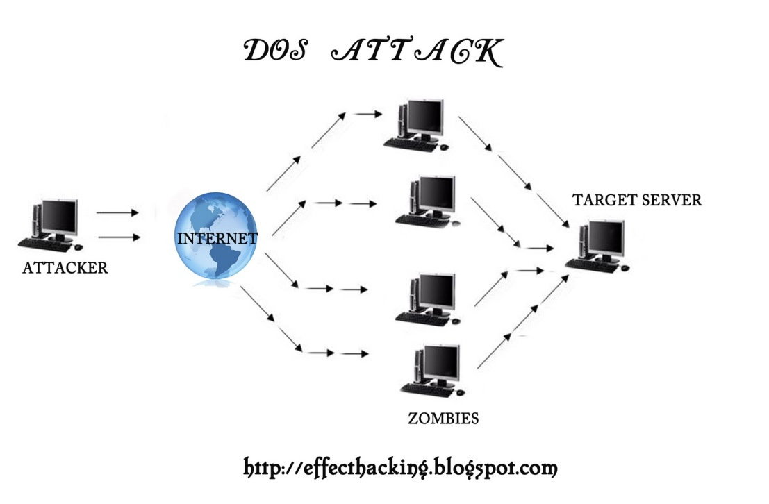
DENIAL OF SERVICE ATTACK
Attempt to make a machine or network unavailable to its intended users

Slide 182
SOCIAL ENGINEERING
Social engineering is the art of manipulating people so they give up confidential information
Phishing
Baiting
Baiting: These socially engineering schemes know that if you dangle something people want, many people will take the bait.
It can be in the form of a music or movie download on a peer-to-peer site

Slide 183
Phishing
It is an attempt to acquire sensitive information such as usernames, passwords and credit card details by masquerading as a trust worthy entity in an electronic communication.
The message may explain there is a problem that requires you to "verify" of information by clicking on the displayed link and providing information in their form
The message may notify you that you’re a ’winner’. Maybe the email claims to be from a lottery, or a dead relative, or the millionth person to click on their site
The message may ask for help
Response to a question you never had

Slide 184
How to recognize phishing emails?
Spelling and bad grammar
Links in email
Threats
Spoofing popular companies or websites

Slide 185
BUFFER OVERFLOW ATTACK
A buffer overflow occurs when a program or process tries to store more data in a buffer (temporary data storage area) than it was intended to hold.
Buffers are created to contain a finite amount of data, the extra information - which has to go somewhere - can overflow into adjacent buffers, corrupting or overwriting the valid data held in them
In buffer overflow attacks, the extra data may contain codes designed to trigger specific actions, in effect sending new instructions to the attacked computer that could, for example, damage the user's files, change data, or disclose confidential information

Slide 186
CYBER THEFT
Most involve theft of money
“Inside jobs”
Unauthorized activity
Attacks through the Internet
Most companies don’t report

Slide 187
Cyberterrorism
Use IT to attack electronic infrastructure, exchange information or make threats
Terror related
More political motivation than criminal
Examples
Shut down of government network and banks in Estonia
Non-deliberate shut down of systems at nuclear reactor

Slide 188
Unauthorized Use at Work
Time and resource theft
Doing private consulting
Doing personal finances
Playing video games
Unauthorized use of the Internet or networks
Recreational surfing
Racist or offensive e-mail
Pornographic sites
Sniffers
Monitor network traffic or capacity
Find evidence of improper use

Slide 189
Adware and Spyware
Adware
Useful software allows ads without consent
Spyware
Type of Adware
Can steal private information
Add advertising links to Web pages
Redirect affiliate payments
Change a users home page and search settings
Make modem call premium-rate numbers
Leave security holes that let Trojans in
Degrade system performance
Removal often not completely successful

Slide 190
How to protect from cybercrime?
Antivirus
Virtual private networks
Intrusion detecting systems
Data backup
Annual security plan testing
Security plan compliance audit
Biometrics

Slide 191
COMPUTER FORENSICS
“Forensic computing is the process of identifying, preserving, analyzing and presenting digital evidence in a manner that is legally acceptable.”(Rodney Mckemmish 1999).

Slide 192
NEEDS OF COMPUTER FORENSICS
To produce evidence in the court that can lead to the punishment of the actual.
To ensure the integrity of the computer system.
To focus on the response to hi-tech offenses, started to intertwine
GOAL OF COMPUTER FORENSICS
The main goal of computer forensic experts is not only to find the criminal but also to find out the evidence and the presentation of the evidence in a manner that leads to legal action of the criminal.

Slide 193
DIGITAL EVIDENCE
“Any data that is recorded or preserved on any medium in or by a computer system or other similar device, that can be read or understand by a person or a computer system or other similar device. It includes a display, print out or other output of that data.”
Latent as fingerprint or DNA
Fragile and can be easily altered, damaged, or destroyed.
Can be Time sensitive

Slide 194
TYPES OF DIGITAL EVIDENCE
1) PERSISTANT DATA, Meaning data that remains intact when the computer is turned off. E.g. hard drives, disk drives and removable storage devices (such as USB drives or flash drives).
2) VOLATILE DATA, Which is data that would be lost if the computer is turned off. E.g. deleted files, computer history, the computer's registry, temporary files and web browsing history.

Slide 195
RULES OF EVIDENCE
1) Admissible, Must be able to be used in court or elsewhere.
2) Authentic, Evidence relates to incident in relevant way.
3) Complete (no tunnel vision), Exculpatory evidence for alternative suspects.
4) Reliable, No question about authenticity & veracity.
5) Believable, Clear, easy to understand, and believable by a jury.

Slide 196
LOCATIONS FOR EVIDENCE
Internet History Files
Temporary Internet Files
Slack/Unallocated Space
Buddy lists, personal chat room records, P2P, others saved areas
News groups/club lists/posting
Settings, folder structure, file names
File Storage Dates
Software/Hardware added
File Sharing ability
E-mails

Slide 197
Computer forensics methodogy
1) Shut Down the Computer
2) Document the Hardware Configuration of The System
3) Transport the Computer System to A Secure Location
4) Make Bit Stream Backups of Hard Disks and Floppy Disks
5) Mathematically Verify Data on All Storage Devices
6) Document the System Date and Time
7) Make a List of Key Search Words
8) Evaluate the Windows Swap File
9) Evaluate File Slack
10)Evaluate Unallocated Space (Erased Files)
11) Search Files, File Slack and Unallocated Space for Key Words
12)Document File Names, Dates and Times
13)Identify File, Program and Storage Anomalies
14)Evaluate Program Functionality
15)Document Your Findings

Slide 198
APPLICATIONS OF COMPUTER FORENSICS
FINANCIAL FRAUD DETECTION
CRIMINAL PROSECUTION
CIVIL LITIGATION

Slide 199
UNIT 5
EMERGING TRENDS IN TECHNOLOGY FOR MANAGEMENT: Introduction to SaaS - Cloud Computing - IT Personalization Management - VoIP - Automatic Speech Recognition - Virtual Reality - CAVE - Biometrics - Digital Cash - Wearable Technology – Multi – Sate CPU‘s – Holographic Storage Devices – RFID - Ethics and Privacy Concerns in IT

Slide 200
SaaS
Software as Service is a software delivery model in which software and data are hosted centrally and accessed via web. It can be rented
Configuration and customization-according to the customer
Accelerated feature delivery- weekly updates
Multi tenant architecture- single instance of the software for multiple client organizations
Open integration protocols- API’S and protocols for accessing company’s internal systems

Slide 201
Advantages of SaaS
LOWER COST OF OWNERSHIP
Focus on Core Competency
Access Anywhere
Freedom to Choose (or Better Software)
Faster Product Cycles
No CAPEX only OPEX
VENDOR BENEFITS:
Increased Total Available Market
Lower Development Costs & Quicker Time-to-Market
Improved Customer Relationships

Slide 202
Applicability and types of SaaS
Enterprise Software application:
Sharing of data between internal and external users e.g. : Salesforce CRM application
Single user Software application:
Runs on single user computer and serves 1 user at a time e.g. : Microsoft office
Business Utility SaaS:
Applications like Salesforce automation are used by businesses and individuals for managing and collecting data, streamlining collaborative processes and providing actionable analysis. Popular use cases are Customer Relationship Management (CRM), Human Resources and Accounting.
Social Networking SaaS:
Applications like Facebook are used by individuals for networking and sharing information, photos, videos, etc.

Slide 203
IMPORTANT FACTORS OF A GOOD SaaS DESIGN
Three key differentiators that separate well-designed SaaS application from a poorly designed one
1.Scalability
2.Multi tenant efficient
3.Configurable
Scaling the application - maximizing concurrency, and efficient use of resources i.e. optimizing locking duration, statelessness, sharing pooled resources such as threads and network connections, caching reference data, and partitioning large databases

Slide 204
Multi-tenancy – important architectural shift from designing isolated, single-tenant applications One application instance should accommodate users from multiple other companies at the same time while providing transparency. This requires an architecture that maximizes the sharing of resources efficiently across tenants
Configurable - a single application instance on a single server has to accommodate users from several different companies. Customizing the application for one customer will change the application for other customers as well.Traditionally customizing an application would mean changes in the code.Each customer must use metadata to configure the way the application appears and behaves for its users. Customers configuring applications must be simple and easy without any extra development or operation costs

Slide 205
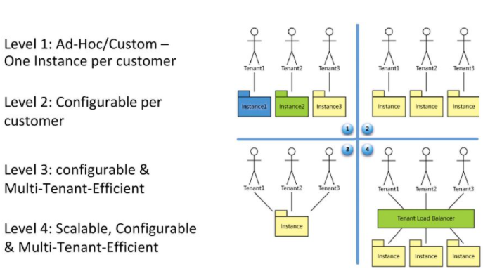

Slide 206
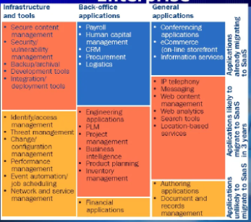
SaaS Adoption by Segment

Slide 207
CLOUD COMPUTING
Cloud Computing refers to manipulating, configuring, and accessing the applications online. It offers online data storage, infrastructure and application.
Cloud Computing is both a combination of software and hardware based computing resources delivered as a network service

Slide 208
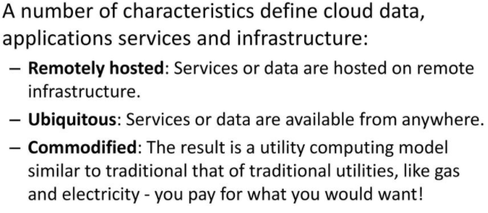
CHARACTERISTICS OF CLOUD COMPUTING

Slide 209
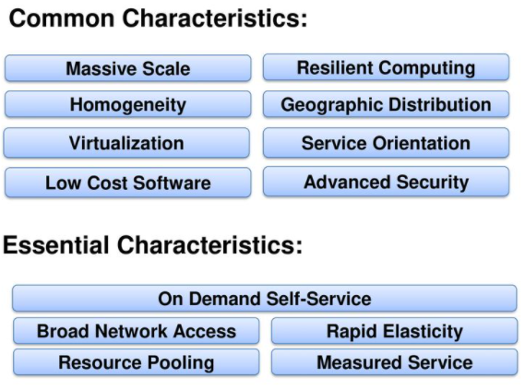

Slide 210
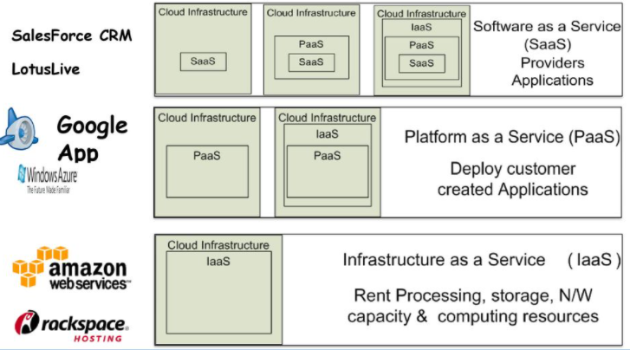
CLOUD SERVICE MODELS

Slide 211
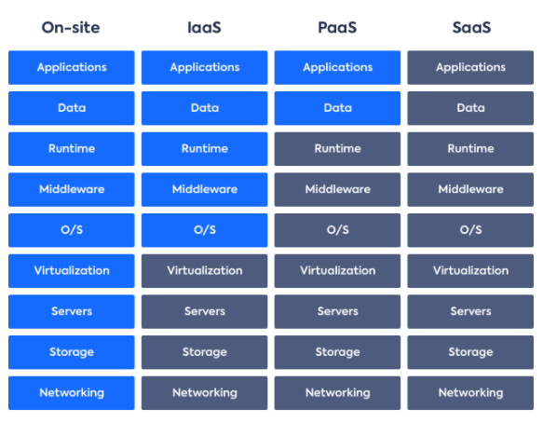

Slide 212
IaaS Examples: Amazon Web Services (AWS), Google Compute Engine (GCE), IBM Cloud
PaaS Examples: Google App Engine, Windows Azure, SAP cloud
SaaS Example: Salesforce, Microsoft office 365

Slide 213
ADVANTAGES OF CLOUD COMPUTING
• Lower computer costs
• Improved performance
• Reduced software costs
• Instant software updates
• Improved document format compatibility
• Unlimited storage capacity
• Increased data reliability
• Universal document access
• Latest version availability
• Easier group collaboration
• Device independence

Slide 214
DISADVANTAGES OF CLOUD COMPUTING
• Requires a constant Internet connection
• Does not work well with low-speed connections
• Features might be limited
• Can be slow
• Stored data can be lost
• Stored data might not be secure

Slide 215
ETHICS AND PRIVACY CONCERNS IN IT

Slide 216
COMPUTER ETHICS
Computer Ethics is the study of ethical issues that are associated primarily with computing machines and the computing profession.
Cyber ethics is the field of applied ethics that examines moral, legal, and social issues in the development and use of cyber technology.
Computer ethics is the analysis of the nature and social impact of computer technology and the corresponding formulation and justification policies for the ethical use of such technology.

Slide 217
CATEGORIES OF COMPUTER ETHICS PROBLEMS
Those ethical problems for which the computer is the instrument of the unethical act. For example , the use of a computer to defraud the bank.
Those problems for which the computer is the object of the unethical act. For example, stealing computer software and installing it on one’s own computer to access other’s information.
Those problems associated with the autonomous nature of computers.

Slide 218
PRIVACY
The basic right of an individual to control access to and use of information about him/herself.
Computers make privacy more difficult to protect, since large amounts of data on individuals and corporations are centrally stored on computers where an increasing number of individuals can access it.
Privacy invasion and illegal purposes leading to serious ethical issues like computer abuse – hacking, cyber crimes, computer virus, software piracy, cyber squatting and internet defamation

Slide 219
COMPUTER CODE OF ETHICS
Don’t use a computer to harm other people
Don’t interfere with other people’s computer work
Don’t snoop around in other people’s computer files
Don’t use a computer to steal
Don’t use a computer to bear false witness
Don’t copy software for which you have not paid
Don’t use other people’s computer resources without authorization
Don’t appropriate other people’s intellectual output
Think about the social consequences of the program you are writing
Use a computer in ways that insure consideration and respect for your fellow humans

Slide 220
SECURING THE WEB
Once your business is connected to the internet , it’s your responsibility to protect your business data and information against unwanted intruders.
Sensitive information such as customer details, pricing lists and personal records can all be stolen, corrupted or even destroyed unless protected properly

Slide 221
Some issues to consider when securing your website are:
Working procedures
Virus and spy ware protection software
Firewalls
Back up data
Using secure passwords

Slide 222
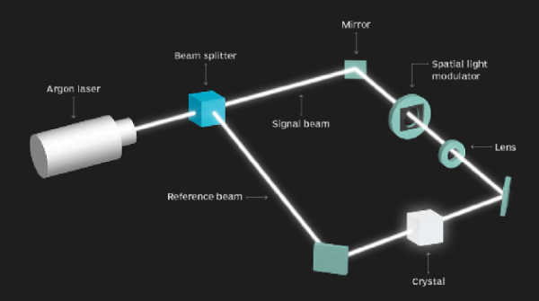
HOLOGRAPHIC STORAGE DEVICES

Slide 223
An example of the basic operation behind an HDSS starts with the firing of a blue-green argon laser.
A beam splitter then separates the laser into two beams -- the signal beam and the reference beam.
The signal beam travels straight until it bounces off a mirror and into a spatial light modulator, which is an LCD that shows pages of raw data. The data is carried to a light-sensitive crystal.
The reference beam emanates from the side of the beam splitter, taking a different path to the crystal. When the two beams meet, a pattern is created on the crystal that stores data in the volume of the crystal. Data can be stored in different areas in the crystal.

Slide 224
Holographic storage uses green lasers to write data pages containing hundreds of kilobytes of data in the form of a hologram inside a holographic crystal
Holographic storage can store information in a three-dimensional (3D) space, unlike other storage options like HDDs and flash storage, which use a two-dimensional (2D) space, allowing data to be stored more densely. So, more data can be stored in holographic storage in the same space compared with HDDs

Slide 225
The practical use of the storage technology for the cloud in the future would involve developing methods that will allow for the scaling of the storage capacity by increasing the number of partitions inside the device while maintaining the same access rates across multiple partitions
The data can be accessed at much higher speeds in holographic storage, potentially offering increased access rates because of lower time delays

Slide 226
AUTOMATIC SPEECH RECOGNITION
Automatic Speech Recognition or ASR, as it’s known in short, is the technology that allows human beings to use their voices to speak with a computer interface in a way that, in its most sophisticated variations, resembles normal human conversation.

Slide 227
The most advanced version of currently developed ASR technologies revolves around what is called Natural Language Processing, or NLP in short.
This variant of ASR comes the closest to allowing real conversation between people and machine intelligence and though it still has a long way to go before reaching an apex of development, we’re already seeing some remarkable results in the form of intelligent smart phone interfaces like the Siri program on the iPhone and other systems used in business and advanced technology contexts.

Slide 228
HOW “ASR” WORKS?
You speak to the software via an audio feed
The device you’re speaking to creates a wave file of your words
The wave file is cleaned by removing background noise and normalizing volume
The resulting filtered wave form is then broken down into what are called phonemes. (Phonemes are the basic building block sounds of language and words. English has 44 of them, consisting of sound blocks such as “wh”, “th”, “ka” and “t”.
Each phoneme is like a chain link and by analyzing them in sequence, starting from the first phoneme, the ASR software uses statistical probability analysis to deduce whole words and then from there, complete sentences
Your ASR, now having “understood” your words, can respond to you in a meaningful way.

Slide 229
TUNING TEST: HOW ASR LEARNS FORM HUMAN
Human Tuning: This is a relatively simple means of performing ASR training. It involves human programmers going through the conversation logs of a given ASR software interface and looking at the commonly used words that it had to hear but which it does not have in its pre-programmed vocabulary. Those words are then added to the software so that it can expand its comprehension of speech.
Active Learning: Active learning is the much more sophisticated variant of ASR and is particularly being tried with NLP versions of speech recognition technology. With active learning, the software itself is programmed to autonomously learn, retain and adopt new words, thus constantly expanding its vocabulary as it’s exposed to new ways of speaking and saying thing

Slide 230
SPEECH RECOGNITION SOFTWARE
Dragon Professional
Google Now
Siri
Amazon Lex
Google Docs voice typing
Microsoft Bing API

Slide 231
Practical uses of Automatic Speech Recognition Softwares
Voice recognition software, also called speech recognition software, can be thought of best as intelligent transcription software.
Most of these products will transcribe the spoken word, in real time or from an audio file, into data or text. This information can then be presented in the form of a document or inside of an editable text box.
Buyers operating in the financial industry need to take into consideration existing customer service tools as well as rules regulating the storage and transfer of financial data

Slide 232
Health care — Hospitals and clinics will use voice recognition software to quickly collect patient information and record clinical documentation. Medical transcription can be offered as either a software or a service and can save hospitals countless hours and capital on record keeping. Transcription products intended for use in health care take into consideration HIPAA compliance, while generalized voice recognition tools do not.
Law — Many law firms will employ a voice recognition tool for the extensive bookkeeping and data entry that comes with running a practice. These products can assist with other activities such as task management and client communications as well.
Voice recognition and transcription is also sometimes used in the courtroom to record legal proceedings. In both cases, products intended for use by legal professionals take into consideration regulations that general voice recognition tools don’t normally have to follow.

Slide 233
Customer support — Voice recognition capability is a popular feature within many chatbot offerings. When a customer calls in to a customer support line, the call usually will begin with the customer interacting with a chatbot to narrow down their issue and route them to the correct department. Voice recognition software is used to collect and process a customer’s answers to the prompted questions.
Disability services — Since its advent, voice recognition has been used in software and services geared toward those with disabilities. Speech recognition software is behind much of the closed captioning for television and video media. Voice recognition tools are also used by those with limited use of their hands to transcribe their thoughts.

Slide 234
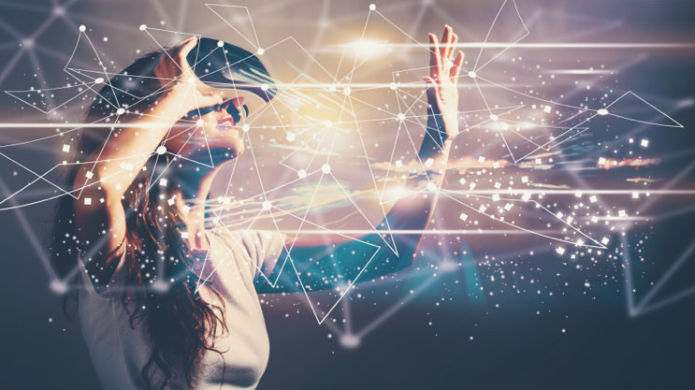
VIRTUAL REALITY
Virtual Reality, or VR, is the use of computer technology to create a simulated environment which can be explored in 360 degrees. Unlike traditional interfaces, VR places the user inside the virtual environment to give an immersive experience

Slide 235
EXAMPLES OF VR
Oculus Rift
Samsung Gear VR
HTC Vive
Google Daydream View

Slide 236
1. Virtual Reality
uses VR headsets or closed head-mounted displays (HMDS) to completely insulate and transpose the user to an alternative world
2. Augmented Reality
adds or supplements to our existing reality with digital objects and digital object overlays
enhances our presence by 'augmenting' reality
3. Mixed or Merged Reality
uses holographic lens to converge VR and AR where virtual objects interact with real-world objects

Slide 237
The main difference between the two is that VR builds the world in which we immerse ourselves through a specific headset. It is fully immersive and everything we see is part of an environment artificially constructed through images, sounds, etc. On the other hand, in augmented reality (AR), our own world becomes the framework within which objects, images or similar are placed. Everything we see is in a real environment and it may not be strictly necessary to wear a headset. The clearest and most mainstream example of this concept is Pokémon Go.
However, there is also a combination of both realities called mixed reality. This hybrid technology makes it possible, for example, to see virtual objects in the real world and build an experience in which the physical and the digital are practically indistinguishable.

Slide 238
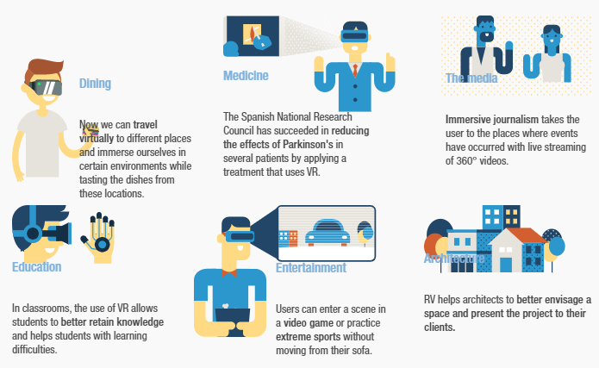
Medicine, culture, education and architecture are some of the areas that have already taken advantage of this technology

Slide 239
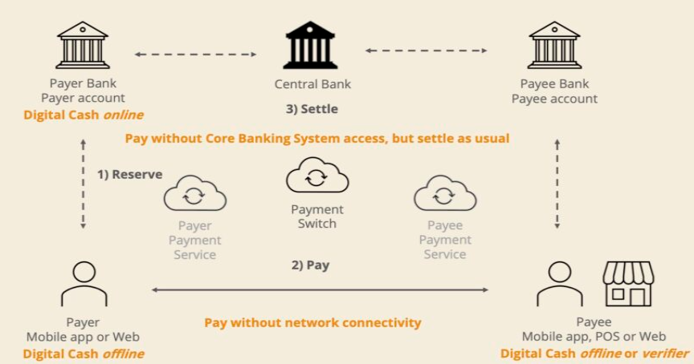
DIGITAL CASH

Slide 240
HOW DIGITAL CASH WORKS?
In order to use digital cash, the end user needs to open an account with a bank. They then need to ask the bank to provide them with e-cash in lieu of their cash. For instance, the bank may deduct Rs1000 from the account and issue 1000 digital coins of Rs1 each.
The bank uniquely marks each coin that it issues. This is done to ensure that each coin is spent only once by a single user. Once it is spent, it reaches a different consumer and gets a different number. This electronic marking makes the digital cash system viable. In the absence of this marking, duplication would make the system unviable.
There are several protocols that banks have developed in order to ensure that the digital cash system works seamlessly. Some of these protocols have been mentioned below
Account Opening: In this case, the bank takes in cash and issues marked digital tokens
Withdrawal: This is the opposite of the account opening. Here the electronic tokens are extinguished, and cash is provided to the customer
Payments: Here, digital coins are extinguished. However, the value of these coins is transferred to the counterparty. This value may be in the form of digital coins or in the form of bank currency depending upon the customer’s preference.

Slide 241
Digital money is money in purely digital form. It is not a physically tangible asset like cash or other commodities like gold or oil.
Digital money can streamline the current financial infrastructure, making it cheaper and faster to conduct monetary transactions. It can also ease monetary policy implementation by central banks.
Examples of types of digital money are cryptocurrencies, central bank digital currencies, and stablecoins.
Digital money is susceptible to hacks and can compromise user privacy.

Slide 242
ADVANTAGES OF DIGITAL MONEY
Digital money eliminates the need for physical storage and safekeeping that is a characteristic of cash-intensive systems. You do not need to invest in a wallet or bank vaults to ensure that your money is not stolen.
Digital money simplifies accounting and record-keeping for transactions through technology. Therefore, manual accounting and separate entity-specific ledgers are not necessary to maintain records of transactions.
While it has already shortened the amount of time and the cost required to transfer money across borders, digital money has the potential to further revolutionize the remittance industry by eliminating intermediaries and further reducing the costs associated with cross-border transfers.

Slide 243
Digital money removes intermediaries in the implementation of monetary policy and makes it possible to include groups of people who were previously excluded from the economy. For example, those who are unbanked can still participate in an economy by using digital money present in their online wallet or mobile phones.
In the case of cryptocurrencies, digital money transactions can become censorship-resistant, meaning they can be impervious to tracking by government or other authorities.

Slide 244
DISADVANTAGES OF DIGITAL MONEY
Digital money is susceptible to hacking. Even as it removes the need for physical safekeeping, digital money's origins in technology ensure that this form of money becomes a target for hackers, who can steal from digital wallets. A seamless financial infrastructure consisting of digitally connected entities can be brought down by hackers. The 2018 SWIFT hacks, which affected multiple countries, are an example. Hacks of digital money on a large scale have the potential to bring a country's financial infrastructure to heel and become a national security threat.
Digital money use can compromise user privacy. Cash is anonymous, and it is nearly impossible to track and trace its users. On the other hand, digital money can be traced. While the use of internet cookies enables targeted advertising, the implications for digital money tracking are more far-reaching. For example, organizations or governments could blacklist or freeze accounts without the permission of users. They could also instigate double-accounting in bank accounts, inflating expenses and reducing the overall total.

Slide 245
Digital money has its own set of costs. For example, digital wallets are required to store digital money. Cryptocurrencies also require custody solutions that act as a failsafe against hackers. Systems that use block chains also have to pay transaction fees, or the costs associated with processing the transaction, to miners.
Digital money presents several challenges on the governance and policy framework front. This form of money is uncharted territory for policymakers, and problems have already begun emerging in its ecosystem. For example, the integrity of stablecoins is already under a cloud after Tether, the most widely used stablecoin in cryptocurrency markets, was found to have co-mingled client and corporate funds and used funds from its reserve backup – to ensure a 1:1 peg to the U.S. dollar – to cover up its debt obligations.

Slide 246
WEARABLE TECHNOLOGY

Slide 247
The most sophisticated examples of wearable technology include AI hearing aids, Google Glass and Microsoft’s HoloLens, and a holographic computer in the form of a VR headset. An example of a less complex form of wearable technology is a disposable skin patch with sensors that transmit patient data wirelessly to a nearby control device.
Wearable technology is any kind of electronic device designed to be worn on the user’s body. Such devices can take many different forms, including jewelry, accessories, medical devices and clothing (or elements of clothing).
The term wearable computing implies processing or communications capabilities, but in reality, the sophistication among wearables can vary

Slide 248
EXAMPLES
Smart jewelry, such as rings, wristbands, watches and pins. Smaller devices typically work in coordination with a smartphone app for display and interaction.
Body-mounted sensors that monitor and transmit biological data for healthcare purposes.
Fitness trackers, often in the form of wristbands or straps, that monitor things like physical activity and vital signs. Trackers may connect wirelessly to an app for data storage, processing and reporting.
Smart clothing with built-in technology that can perform a variety of tasks including fitness or health monitoring, interacting with phones and other devices and changing fabric characteristics to suit the user’s preference, activity or environment.
Augmented reality (AR) headsets that integrate digital information into a display of the user’s environment and mixed reality (MR) headsets that integrate physical reality and digital content in a way that enables interaction with and among real-world and virtual objects. (VR headsets, at the far end of the virtuality continuum, entirely replace the user environment with digital information.)
AI hearing aids that can filter out unwanted noises and automatically adapt for best performance in the user’s current environment. Such devices, sometimes referred to as hearable, can also incorporate capabilities such as fitness tracking, audio streaming and translation.

Slide 249
MULTI STATE CPU’s

Slide 250
Currently, CPUs run in a binary-state environment, meaning that they are solely capable of recognizing data that is represented by a sequence of 1s and 0s. For instance, the binary equivalent of the letter “A” is “01000001”. One of the drawbacks of binary code is that a one character letter such as “A” has to be converted into an 8 character string in order for the computer to recognize it.
To further illustrate this point let us take the word “binary” and convert it into its binary equivalent of “011000100110100101101110011000010111001001111001”.
This increase in character string length is a major obstacle in increasing the processing speeds of today’s computers

Slide 251
Bring in the Multi-state CPU. Instead of using the traditional two states to represent the information, they will use a number of states; most likely ten to begin with for the numbers 0 through 9. This will mean a major breakthrough in processing speed.
As stated earlier, any character is represented in binary code as an eight digit string of with each character representing two possibilities. Therefore the number of possibilities for a string is 2x2x2x2x2x2x2x2 or 256 combinations. Compare that to a multi-state CPA, where each character has 10 possibilities and we can attain a number of combinations far greater than 256 in only a three character string: 10x10x10 or 1000 combinations.

Slide 252
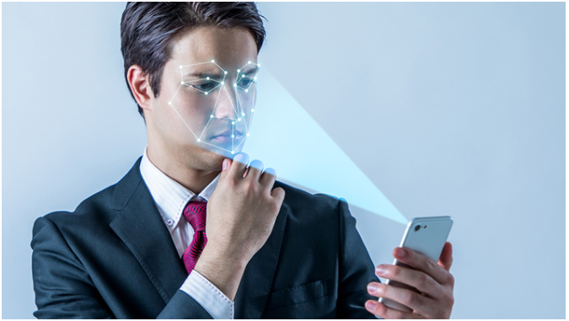
BIO-METRICS

Slide 253
Biometrics are rising as an advanced layer to many personal and enterprise security systems. With the unique identifiers of your biology and behaviors, this may seem foolproof.
Modern cybersecurity is focused on reducing the risks for this powerful security solution: traditional passwords have long been a point of weakness for security systems. Biometrics aims to answer this issue by linking proof-of-identity to our bodies and behavior patterns.

Slide 254
TYPES OF BIOMETRIC SECURITY
Biological biometrics use traits at a genetic and molecular level. These may include features like DNA or your blood, which might be assessed through a sample of your body’s fluids.
Morphological biometrics involve the structure of your body. More physical traits like your eye, fingerprint, or the shape of your face can be mapped for use with security scanners.
Behavioral biometrics are based on patterns unique to each person. How you walk, speak, or even type on a keyboard can be an indication of your identity if these patterns are tracked.

Slide 255
EXAMPLES OF BIOMETRIC SECURITY
Voice Recognition
Fingerprint Scanning
Facial Recognition
Iris Recognition
Heart-Rate Sensors

Slide 256
Advanced biometrics are used to protect sensitive documents and valuables. Citibank already uses voice recognition, and the British bank Halifax is testing devices that monitor heartbeat to verify customers' identities. Ford is even considering putting biometric sensors in cars.
Biometrics are incorporated in e-Passports throughout the world. In the United States, e-passports have a chip that contains a digital photograph of one’s face, fingerprint, or iris, as well as technology that prevents the chip from being read — and the data skimmed — by unauthorized data readers.

Slide 257
Biometrics scanners are becoming increasingly sophisticated. You can even find biometrics on phone security systems. For example, the facial recognition technology on Apple's iPhone X projects 30,000 infrared dots onto a user's face to authenticate the user by pattern matching. The chance of mistaken identity with the iPhone X biometrics is one in a million, according to Apple.

Slide 258
Biometrics - Identity & Privacy Concerns
Biometric authentication is convenient, but privacy advocates fear that biometric security erodes personal privacy. The concern is that personal data could be collected easily and without consent.
Biometric Data Security Concerns
A more immediate problem is that databases of personal information are targets for hackers. For example, when the U.S. Office of Personnel Management was hacked in 2015, cybercriminals made off with the fingerprints of 5.6 million government employees, leaving them vulnerable to identity theft.

