Slide 1
MODULE VI
MECHATRONICS SYSTEMS
Mechatronics Design process-stages -Traditional and Mechatronics design concepts- Case studies of Mechatronics systems- Pick and place Robot - Autonomous mobile robot - Engine Management system- Automatic car park barrier
Introduction to data acquisition and control systems, virtual instrumentation, interfacing of various sensors and actuators with PC.

Slide 2
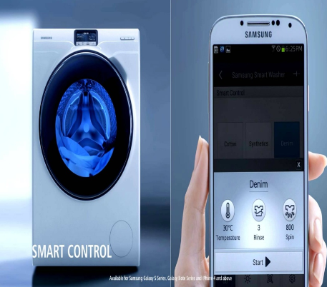
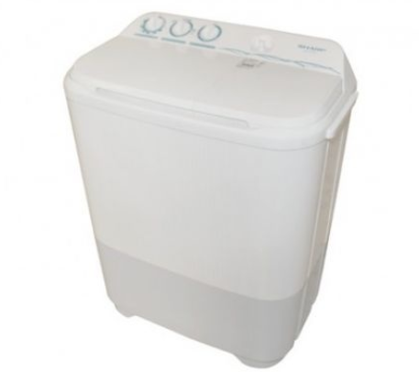
TRADITIONAL Vs MECHATRONICS
Vs

Slide 3
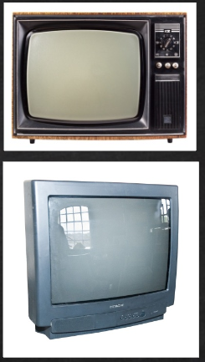

CONT…
Vs

Slide 4
CONT…
Traditional – Sequential approach to design
Mechatronics – concurrent inclusions of various disciplines

Slide 5
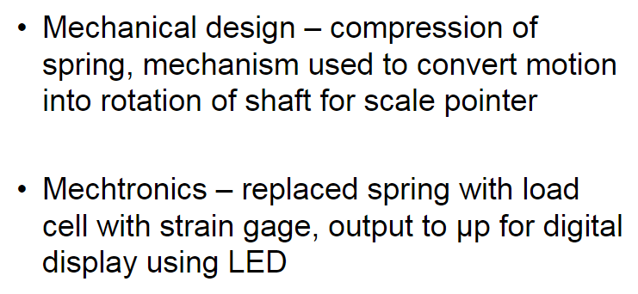
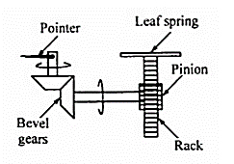
EXAMPLE 1 – WEIGHING MACHINE

Slide 6
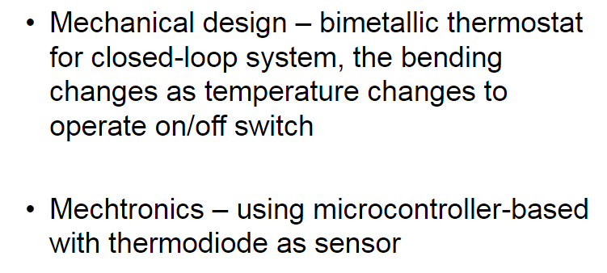
EXAMPLE 2 – CENTRAL HEATING SYSTEM

Slide 7
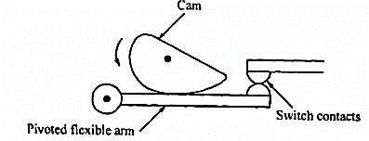
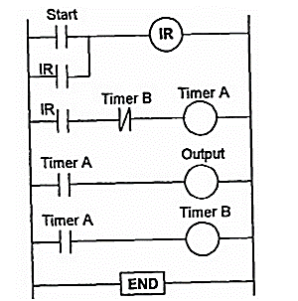
EXAMPLE 3 – TIMED SWITCH

Slide 8
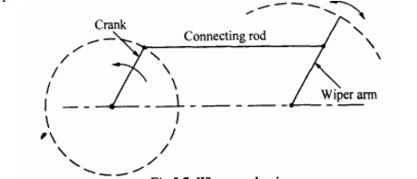
EXAMPLE 4 – WIPER MECHANISM

Slide 9
COMPARISON
TRADITIONAL | MECHANICAL
Sequential approach | Concurrent inclusion of all discipline
Less flexible | More flexible
Less accurate | More accurate
More complicate mechanical design | Less complicate mechanical design
Involves more components | Involves lesser components
More moving parts | Few moving parts

Slide 10
DESIGN PROCESS
NEED
ANALYSIS OF PROBLEM
PREPERATION OF SPECIFICTION
GENERATION OF POSSIBLE SOLUTION
SELECTION OF SUITABLE SOLUTION
PRODUCTION OF DETAILED DESIGN
PRODUCTION OF WORKING DRAWINGS

Slide 11
CASE STUDY 1
CAR PARKING BARRIER

Slide 12
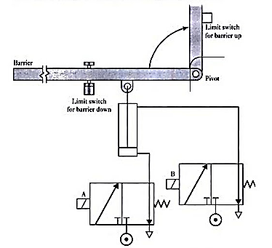
CAR PARKING BARRIER

Slide 13
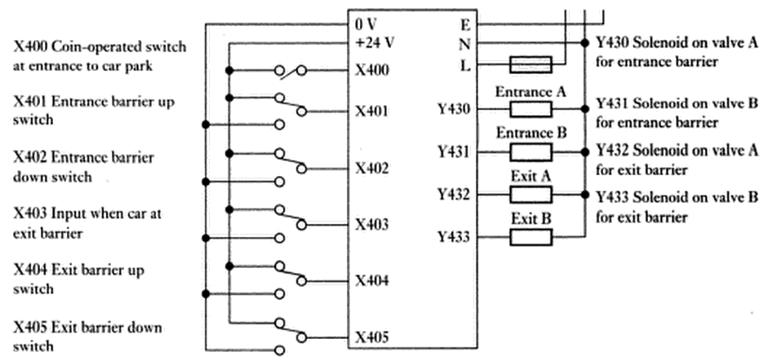
PLC BLOCK – CAR PARKING BARRIER

Slide 14
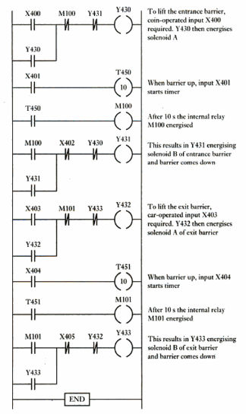
LADDER DIAGRAM

Slide 15
CASE STUDY 2
PICK AND PLACE ROBOT

Slide 16
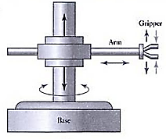
PICK AND PLACE ROBOT

Slide 17
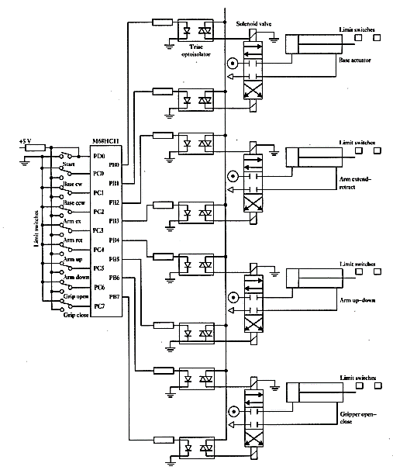

Slide 18
CASE STUDY 3
ENGINE MANAGEMENT SYSTEM

Slide 19
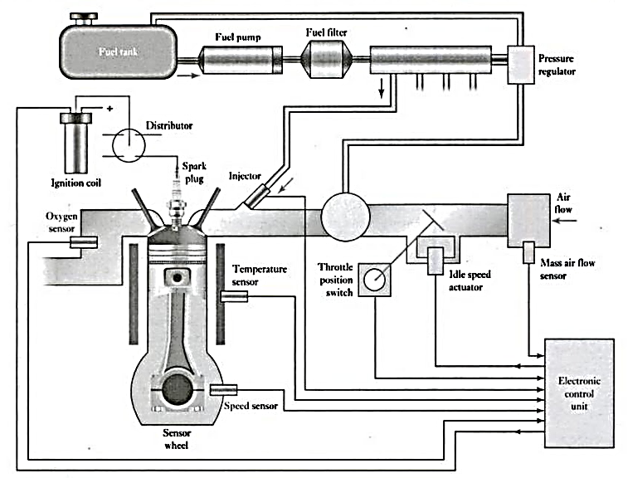

Slide 20
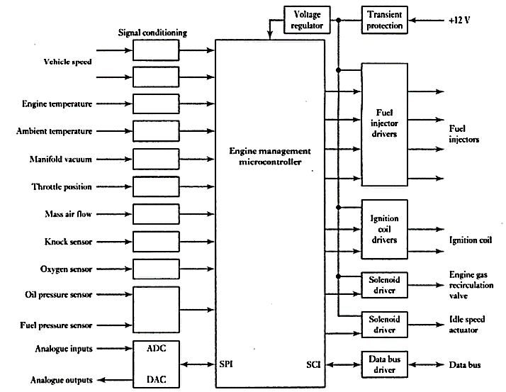

Slide 21
CASE STUDY 3
AUTONOMOUS MOBILE ROBOT

Slide 22
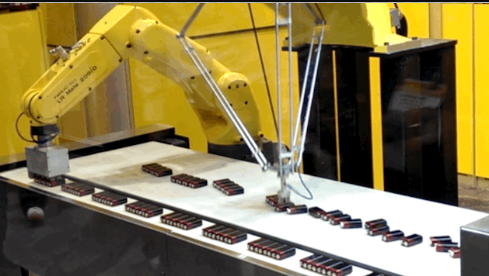
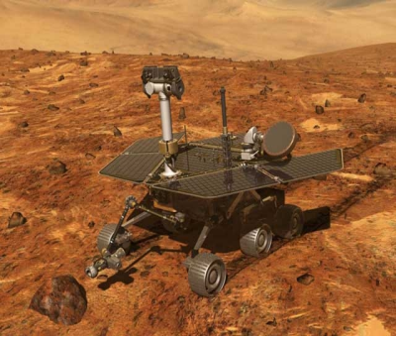

Slide 23
NEED / APPLICATION FOR AMR
Surveillance
Patrolling
Target Identification and Tracking
Remotely operated weapons
Disaster management

Slide 24
REQUIREMENTS FOR AMR
Robots have to be capable of achieving task objectives without human input
Robots have to be able to make and execute their own decisions based on sensor information
Robots have to be able to adjust to changes in the environment

Slide 25
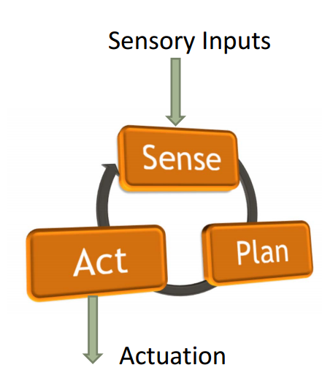
STEPS IN AMR

Slide 26
TASKS TO BE ADDRESSED FOR AMR
  Modeling of robot mechanisms
  Robot sensor selection
  Control of actuators
  Control architectures

Slide 27
Modeling of robot mechanisms
  Kinematics computes the joint angle configuration necessary to reach a particular point in space.
  Dynamics computes a trajectory for the robot such that it reaches the desired goal without colliding with obstacles

Slide 28
Robot sensor selection
  Two things to sense
  Its own state
  The surroundings
  Two types
  Passive
    Thermometer, Potentiometers, Accelerometer
    Cameras, Contact sensors, Compass
  Active
    Optical Encoder, proximity sensor
    Sonar, Lasers, GPS

Slide 29
Control of actuators
  To get a particular robot actuation to a particular location it is important to apply the correct amount of force or torque to it.
  To accurately achieve a task in an intelligent environment, a robot has to be able to react dynamically to changes in its surrounding
  The most common control approach is PD-control (proportional, derivative control)

Slide 30
Control architectures
  Series planning architectures
  Parallel planning architectures
  Hybrid architectures

Slide 31
DATA ACQUISITION & CONTROL

Slide 32
DA&C
Collection of add-on hardware and software components
Monitoring system - receives data from a real-world process through sensor and display the data
Controlling system - convert low-power computer signals to real world signals through actuators resulting in motion, heat, pressure, etc.

Slide 33
BLOCK DIAGRAM
PHYSICAL SYSTEM
TRANSDUCER ( SENSOR) / ACTUATOR
SIGNAL CONDITIONING
A/D CONVERTOR / D/A CONVERTOR
COMPUTER

Slide 34
TRANSDUCERS (SENSORS)
Sense physical phenomena and translate it into electric signal.
Temperature
Pressure
Light
Displacement
Level
Force

Slide 35
ACTUATORS
A device that activates process control equipment by using power of:
Pneumatic
Hydraulic
Mechanical
electrical

Slide 36
SIGNAL CONDITIONING
Electrical signals are conditioned
The following features may be available:
Amplification
Isolation
Linearization
Filtering

Slide 37
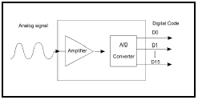
A/D CONVERTOR
Changes analog voltage or current levels into digital information
The conversion is necessary to enable the computer to process or store the signals

Slide 38
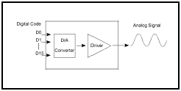
D/A CONVERTOR
Converts digital information into analog voltage or current
It allows the computer to control real-world events

Slide 39
CRITERIA FOR A/D OR D/A
Number of channels
Type of signals
Sampling rate (in samples per second)
Resolution (usually measured in bits of resolution)
Input range (specified in full-scale volts)
Noise and nonlinearity

Slide 40
SIGNAL TYPE
Analog
  Signal is continuous
  Example: strain gage. Most of transducers produce analog signals
Digital
  Signal is either ON or OFF
  Example: light switch.

Slide 41
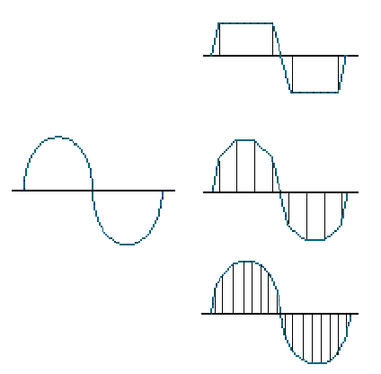
SAMPLE RATE
Determines how often conversions take place.
The higher the sampling rate, the better.
ANALOGUE
4 SAMPLES / CYCLE
8 SAMPLES / CYCLE
16 SAMPLES / CYCLE

Slide 42
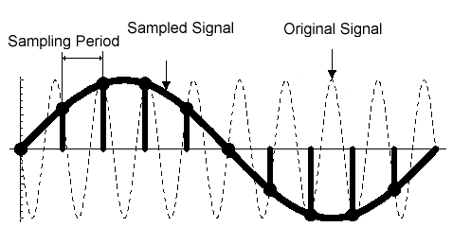
Cont…
Acquired signal gets distorted if sampling rate is too small.

Slide 43
RANGE
Minimum and maximum voltage levels that the A/D converter can quantize
Ranges are selectable (either hardware or software) to accurately measure the signal

Slide 44
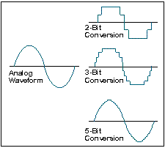
RESOLUTION

Slide 45
SOFTWARE
Connects DA&C with PC
Software driver package or special application software like - MATLAB, LabVIEW, etc,.
Functions:
  Integrate DAQ boards in a computer
  Acquire data at required sampling rate.
  Analyze and display the acquired data.
  Stream data to and from disk.

Slide 46
VIRTUAL INSTRUMENTATION
To test, analyze, control and design virtually with the help of PC equipped with data acquisition hardware and software to perform the functions of traditional instruments.
Control of external hardware device also.

Slide 47
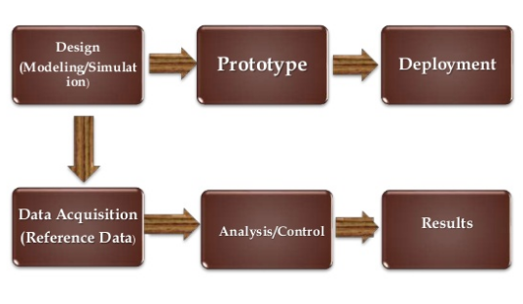
Cont..

Slide 48


