Slide 1
MODULE I INTRODUCTION
Introduction to Mechatronics- Systems- Concepts of Mechatronics approach- Need for Mechatronics- Emerging area of Mechatronics- Sequential controllers.
Introduction to Sensors & Transducers – Performance Terminology- Sensors for motion and position measurement, force, torque, tactile, temperature sensors, ultrasonic sensors, hall-effect sensors. Selection of sensors for different applications, Signal Conditioning.

Slide 2
INTRODUCTION
Synergistic integration - mechanical engineering with electronics and intelligent computer control - design and manufacturing - industrial products and processes.

Slide 3
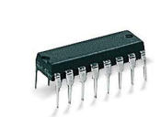
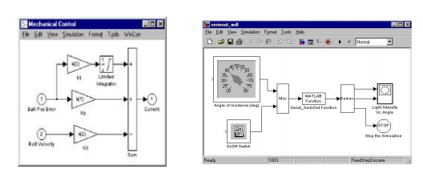

Slide 4
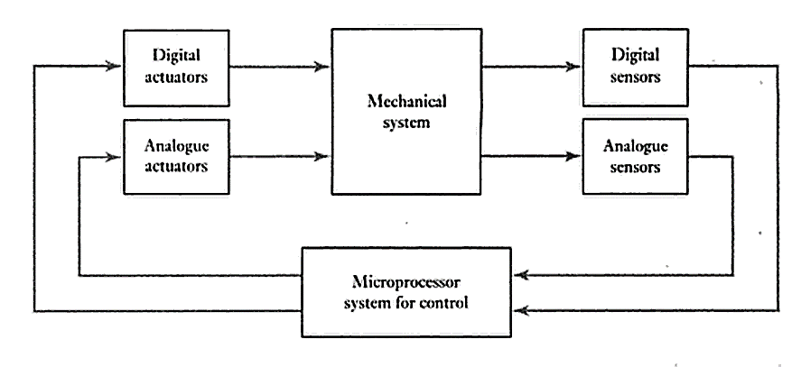
BASIC ELEMENTS OF MECHATRONICS

Slide 5
NEED FOR MECHATRONICS
Better design of products
Better process planning
Reliable and quality oriented products
Intelligent process control
Batch production
Changing design perspective
Ease of reconfiguration of process
Demand for increased flexibility
Dynamic market condition

Slide 6
EMERGING AREA OF MECHATRONICS
Automation and Robotics
Computer integrated manufacturing
Unmanned vehicles
CNC machines
Sensing & control system
Automobile
Human machine interface
Medical diagnosis

Slide 7
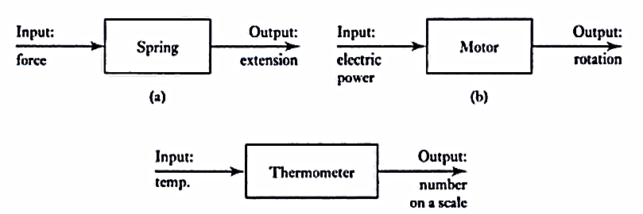
SYSTEM
Box / block diagram – i/p & o/p – concerned only with relationship between i/p & o/p

Slide 8
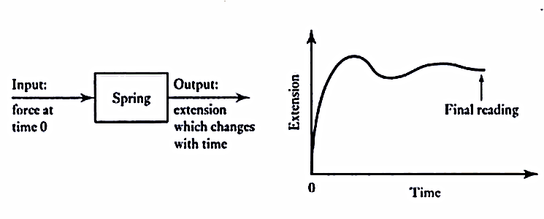
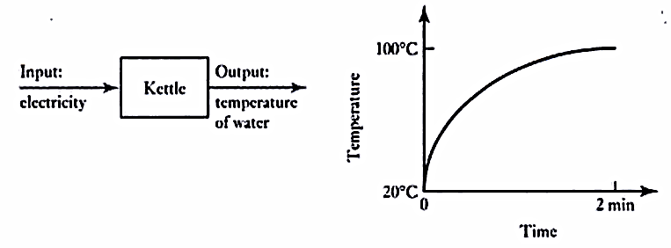
MODELLING OF SYSTEM
Represents real behavior of the system by mathematical equation

Slide 9
CONNECTED SYSTEMS
Interconnected blocks – each block with specific functions

Slide 10
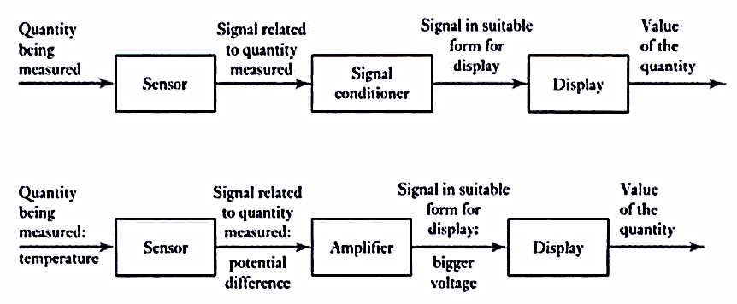
MEASUREMENT SYSTEMS
Used for making measurements
Elements:
Sensor
Signal conditioner
Display

Slide 11
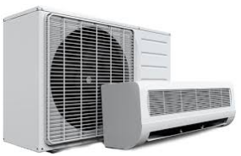
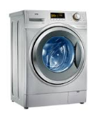
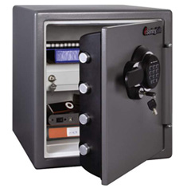
CONTROL SYSTEMS
Particular value
Sequence of events
Event to occur or not

Slide 12
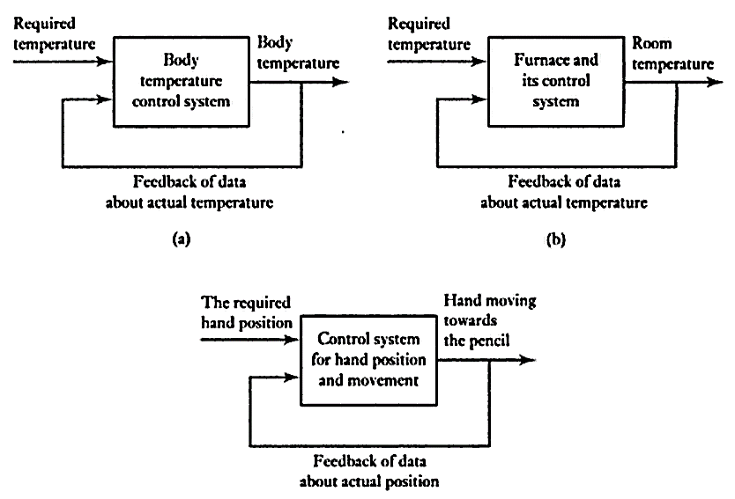
FEEDBACK CONTROL
Signals feedback from the output

Slide 13
TYPES OF CONTROL SYSTEM
Open loop control system ( event to happen or not)
Input
Output

Slide 14
Cont…
Closed loop control system (to a value)
Input
Output

Slide 15
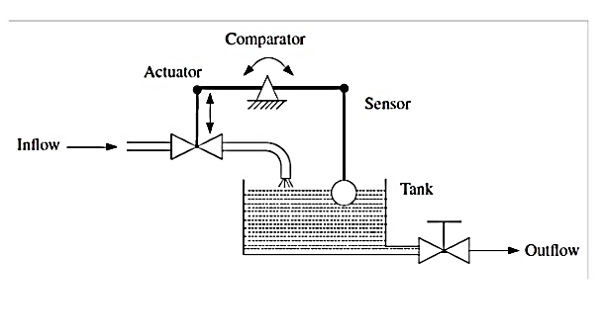

Slide 16
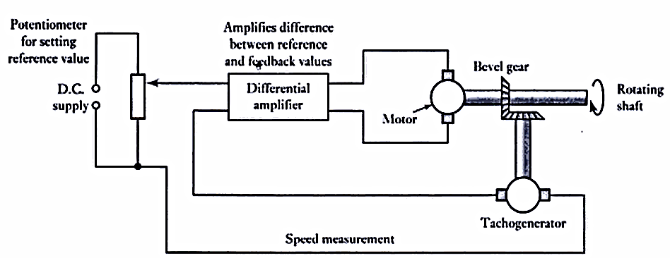

Slide 17
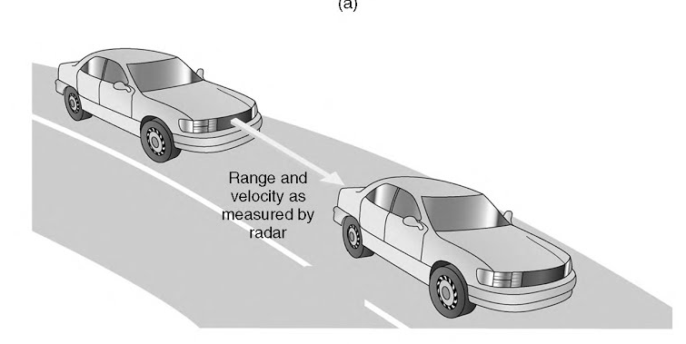

Slide 18
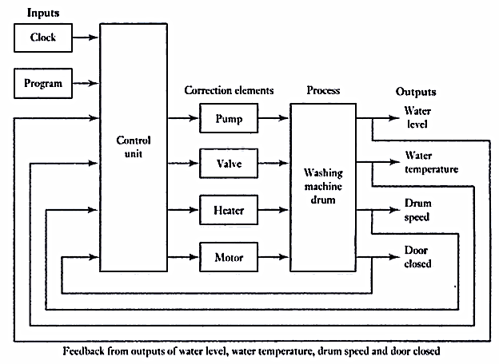
SEQUENTIAL CONTROLLER
Controls the action in a time or event driven sequence.

Slide 19
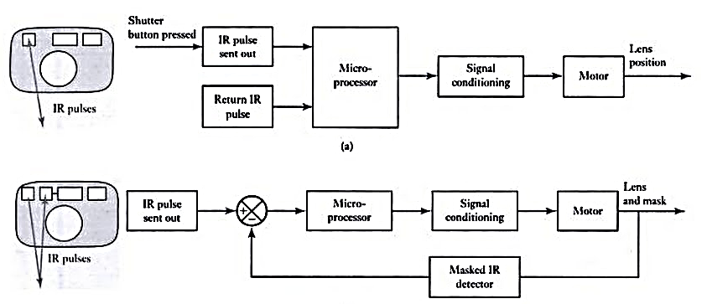
DIGITAL CAMERA WITH AUTOMATIC FOCUS

Slide 20
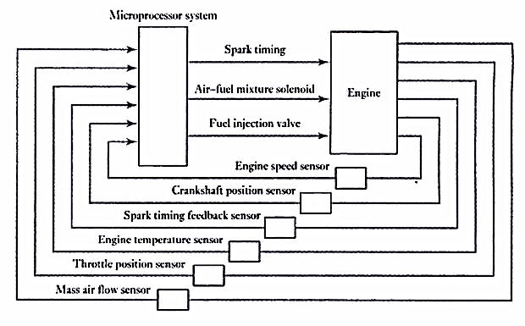
ENGINE MANAGEMENT SYSTEM

Slide 21
SENSORS
Sensors:
A device which provides a usable output in response to a specified measurand
Transducer
A device that converts a signal from one form of energy to another form

Slide 22
STATIC SPECIFICATION
Range - limits between which the input can vary
Span - difference between the maximum and minimum values of the input
Error - difference between the result of the measurement and the true value
Accuracy – expressed as percentage of full-scale
Sensitivity - the ratio of change in output value of a sensor to the per unit change in input value

Slide 23
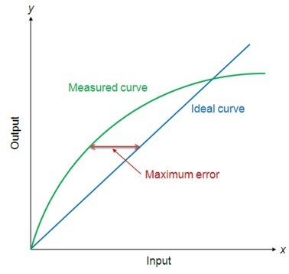
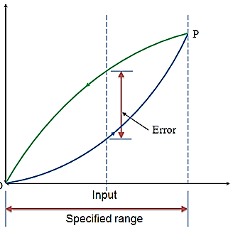
Cont..
Non linearity error - the maximum deviation of the actual measured curve of a sensor from the ideal curve
Hysteresis error

Slide 24
Cont..
Repeatability / reproducibility - the ability of a sensor to give same output for repeated applications of same input value
Stability - the ability of a sensor device to give same output when used to measure a constant input over a period of time
Dead band - the range of input values for which there is no output
Resolution - the smallest detectable incremental change of input parameter that can be detected in the output signal

Slide 25
DYNAMIC SPECIFICATION
Response time – time taken to reach 95% of steady state value
Settling time – time taken to settle within some % of steady state error

Slide 26
CLASSIFICATION
Displacement, position and proximity sensors
Velocity
Force
Fluid pressure
Liquid flow
Liquid level
Temperature
Light sensors

Slide 27
DISPLACEMENT, POSITION AND PROXIMITY SENSORS
Potentiometer sensor
Strain-gauged element
Capacitive element
Linear Variable Differential transformer (LVDT)
Eddy current proximity sensor
Inductive proximity sensor
Optical encoders
Pneumatic sensors
Proximity switches
Photosensitive sensor
Hall effect sensor

Slide 28
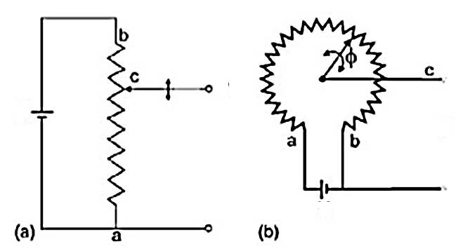
POTENTIOMETER SENSOR
V_{O} = $\frac{R_{2}}{\left(R_{1}+ R_{2}\right)}$ $V_{I}$
R_{I}
V_{I}
V_{O}
R₂
V_{O}
V_{I}
Feedback loop to ensure that the moving member or component reaches its commanded position
Machine-tool controls, elevators, liquid-level assemblies, forklift trucks, automobile throttle controls
Control of injection molding machines, woodworking machinery, printing, spraying, robotics

Slide 29
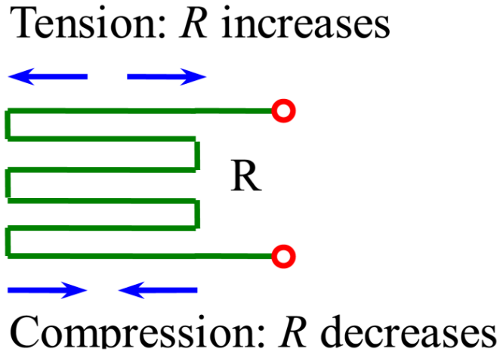
STRAIN GAUGE ELEMENT
G – GAUGE FACTOR
Bending and deflection measurement, compression and tension measurement and strain measurement
Force measurement in machine tools, hydraulic or pneumatic press
Impact sensors in aerospace vehicles

Slide 30
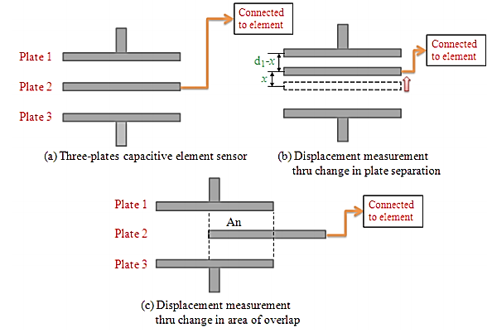
CAPACITIVE SENSOR
C = ε_{r} ε_{o} A / d
• Automatic Feed hopper level monitoring
• Grease level monitoring
• Level control of liquids
•To measure shape errors in the part being produced
•To test assembled parts for uniformity, thickness or
•Machine tool monitoring

Slide 31
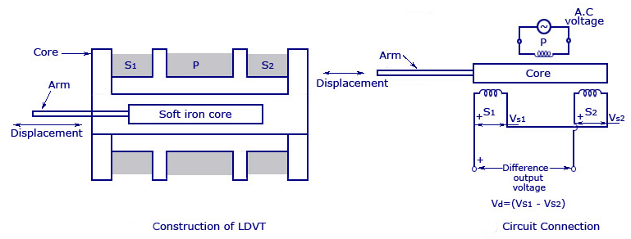
LINEAR VARIABLE DIFFERENTIAL TRANSFORMER (LVDT)

Slide 32
APPLICATION -LVDT
• Measurement of spool position in a wide range of servo valve applications
• To provide displacement feedback for hydraulic cylinders
• To control weight and thickness of medicinal products viz. tablets or pills
• For automatic inspection of final dimensions of products being packed for dispatch
• To measure distance between the approaching metals during Friction welding process
• To continuously monitor fluid level as part of leak detection system
• To detect the number of currency bills dispensed by an ATM

Slide 33
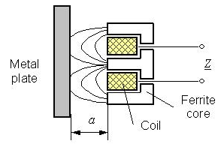
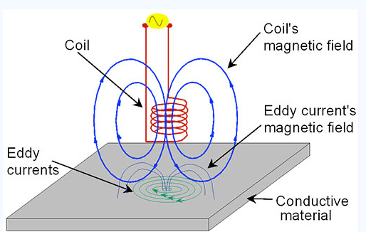
EDDY CURRENT PROXIMITY SENSOR
• Automation requiring precise location
• Machine tool monitoring
• Final assembly of precision equipment such as disk drives

Slide 34
INDUCTIVE PROXIMITY SENSOR
• Industrial automation: counting of products during production or transfer
• Security: detection of metal objects, arms, land mines

Slide 35
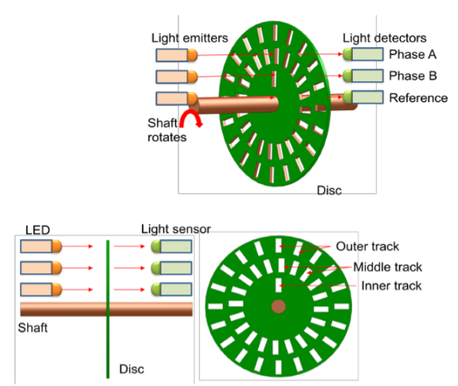
OPTICAL ENCODER – RELATIVE (INCREMENTAL ENCODER)

Slide 36
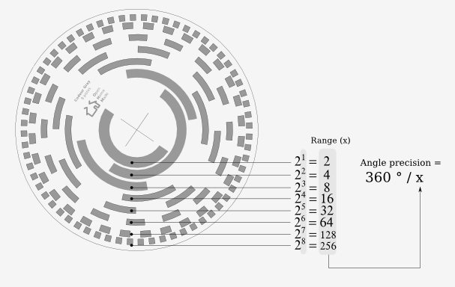
OPTICAL ENCODER - ABSOLUTE
Application : Servo motors to measure the rotation of shafts

Slide 37
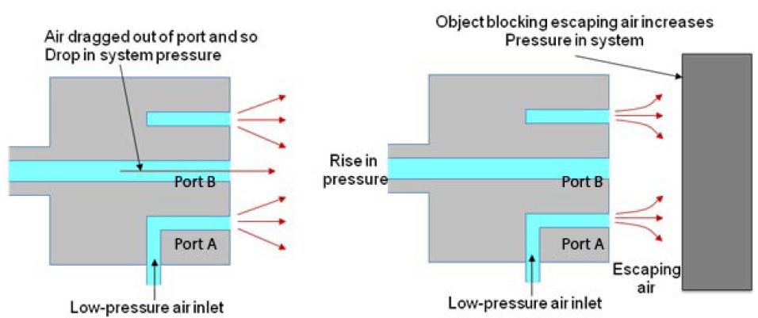
PNEUMATIC SENSOR
Application : Robotics, pneumatics and for tooling in CNC machine tools

Slide 38
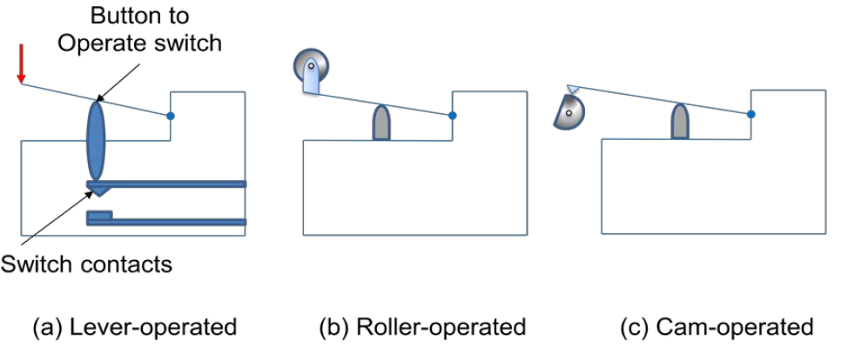
PROXIMITY SWITCH
Application : to detect the presence of an item on the conveyor belt

Slide 39
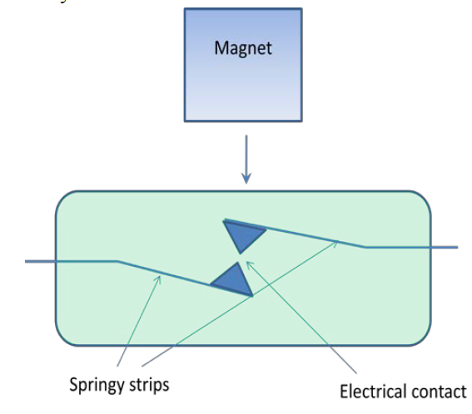
REED SWITCH
Application : to check closure of doors

Slide 40
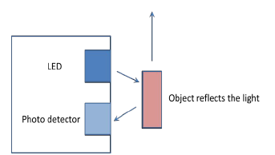
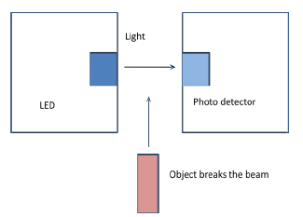
PHOTOSENSITIVE SENSOR
Application : to check closure of lift doors

Slide 41
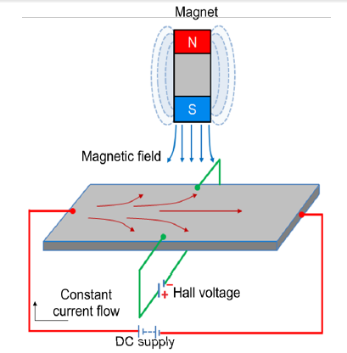
HALL EFFECT SENSOR
Hall voltage α distance between magnet and conductor
Application : to check the level of fuel in the tank

Slide 42
VELOCITY & MOTION SENSORS
Optical encoder
Tachogenerator
Pyroelectric sensors

Slide 43
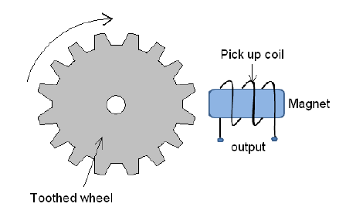
TACHOGENERATOR
EMF = N . Φ . n . ɷ . Sin (ɷt)
N – No. of teeth
n – No of turns in the coil
ɷ - angular velocity
Φ – magnetic flux
t - time
Application : to measure angular velocity of the shaft

Slide 44
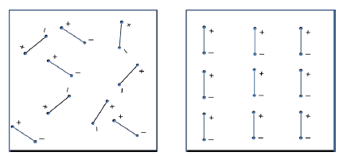
PYROELECTRIC SENSORS
BEFORE POLARISATION
AFTER POLARISATION
Change in temperature α change in charge
Application : to detect intruders & heat source
In engine analysis

Slide 45
FORCE SENSORS
Force can be measured by the measurement of displacements. Eg: Spring balance.
Strain gauge load cell
Piezoelectric sensors

Slide 46
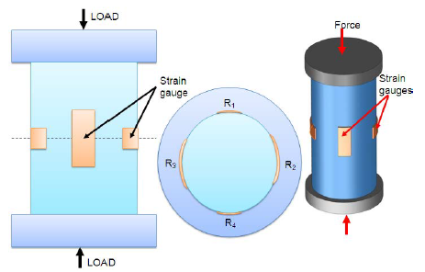
STRAIN GAUGE LOAD CELL
FORCE APPLIED
COMPRESSION / TENSION
CHANGE IN RESISTANCE
Change in resistance α Strain α measure of force applied
Application : laboratory balances, industrial scales, platform scales etc.

Slide 47
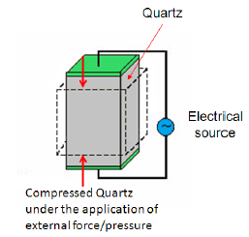
PIEZOELECTRIC SEENSORS
Materials: Quartz, Topaz, Tourmaline minerals group
Charge generated α displacement due to compression / tension α Force applied
Application : to monitor combustion in automotive industry, touch pads of mobile phones, used in medical, aerospace & nuclear instrumentation.

Slide 48
PRESSURE SENSORS
Fluid pressure can be measured by the elastic deformation. Eg: diaphragms, capsules, bellows, bourdon tubes.
Piezoelectric sensor
Tactile sensor

Slide 49
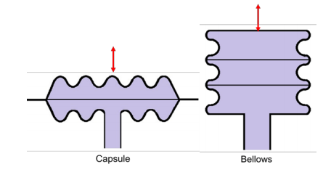
DIAPHRAGM, CAPSULES & BELOWS
USED IN COMBINATION WITH STRAN GAUGE & LVDT
CAPSULE – corrugated diaphragm & BELLOWS – a stack of capsules
DIAPHRAGM
Materials: SS, PB, Ni, RUBBER WITH NYLON

Slide 50
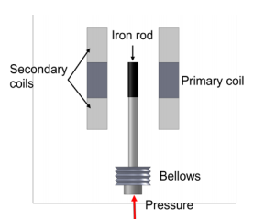
BELLOW WITH LVDT

Slide 51
BOURDON TUBE
Materials: SS, PB

Slide 52
TACTILE SENSOR
A.C. INPUT TO LOWER PVDF LAYER
VIBRATIONS GENERATED
TRANSMITTED TO UPPER PVDF LAYER VIA SOFT LAYER
CAUSES ALTERNATING VOLTAGE IN UPPER PVDF
ANY PRESSURE CHANGES THE VOLTAGE GENERATED
POLYVINYLIDENE FLUORIDE

Slide 53
LIQUID FLOW SENSORS
Traditional method: to measure pressure drop at the constrictions of the flow
$Q= \frac{A_{1}}{\sqrt{1− {(A_{2} − A_{1} )}^{2}}}$ * $\sqrt{\frac{2( P_{1} − P_{2})}{ρ}}$
Eg : Orifice plate
Turbine meter : rotation of rotor
Change in magnetic flux of magnetic pickup coil
Generation of alternative emf

Slide 54
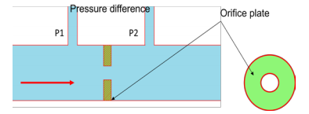
LIQUID FLOW SENSOR ORIFICE PLATE

Slide 55
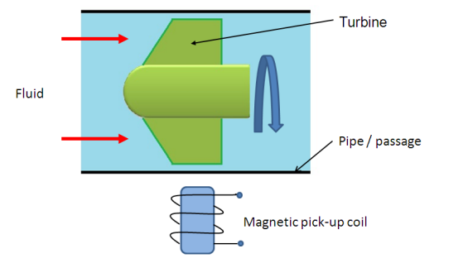
TURBINE METER
emf generated α number of magnetic pulse α angular velocity of rotor α fluid flow rate

Slide 56
LIQUID LEVEL SENSORS
Monitoring the position of the liquid surface. Eg: float
Indirectly by measuring the weight ( A*h*ρ*g ) Eg: load cell , pressure (h*ρ*g) etc

Slide 57
LIQUID LEVEL SENSOR – FLOAT with POTENTIOMETER / LVDT / STRAIN GAUGE

Slide 58
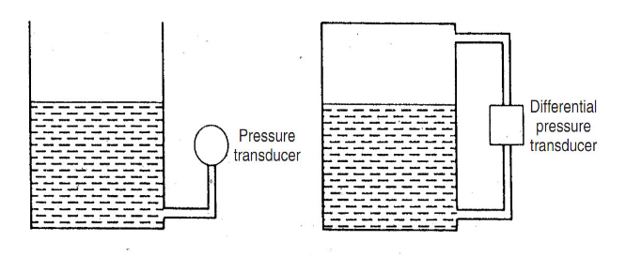
DIFFERENTIAL PRESSURE CELL

Slide 59
TEMPERATURE SENSORS
Monitoring the expansion / contraction of the material. Eg: Bimetallic strip
Change in the resistance Eg: RTD, Thermistor
Thermoelectric emf Eg: Thermo diodes, Thermo transistor, Thermocouple

Slide 60
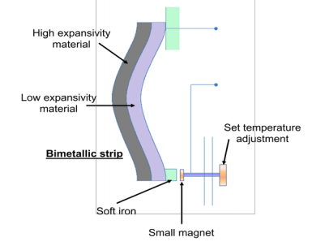
TEMPERATURE – BIMETALLIC STRIP
Application : to protect the heat appliances

Slide 61
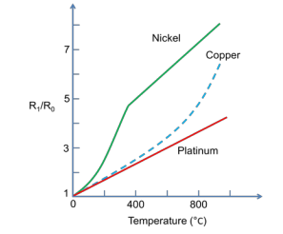
TEMPERATURE – RESISTANCE TEMPERATURE DETECTORS
Pt, Ni, Ni-Cu

Slide 62
APPLICATION - RTD
• To maintain correct temperature in the food handling and processing industry - Textile production - Plastics processing - Petrochemical processing equipments
• To control the operations of consumer appliances such as toasters, coffee makers, refrigerators, freezers, hair dryers, etc.
• Air, gas and liquid temperature measurement in pipes and tanks
• Exhaust gas temperature measurement

Slide 63
TEMPERATURE – THERMISTOR
sintered metal oxide (mixtures of metal oxides, chromium, cobalt, iron, manganese and nickel) or doped polycrystalline ceramic containing barium titanate (BaTiO3)

Slide 64
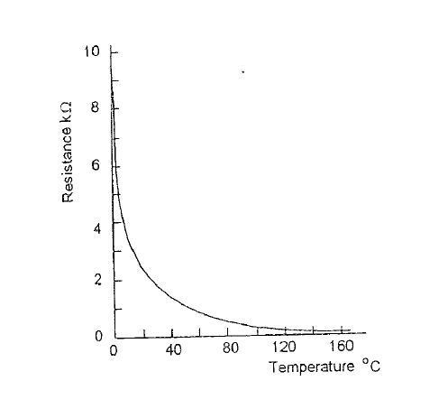
TEMPERATURE – THERMISTOR

Slide 65
APPLICATION - THERMISTOR
• To monitor the coolant temperature - the temperature of an incubator - the temperature of battery packs while charging - temperature of hot ends of 3D printers
• To maintain correct temperature in the food handling and processing industry equipments
• To control the operations of consumer appliances such as toasters, coffee makers, refrigerators, freezers, hair dryers, etc.

Slide 66
TEMPERATURE – THERMO DIODES & THERMO TRANSISTOR
Diodes : potential difference between p-n junction
linear function
needs signal conditioning
Transistor : voltage across emitter & base
2 transistor with different collector current – difference in base-emitter voltage directly proportional to T difference

Slide 67
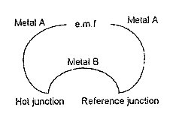
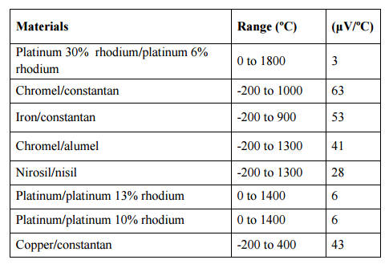
TEMPERATURE – THERMOCOUPLE

Slide 68
APPLICATION - THERMOCOUPLES
• To monitor temperatures and chemistry throughout the steel making process
• Testing temperatures associated with process plants e.g. chemical production and petroleum refineries
• Testing of heating appliance safety
• Temperature profiling in ovens, furnaces and kilns
• Temperature measurement of gas turbine and engine exhausts
• Monitoring of temperatures throughout the production and smelting process in the steel, iron and aluminum industry

Slide 69
LIGHT SENSORS
Photo resistor (LDR) – CdS – light intensity resistance
Photo diodes – light intensity into emf

Slide 70
LIGHT SENSORS APPLICATION
Camera:
Light Meters, Automatic Shutter Control, Auto-focus, Photographic Flash Control
Medical:
CAT Scanners - X ray Detection, Pulse Oximeters, Blood Particle Analyzers
Industry :
Bar Code Scanners, Brightness Controls, Encoders, Position Sensors
Safety Equipment :
Smoke Detectors, Flame Monitors

Slide 71
SELECTION OF SENSORS
Nature of variable measured
Nature of output from the sensors
Terminology of sensors
Environmental factors
Economic factors

Slide 72
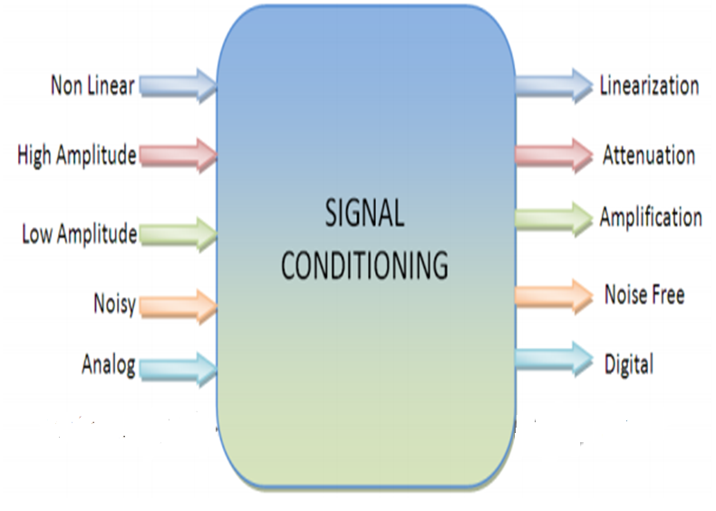
SIGNAL CONDITIONING

Slide 73
MODULE 1 SUMMARY
Mechatronics basics
System - Modeling system
Measurement system
Control system – open loop, closed loop
Sequential controller
Sensors & transducer
Terminologies
Displacement
Position
Velocity
Force / pressure
Liquid flow
Liquid level
Temperature
Light
Selection of sensor
Signal conditioning

