Slide 1

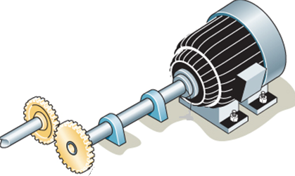
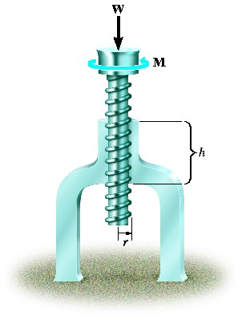
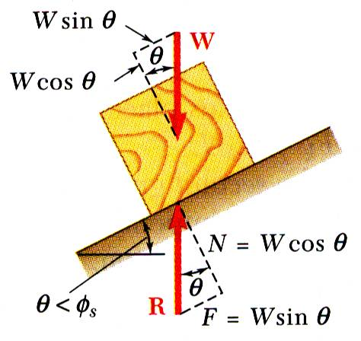
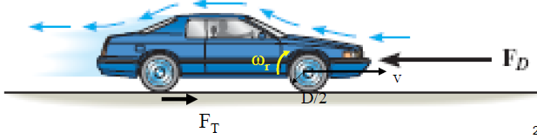
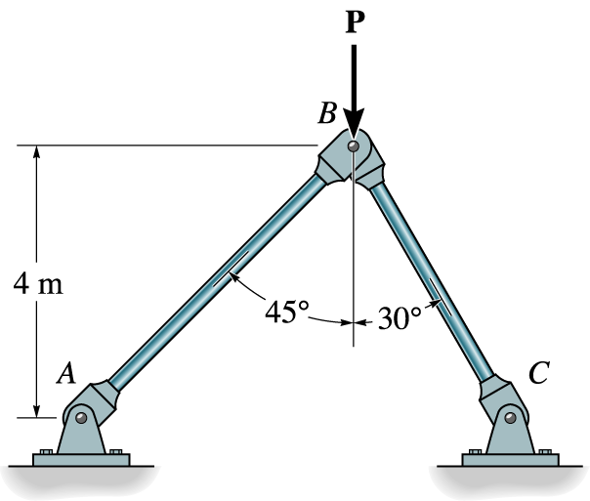


KINEMATICS OF MACHINERY
MEC 2211
MODULE 5
Gear Trains

Slide 2
Introduction to
Gear Trains
Combination of gears used to
    decrease or
    increase the speed of driven shafts
Widely used in
    watches
    mills
    automobile

Slide 3
Gear Trains (contd.)
Types
Simple Gear Train
Compound Gear Train
Epi-cyclic Gear Train
    Simple
    Compound

Slide 4
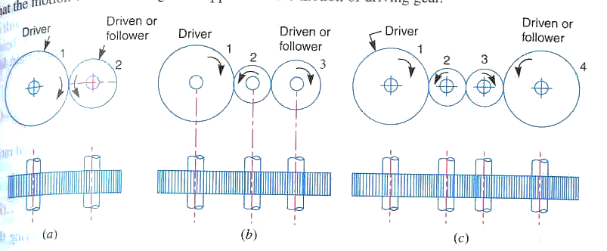
Simple Gear Train
Gears rotate in separate axes
Driver and follower rotate
  In the same directions if the no. of gears is add
  In the opposite direction if the no. of gears is even
Odd (Same ) Even (opposite)

Slide 5
Simple Gear Train (Contd..)
Speed Ratio

Slide 6
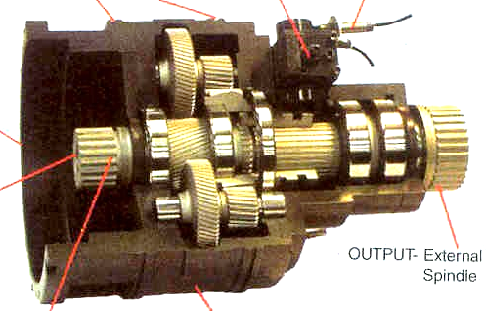
Compound Gear Train
Two gears of gear train rotate in the same shaft
Multiplication of speed change

Slide 7
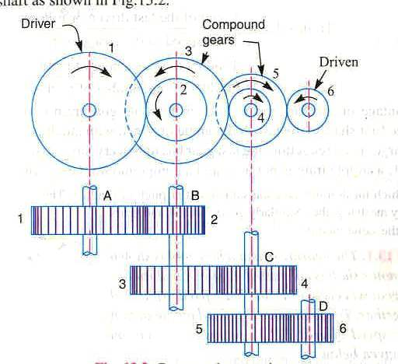
Compound Gear Train (Contd.)
Speed ratio

Slide 8
Problem 1
The figure shows the internal gearing of a “spinner” used for drilling works. If the motor M, rotates the shaft S with a constant angular velocity of 100 rpm, calculate
(i) the train speed/gear ratio,
(ii) the angular velocity of output gear D in rpm.
(Ans: i. 2.5 , ii. 40rpm)

Slide 9
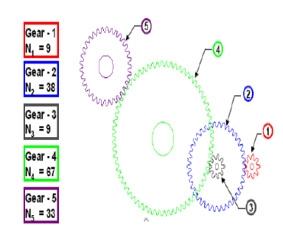
Problem 2
For the system of gears shown, find the speed ratio

Slide 10
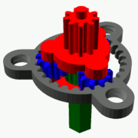
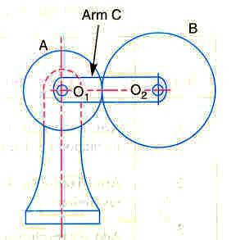
Planetary Gear Train
Also called as Epicyclic gear train
Axis of one gear (planet- B) revolve around another gear (sun -A)
Consists of sun, planet and arm
Planet may also mesh with an annulus (internal gear)
Used for speed reduction in less space

Slide 11
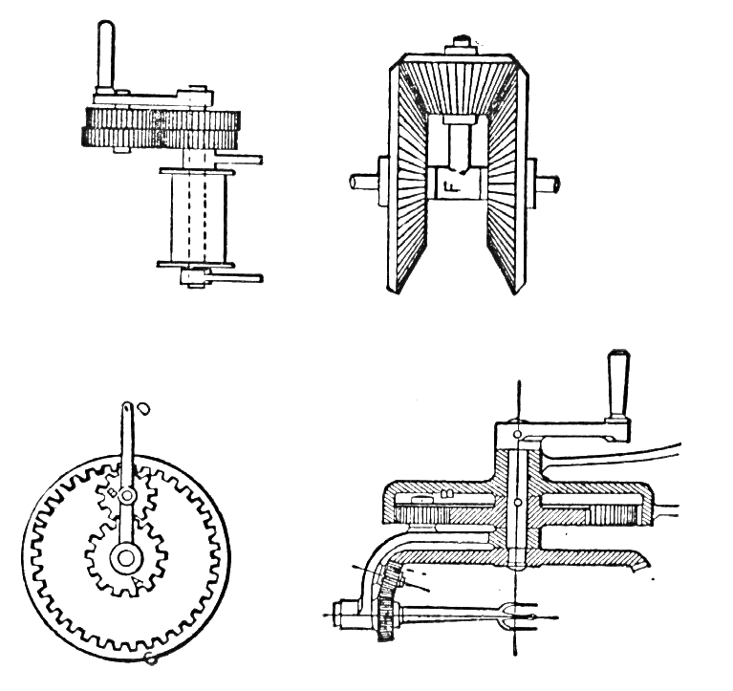
Simple Planetary Gear Train
D
Each gear rotate in separate axis
the arm D , connected to the input shaft, moves around its axis at A
the sun wheel A is fixed
the planet wheel B moves in the direction of the moving arm
the Internal gear C (annulus) is connected to output shaft
B
A
C

Slide 12
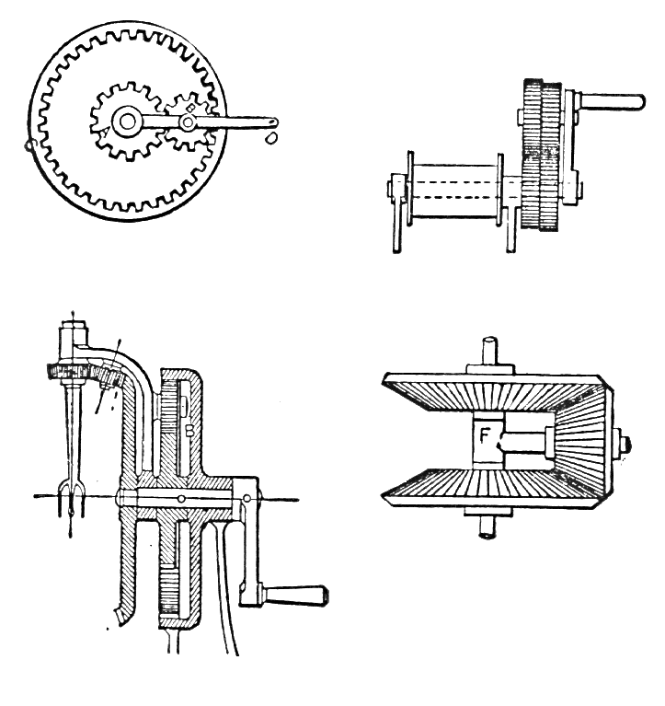
Simple Planetary Gear Train (contd.)
Epi-cyclic Bevel Gears (Differential)
A
an arm FG is fast on a shaft AA
bevel wheel B is loose on this arm
bevel wheels D and C are loose on the shaft AA
differential motions of the arm FG around and with shaft A ,
or, by making the arm loose on the shaft, a differential motion of the shaft and arm can be obtained.
D
B
C
G
A

Slide 13
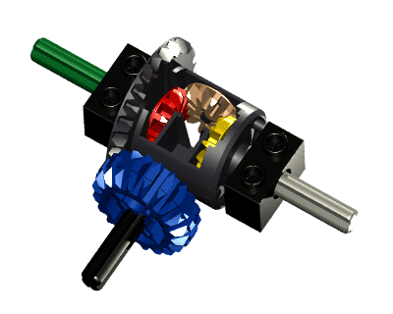
Differential Gear Train

Slide 14
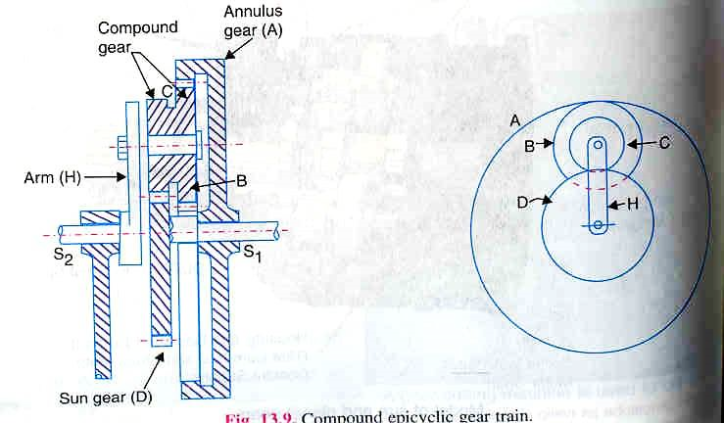
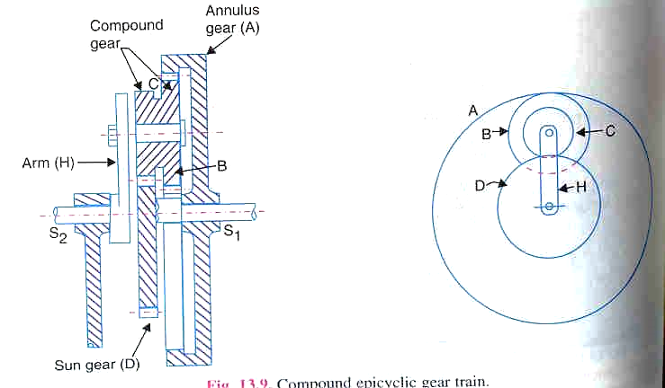
Compound Gear Train
D is the fixed sun gear
A is the internal gear connected to S₁
B & C are compounded planet gear
B meshes with sun
C meshed with annulus
H is the arm connected to S₂
S₁ and S₂ are input and
output shafts
C

Slide 15
Torques in Gear Train
There are three torques in gear train
  Input torque
  Output torque
  Holding Torque
Under equilibrium ΣT=0 i.e., T_{O}+T_{I}+T_{H}=0
Assuming no power loss
Input power=output power ΣTω=0

Slide 16
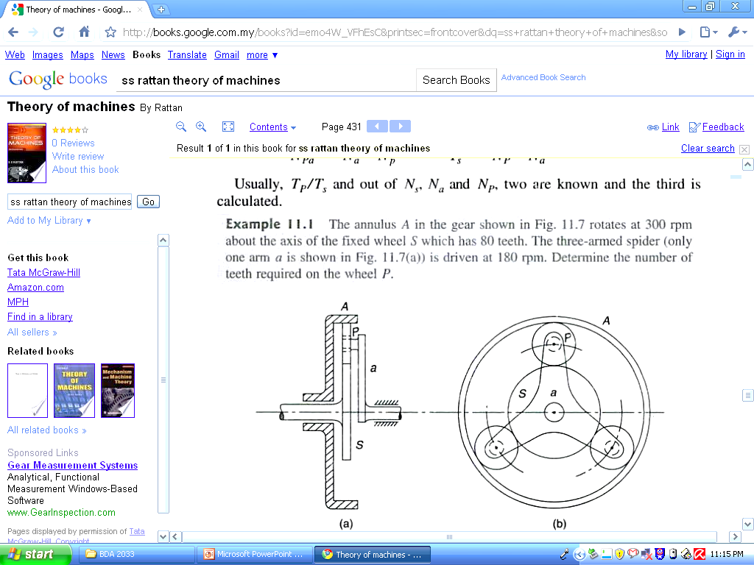
Problem 3

Slide 17
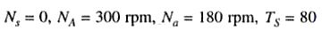
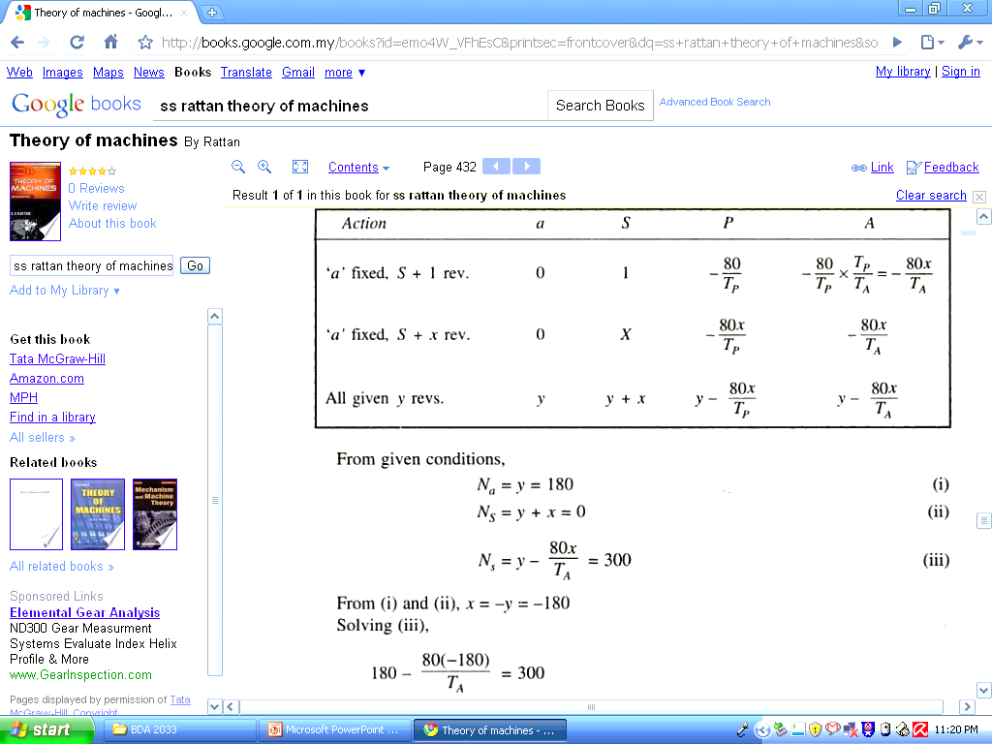
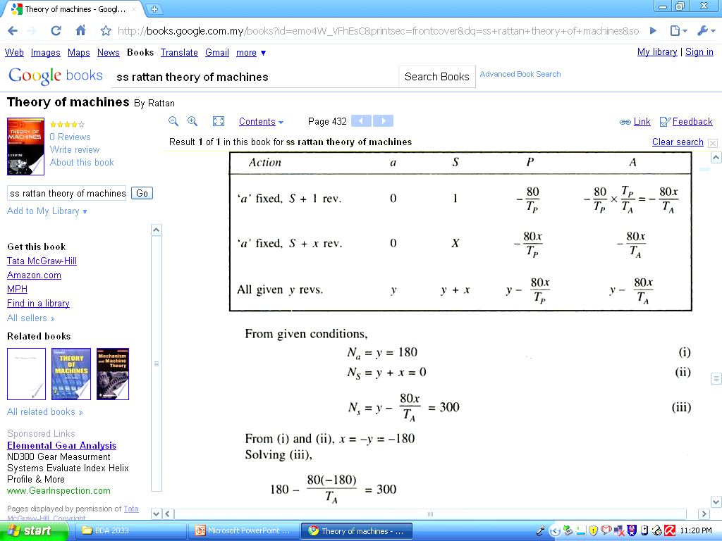
Solution
Given
N_{P}
N_{A}
N_{A}

Slide 18
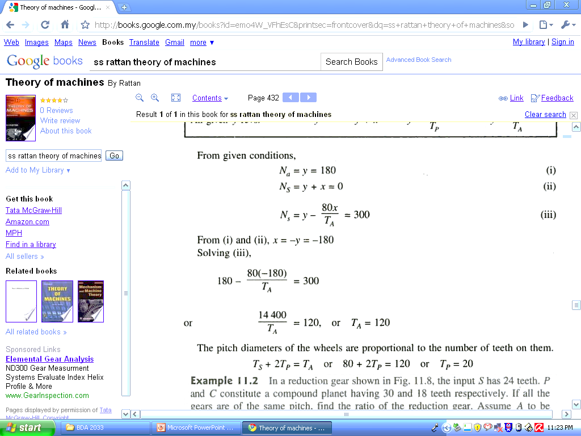
Solution (Contd.)
From Figure (b), D_{S}+2D_{P}=D_{A}
D_{P}
D_{S}
D_{A}
D_{P}

Slide 19
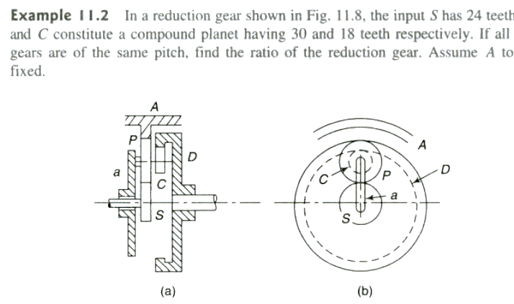
Problem 4

Slide 20
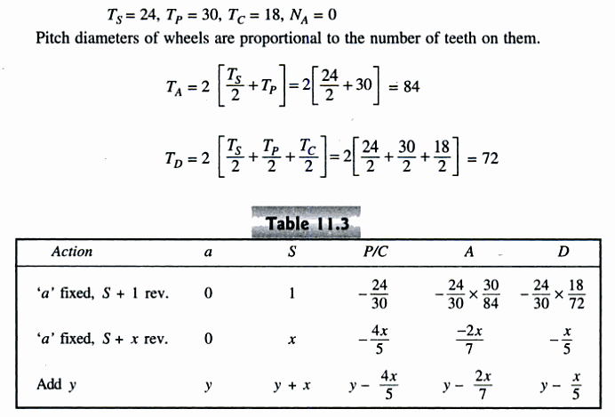
Solution

Slide 21
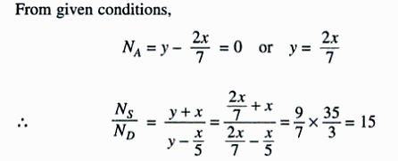
Solution (Contd.)

Slide 22
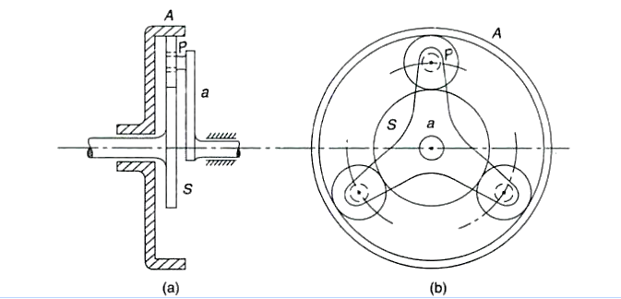
Problem 5
In an epi-cyclic gear train the sun S, Annulus A and Planet P form the gear train. Size of the wheels are such that speed of arm is 1/5th speed of sun. Minimum number of teeth on any wheel is 16. If the driving torque at S is 100 Nm. Find the power transmitted and holding torque for stationary annulus if the efficiency is 95%

