Slide 1

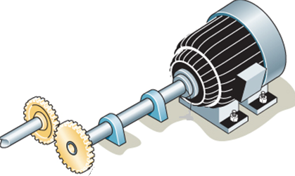
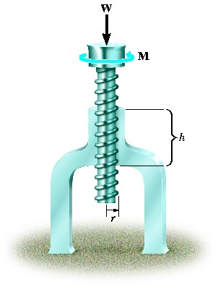
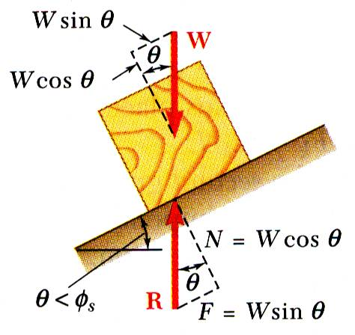
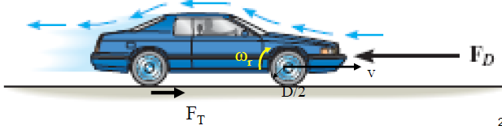
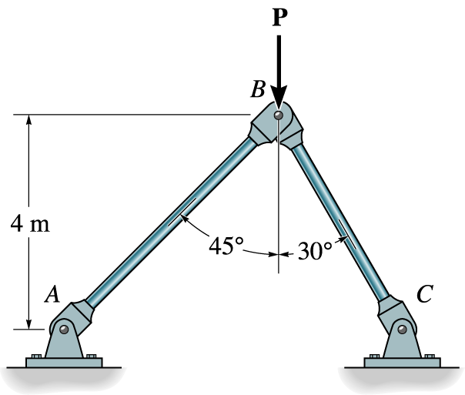


KINEMATICS OF MACHINERY
MEC 2211
MODULE 5
GEARS

Slide 2
Introduction to Gears
  Gears are widely used and most important form of mechanical drive
Used in many fields and under wide range of conditions
From watches and instruments to the heaviest and most powerful machinery.

Slide 3
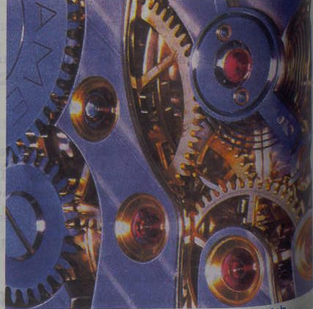
Introduction (contd..)
Watch Mechanism

Slide 4
Introduction (contd..)
Mercedes-Benz Manual Transmission

Slide 5
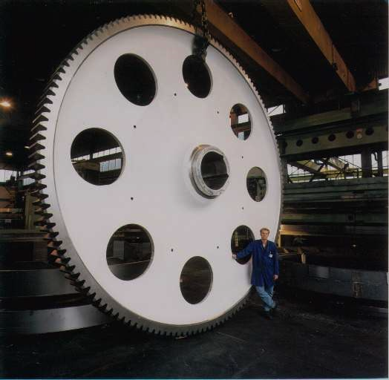
Introduction (contd..)
Gear for Cement Industry

Slide 6
Introduction (contd..)
Gears are used for transmitting a synchronous motion directly between shafts
Shafts may be parallel or at any skew axis
They are the most durable and rugged of all mechanical drives
Transmitting power with high efficiency (up to 99% in the case of parallel shafts)
Peripheral forces from decimals of a gram to thousands of tons
Torques up to a thousand ton-meters
Power from negligibly small values to tens of thousands of kilowatts
Diameter form a millimeter to ten or more meters.

Slide 7
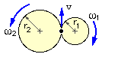
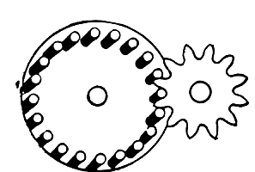
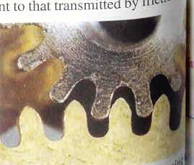
History of Gears
3000 years old
4th century BC ,Aristotle used friction wheels
Greeks metal wheels with wedge shaped teeth
Used in clocks, bi-cycles
Metal gears in the 18th century

Slide 8
Classification of Gears
GEARS
Position of teeth
Spur
Helical
Spiral
Double Helical
Type of Meshing
Internal
External
Rack and pinion
Position of Shafts
Parallel shafts
Intersecting shafts
Non Parallel –Non Intersecting shafts

Slide 9
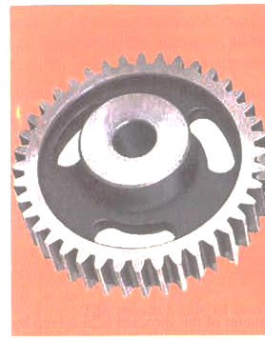
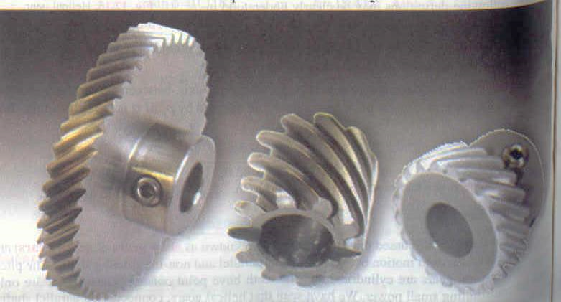
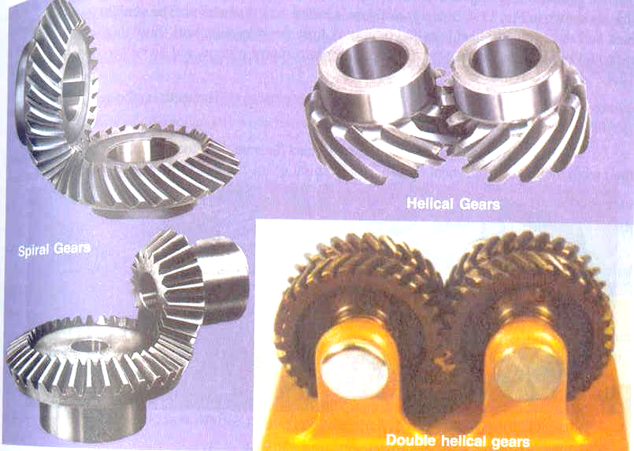
Position of teeth
Spur
Helical
Spiral
Double helical
(Herringbone)

Slide 10
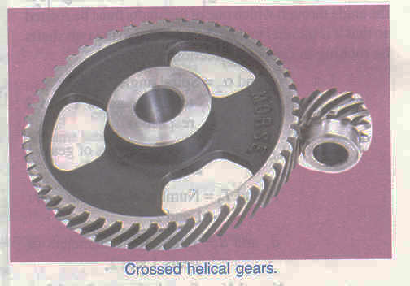
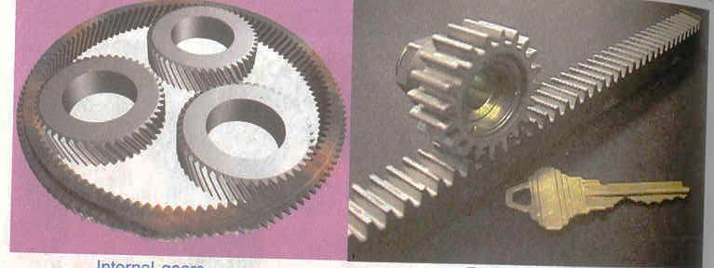
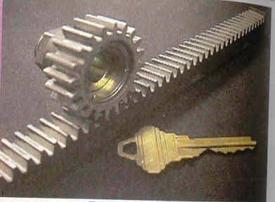
Types of Meshing
External
Internal
Rack and pinion

Slide 11
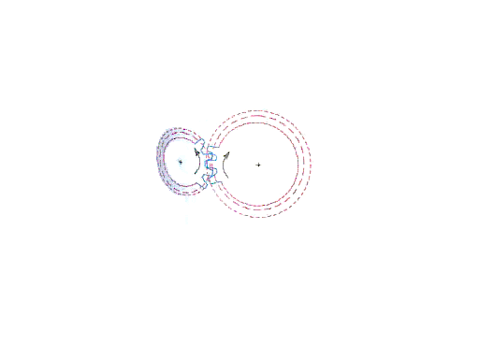
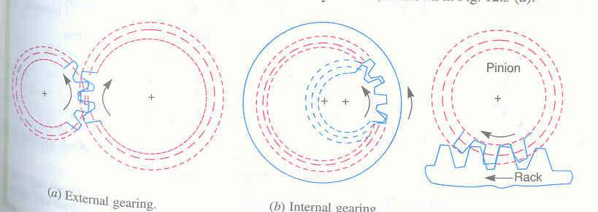
Types of Meshing (contd..)
External (opposite)
Internal (same)
Rack and pinion
(reciprocating -rotary)

Slide 12
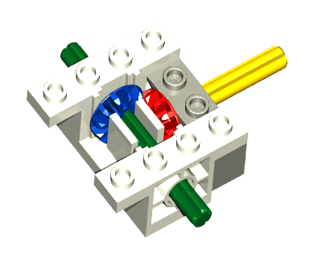
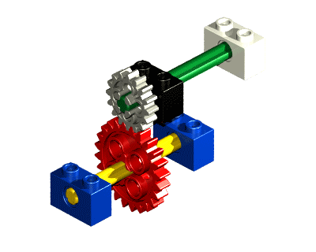
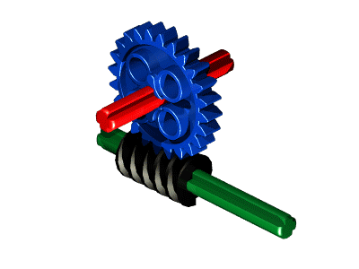
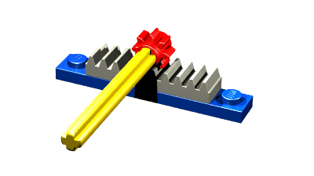
Gears in Action
Bevel Gears
Worm & Gear
Spur Gears
Rack and Gear

Slide 13
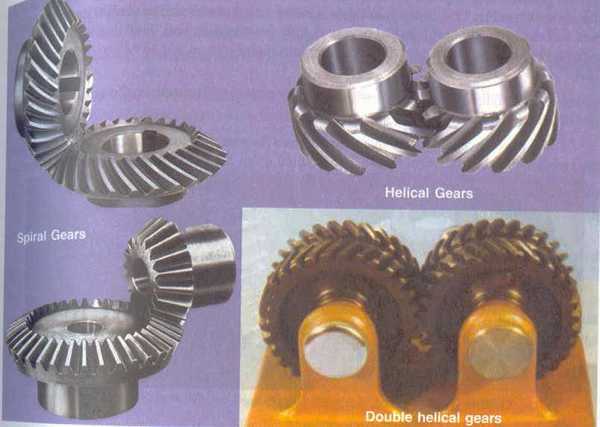
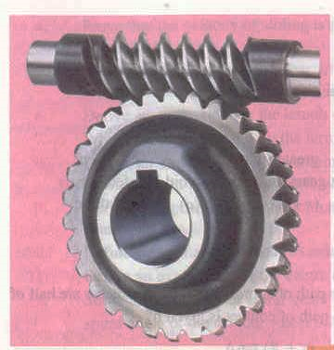
Position of Shafts
Non Parallel –Non Intersecting shafts
Parallel shafts
Intersecting shafts

Slide 14
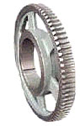
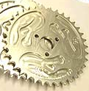
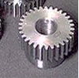


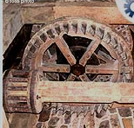
Gear Materials
Steel Gears
Cast Iron Gears
Plastic Gears
Powdered Metal Gears
Copper Gears
Brass Gears
Aluminum Gears
Other Metal Gears
Wood Gears

Slide 15
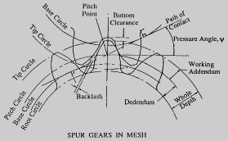
Nomenclature-Gears in Mesh

Slide 16
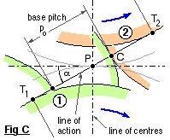
Gears in Mesh (Contd..)

Slide 17
Gear Nomenclature (Contd..)
Circular Pitch p = π D / T
Metric module, m = D_{p} / T_{p}
= D_{w} / T_{w}
Centre distance, C = (D_{w} + D_{p}) / 2
Tangential velocity, v = π D_{p} N_{p}/ 60
=π D_{w} N_{w} / 60
Gear reduction ratio, R = T_{w} / T_{p}
= D_{w} / D_{p}
= N_{p} / N_{w}

Slide 18
Conjugate Profile
A primary requirement of gears is the constancy of angular velocities
Constant velocity is the 'conjugate action' of the gear tooth profile.
They should obey law of gearing
A common normal to the tooth profiles at their point of contact must pass through a fixed point on the line of centers which divides the line of centres in the inverse velocity ratio.
The fixed point is called the pitch point
Any two profiles engaging each other and satisfying the law of gearing are conjugate curves.

Slide 19
Law of Gearing
Consider two arbitrary teeth profiles in meshing
Let ω₁ be the angular velocity of gear 1
And ω₂ be the angular velocity of gear 2
n-n is the common normal at the point of contact
t-t be the common tangent at eh point of contact
C & D are points of contact at gears 1 & 2 respectively
V_{C}
t
Their corresponding velocities are V_{C} and V_{D}
Resolving the velocities and parallel to common tangent and common normal and finding their relative velocities along common normal:
V_{C} cosα-V_{D} cosβ
Relative velocity should be zero along n-n to maintain contact
Hence V_{C} cosα-V_{D} cosβ=0
n
V_{D}
F
β
α
C,D
β
A
B
P
α
t
E
n

Slide 20
Law of Gearing (Contd..)
V_{C}
t
n
V_{D}
V_{C} cosα-V_{D} cosβ=0
(ω₁ X AC X AE/AC )-(ω₂ X BD X BF/BD )=0
ω₁ AE- ω₂ BF=0
ω₁/ ω₂ =BF/AE=BP/AP as Δ BPF and ΔAPE are similar
Hence ω₁/ ω₂ =BP/AP
F
β
α
C,D
β
A
B
P
α
t
E
n
A common normal to the tooth profiles at their point of contact must pass through a fixed point on the line of centers which divides the line of centres in the inverse velocity ratio.
The fixed point is called the pitch point

Slide 21
Velocity of Sliding
Sliding of gear teeth will occur along the common tangent t-t
Resolving the velocities parallel to common tangent and finding their relative velocities along common tangent:
= V_{C} sinα-V_{D} sinβ
V_{C}
t
n
V_{D}
F
β
α
C,D
β
A
B
P
α
=(ω₁ X AC X EC/AC )-(ω₂ X BD X FD/BD )
=ω₁ EC- ω₂ FD
=ω₁ (EP+PC)- ω₂ (FP-PD)
=(ω₁ + ω₂ )PC
as PC=PD and
ω₁ EP- ω₂ FP=0
Because Δ BPF and ΔAPE are similar
and ω₁/ ω₂ =BP/AP (law of gearing)
BP/AP=EP/FP
t
E
Hence the velocity of sliding is :
“summation of angular velocities of two meshing gears multiplied by the distance between pitch point and point of contact”
n
(ω₁ + ω₂ )PC

Slide 22
Conjugate profile (contd.)
Two standard profiles are
  Involute
  Cycloidal
Involute is a curve traced by a point on a straight line when it rotates around a circle without slipping
Cycloide is the path traced by a point on the circle when it rolls over another circle without slipping
Involute
Cycloidal
.
.
.
.

Slide 23
Conjugate profile (contd.)
Differences between Involute and Cycloidal Profiles
Involute
Centre distance can be varied
Pressure angle is constant
Made of single curve
Manufacturing easy
Not stronger
Interference occurs
Wear is more
Cycloidal
Centre distance cannot be varied
Pressure angle varies
Made of two curves
Manufacturing difficult
stronger
Interference does not occur
Wear is less

Slide 24
Applications
Agro Industry
Automotive Gears
Conveyor Systems
Instrumentation Gears
Marine Gears
Mill heads
Mining Gears
Power Station
Wind Turbine
Dr.S. Rasool Mohideen
Department of Mechanical Engg
B.S.Abdur Rahman University, Chennai

Slide 25
Belts will not break because of overload.
Advantages
Transmits exact Velocity ratio
Transmit larger power
High efficiency
Reliable
Compact

Slide 26
Disadvantages
Manufacturing needs special tools
Errors in teeth lead to vibrations
Considerably expensive

Slide 27
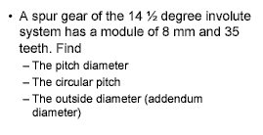
Problem 1

Slide 28
Solution
Module, m = D / T
8 = D / 35
Therefore D = 280 mm
Circular Pitch = π D / T
= π (280)/35=25.13 mm

Slide 29
Problem 2
In a gears in mesh, the smaller gear has thirteen teeth, while the larger gear has twenty-one teeth. Find the Gear Ratio
Solution:
G= T/t = 21/13=1.62
This means that for every one revolution of the smaller gear, the larger gear has made1/1.62 = 0.62 revolutions

