Slide 1
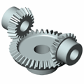
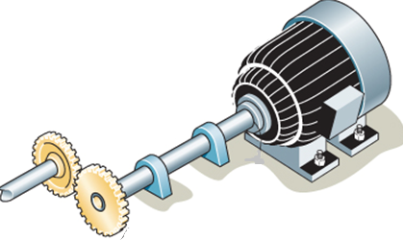
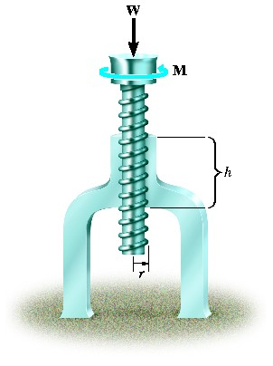
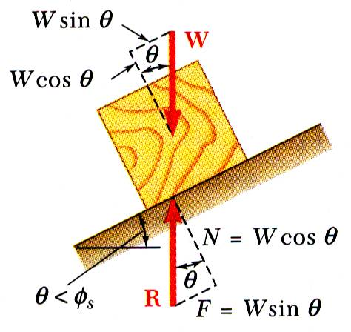
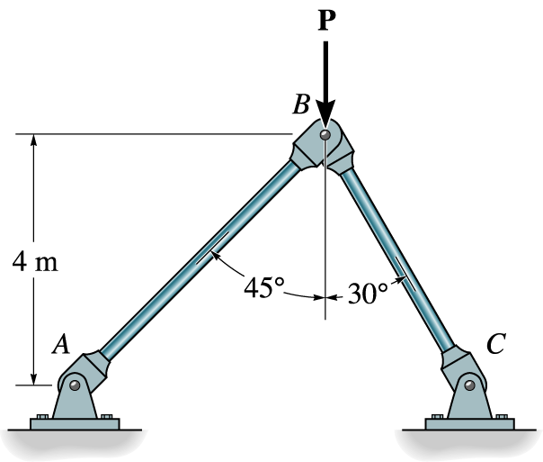
KINEMATICS OF MACHINERY
MEC 2211
MODULE 3

Slide 2
MODULE 3 ACCELERATION ANALYSIS
Intro
Acceleration Analysis of a Rotating Link by graphical method
Acceleration Analysis of a FBM
Acceleration Analysis of a SCM
Corioli’s Component of Acceleration
Complex Algebraic Method

Slide 3
Acceleration Analysis of a Rotating Link
Consider a link “OA” rotating at ω rad/sec , clockwise around the pivot “O” initially , angular acceleration α moved to A’ with velocity ω+d ω
Initial velocity = V_{AO}= OA (ω)
Final velocity=V_{A’O}= OA (ω+d ω)
Referring to the figure, changed velocity is made of two components namely tangential component (T) and centripetal component (C)
Centripetal component (C) of Acceleration:
Changed velocity parallel to OA =V_{A’O} sindθ
Changed velocity parallel to OA = 0-V_{A’O} sinθ= OA (ω+d ω) sin(dθ)
= OA(ω+ αdt) sin(dθ)
Applying limit, Lt dt tends to zer0, The above equation becomes OA X ω²
Hence the magnitude of Centripetal component of acceleration is length of the link times its angular velocity square
Its Direction is parallel to the link and its sense is towards the pivot
V_{AO}
A
A’
T
ω
α
V_{A’O}
C
O

Slide 4
Acceleration Analysis (Contd..)
V_{AO}
A
A’
ω
V_{A’O}
α
C
T
O
Tangential component (T) of Acceleration:
Changed velocity perpendicular to OA =V_{A’O} cosθ
Changed velocity perpendicular l to OA = V_{AO} -V_{A’O} cosθ
= OA (ω+d ω) cosθ
Acceleration perpendicular to OA = OA(dω/dt)=OA (α)
Hence the magnitude of Centripetal component of acceleration is length of the link times its angular acceleration
Its Direction is perpendicular to the link and its sense is towards the pivot

Slide 5
Acceleration Analysis of FBM
Consider a FBM, OABC (Link OC is fixed)
Link OA rotates with ω rad/sec, and α rad/sec² CW
Loop closure equation (LCE) for the FBM shown is
P_{AO}+P_{BA}+P_{CB}+P_{OC}=0
Consider the feasible velocity equation after conversion V_{BA}+V_{AO} = V_{BO}
Convert it to acceleration equation A_{BA}+A_{AO} = A_{BO}
Each rotating link will have two components as such centripetal component and tangential component
Therefore the acceleration table is developed as below
A
B
O
C

Slide 6
Acceleration Analysis of FBM (Contd..)
Acceleration Table
Acceleration Component | Vector representation |  | Magnitude | Direction | Sense
 | Centripetal component | Tangential component
A_{AO} | o'a₁’ |  | OA X ω₂² | II OA | O
 |  | a₁'a’ | OA Xα₂ | OA | CW
A_{BA} | a'b₁’ |  | AB X ω₃² | II OA | A
 |  | b₁'b’ | --- | AB | ---
A_{BO} | o'b₁' |  | CB X ω₄² | II CB | C
 |  | b₁‘b’ | --- | CB | ----

Slide 7
Acceleration Analysis of FBM (Contd..) Acceleration Diagram
Referring the table ( capital alphabets refer to fig. 1 and small alphabets refer to fig.2)
Choose an arbitrary point o’ ( also c’) and draw a line parallel to OA (Fig.1) to length of OA(ω₂²), towards O in fig.1(downwards) to get point a₁’. This is the centripetal component for A_{AO}
From a₁’draw another line perpendicular to OA ( of fig.1)for a length of OA(α) to get the point a’. This is the tangential component for A_{AO}
From a’, draw a line parallel to AB to the length of AB (ω₃²), towards A to get the point b₁’
Through b₁’ draw a line perpendicular to AB
Draw a line parallel to BC from c’ ( or o’) to the length of BC(ω₄²), to get point b₂’.
Through b2’ draw a line perpendicular to CB
Perpendiculars from b1’and b2’ will meet at point b’
Lines joining points o’, a’ and b’ is the acceleration diagram
O’
c’
b₂’
a₁’
A
B
a’
b’
Fig.2
O
C
b₁’
Fig.1

Slide 8
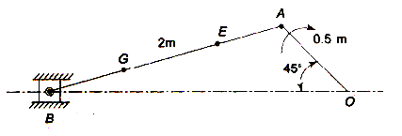
Acceleration Analysis of Slider Crank Mechanism
For the SCM shown, OA rotates with constant angular velocity,ω₂ (given)
Hence the angular acceleration( α) is zero
Therefore there is no tangential component for OA
Similarly the slider B has only a linear component, it doesn’t have a centripetal and tangential component
Acceleration table is thus developed as shown below
 | Centripetal | Tangential | Magnitude | Direction | Sense
A_{AO} | o’a’ |  | OAXω₂² | IIOA | -->O
A_{BA} | a’b₁’ |  | ABXω₃² | IIAB | -->A
 |  | b₁’b’ | --- | AB | ---
A_{BO} | o’b’ (linear ) |  | ---- | IIOB | ---

Slide 9
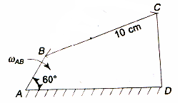
Problem 1
ABCD is a Four Bar Chain with the link AD is fixed as in Figure . The length of the links are AB = 6.25 cm, BC = 17.5 cm, CD = 11.25 cm, DA = 20 cm. The crank AB makes 100 rpm in the clockwise direction. Find the angular acceleration of the links CD and BC when the angle BAD is 60˚.

Slide 10
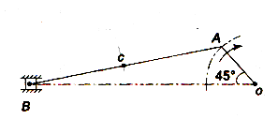
Problem 2
The crank of a slider crank mechanism rotates clockwise at constant speed of 300 rpm. The crank is 15 cm and the connecting rod is 60 cm long. Determine (a) linear velocity and acceleration of the midpoint of the connecting rod, (b) angular velocity and angular acceleration of the connecting rod at crank angle of 45˚ from inner dead centre position.

Slide 11
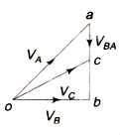
Solution
Draw vector ‘oa’ perpendicular to OA to represent velocity of A wrt ‘O’ such
that m/s. Draw by using appropriate scale.
From point ‘a’, draw vector ‘ab’ perpendicular to AB to represent velocity of B wrt A.
From point ‘o’, draw ‘ob’ parallel to the path motion of B to represent velocity of B. The vector ‘ab’ and ‘ob’ intersect at ‘b’. By measurement, = Vector ‘ab’ = 3.4 m/s. and =vector ‘ob’= 4 m/s.
Since ‘C’ is the midpoint of AB, then, c is also the midpoint of vector ‘ab’. Join ‘oc’. This will represent velocity of C, that is. By measurement
Angular velocity of the connecting rod BA,
rad/s
r
m/s

Slide 12
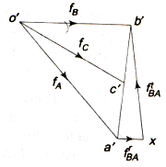
Solution (Contd..)
To get the acceleration diagram:
Draw o’a’ parallel to AO to represent the centripetal component of acceleration of A wrt O i.e m/s² according to suitable scale.
The acceleration of B wrt A must have two components that is
Centripetal component, and (ii) tangential component, . Both (i) and (ii) components are mutually perpendicular.
Therefore from point a’ draw a’x parallel to BA to represent m/s².
From point ‘x’ draw vector xb’ perpendicular to a’x.
From o’, draw vector o’b’ parallel to the path of motion of B to represent acceleration of B that is. The vectors xb’ and o’b’ intersect at b’.
Since ‘C’ is the midpoint of AB, thus c’ is also the midpoint of a’b’. Join o’c’. The vector o’c’ represents acceleration of mid point of ‘c’ of the connecting rod i.e
Vector o’c’ = 117 m/s²
Angular acceleration of the connecting rod BA rad/s
rad/s²

Slide 13
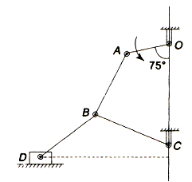
Tutorial 1
In Figure shown, the angular velocity of crank OA is 600 rpm. Determine the linear velocity of the slider D and the angular velocity of the link BD, when the crank is inclined at an angle of 75˚ to the vertical. The dimensions of the various links are : OA = 28 mm, AB = 44 mm, BC = 49 mm, BD = 46 mm and the centre distance between the centre’s of rotation O and C is 65 mm. Path of the travel of slider is 11 mm vertically below the fixed point C. [Ans: 1.48 m/s, 34.8 rad/s]

Slide 14
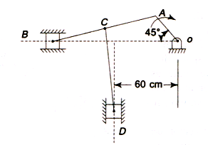
Tutorial 2
The lengths of various links of a mechanism as shown in Figure 5.12 are: OA = 30 cm, AB = 100 cm, CD = 80 cm, and AC = CB. Determine for the given configuration the velocity of the sliders B and D, if the crank OA rotates at 60 rpm in the clockwise direction. Also find the angular velocity of the link CD.
[Ans: 1.7 m/s, 0.45 m/s, 2 rad/s]

Slide 15
Acceleration Of Slider On A Rotating Link
A
A’
Slider on a rotating link will have two movements translation along the link and rotation around pivot
Hence the final acceleration of the slider B with respect to O, A_{BO} is made of two components
Component parallel to sliding or parallel to the link on which it slides
Component perpendicular to the link on which it slides
First component is called Corioli’s component whose magnitude is given as 2 (V_{BO})(ω_{AO})
B’
B
α
C
T
O

Slide 16
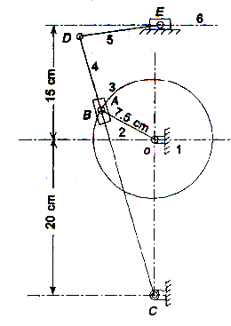
Tutorial 3
Figure shows a shaper mechanism. Crank OA is 7.5 cm, lever CBD is 35.5 cm, and link DE is 10 cm. The crank rotates at a uniform speed of 200 rpm. Determine (a) Linear velocity of slider link 6, (b) Angular velocity of CD.
[Ans: 1.6 m/s, 4.57 rad/s]

