Slide 1

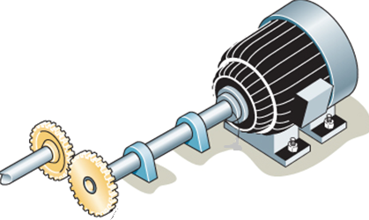
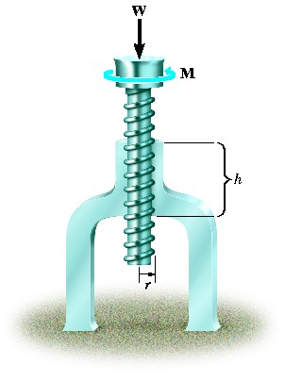
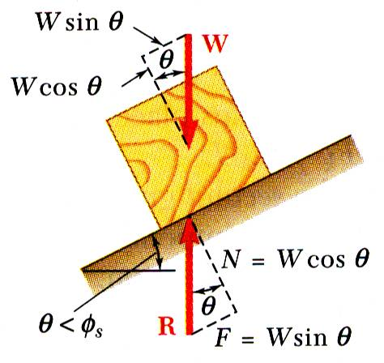
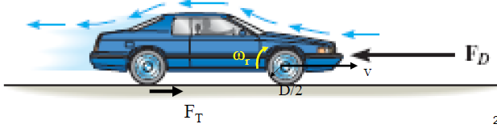
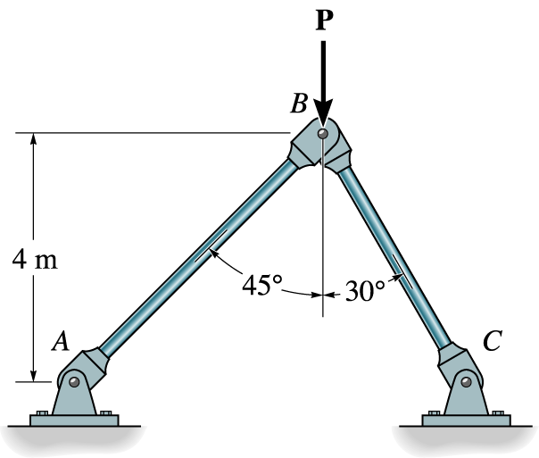


KINEMATICS OF MACHINERY
MEC 2211
MODULE 2

Slide 2
MODULE 2
VELOCITY ANALYSIS
Intro
Position and Displacement
LCE
Relative velocity
Graphical method
Instantaneous centre Method
Complex Algebraic Method

Slide 3
Motion Analysis
Major Parameters
  Position –with respect to a coordinate system
  Displacement –position difference
  Velocity- rate change of displacement
  Acceleration- rate of change of velocity
  -Rate of change of acceleration ?
All are vector quantity

Slide 4
Position
Position of an object is defined with respect to a datum
This datum is nothing but a coordinate system (CS)
Considering a Cartesian coordinate system,
Let the point “A” be at x distance from Y axis and y distance from X axis
Point “A” is positioned at a particular direction (angle) and Magnitude
Hence it is represented as vector
Position of “A” with respect to the origin “O” is written as P_{AO} and denoted as vector oa
When the observer is at another sub CS, then the position of point A with respect to sub CS is called Apparent position and position with respect to main CS is Absolute position
P_{AO}=P_{AB} + P_{BO} i.e., oa =ob+ ba
Y
x
A
B
y
O
X

Slide 5
Displacement
It is the position difference of a point
Suppose the point “A” moves to “A₁”, their position difference “AA₁” is termed as displacement
This is actually the difference between vectors oa and oa₁
D=P_{AO}-P_{A1O}
d=oa-oa₁
Y
A
A₁
O
X

Slide 6
Loop Closure Equation
3
B
2
C
4
Consider the Four bar mechanism ABCD
Assembly of the four links kinematically
Fixing link 1 in CS, Position of A with respect to O is P_{AO}
Fixing link 2 with link 1, absolute position of B i.e., P_{BO}=P_{BA}+P_{AO}
Fixing link 3 to link 2, absolute position of C i.e., P_{CO}=P_{CB}+P_{BO}
Fixing link 4 with link 3, absolute position of B i.e., P_{DO}=P_{DC}+P_{CO}
Fixing link 1 and link 4, absolute position of A i.e., P_{AO}=P_{AD}+P_{DO}
Therefore P_{AO}=P_{AD}+P_{DC}+P_{CB}+P_{BA}+P_{AO}
Canceling the same terms, P_{AD}+P_{DC}+P_{CB}+P_{BA} = 0
The above equation is called LOOP CLOSURE EQUATION (LCE)
which is nothing but the position difference between the various points of the mechanism in sequence and is equal to zero
A
1
D
Y
Y
B
B
Y
Y
C
C
B
A
D
A
D
O
X
O
X
A
D
A
D
O
X
O
X

Slide 7
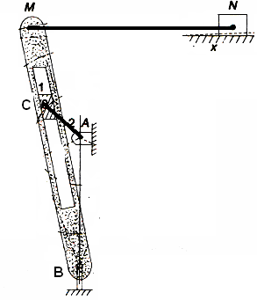
Loop Closure Equation (Contd..)
LCE for the OCM shown in Fig. 1 is written as
P_{QP}+P_{RQ}+P_{SR}+P_{PS}=0
LCE for the QRM mechanism shown in Fig. 2
Two loops are there
  ABCDA
  BMNOB
  P_{DB}+P_{CD}+P_{AC}+P_{BA}=0
  P_{MB}+P_{NM}+P_{ON}+P_{BO}=0
Q
S,
R
P
Fig. 1
, O
D,
Fig. 2

Slide 8
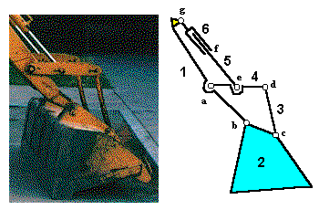
Problem1
Find the loop closure equation for the mechanism shown (Link 2 is fixed)
LCE:
The loop is bcdefgab
P_{cb}+P_{dc}+P_{ed}+P_{fe}+P_{gf}+P_{ag}+P_{ba}=0

Slide 9
Problem 2
Find the LCE for the mechanism shown
U
S
R
T
Q

Slide 10
Velocity Analysis
Velocity analysis of mechanism can be carried out by many methods
Some of them are
  Relative velocity method,
  Instantaneous centre method and
  Algebraic method
First two methods listed above are graphical methods
Last method is analytical

Slide 11
Relative Velocity Method
If we want to find the speed of a man travelling inside a metro train from Air Port
  First we must find the speed of man (with respect to train )
  Next we must find the speed of train (with respect to station)
  Summing up the two speeds will give the speed of man (with respect to station)
This is called relative velocity

Slide 12
Relative Velocity of Turning Link
Consider a link “OA” rotating at ω rad/sec, clockwise around the pivot “O”
Initial position = P_{AO}
Final Position =P_{A’O}
Change in position= AA’
i.e., displacement = AA’
Arc length AA’= OA sin (dθ) =OA (dθ) as dθ is small
Therefore velocity V_{AO} = rate of change of displacement
=OA(dθ/dt) =OA (ω)
The relative velocity of any point A of a rotating link about the pivot O is denoted as V_{AO}
Its magnitude is OA (its distance from pivot) times ω
It is direction is perpendicular to the position of link
It is represented as vector oa
A’
A
ω
O

Slide 13
Relative Velocity of Sliding Link
V_{BO}
B
Consider a link “B” sliding with a linear velocity of v m/sec,
The relative velocity of B is denoted as V_{BO}
It is direction is parallel to the motion of link B
It is represented as vector ob

Slide 14
Relative Velocity of Turning- Sliding Link
Consider a link “B” sliding on link OC , with relative velocity V_{BC,} acting parallel to to the link OC ( slider motion)
Link OC turns around O with ω rad/s ,
The relative velocity of C is denoted as V_{CO,} Acting perpendicular to link OC
The absolute velocity of B is V_{BO}=V_{BC}+ V_{CO}
It is represented as vector ob
V_{BC}
V_{CO}
C, B (on slider)
O

Slide 15
Velocity Analysis of FBM
Consider a FBM, OABC (Link OC is fixed)
Link OA rotates with ω rad/sec, CW
Loop closure equation (LCE) for the FBM shown is
  P_{AO}+P_{BA}+P_{CB}+P_{OC}=0
Convert it to velocity equation
  I.e., V_{AO}+V_{BA}+V_{CB}+V_{OC}=0
In the above equation , term V_{CB} is not feasible as point C cannot move (point in the fixed link)
It is feasible, if we have V_{BC}
Therefore V_{BC} = -V_{CB}
Similarly V_{CO} is zero ( as it is fixed)
B
A
O
C

Slide 16
Velocity Analysis of FBM (Contd..)
Now rewriting the velocity equation, we get
V_{AO}+V_{BA}-V_{BC} =0 or V_{AO}+V_{BA} = V_{BC}
V_{BC} can also be written as V_{BO} as O and A points in the fixed link
Therefore V_{BA}+V_{AO} = V_{BO}
Now develop the velocity table
Velocity Component | Vector representation | Magnitude | direction | Sense
V_{AO} | oa | OA X ω₂ | OA | CW
V_{BA} | ab | - | AB | -
V_{BO} | ob | - | CB | -

Slide 17
Velocity Analysis of FBM (Contd..)
Velocity Diagram
Components of Velocity diagram are nothing but the vectors shown in column 2 in the table
From an arbitrary point O , start drawing the first component oa, which is completely known
Draw a line perpendicular to link OA to the length of OA(ω₂) downwards
For the second component ab, as only its direction is known, draw a line through point b , perpendicular to link AB
Similarly for the third component ob or cb, since only its direction is known, draw a line through point o , perpendicular to link CB
The perpendicular lines thro’ points o and a will meet at the unknown point b
Hence “oab” form the velocity (vector) diagram for the mechanism “OABC”
b
o
c,
B
a
A
O
C

Slide 18
Velocity Analysis of FBM
Velocity Diagram (Contd..)
To find the angular velocity of link AB, measure ab in the VD and divide it length AB i.e., V_{BA}= AB (ω₃)
Therefore ω₃ = V_{BA}/AB or ab/AB
Similarly ω₄ = V_{BC}/CB or bc/AB
Sense?
To find the sense of angular velocities(ω):
Comparing the two figures
In Fig.2, the velocity component ab shows link AB in fig.1 would move up wards,
  i.e., end B would rotate CCW with respect to pivot A . Hence the sense of ω₃ is CCW
Similarly, the velocity component cb in Fig.2, shows link CB in fig.1 would move towards right,
  i.e., end B would rotate CW with respect to pivot A . Hence the sense of ω₃ is CCW
B
A
O
C
Fig.1
b
o
c,
a
Fig.2

Slide 19
Velocity Analysis of FBM
Velocity Diagram (Contd..)
E
To find the velocity of intermittent point D :
Portion AB and AD will have same angular velocity (ω₃)
ω_{AB}= ω_{AD}= ω₃, i.e., V_{BA}/AB = V_{DA}/AD
Hence AD/AB = V_{DA} / V_{BA} or V_{DA} =V_{BA} (AD/AB)
= ad
So plot point d at ad ( V_{DA}) distance from point a in fig. 2 and join od. This gives the absolute
velocity of D (V_{DO})
To find the velocity of offset point E :
Join point E with points A and B
V_{EO}=V_{EA}+V_{AO} and V_{EC}=V_{EB}+V_{BC}
As V_{EO}=V_{EC}, V_{EA}+V_{AO}=V_{EB}+V_{BC} or oa+ae = eb+bc
Now draw a line perpendicular to AE ( in fig.1) through point a in fig.2 and another line perpendicular to EC (in fig.1) through point b in fig.2. These lines would intersect to give point e in V/D. Join e with o to get the absolute velocity of E
D
B
A
O
C
Fig.1
b
o,
c
d
Fig.2
e
a

Slide 20
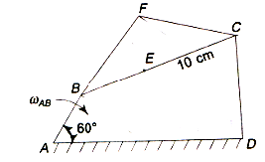
Problem 1
ABCD is a Four Bar Chain with the link AD is fixed as in Figure . The length of the links are AB = 6.25 cm, BC = 17.5 cm, CD = 11.25 cm, DA = 20 cm. The crank AB makes 100 rpm in the clockwise direction. Find the following when the angle BAD is 60˚.
The angular velocity of the links CD and BC
Velocity of point E, 10 cm from C on the link BC.
The velocity of point F, which is 10.5 cm from B and C and lying outside ABCD.

Slide 21
Velocity Component | Vector representation | Magnitude | direction | Sense
V_{BA} | ab | 6.25 X 10.47 | AB | CW
V_{CB} | bc | - | CB | -
V_{CO} | ac | - | OC | -
F
C
LCE
V_{BA}+V_{CB}+V_{DC}+V_{AD}=0
V_{BA}+V_{CB}-V_{CD}=0
V_{BA}+V_{CB}=V_{CD}
B
A
D

Slide 22
Velocity Component | Vector representation | Magnitude | direction | Sense
V_{BA} | ab | 6.25 X 10.47 | AB | CW
V_{CB} | bc | - | CB | -
V_{CA} = V_{CD} | ac | - | DC | -
c
d,a
b

Slide 23
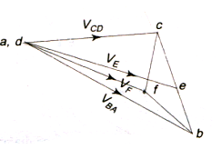
Solution
Draw the schematic diagram given to scale
Write the loop closure equation
Convert it to velocity equation
Check the feasibility and rewrite
Develop the relative velocity table
Draw the velocity diagram to scale
Find the necessary unknowns
By measurement, dc = 3 cm, thus
cm/s
Angular velocities of link CD and BC rad/s
Locate point ‘e’ on ‘bc’ using ratio;
scale: 1cm = 15 cm/s (for example)
rad/s
(or)
cm/s

Slide 24
Solution (Contd..)
Locate the point F on the free body diagram.
Draw ‘bf’ perpendicular to BF,
and ‘cf’ perpendicular to CF to intersect at’f’.
Then ‘af’ is the velocity of F.
cm (scaled down)
cm/s.

Slide 25
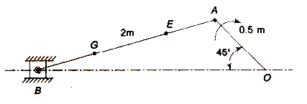
Problem 2
The crank and connecting rod of a theoretical steam engine are 0.5 m and 2.0 m long respectively. The crank makes 180 rpm in the clockwise direction. When it has turned 45˚ from the inner dead centre position, determine;
Velocity of pistons
Angular velocity of the connecting rod
Velocity of point E on the connecting rod 1.5 m from the gudgeon pin.

Slide 26
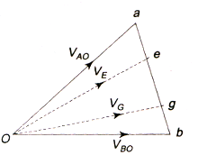
Solution
rad/sec
r
The vector ‘oe’ represents velocity of E w.r.t O. By measurement;
Velocity of point E,
= vector ‘oe’ = 8.5 m/s

