Slide 1
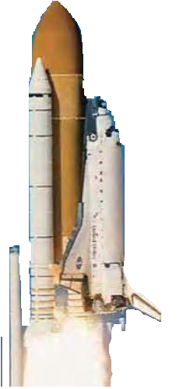

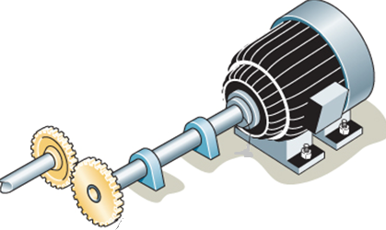
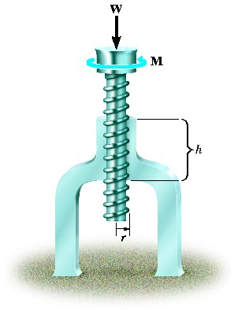
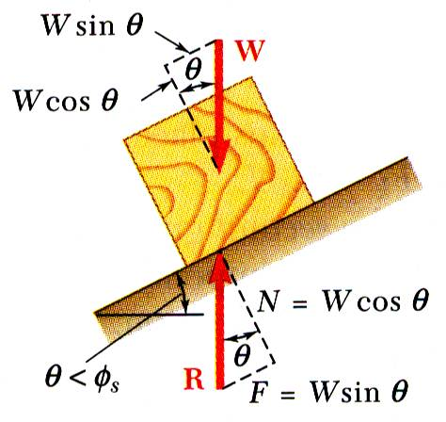
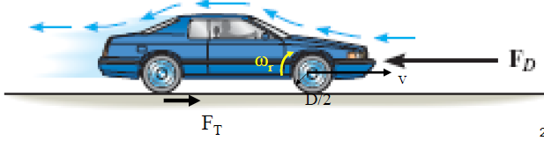
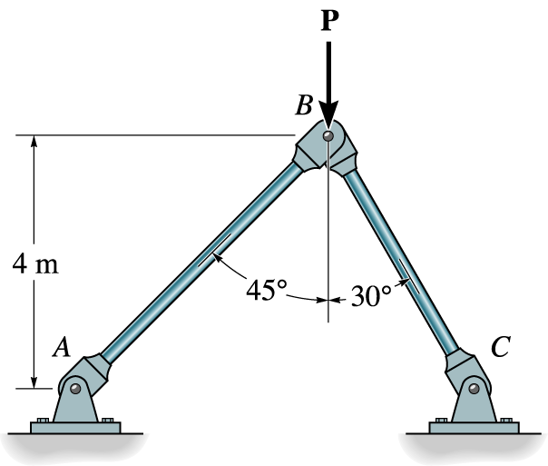


ENGINEERING MECHANICS
GE 107
Lecture 8

Slide 2
Unit III Properties of Surfaces and Solids
Determination of Areas and Volumes –
  First moment of area and the Centroid of sections –
  Rectangle, circle, triangle from integration –
  T section, I section, Angle section, Hollow section by using standard formula –
Second and product moments of plane area –
  Physical relevance –
  Rectangle, triangle, circle from integration –
  T section, I section, Angle section, Hollow section by using standard formula –
Parallel axis theorem and perpendicular axis theorem –
Polar moment of inertia
Mass moment of inertia –
  Derivation of mass moment of inertia for rectangular section, prism, sphere from first principle –
  Relation to area moments of inertia.

Slide 3
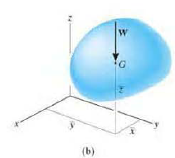
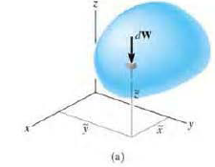
Centre of Gravity
A body is composed of an infinite number of particles of differential size.
If the body is located within a gravitational field, then each of these particles will have a weight dW (Figure a)
These weights will form an approximately parallel force system
The resultant of this system is the total weight of the body, which passes through a single point called the centre of gravity G (Figure b)

Slide 4
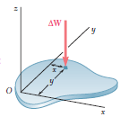
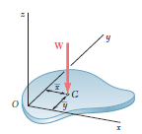
Centre of Gravity of a 2D rigid Body
Let us first consider a flat horizontal plate (figure a) and divide the plate into n small elements
The coordinates of the first element are denoted by x₁ and y₁, those of the second element by x₂ and y_{2,} etc.
The forces exerted by the earth on the elements of plate will be denoted, respectively, by ΔW₁, ΔW₂, . . . , ΔW_{n}.
Their resultant is therefore a single force in the same direction.
The magnitude W of this force is obtained by adding the magnitudes of the elemental weights.

Slide 5


Centre of Gravity of a 2D rigid Body (Contd.)
To obtain the coordinates of the point G (x and y) where the resultant W should be applied, we write that the moments of W about the y and x axes are equal to the sum of the corresponding moments of the elemental weights
If we now increase the number of elements into which the plate is divided and simultaneously decrease the size of each element, we obtain in the limit the following expressions:

Slide 6


Centroid of Area
In the case of a flat homogeneous plate of uniform thickness, the magnitude ΔW of the weight of an element of the plate can be expressed as ΔW = γt ΔA
  where γ is the specific weight (weight per unit volume) of the material
  t is the thickness of the plate
  ΔA is the area of the element
Similarly, we can express the magnitude W of the weight of the entire plate as W = γ tA
Substituting for ΔW and W in the moment equations and dividing throughout by γ t, we obtain
Or

Slide 7


First Moments of Areas
The integral ∫x dA in the equation of preceding slide is known as the first moment of the area A with respect to the y axis and is denoted by Q_{y}.
Similarly, the integral ∫y dA defines the first moment of A with respect to the x axis and is denoted by Q_{x}.
We can write
Therefore

Slide 8
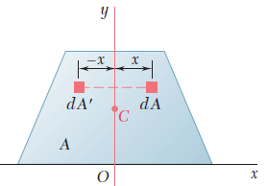
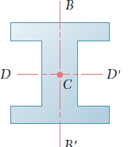
Centroid of Symmetric Areas
When an area A possesses an axis of symmetry BB’, its first moment with respect to BB’ is zero, and its centroid is located on that axis.
For example, in the case of the area A of Figure shown, which is symmetric with respect to the y axis, we observe that for every element of area dA of abscissa x there exists an element dA’ of equal area and with abscissa -x.
It follows that the integral is zero and, thus, Q_{y} = 0.
It also follows that x = 0. Thus, if an area A possesses an axis of symmetry, its centroid C is located on that axis.
If an area or line possesses two axes of symmetry, its centroid C must be located at the intersection of the two axes

Slide 9
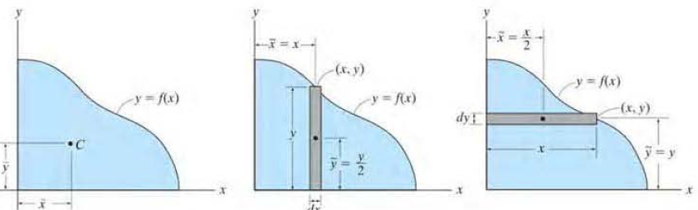
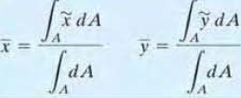
Determination of Centroid by Integration
If an area lies in the x-y plane and is bounded by the curve y =f(x), as shown in Figure, then its centroid will be in this plane and can be determined from integrals namely,
These integrals can be evaluated by performing a single integration, if we use a rectangular strip for the differential area element.
For example. if a vertical strip is used, the area of the element is dA = Ydx and its centroid is located at x = x and y = y/2.
If we consider a horizontal strip, then its area and centroid is located at x = x/2 and y= - y.

Slide 10
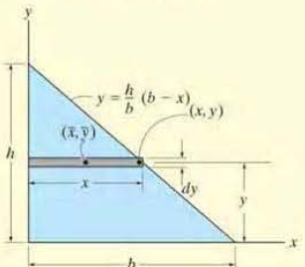
Centroid of Triangle
Determine the distance y measured from the x axis to the centroid of the area of the triangle shown in Figure

Slide 11

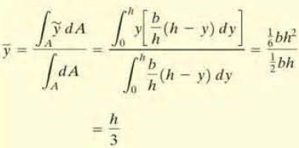
Centroid of Triangle (Contd.)
Consider a rectangular element having a thickness dy and located in an arbitrary position so that it intersects the boundary at (x, y).
The area of the element is dA= x dy
Its centroid is located at
distance from the x axis.
Applying the centroid integral equation and integrating with respect to y yields

Slide 12
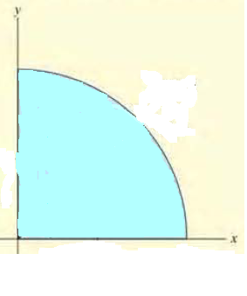
Centroid of Quarter of Circle
Locate the centroid for the area of a quarter circle shown

Slide 13
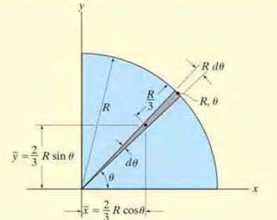

Centroid of Quarter of Circle (Contd.)
Polar coordinates will be used. since the boundary is circular.
We choose the element in the shape of a triangle as in figure.
Actually the shape is a circular sector, however, simplified as triangular.
The element intersects the curve at point (R,θ).
The area of the element is
The centroid of the (triangular) element is located at

Slide 14
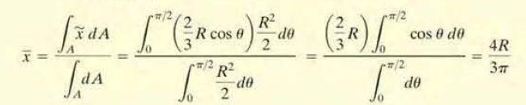
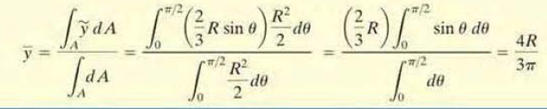
Centroid of Quarter of Circle (Contd.)
Applying centroid integral equation and integrating with respect to θ, we obtain

Slide 15
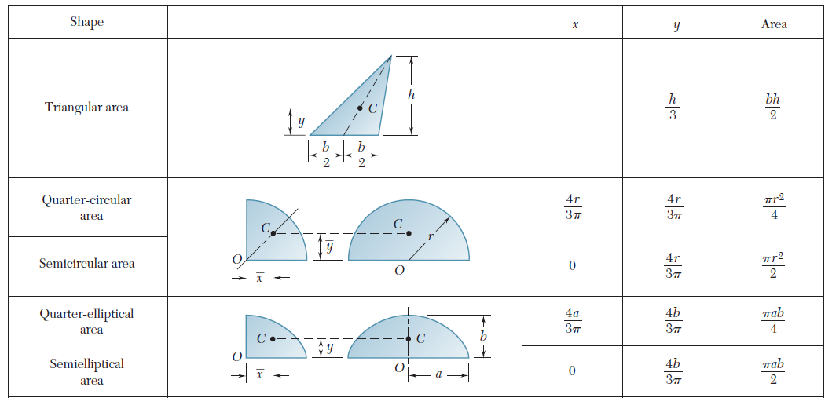
Centroid of Some Common Areas

Slide 16
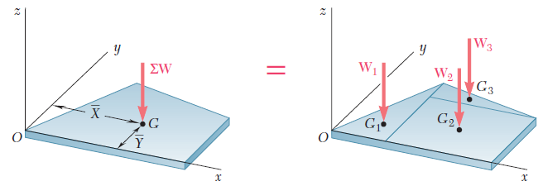
Composite Areas
A flat plate of complex shape can be divided into rectangles, triangles, or the other common shapes shown in Figure.
The abscissa X of its center of gravity ‘G’ can be determined from the abscissas x₁, x₂, . . . , x_{n} of the centers of gravity of the various parts by expressing that the moment of the weight of the whole plate about the y axis is equal to the sum of the moments of the weights of the various parts about the same axis .
The ordinate Y of the center of gravity of the plate is found in a similar way by equating moments about the x axis.

Slide 17
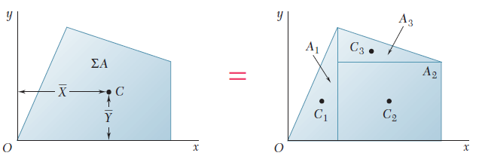
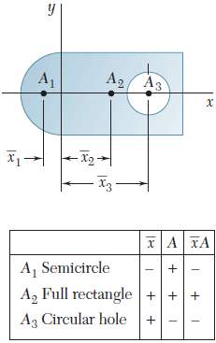
Composite Areas (Contd.)
If the plate is homogeneous and of uniform thickness, the center of gravity coincides with the centroid C of its area
Care should be taken to assign the appropriate sign to the moment of each area.
First moments of areas, like moments of forces, can be positive or negative.
For example, an area whose centroid is located to the left of the y axis will have a negative first moment with respect to that axis.
Also, the area of a hole should be assigned a negative sign

Slide 18
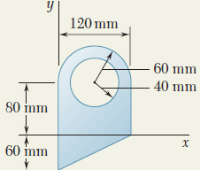
Problem 1
For the plane area shown, determine the location of the centroid.

Slide 19
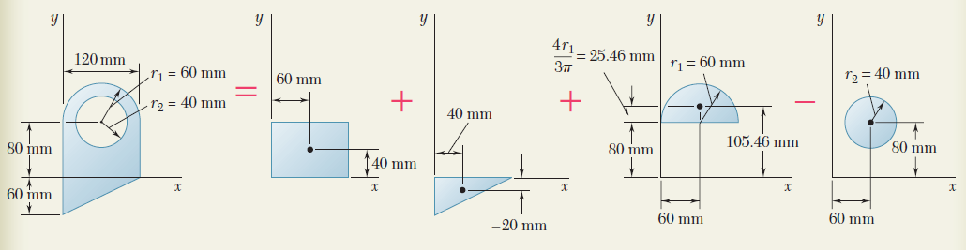
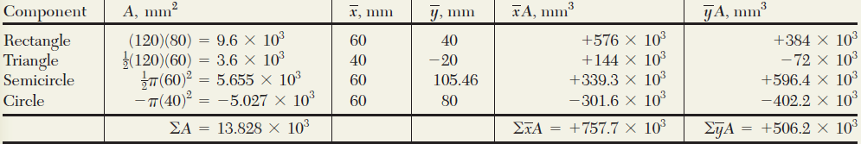



Solution to Problem 1

Slide 20
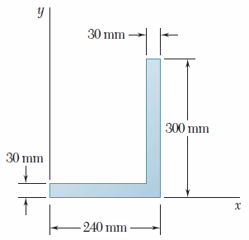
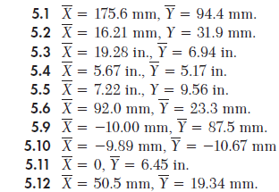
Problem 3
Locate the centroid of the plane area shown

Slide 21
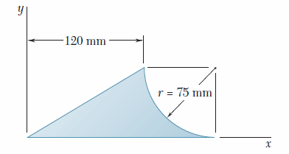
Problem 4
Locate the centroid of the plane area shown

Slide 22
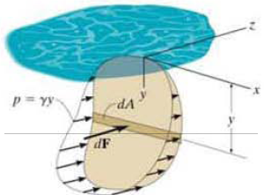
Second Moments of Area
Whenever a distributed loading acts perpendicular to the area and its intensity varies linearly, the computation of the moment of the loading distribution about an axis will involve a quantity called the Second moment or moment of inertia.
For example, consider the plate as shown in the figure is subjected to a distributed loading ‘p’ N/m²
This pressure varies Iinearly with depth, such that p=γy, where γ is the specific weight of the fluid.
Force acting on the differential area dA of the plate is dF=(p)dA= (γ y)dA.
The moment of this force about the x axis is therefore dM =ydF = γ y²dA and so integrating dM over the entire area of the plate yields M = γ ∫y²dA.
The integral ∫y²dA is called second moment or moment of inertia of the area I_{x} about the x axis
Moment of inertia is useful in finding many important structural properties such as bending stress

Slide 23
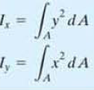
Moment of Inertia
By definition, the moments of inertia of a differential area dA, about the x and y axes are dI_{x}= y²dA and dI_{y} = x²dA, respectively.
For the entire area A the moments of inertia are determined by integration:

Slide 24
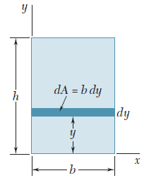

Moment of Inertia of a Rectangular Area
Let us determine the moment of inertia of a rectangle with respect to its base as shown in Figure.
Dividing the rectangle into strips parallel to the x axis, we obtain
dA= b dy, dI_{x} = y²b dy

Slide 25

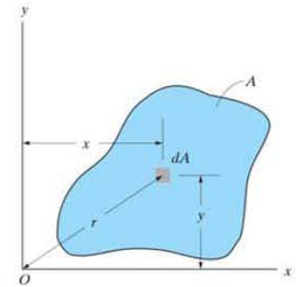

Polar moment of inertia
We can also formulate this quantity for dA about the "pole" O or z axis as shown in figure.
This is known as the Polar Moment of Inertia which is given as
For the entire area the polar moment of inertia is
The polar moment of inertia of a given area can be computed from the rectangular moments of inertia I_{x} and I_{y} of the area if these quantities are already known.
noting that r² = x² +y², we can write

Slide 26
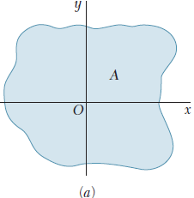
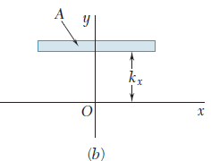

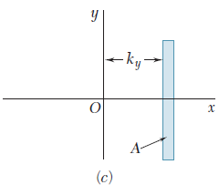

Radius of Gyration of an Area
Consider an area A which has a moment of inertia I_{x} with respect to the x axis (Fig. a).
Let us imagine that we concentrate this area into a thin strip parallel to the x axis (Fig. b).
If the area A, thus concentrated, is to have the same moment of inertia with respect to the x axis, the strip should be placed at a distance k_{x} from the x axis, where k_{x} is defined by the relation
Solving for K_{x}
The distance k_{x} is referred to as the radius of gyration of the area with respect to the x axis.
In a similar way, we can define the radii of gyration k_{y} (Fig c )

Slide 27
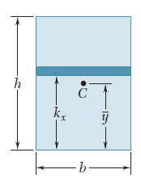

Radius of Gyration of an Area (Contd.)
For the rectangle shown in Fig., let us compute the radius of gyration k_{x} with respect to its base.
Using formulae

Slide 28
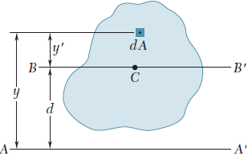



Parallel Axis Theorem
Consider the moment of inertia I of an area A with respect to an axis AA’
Denoting by y the distance from an element of area dA to AA’,
Let us now draw through the centroid C of the area an axis BB’ parallel to AA’;
    this axis is called a centroidal axis.
Denoting by y’ the distance from the element dA to BB’, y = y’ + d,
    where d is the distance between the axes AA’ and BB’.
Substituting for y in the above integral, we write

Slide 29

Parallel Axis Theorem (Contd.)
  The first integral represents the moment of inertia I of the area with respect to the centroidal axis BB’.
The second integral represents the first moment of the area with respect to BB’; since the centroid C of the area is located on that axis, the second integral must be zero.
Finally, we observe that the last integral is equal to the total area A.
Hence we can write
This formula expresses that the moment of inertia I of an area with respect to any given axis AA’ is equal
  to the moment of inertia I of the area with respect to a centroidal axis BB’ parallel to AA’
  plus the product of the area A and the square of the distance d between the two axes.
This theorem is known as the parallel-axis theorem.

Slide 30
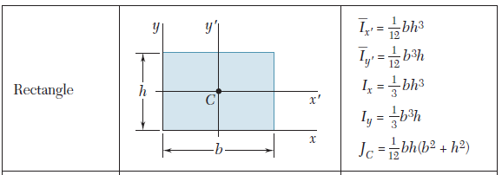
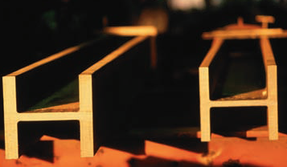
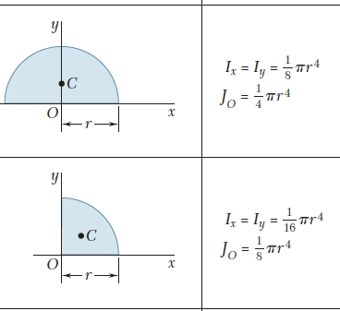
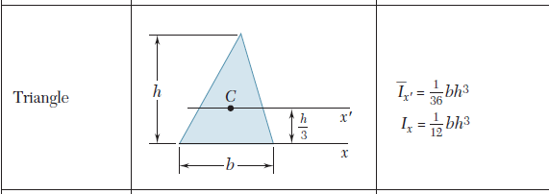
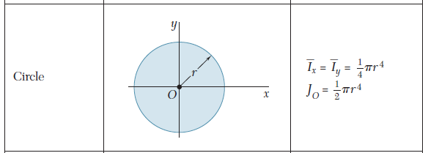
Moments of Inertia of Composite Areas

Slide 31
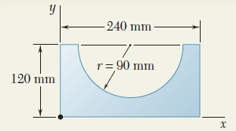
Problem 5
Determine the moment of inertia of the shaded area with respect to the x axis.

Slide 32
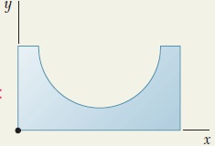
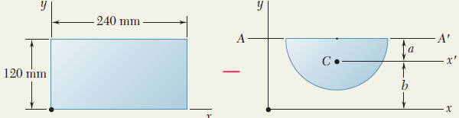
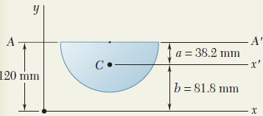

Solution to Problem 5
Moment of Inertia of Rectangle.
Moment of Inertia of Half Circle.
To find the location of the centroid C of the half circle with respect to diameter AA’.
The distance b from the centroid C to the x axis is

Slide 33


Solution to Problem 5 (Contd.)
Compute the moment of inertia of the half circle with respect to diameter AA’
Compute the area of the half circle
Using the parallel-axis theorem, the value of I_{x’} is found as
Again to find I about the value of I_{x} is
Moment of Inertia of Given Area is obtained by subtracting the moment of inertia of the half circle from that of the rectangle, i.e.,

Slide 34
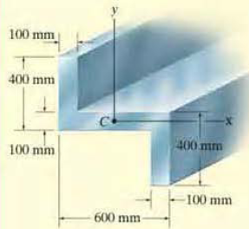
Problem 6
Determine the moments of inertia for the cross-sectional area of the member shown in figure about the x and y centroidal axes.

Slide 35
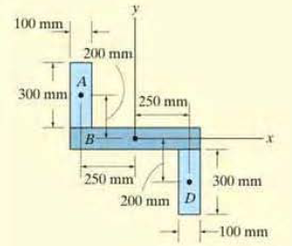


Solution to Problem 6
The cross section can be subdivided into the three rectangular areas A, B and C as shown in figure.
Hence using the parallel axis theorem for rectangles A and D, the calculations are as follows
For rectangle B

Slide 36

Solution to Problem 6 (Contd.)
Summing up the MIs

Slide 37

Problem 7
Determine the moment of inertia and the radius of gyration of the shaded area with respect to the x axis.

