Slide 1

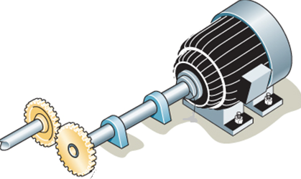
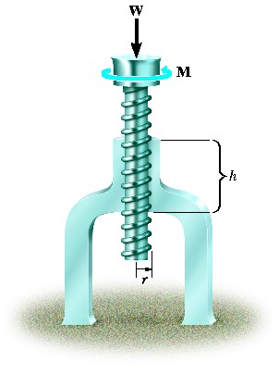
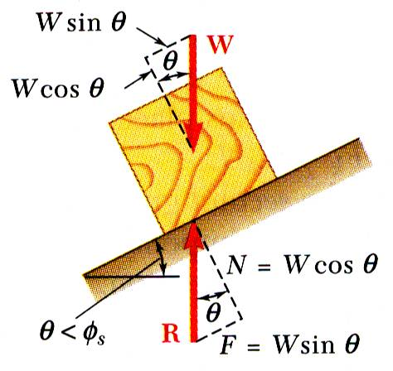
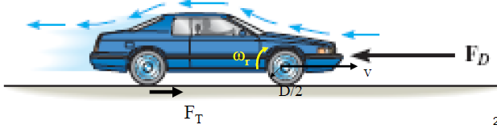
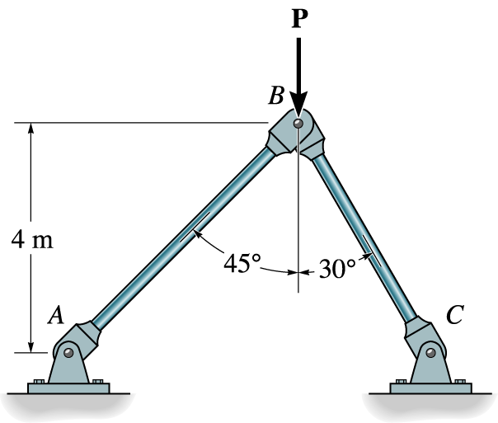


ENGINEERING MECHANICS
GE 107
Lecture 2

Slide 2
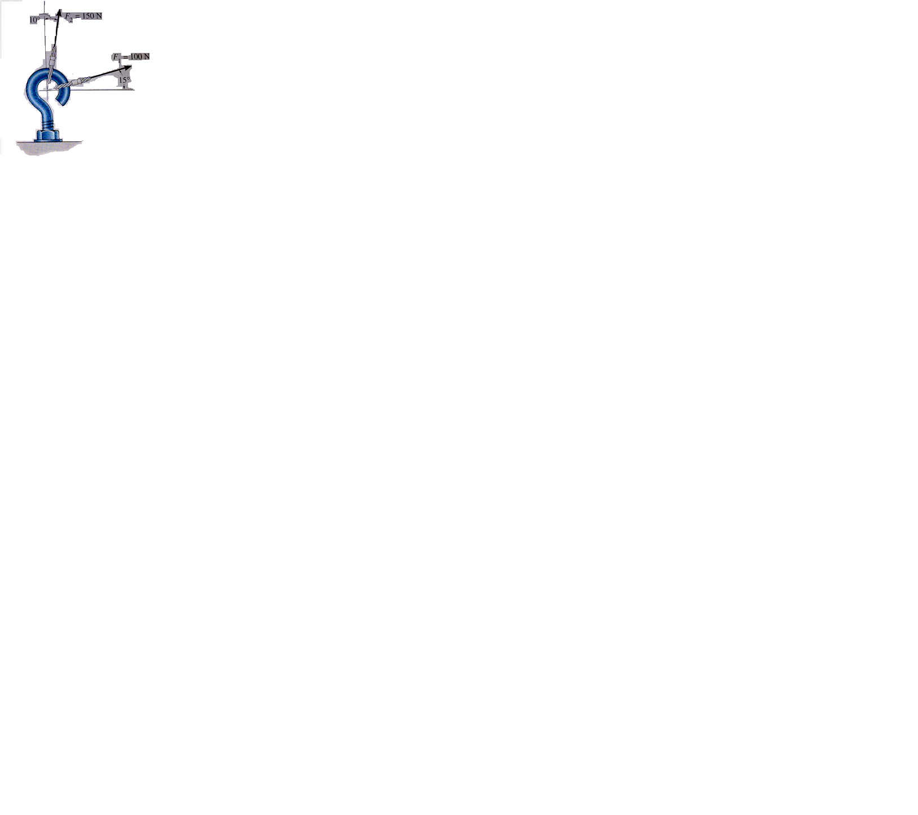
Problem 1
    The screw eye shown below is subjected to two forcesF₁ and F₂. Find the magnitude and direction of resultant force. Solution: The Unknowns to be found are R and φ.
    R can be found by using cosine law
115°
θ°
φ°
15°
Courtesy: Hibbeler/Eg.1

Slide 3
Example 1 Solution (Contd..)
To find φ, we need θ. This can be obtained from Sine law .

Slide 4
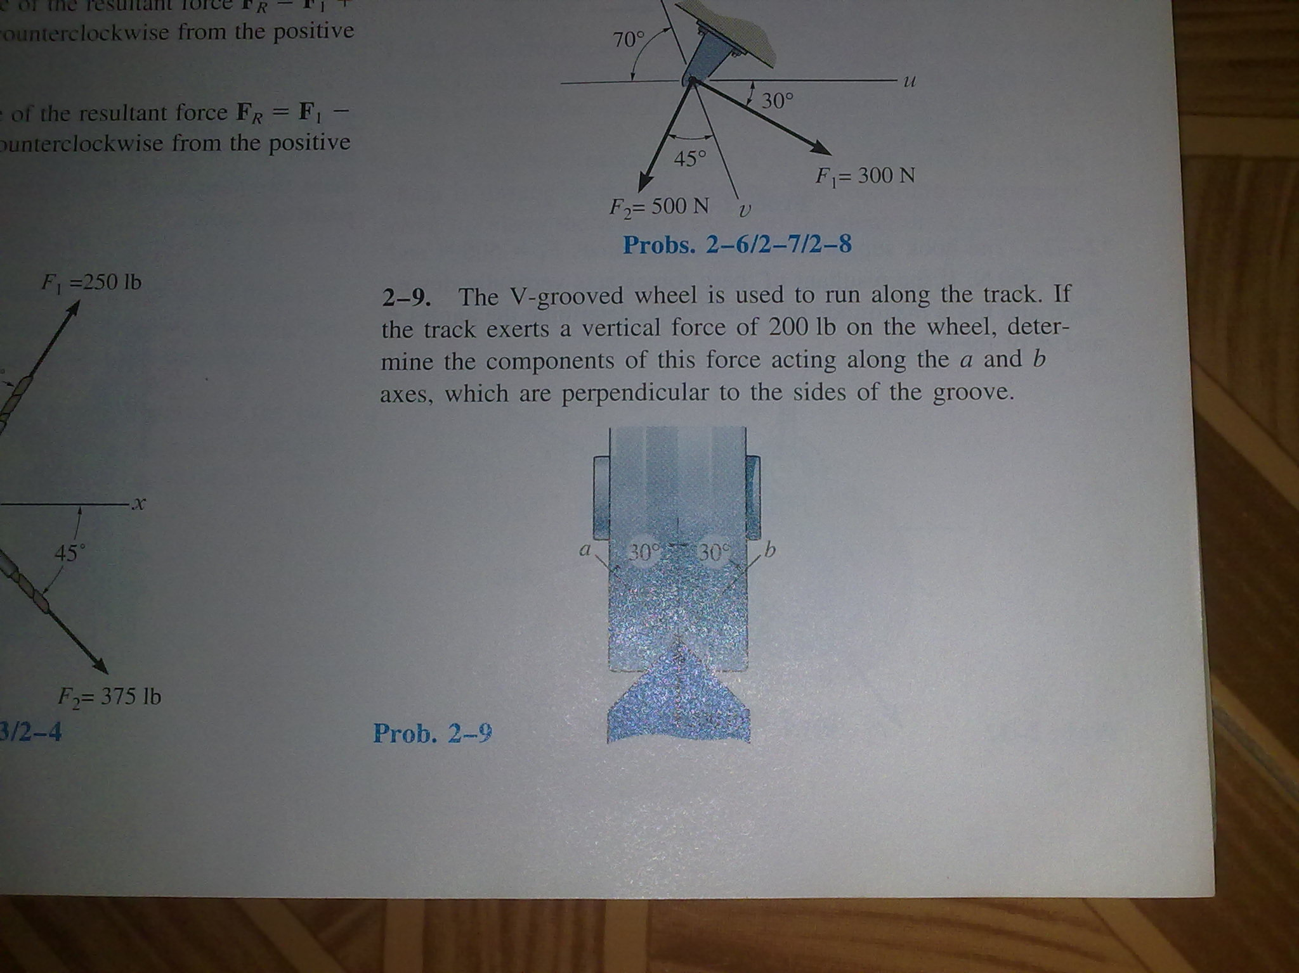
Problem 2
The V grooved wheel is used to run along a track. If the track exerts a vertical force of 200N on the wheel, determine the components of forces acting along the axes a and b, which are perpendicular to the sides of the groove.
200 N
(Hibbeler, Ex-2.9)

Slide 5
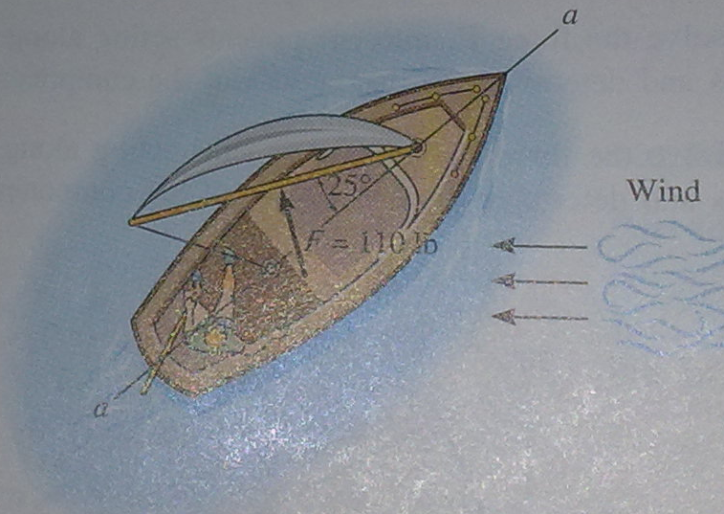
Problem 3
The wind is deflected by the sail of the boat such that it exerts a resultant of 110 N perpendicular to the sail. Resolve the force into two components, one parallel to and the other perpendicular to the keel a-a of the boat.
a
Solution:
F”
25°
65°
25°
F’
110 N
a
(Hibbeler, Ex-2.11)
Similarly

Slide 6
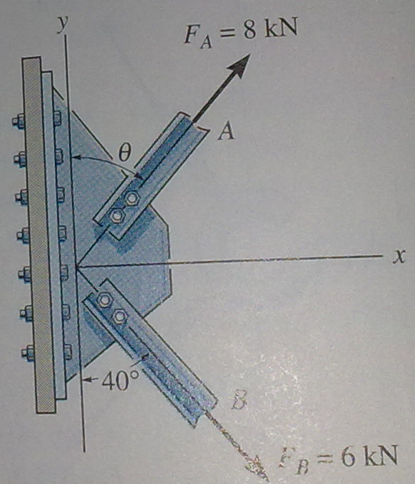
Problem 4
The plate is subjected to two forces at A and B as shown below. If θ=60°, determine the magnitude of the resultant of these forces and its direction measured clockwise from the positive x axis.

Slide 7
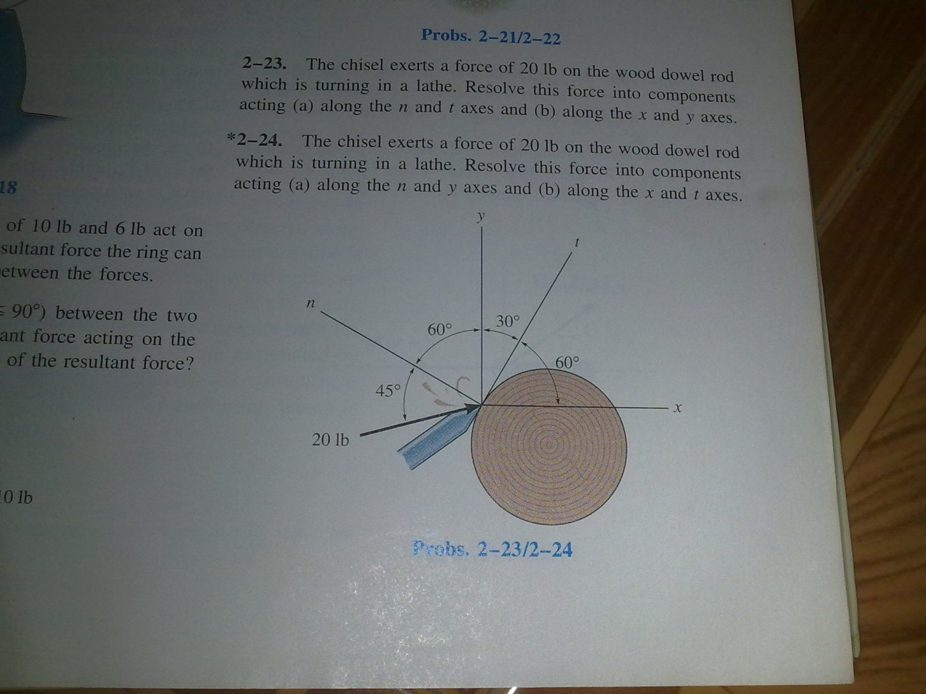
Problem 5
The chisel exerts a force of 20 N on the wood dowel rod which is turning in the lathe. Resolve this force in to components acting along (i) x and y axes and (ii) n and t axes
F_{t}
-F_{n}
180°-45°-90 ° =45 °
60°
30°
180°-15°-90 ° =75 °
60°
F_{y}
45°
15 °
190°-180 °=15 °
F_{x}
Resolving along X-Y axes
(Hibbeler, Ex-2.23)
Resolving along n-t axes

Slide 8
Problem 6
If five forces acting on a particle as shown and the algebraic sum of horizontal components is -324.90 kN, determine the magnitude of force P and the resultant. SOLUTION:
282.84 N
36.86°
F₁=100 N
P N
F_{1y}=F₁sinθ₁
30°
100 N
F_{1x}=F₁cosθ₁
45°
F₃=165 N
3
30°
4
75 N
F₂=-282.84 N
F_{2y}= -F₂cosθ₂
F_{4y}=F₄sinθ₄
F₄=- P N
45°
F₃=F_{y}
F_{4x}=-F₄cosθ₄
F_{2x}= -F₂sinθ₂
Force | Magnitude, N | Direction (angle) | X component | Y component
F₁ | 100 | 36.86° | 80.01 | 59.99
F₂ | 282.84 | 45° | -199.99 | -199.99
F₃ | 165 | 90° | 0 | 165
F₄ | P | 30° | -0.866 P | 0.5 P
F₅ | 75 | 0° | -75 | 0
 |  |  | ΣF_{x}=-194.98-0.866 P | ΣF_{y}=25+0.5 P
F₅=-F_{5x}
F₅=75 N

Slide 9
Solution (Contd..)
Force | Magnitude, N | Direction (angle) | X component | Y component
F₁ | 100 | 36.86° | 80.01 | 59.99
F₂ | 282.84 | 45° | -199.99 | -199.99
F₃ | 165 | 90° | 0 | 165
F₄ | P | 30° | -0.866 P | 0.5 P
F₅ | 75 | 0° | -75 | 0
 |  |  | ΣF_{x}=-194.98-0.866 P | ΣF_{y}=25+0.5 P

Slide 10
Equilibrium of a Particle
Resultant force acting on a particle is zero
Net effect of forces is zero
The particle is in equilibrium
  According to Newton’s first law of motion, a particle remains in its state of rest or uniform motion (equilibrium) , if the resultant force is zero

Slide 11
Equilibrium of a Particle (Contd..)
For a particle acted upon by two forces to be in equilibrium, the two forces should be equal, opposite and collinear.
For a particle acted upon by more than two forces to be in equilibrium, the force polygon should be a close one.
F
-F
F₂
F₁
F₁
F₃
F₃
F₂

Slide 12
Equilibrium of a Particle (Contd..)
The condition for equilibrium of particle is expressed algebraically as
R=Σ F=0
Resolving each force in to two rectangular components
Therefore , the condition for equilibrium is
Σ F_{x}=0 and Σ F_{y}=0

Slide 13
Example 1
A particle is acted upon by four forces as shown below. To check whether they are in equilibrium:
    A force polygon is drawn and it can be seen that it is a closed one(starting point of first vector and ending point of last vector are same).
    To check analytically, the forces are resolved along x and Y axes
30°
F₁=300 N
F₄=400 N
F₁=300 N
F₂=173.2 N
F₄=400 N
F₃=200 N
F₂=173.2 N
F₃=200 N
30°

Slide 14
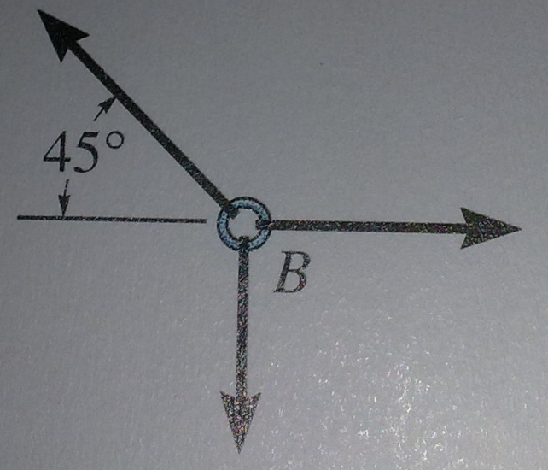
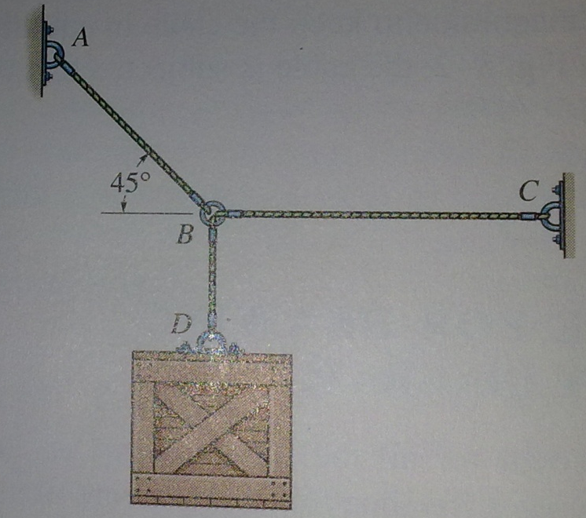
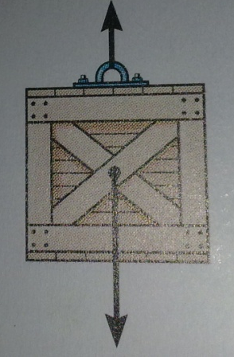
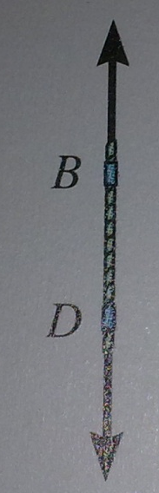
Free Body Diagram
All the forces acting on a particle are to be accounted to apply equilibrium conditions.
To get the forces , a FBD is necessary.
It is a sketch of the particle, isolated from the surroundings.
For example , consider the crate shown below which is suspended by cables
F_{A}
F_{B}
F_{D}
F_{C}
W
F_{B}
FBD of Crate
F_{D}
FBD of Ring at B
FBD of Cord BD
Courtesy: Hibbeler

Slide 15
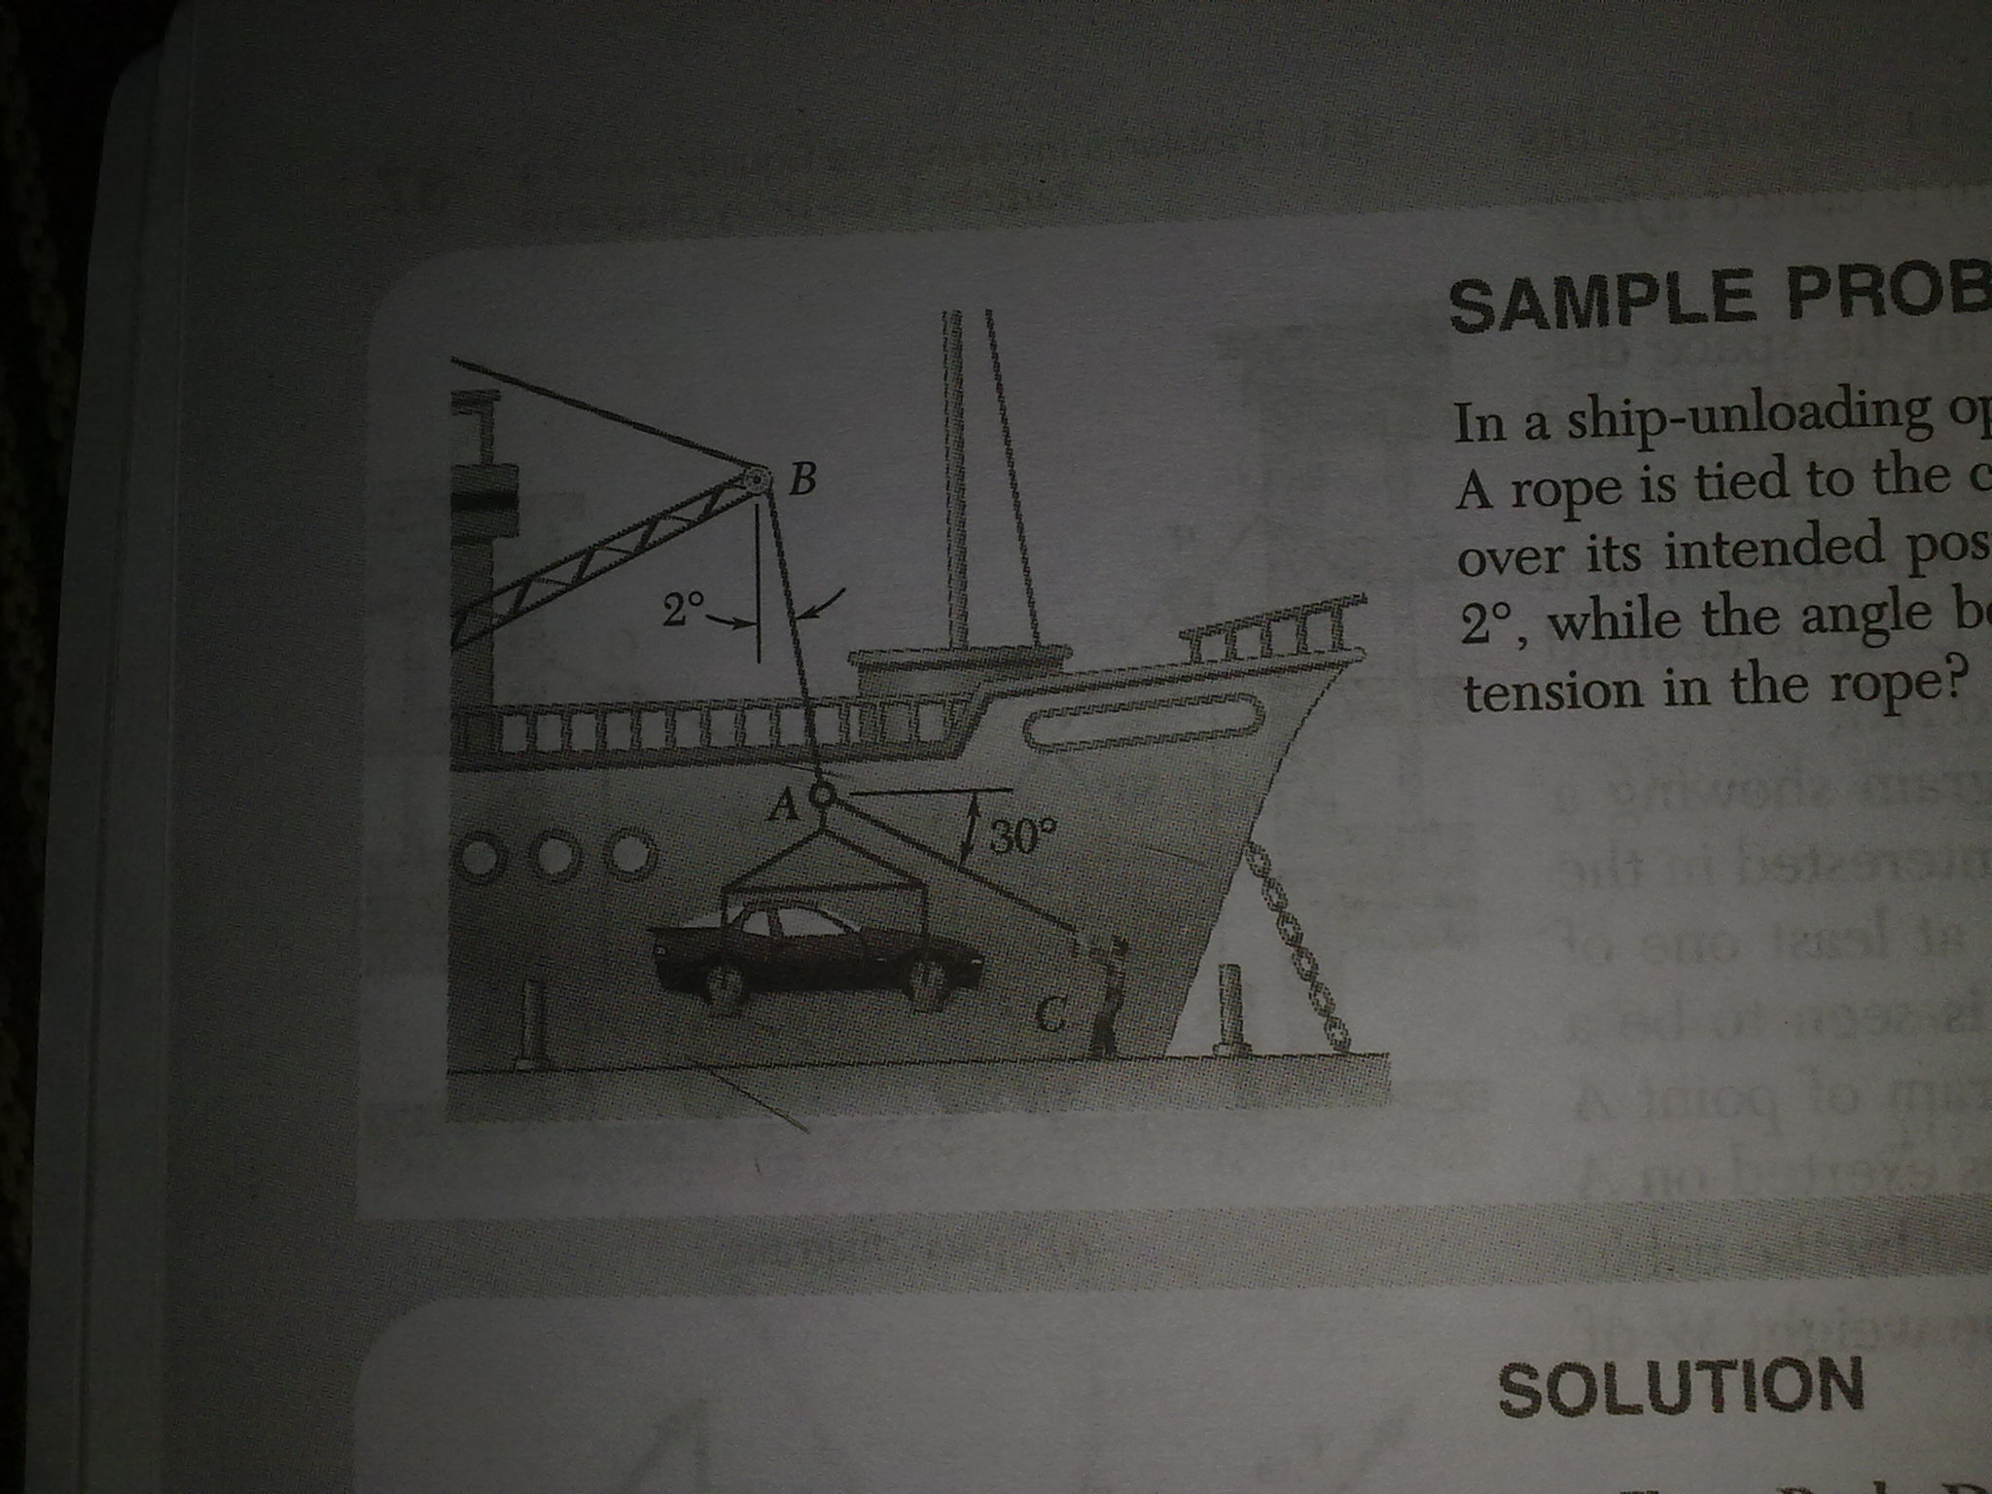
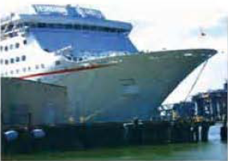
Problem 7
Ina ship unloading process, a 3500 N automobile is supported by a cable. A rope is tied to the cable at A as shown and pulled in order to keep the automobile over its intended position. Determine the tension in the rope.
Courtesy: Hibbeler
Courtesy: Beer & Johnson

Slide 16
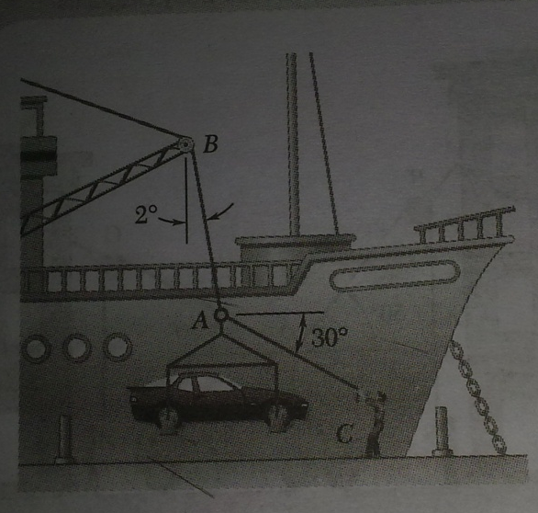
Solution
  The FBD at the ring A accounts all the three forces
  Since there are only three forces, sine rule can be used after finding the unknown angles in the triangle
30°
T_{AB}
B
W
T_{AB}
2°
90-32=58°
90-32=58°
90+30=120°
90+30=120°
A
30°
T_{AC}
T_{AC}
C
W=3500N

