Slide 1


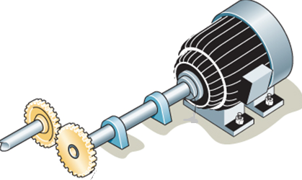
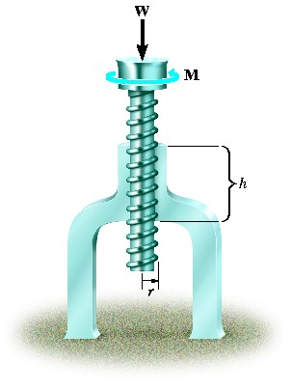
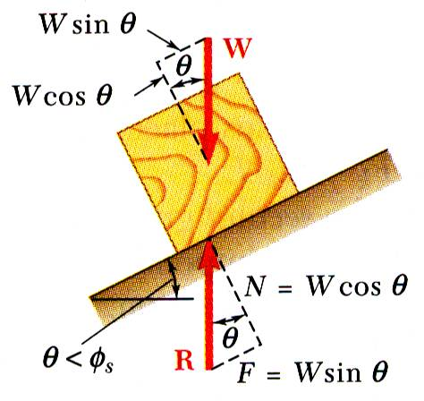
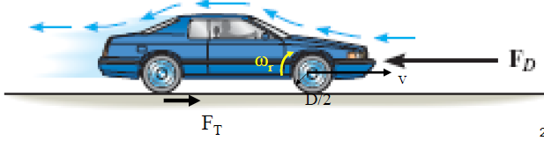
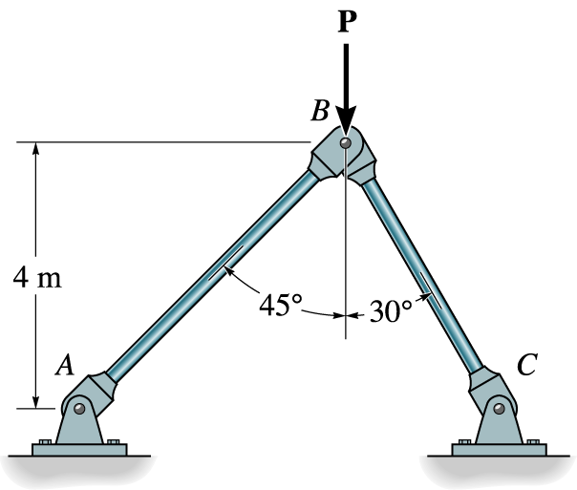


ENGINEERING MECHANICS
GE 107
Lecture 10

Slide 2
Unit IV
Dynamics Of Particles
Review of laws of motion
  – Newton’s law
  – Work Energy Equation of particles
  – Impulse and Momentum
  – Impact of elastic bodies.
Introduction to vibrations
  - Single degree of freedom systems
  – with and without damping

Slide 3
Introduction
Dynamics is dealing with the study of effect of forces on the moving objects
Newton’s first and third laws of motion were used extensively in statics to study bodies at rest and the forces acting upon them.
These two laws are also used in dynamics; in fact, they are sufficient for the study of the motion of bodies which have no acceleration.
When the bodies are accelerated, i.e., when the magnitude or the direction of their velocity changes, it is necessary to use Newton’s second law of motion to relate the motion of the body with the forces acting on it.

Slide 4
Newton’s second law can be stated as follows:
  If the resultant force acting on a particle is not zero,
  the particle will have an acceleration proportional to the magnitude of the resultant and
  in the direction of this resultant force.

Slide 5
Introduction
Mechanical vibration is the motion of a particle or body which oscillates about a position of equilibrium.
Most vibrations in machines and structures are undesirable due to increased stresses and energy losses.
Time interval required for a system to complete a full cycle of the motion is the period of the vibration.
Number of cycles per unit time denotes the frequency of the
vibrations.
Maximum displacement of the system from the equilibrium position is the amplitude of the vibration.
.

Slide 6
Classification
LONGITUDINAL TRANSVERSE TORSIONAL

Slide 7
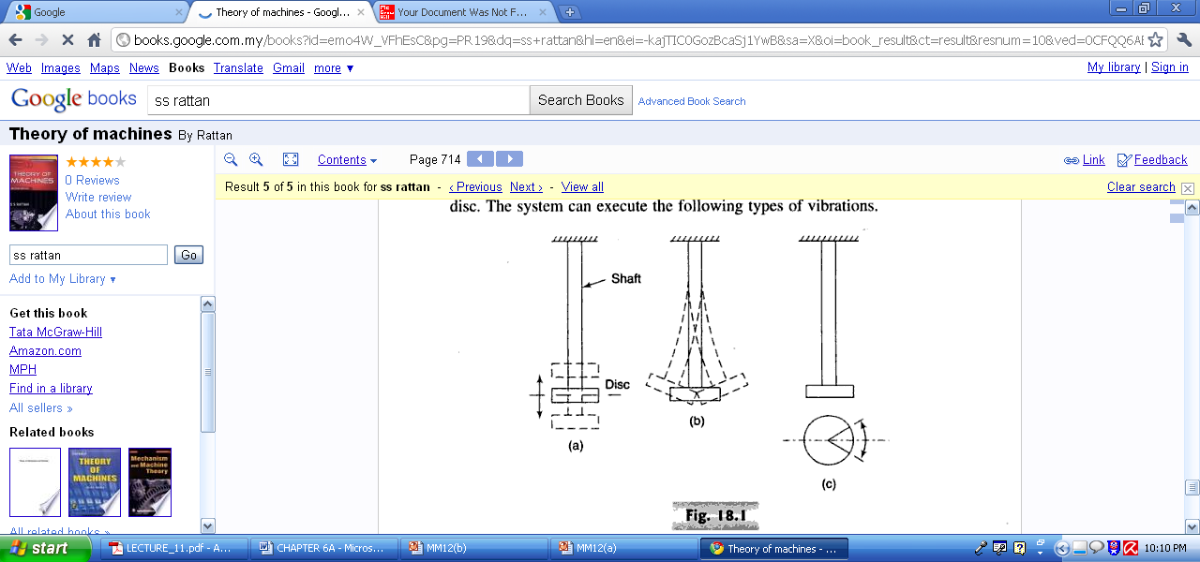
Classification (Contd.)
LONGITUDINAL TRANSVERSE TORSIONAL

Slide 8
Equation of Motion for Undamped Free Vibration

Slide 9
Equation of Motion for Undamped Free Vibration (Contd.)

Slide 10
Equation of Motion for Undamped Free Vibration (Contd.)

Slide 11
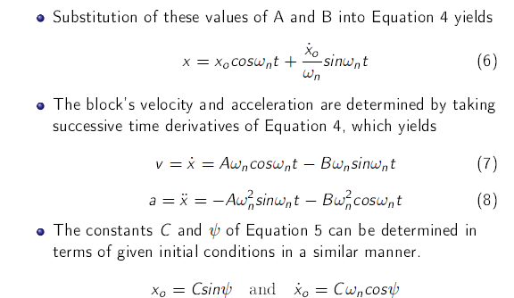
Equation of Motion for Undamped Free Vibration (Contd.)

Slide 12
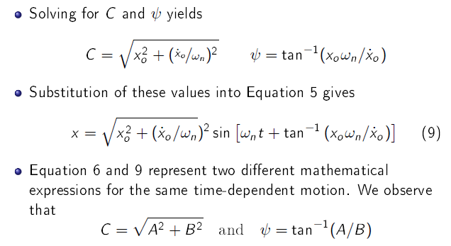
Equation of Motion for Undamped Free Vibration (Contd.)

Slide 13
Graphical Representation of Motion

Slide 14
Graphical Representation of Motion (Contd.)

Slide 15
Problem 1
For the spring-mass system in the figure shown, determine :
(a) the natural frequency of the system in both rad/s and cycles/s (Hz),
(b) the displacement x of the mass as a function of time if the mass is released at t = 0 from a position 30 mm to the left of the equilibrium
position with an initial velocity of 120 mm/s to the right.

Slide 16
Problem 2
For the spring-mass system shown, deter-
mine:
(a) the static deflection , the system period , and the maximum velocity,
(b) the displacement y and the velocity v when t = 3s,
if the cylinder is displaced 0.1 m downward from its equilibrium position and released at time t = 0.

Slide 17
Equivalent Spring Mass System
Any vibrating machine may consists of masses cause vibration
There are elastic members in the machine lead to vibration
The masses and elastic members are modeled as single mass and spring system for vibration analysis
This is known as equivalent spring mass system

Slide 18
Equivalent Spring Mass System (Contd.)

Slide 19
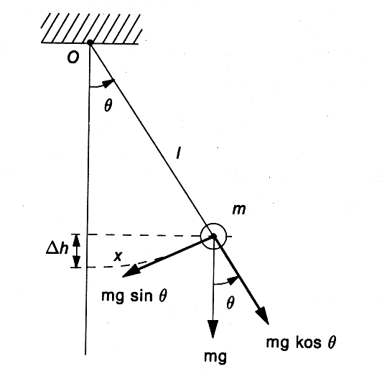
Pendulum System
The natural frequency of a system can be determined by Newton’s Law of Motion as follows
When the pendulum moves θ, therefore the force is occurred cause of the gravity.
when the moment force is move at the origin O,
(sin θ = θ because θ to small)
According to Newton’s Second Law of Motion
Therefore;
The equation above is similar to simple Harmonic Motion expression when you simplify ;
Hence and suppose Moment of inertia of m at O is , then
So the Natural frequency in Hz is

Slide 20
Inertia-Shaft / Disc System
Equation of motion is derived as
Hence
Where K is the torsional stiffness and
J_{D} is the polar mass moment of inertia of disc
and
where ρ is the mass density, h is the thickness, D is the diameter and W is the weight of the disc
l
K_{t}, θ
θ
J

Slide 21
Equivalent Stiffness
In a system comprising of many springs, it can be modeled as single spring by finding equivalent stiffness
Springs in Series
For a system comprising of two springs with stiffness K₁ and K₂(Fig a) and displacements ‘a’ and ‘b’, can be replaced with a spring with equivalent stiffness k_{e} to displace ‘c’ distance (Fig b)
K₁
K₁
K’
K’_{e}
a
K₂
m
c
K₂
m
m
b
m
(a)
(b)

Slide 22
Equivalent Stiffness (Contd.)
We know kδ=mg , δ=mg/k
Applying this to figure (b), c=mg/k_{e,} a+b=mg(1/k₁+1/k₂)
Therefore or
For the parallel system displacements a=b = mg(k₁+k₂)
In the equivalent system c=mg k_{e}
a=b=c and mg (k₁+k₂)= mg k_{e}
Hence k₁+k₂=k_{e}
    Spring in Parallel
K₁
K₂
K_{e}
m
x
m
x

Slide 23
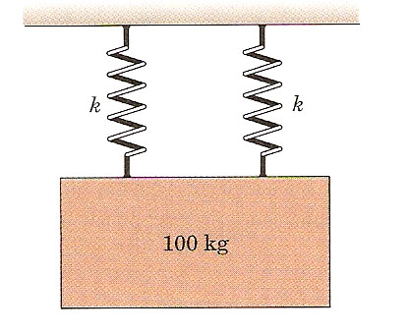
Problem 3
A 100 kg mass has a downward velocity of 0.5 m/s as it passes through its equilibrium position. Calculate the magnitude of its maximum acceleration. Each of two springs has a stiffness k = 180kN/m.

Slide 24
Problem 4

